Slide 1
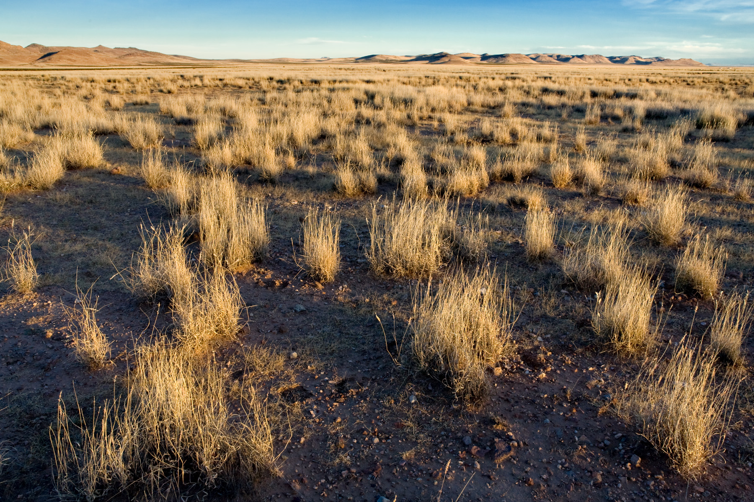
Finding rare plants from aerial imagery.

Slide 2
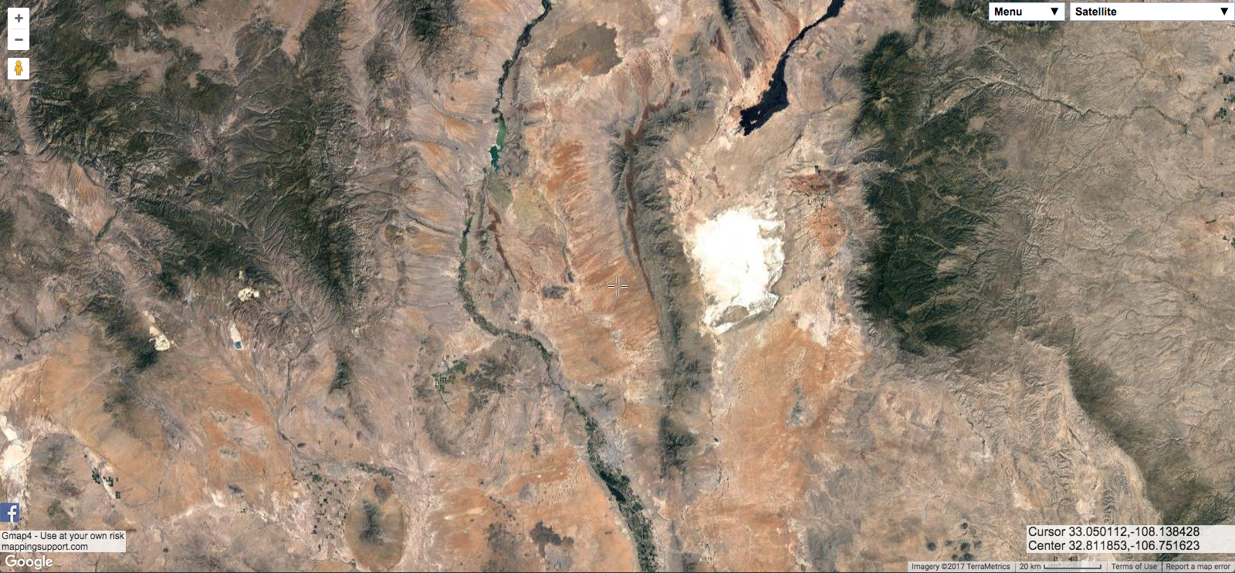
Aerial imagery via gmap4.com;
see also maps.google.com, Google Earth!

Slide 3
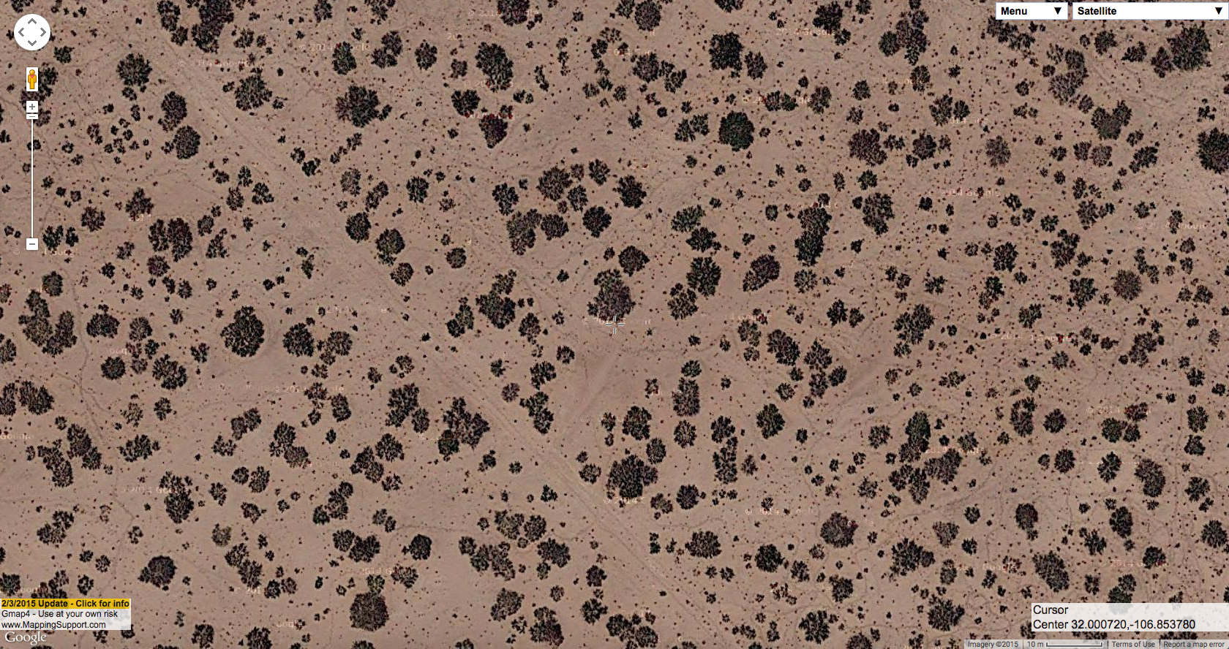
Notes:
We’ll focus on low-elevation habitats, in part because that’s mostly where the BLM land is and where I work. This is mesquite shrubland, southwest of Las Cruces north of Afton. All of these are zoomer in all the way on Google aerial imagery, you can see the little tiny scale bar at lower right is 10 meters, so the shrubs are averaging around 4-5 meters wide.

Slide 4
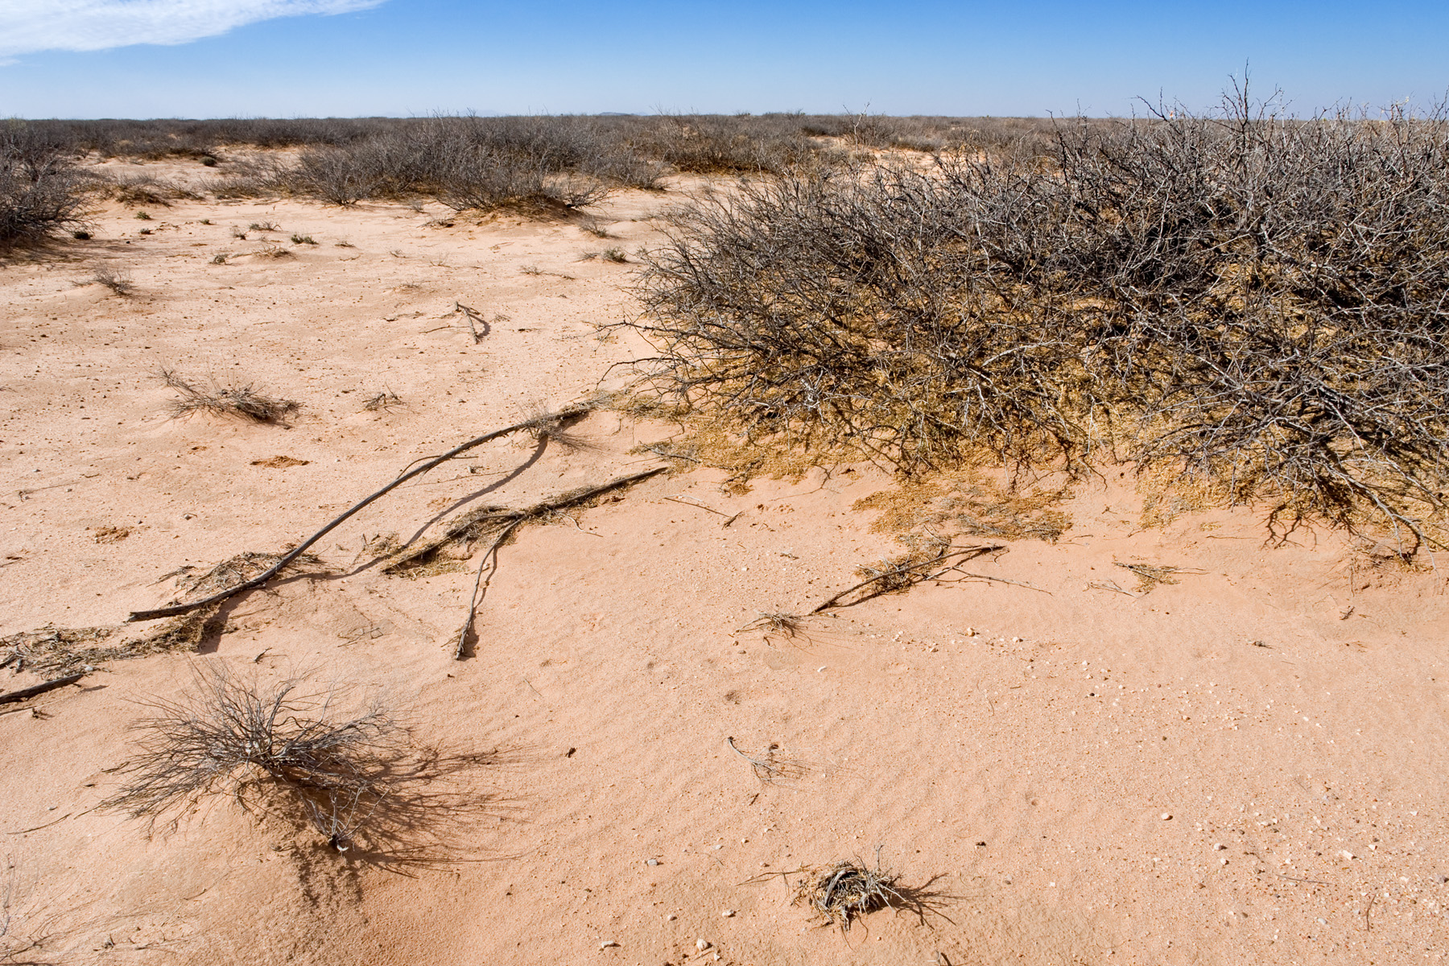
Notes:
And this is what it looks like on the ground. This particular area of mesquite shrubland has pretty low diversity.

Slide 5
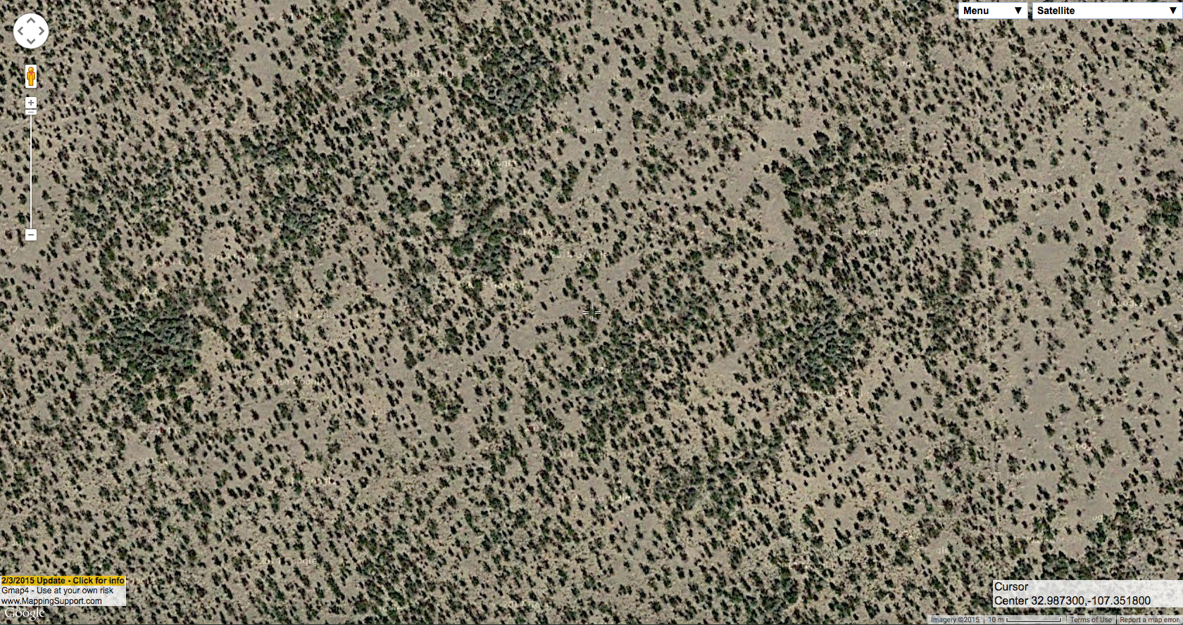
Notes:
And this is mesquite shrubland. The shrubs are much smaller, around a meter across. This is on the east side of the Black Range.

Slide 6
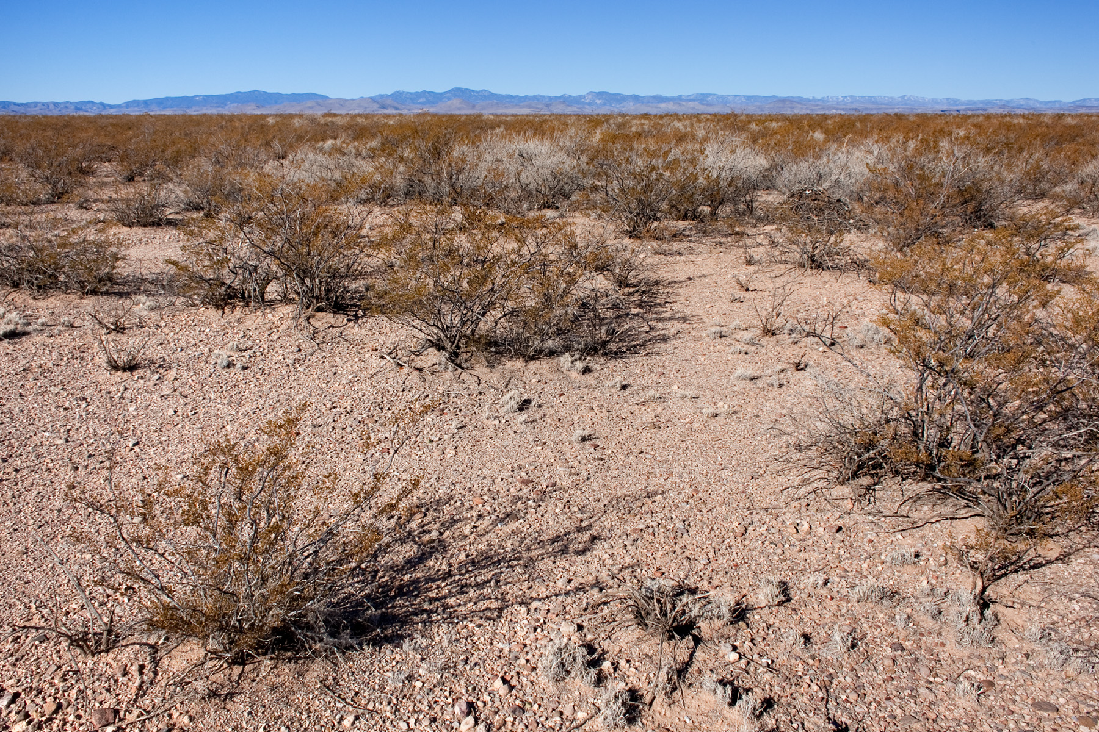
Notes:
And here it is on the ground. The gray shrubs are Flourensia cernua.

Slide 7
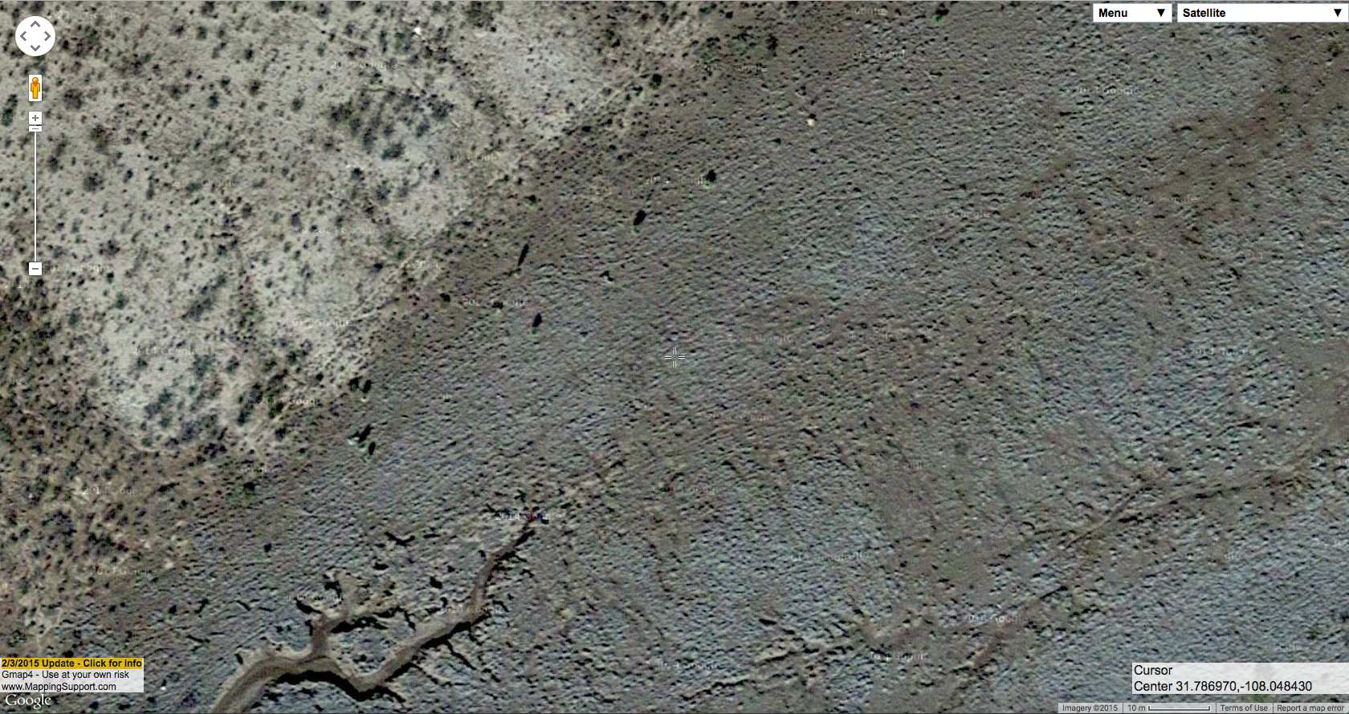
Notes:
This is tobosa grassland, near the Mexican border west of Columbus. You can also see some erosion. The shrubland adjacent to the tobosa grassland is a mixture of some smaller mesquite, creosote bush, and tarbush. Tobosa is usually dark gray on aerial imagery, sometimes a more or less solid stippling and sometimes sparser so that individual plants ca. 0.5 meters across are more distinct and well-separated.

Slide 8
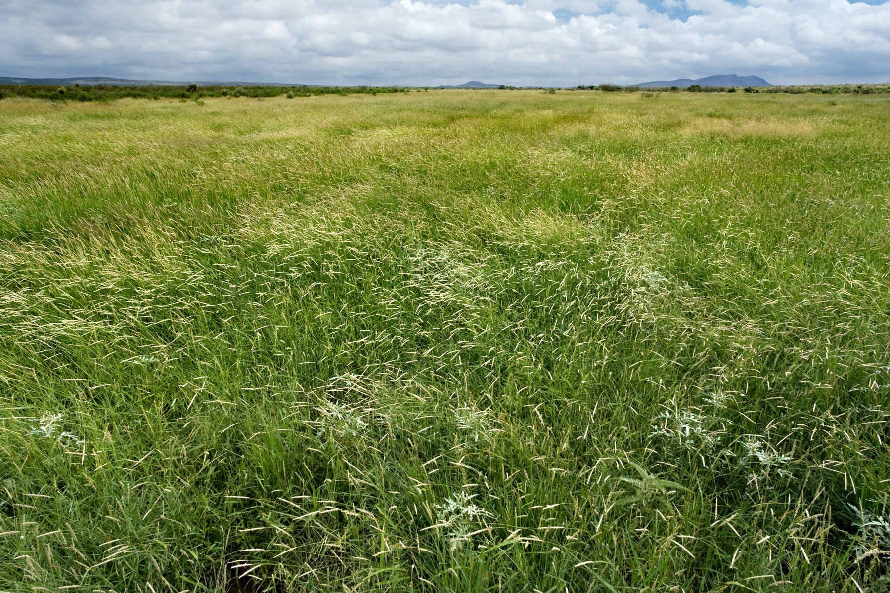
Notes:
And here it is on the ground, during a particularly wet and green September.

Slide 9
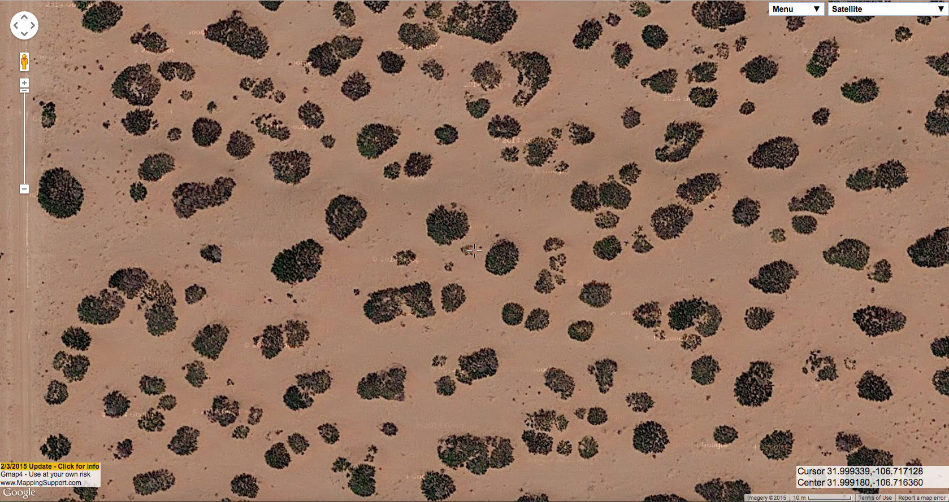
Notes:
We can also sometimes tell something about the soils. On very sandy soils, mesquite tends to be larger and there are few or no surface drainage patterns visible. Instead of flowing across the surface, on sandy soils the rain tends to soak in. This is south-southwest of Las Cruces, west of Chamberino.

Slide 10
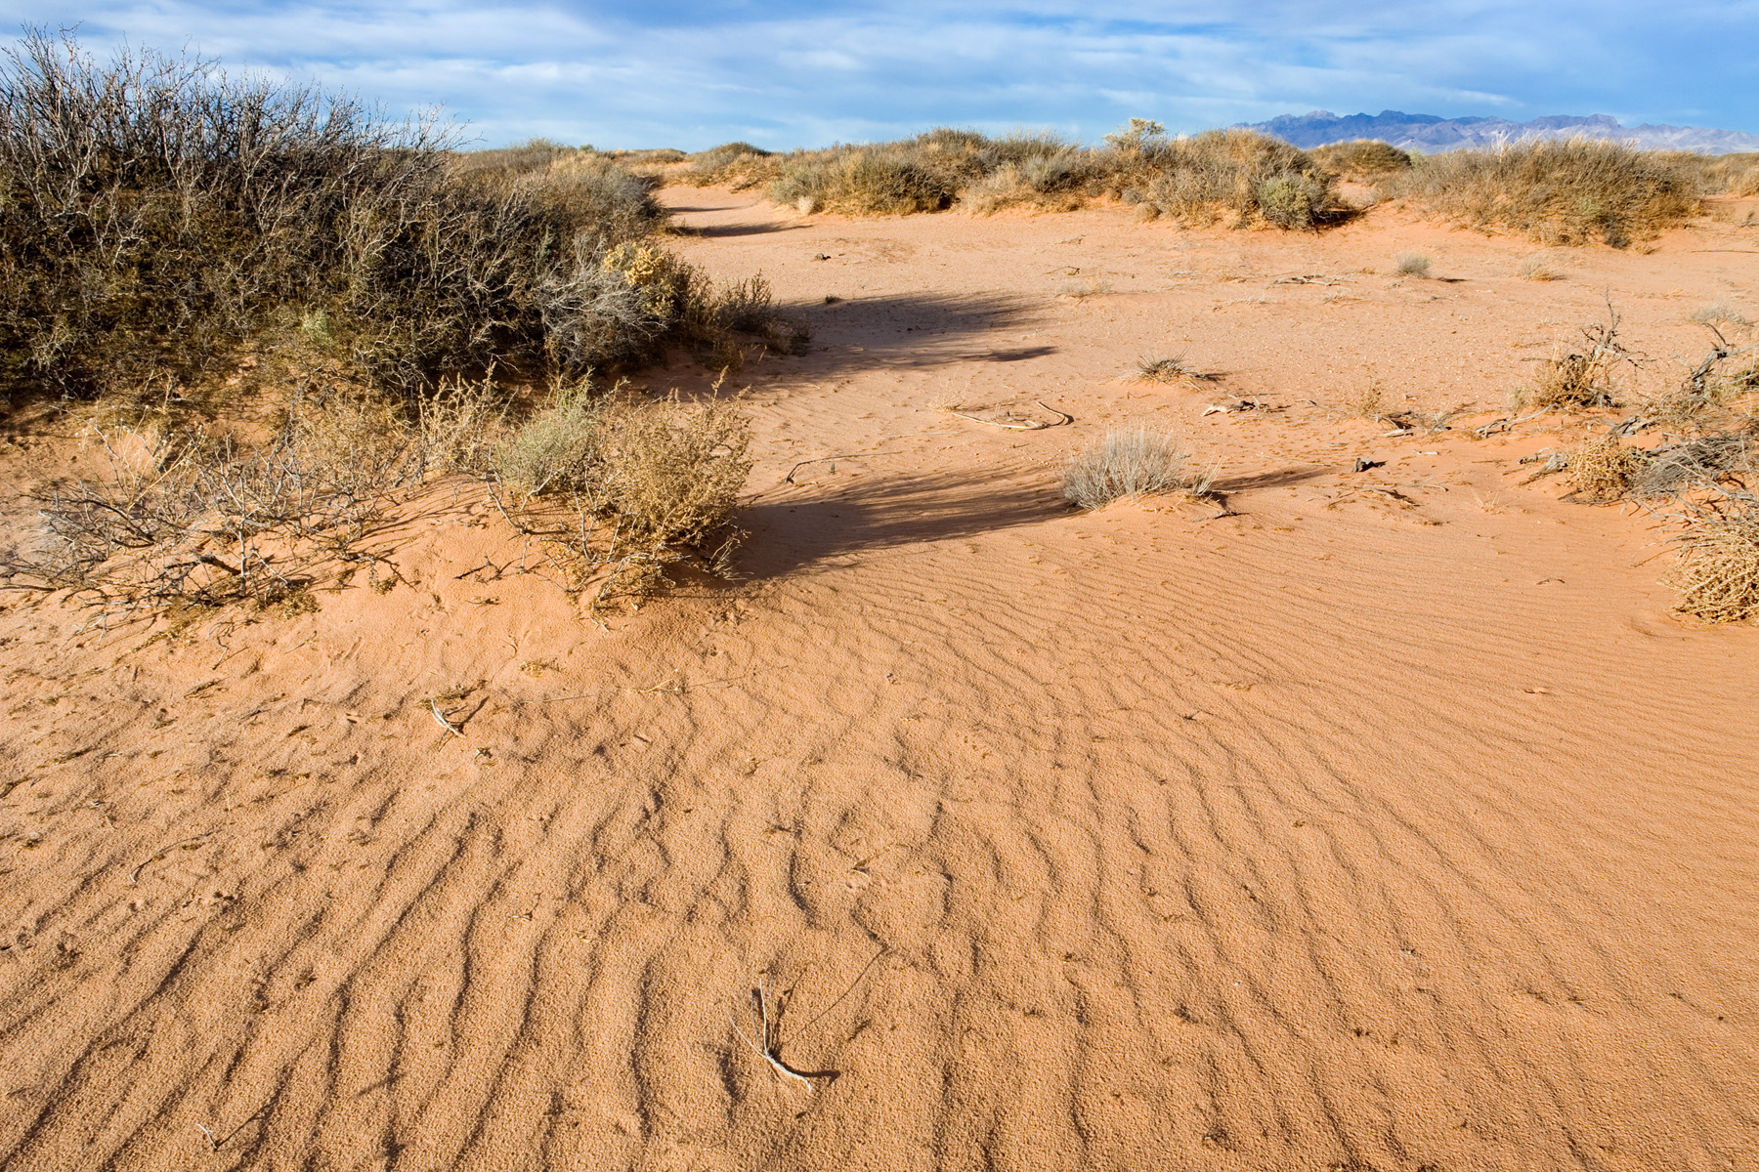
Notes:
This is also pretty low-diversity mesquite shrubland…

Slide 11
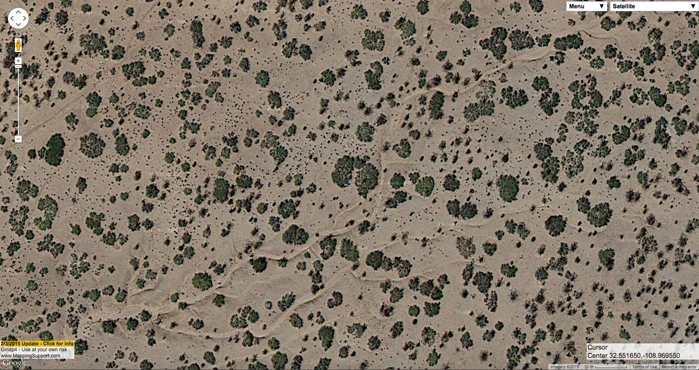
Notes:
This is mesquite shrubland on loamy soils without much sand. Surface drainage patterns are readily visible, and the mesquite is smaller on average. This is northwest of Lordsburg on the north side of the Summit Hills. There is also some creosote bush and snakeweed visible here.

Slide 12
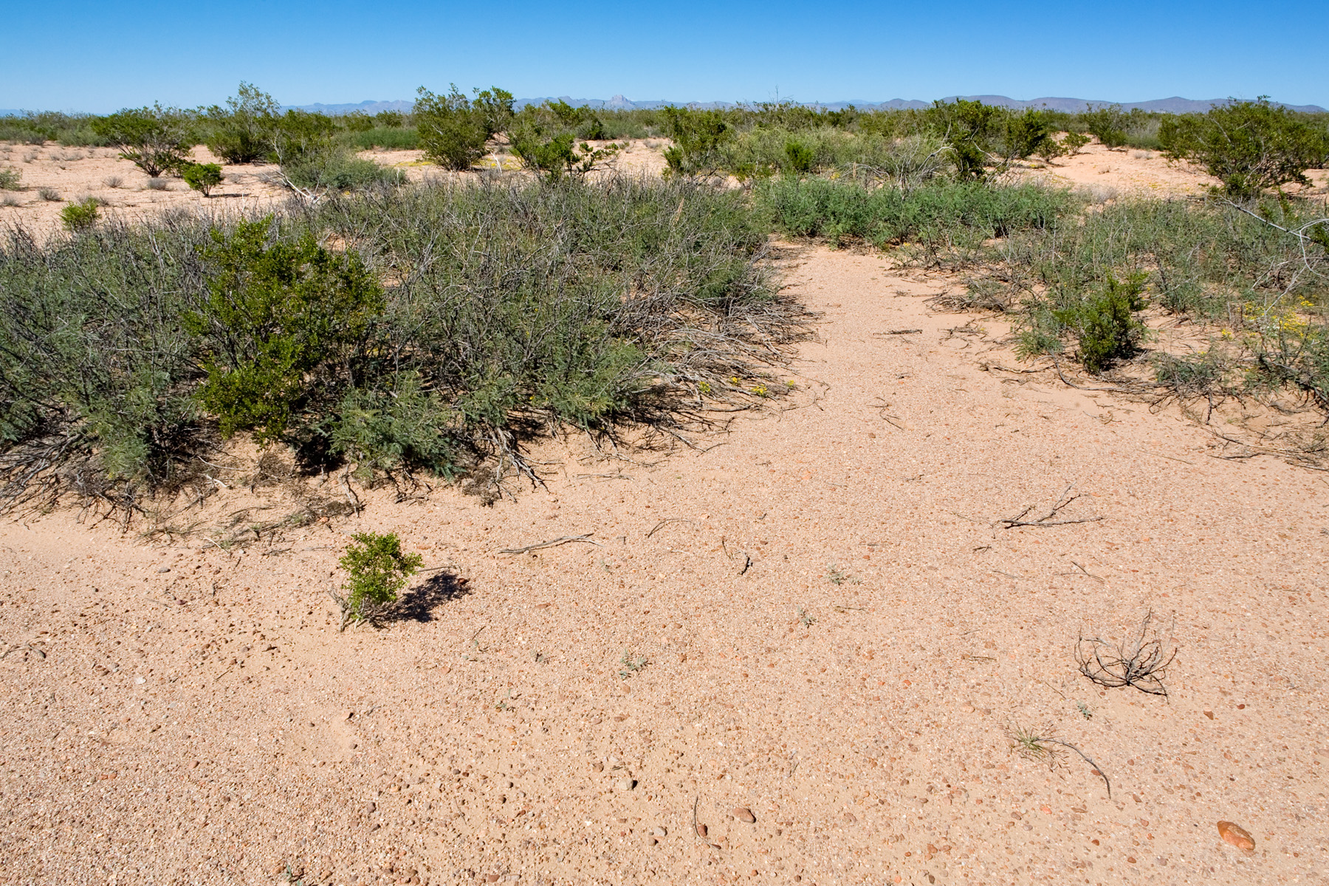
Notes:
And on the ground…

Slide 13
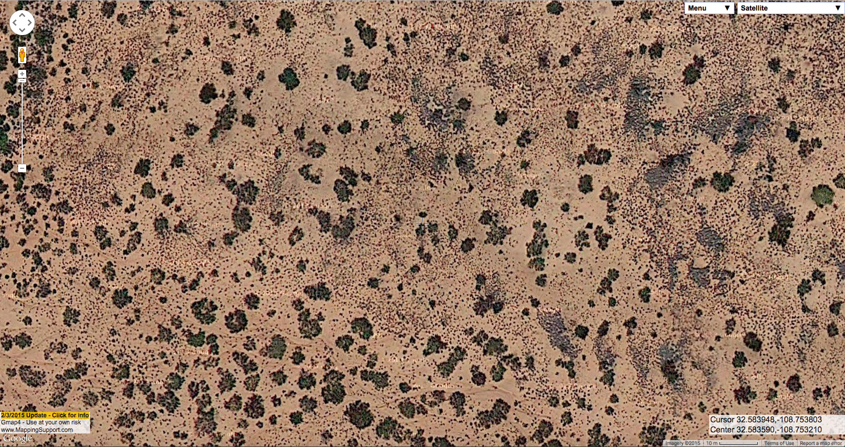
Notes:
This is a mixture of mesquite, tobosa, and snakeweed. When tobosa is dense it’s easy to tell from snakeweed. When it’s sparser, it’s hard. This is north of Lordsburg on the west side of NM Hwy. 464.

Slide 14
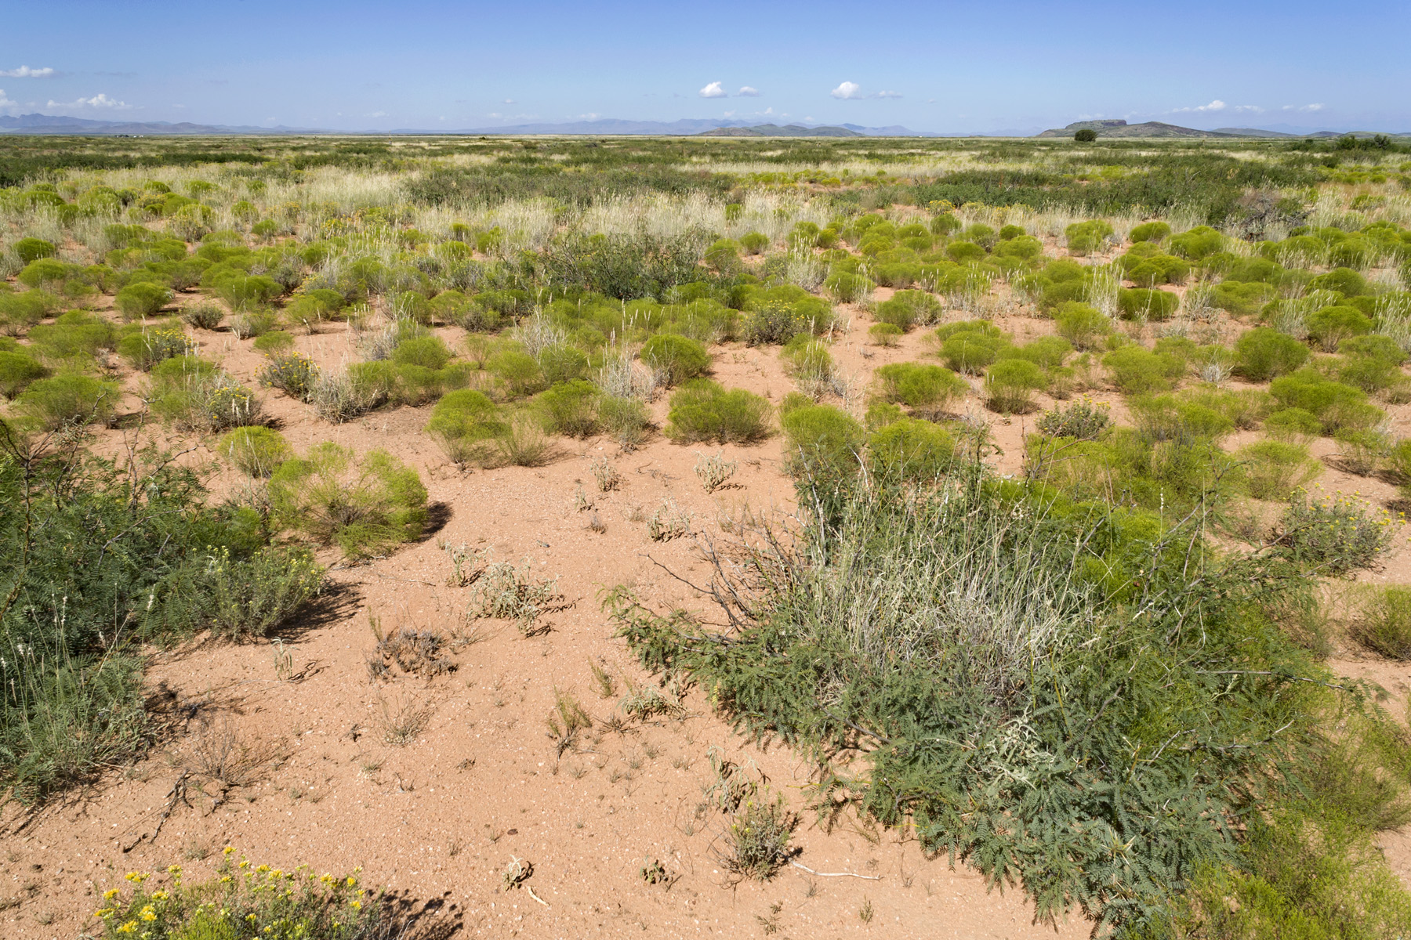
Notes:
Mesquite shrubland with tobosa and broom snakeweed

Slide 15
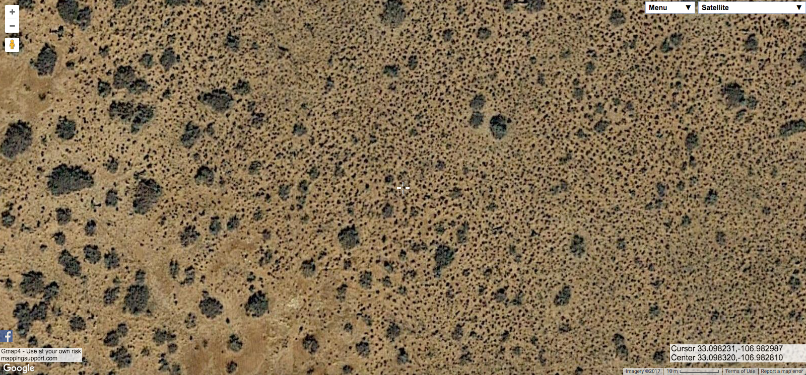
Notes:
And sometimes we’ll get mesquite with other species, in this case one I would not have expected – broom dalea. These smaller shrubs are really not identifiable without checking on the ground… although once you’ve figured out that this little patch is mesquite and broom dalea, it’s not have to identify some nearby and very similar patches as the same. This is on the Jornada del Muerto Plain near the spaceport on the east side of Jornada Lakes.

Slide 16
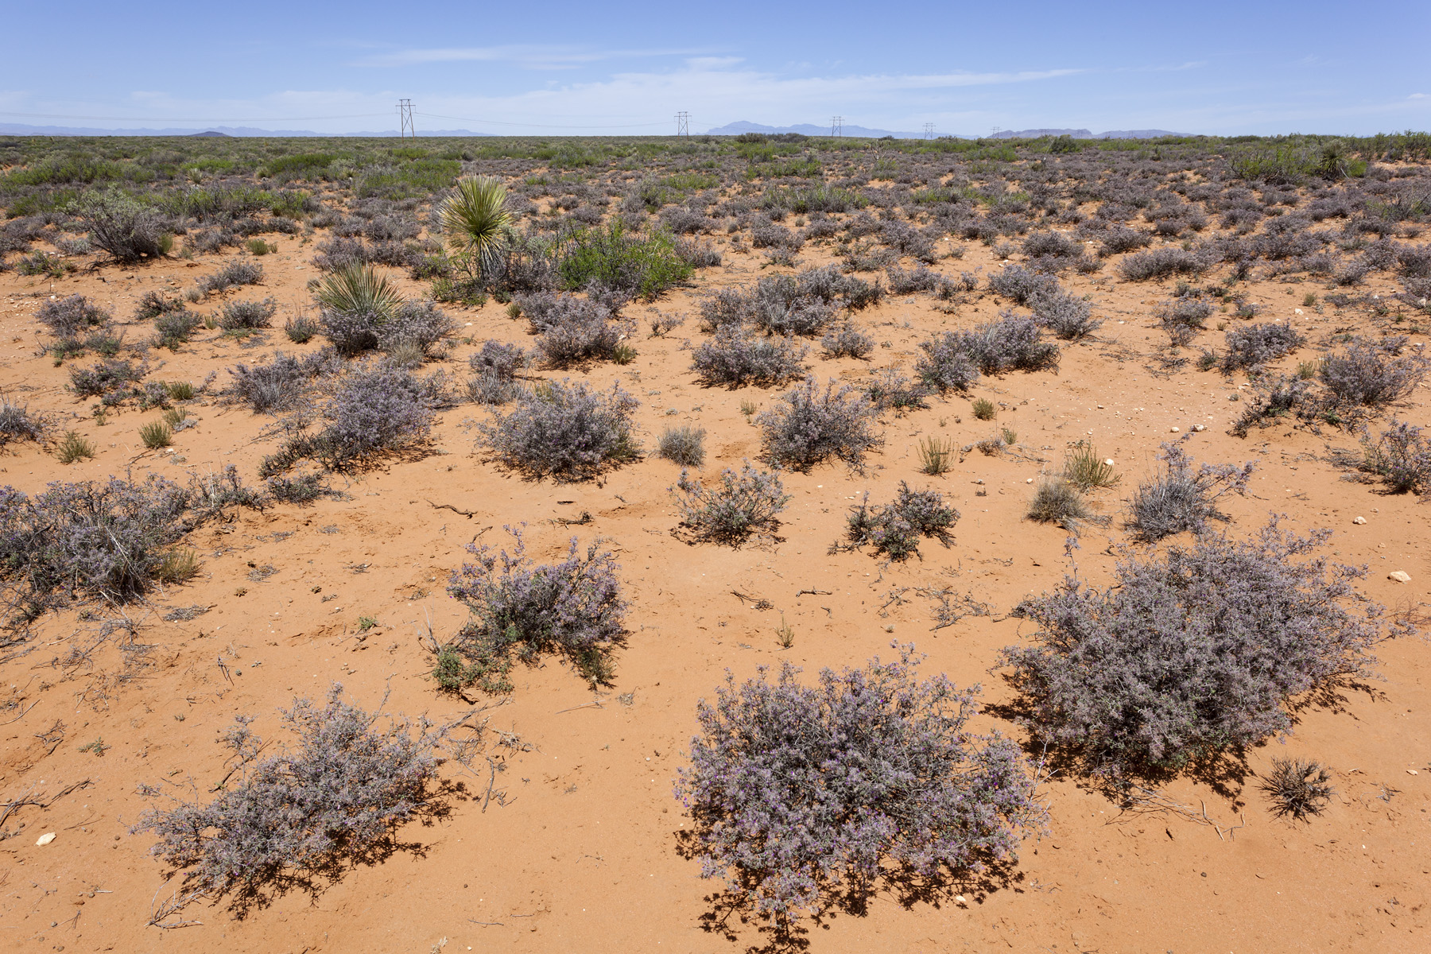
Notes:
Mesquite and plume dalea

Slide 17
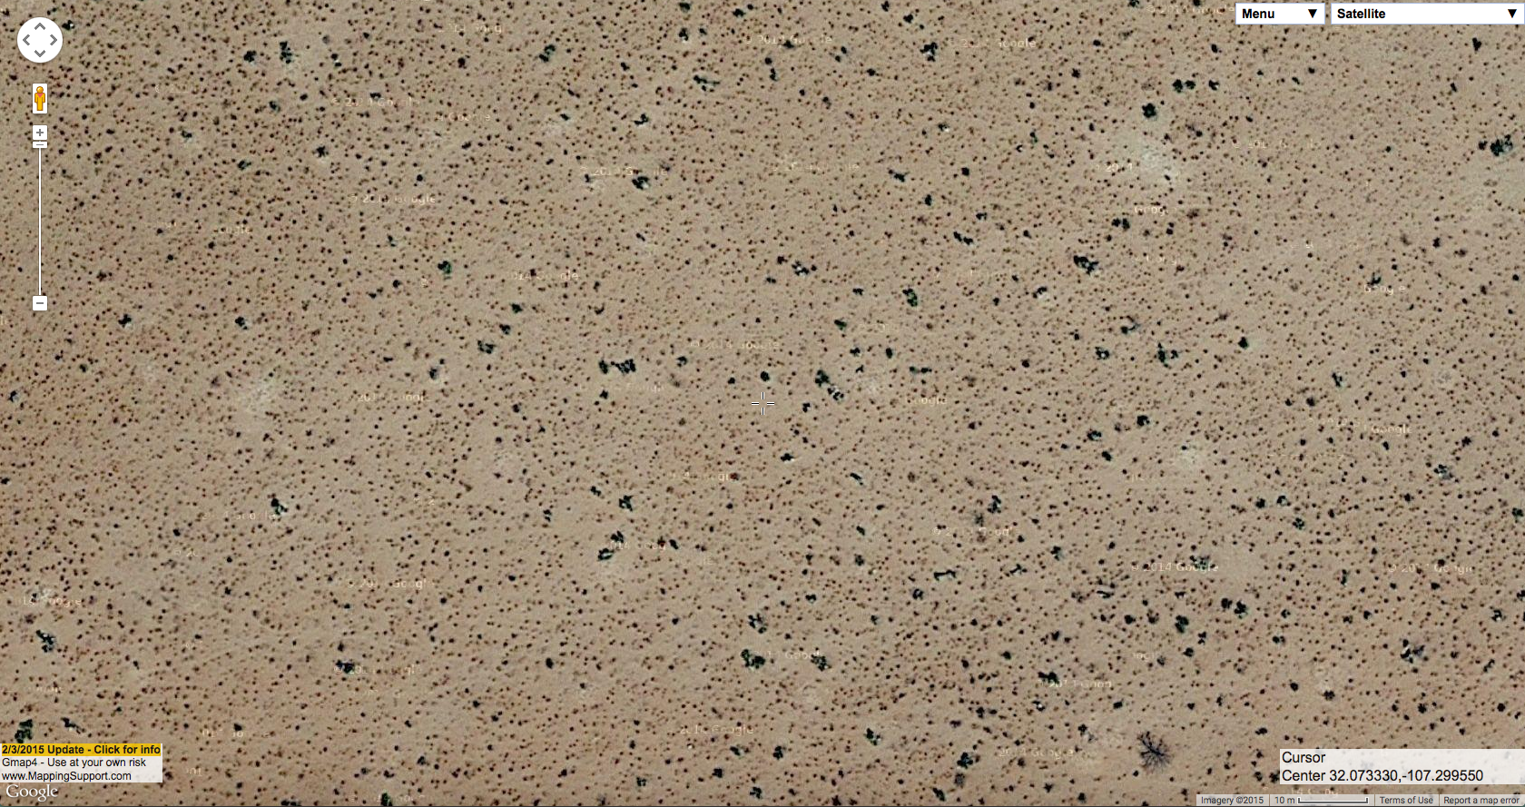
Notes:
Sometimes the plants that are visually dominant on the ground don’t really show up at all on aerial imagery. This tends to be the case with annuals and smaller perennial grasses. The plants visible on aerial imagery here are soaptree yucca and broom snakeweed, plus a little bit of longlleaf jointfir and one mesquite. This is east-southeast of Deming on the west side of the West Potrillo Mountains.

Slide 18
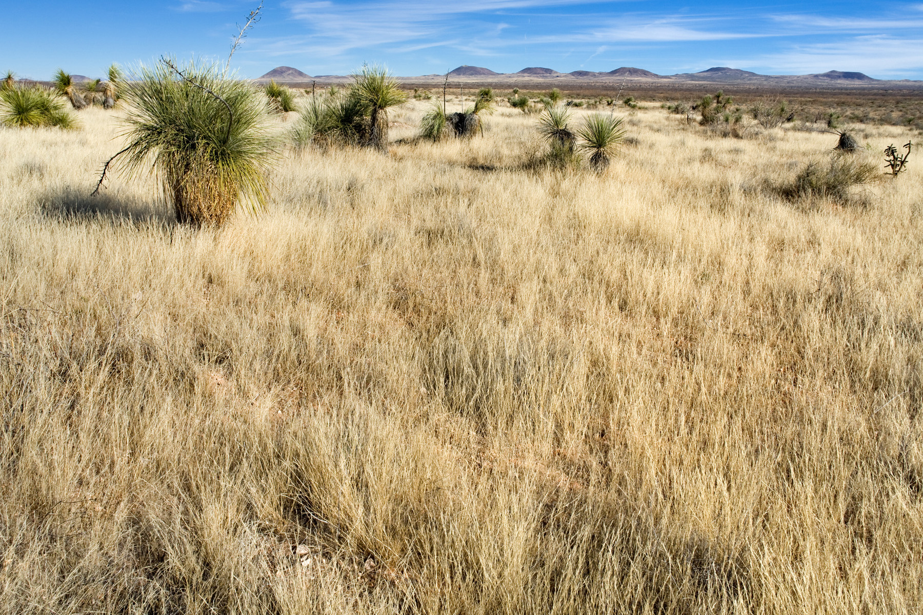
Notes:
Seen on the ground, the dominant plant is sixweeks threeawn.

Slide 19
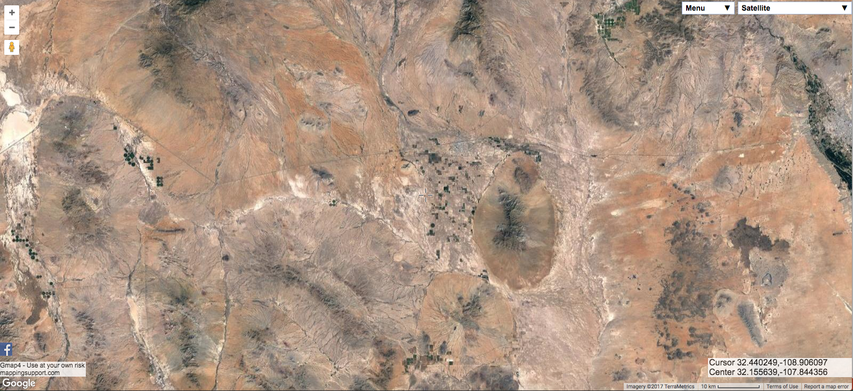
Notes:
OK, that’s a quick intoduction to some of the variation in plant communities you can see on aerial imagery. Now I have a couple of stories to tell, both of which are in Hidalgo County, mostly around Lordsburg.

Slide 20
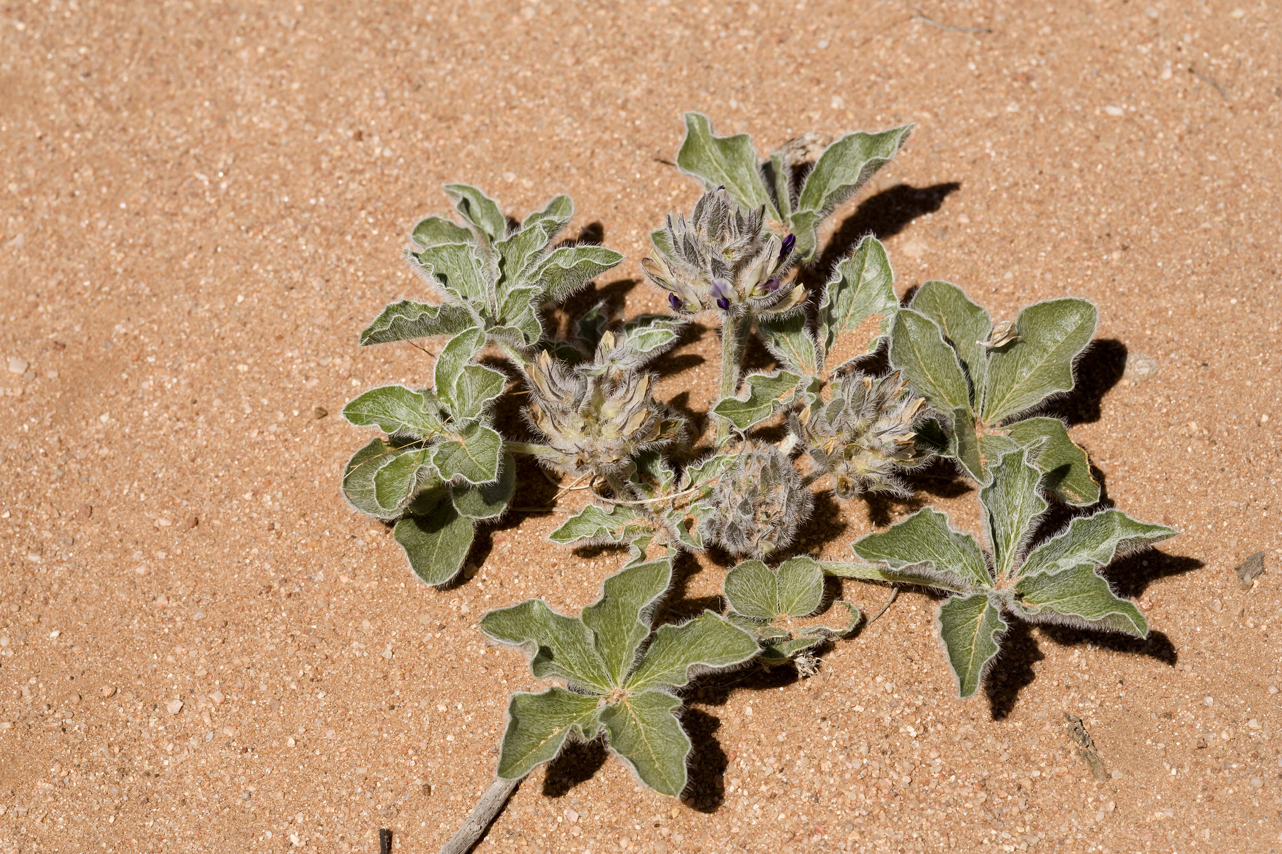
Notes:
This is Pediomelum pentaphyllum, Chihuahua scurfpea. It was petitioned for listing under the Endangered Species Act in 2007.

Slide 21
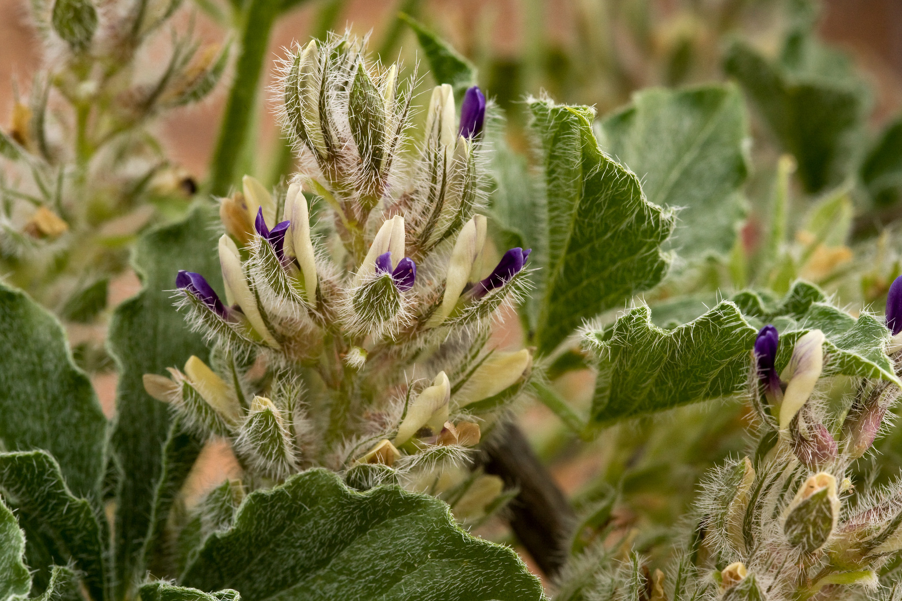
Notes:
Can anyone guess what family it’s in?

Slide 22
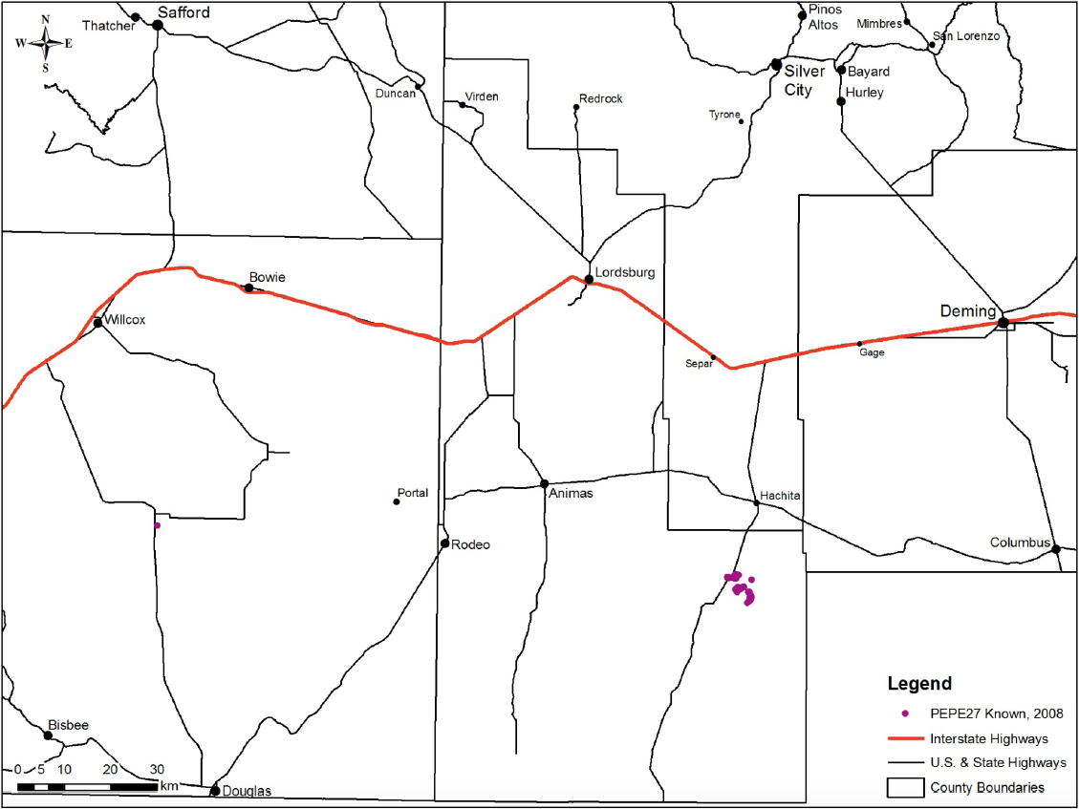
Notes:
When it was petitioned, there were only two populations known, one of perhaps 500 individuals, one of only a couple dozen.

Slide 23
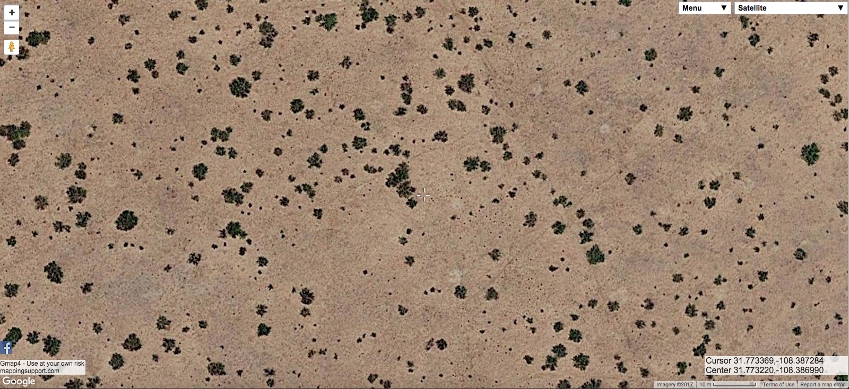
Notes:
This is what the habitat in the big population south of Hachita looks like. This is mesquite shrubland. In some plants there’s also creosote bush. It’s fairly sandy, but it’s coarse sand and doesn’t form coppice dunes.

Slide 24
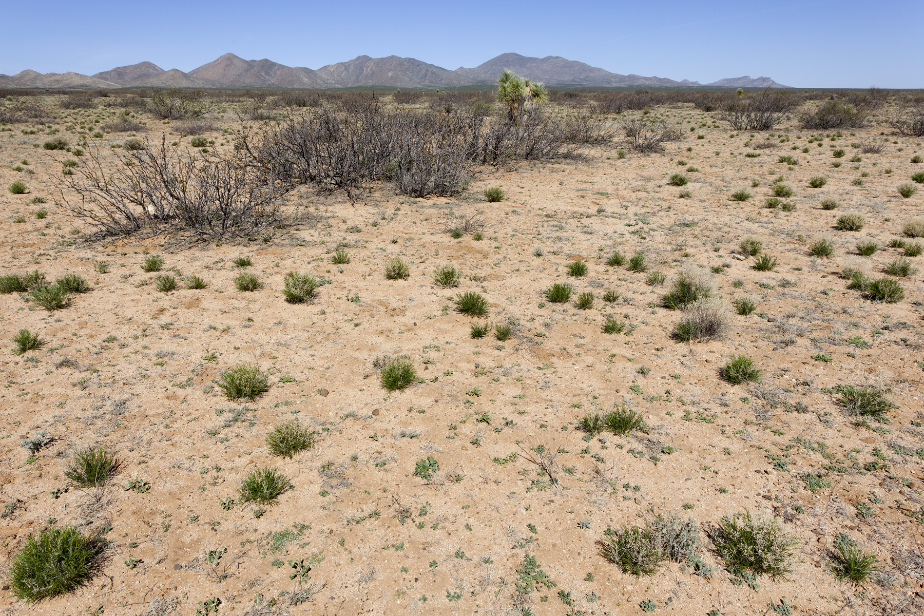

Slide 25
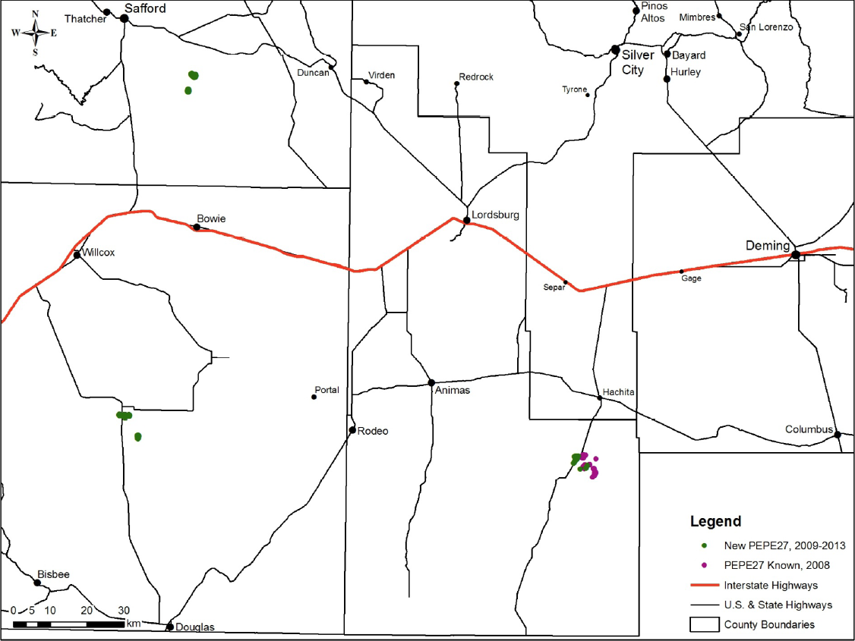
Notes:
We did a lot of surveys between 2008 and 2013. The known populations were expanded a big, and we found a new, relatively small, population southeast of Safford. The overall picture didn’t change much, though. We were focusing mostly on trying to find areas that are like the Hachita population. The Hachita population, though, is in kind of an odd but not terribly distinguishable plant community… a lot of areas look like that on aerial imagery.

Slide 26
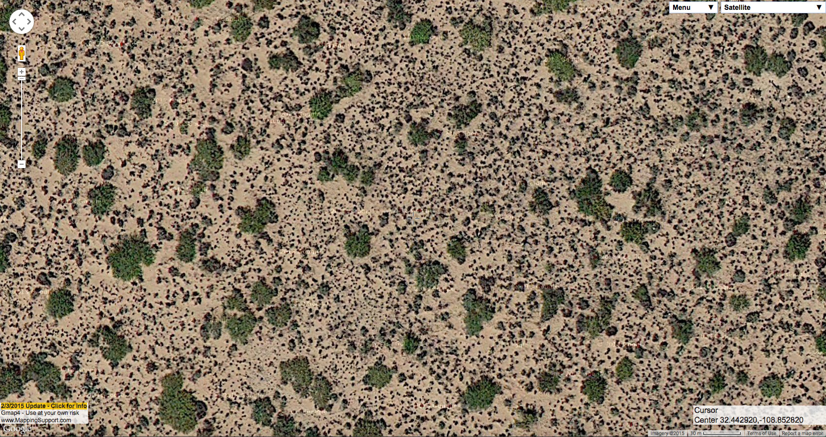
Notes:
In 2014, though, we found a new population northwest of Lordsburg. This gives us a lot to work with. We’ve got sparse mesquite on sandy soil, with lots of “other stuff” mixed in. In this case, that other stuff is mostly sand sagebrush and mesa dropseed.

Slide 27
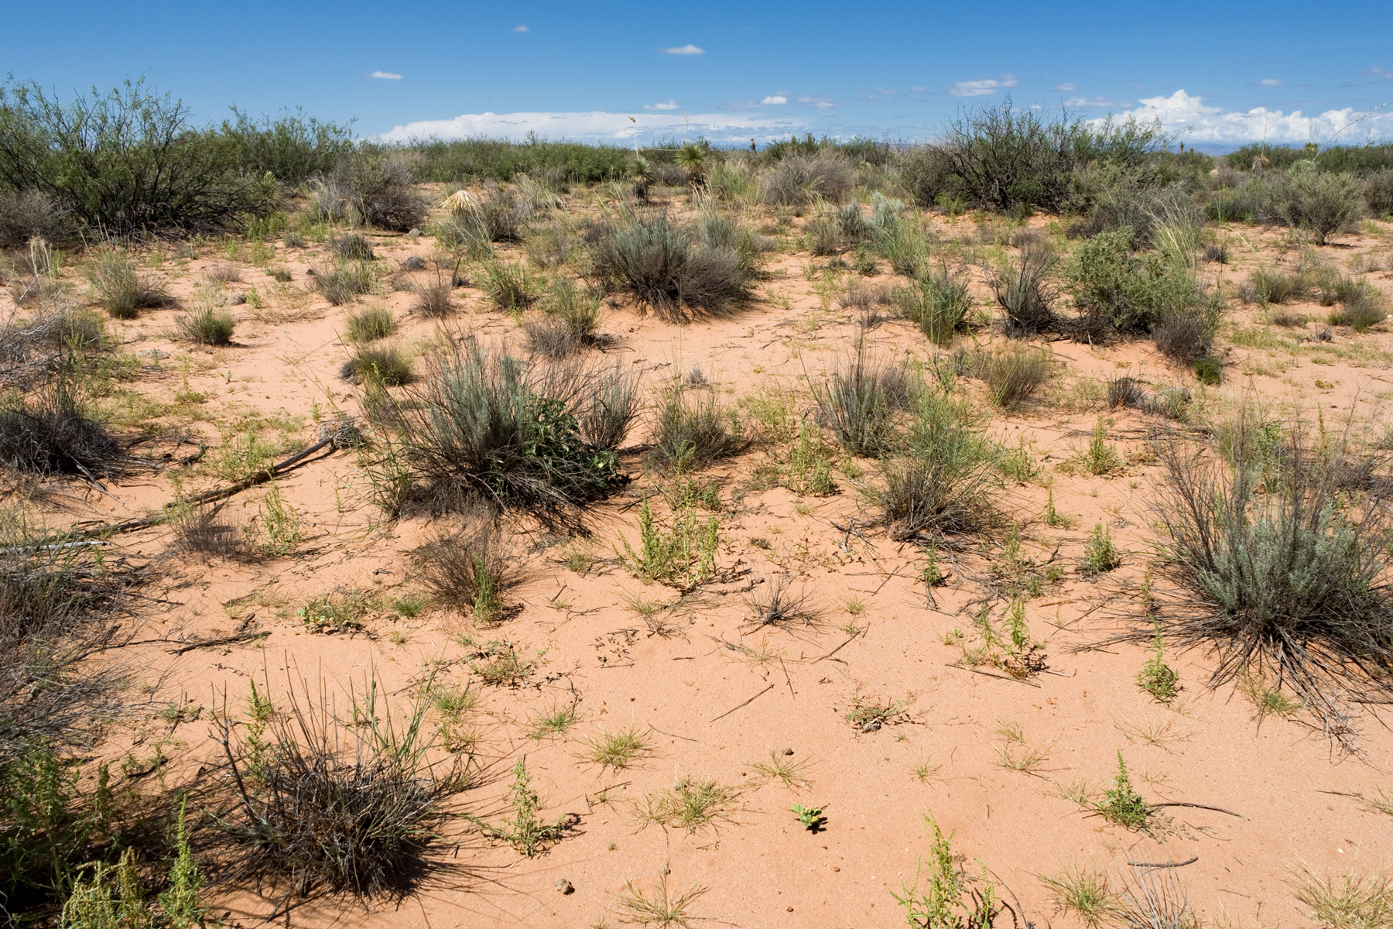
Notes:
Here it is on the ground. This habitat also has a lot of annual forbs that are sand specialists. Here, some of the forbs are Amaranthus acanthochiton. Finding a new population was good news both because it meant there were more of the things out there and because it gave us more to go on in characterizing habitat. Looking at this population and the two Arizona populations, it starts to look like the Hachita population is an outlier. The other three are all on deep sand with mesquite shrubland plus “other stuff”. That’s a habitat I can find on aerial imagery. So, can we find similar habitats, and go look on the ground, and find more populations that way?

Slide 28
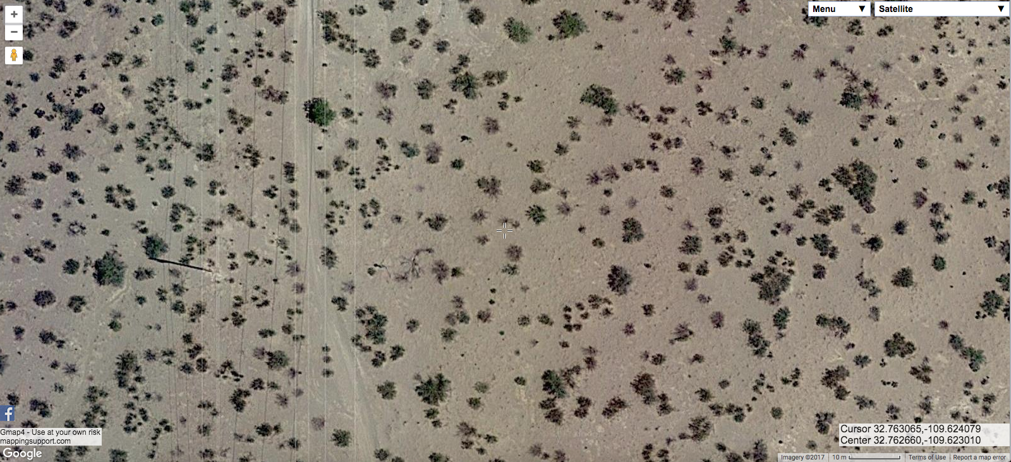
Notes:
This is a similar habitat in Arizona… it doesn’t have nearly as high density or diversity of vegetation, but it’s deep sand with mesquite and smaller shrubs that turn out in this case to mostly be creosote bush.

Slide 29
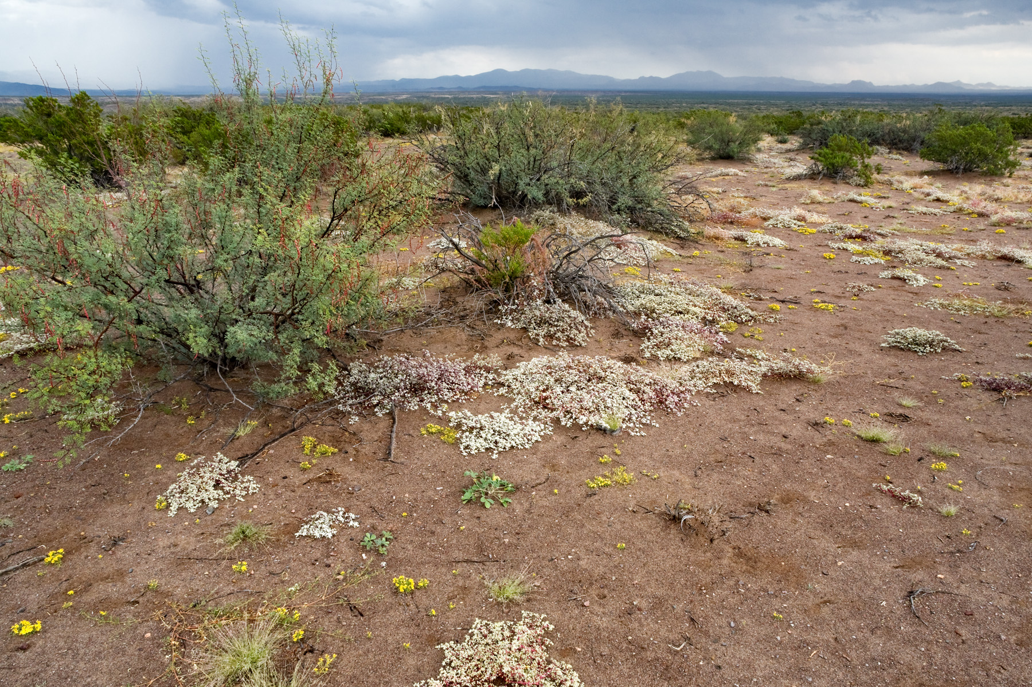
Notes:
Looking on the ground… yup. There’s our scurfpea.

Slide 30
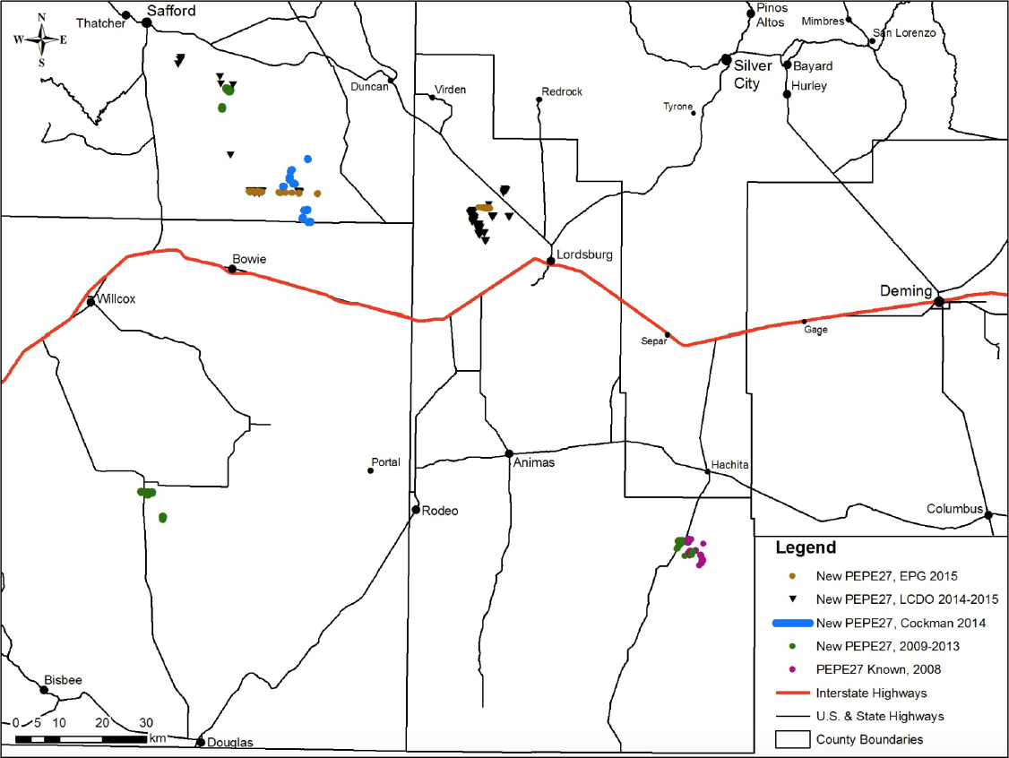
Notes:
Once we started narrowing down on the right habitat and, by good or bad luck depending on how you look at it, happened to have some big projects (including a powerline) that required surveying in that habitat, the number and size of populations went way up. The USFWS is soon going to decide whether or not to list this species (finally—the 360-day review period is turning out to be an 11-year review period), and whereas there was a pretty strong case that it needed to be listed back in 2007, now we can say with some confidence that it’s rare, but not nearly as rare as we thought, and apparently doing OK.

Slide 31
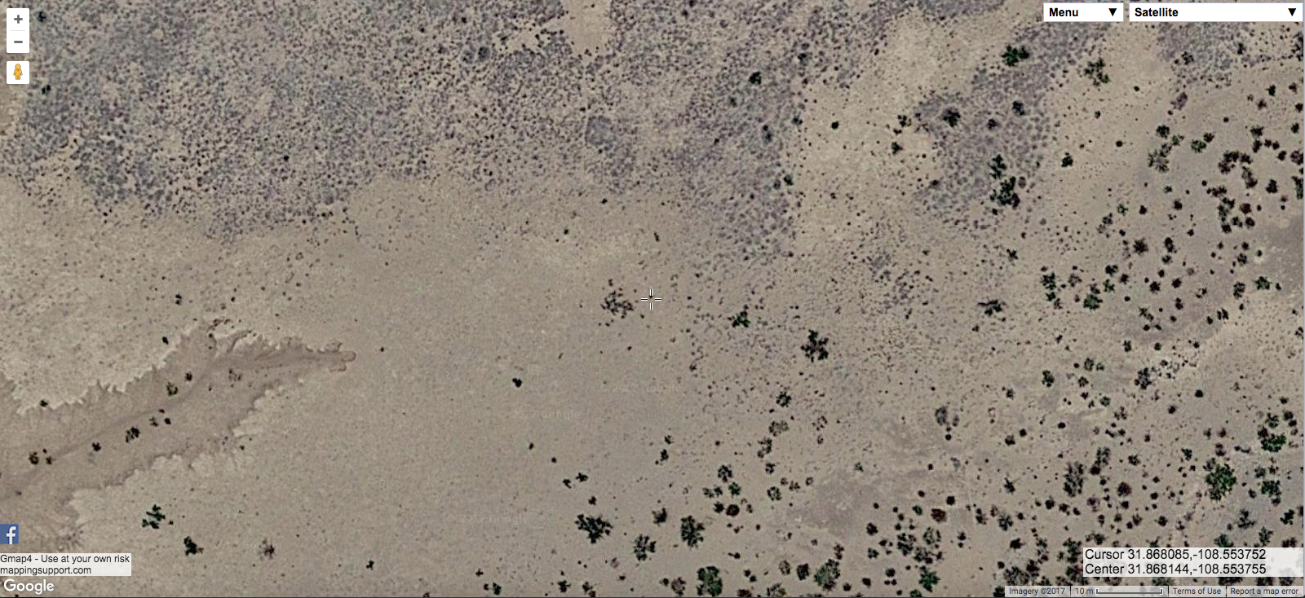
Notes:
Part of my job is deciding whether we need to do surveys. Suppose someone wants to put in a powerline, or a fence, or a trough, or do an herbicide treatment… do we need to go out and survey for rare plants first? Obviously I want to check on the ground as much as I can, but aerial imagery really lets me narrow things down. So, should we do scurfpea surveys here? Nope. This is loamy or clayey soil with mesquite and some kind of fairly large perennial grasses… probably tobosa or alkali sacaton.

Slide 32
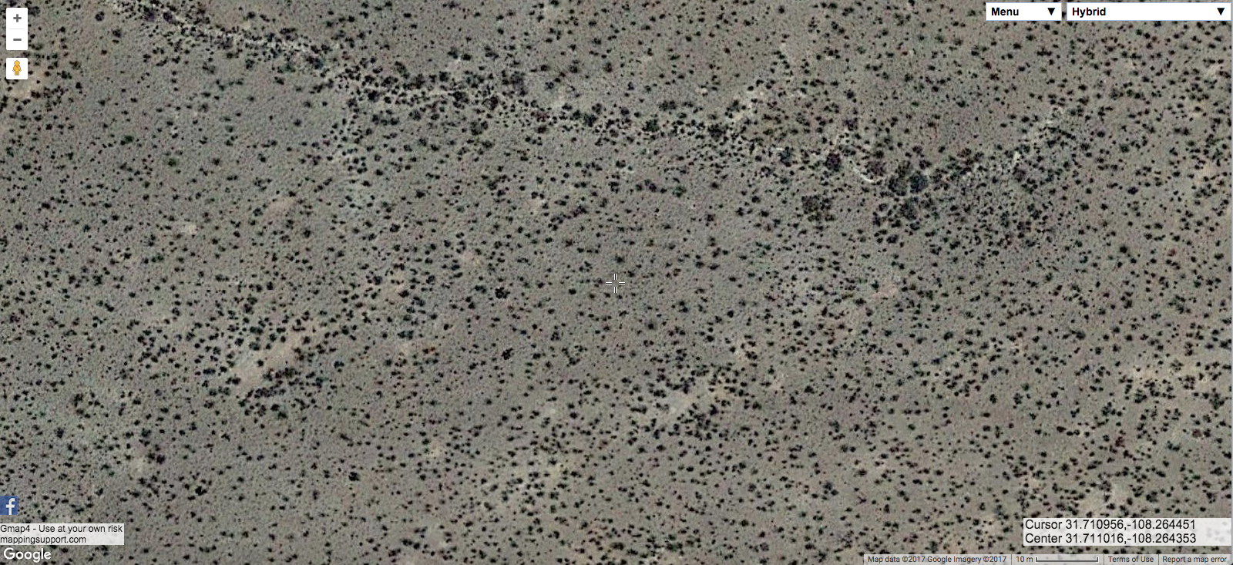
Notes:
How about here? Nope, this is creosote shrubland on gravelly soil. The lighter spots, BTW, are from kangaroo rats.

Slide 33
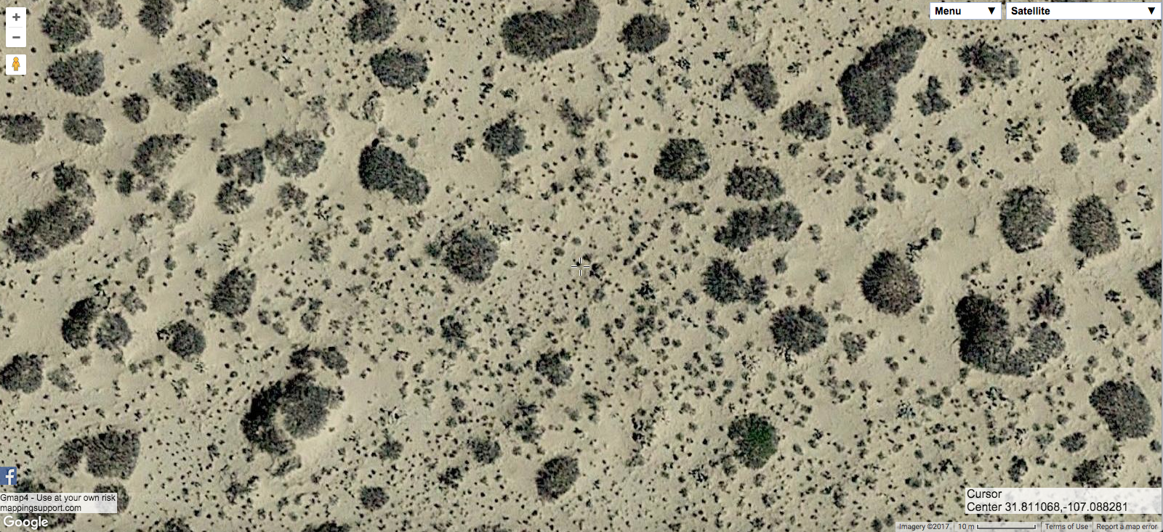
Notes:
How about here? Yup, that’s mesquite with other stuff on sand. I did actually check here and did not find any… but it looked like the right habitat on the ground, too… this is east of Columbus on the south side of NM Hwy 9.

Slide 34
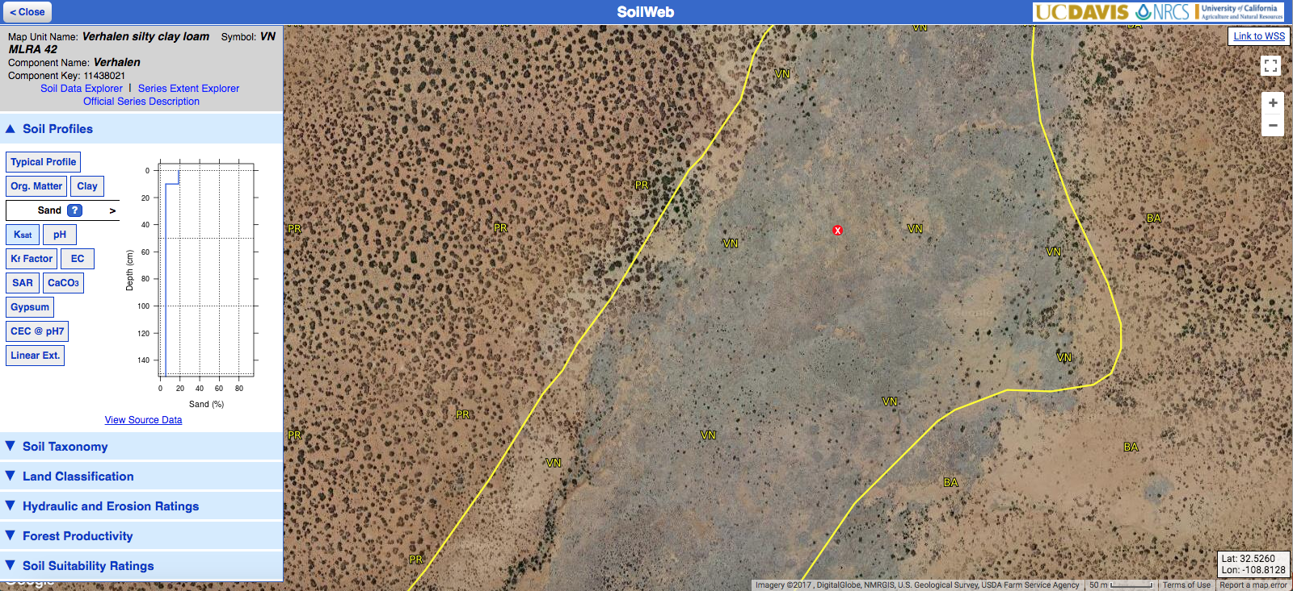
Notes:
Also, although I’m focusing on aerial imagery here, there are a lot of other tools available for looking at plant habitats. One of the other most useful ones is soil mapping, which you can get online.

Slide 35
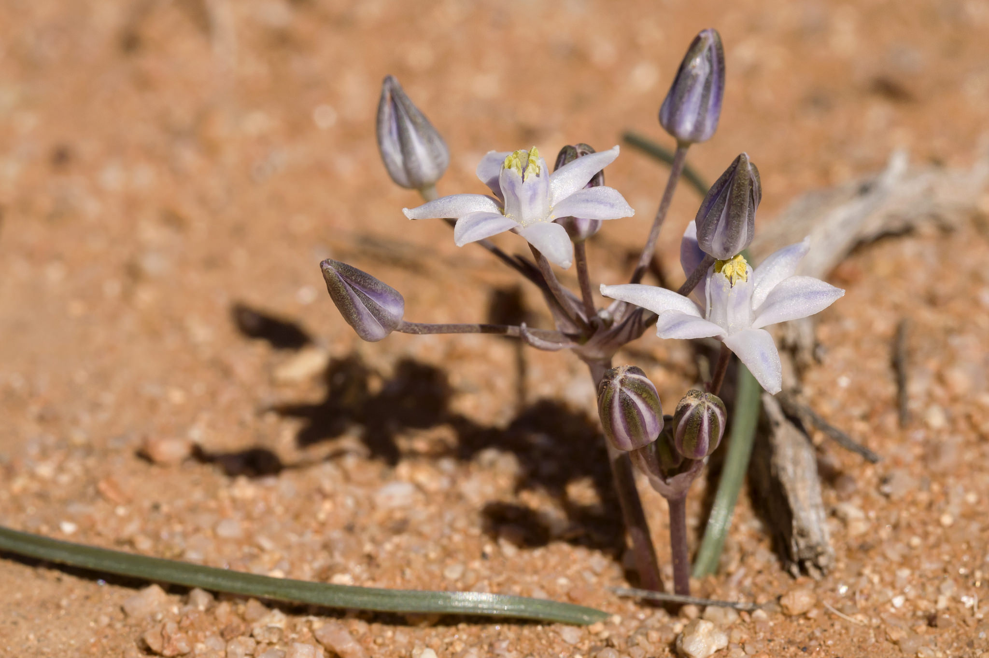
Notes:
Now for the second story. In 2015, I found this little plant. I didn’t recognize it, so I took some pictures. Looking in Kelly Allred’s Flora Neomexicana III, it didn’t key out quite right but I ended up at Androstephium breviflorum. So, I labelled my photos as such and went on my way.

Slide 36
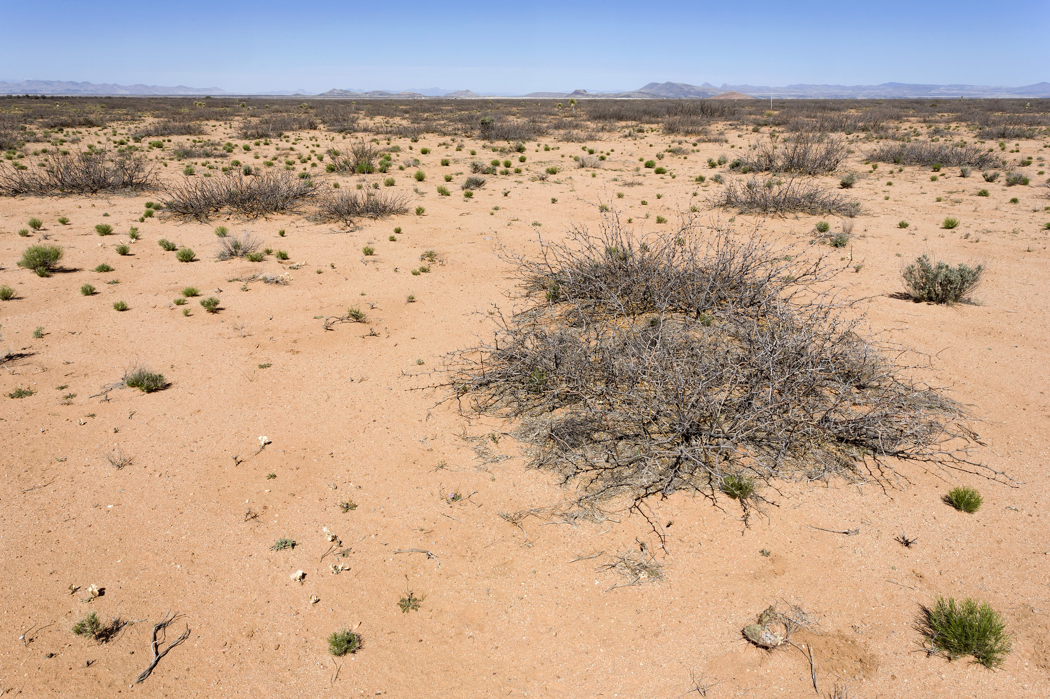
Notes:
Here’s the habitat. Kind of coarse sandy loam, sparse mesquite shrubland, no coppice dunes. Not real exciting. This is one the west side of NM Hwy. 464 north of Lordsburg.

Slide 37
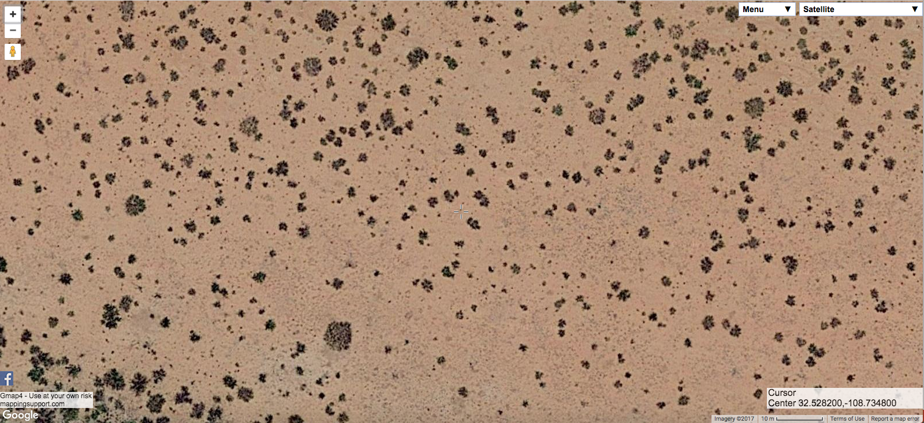
Notes:
And from the air…

Slide 38
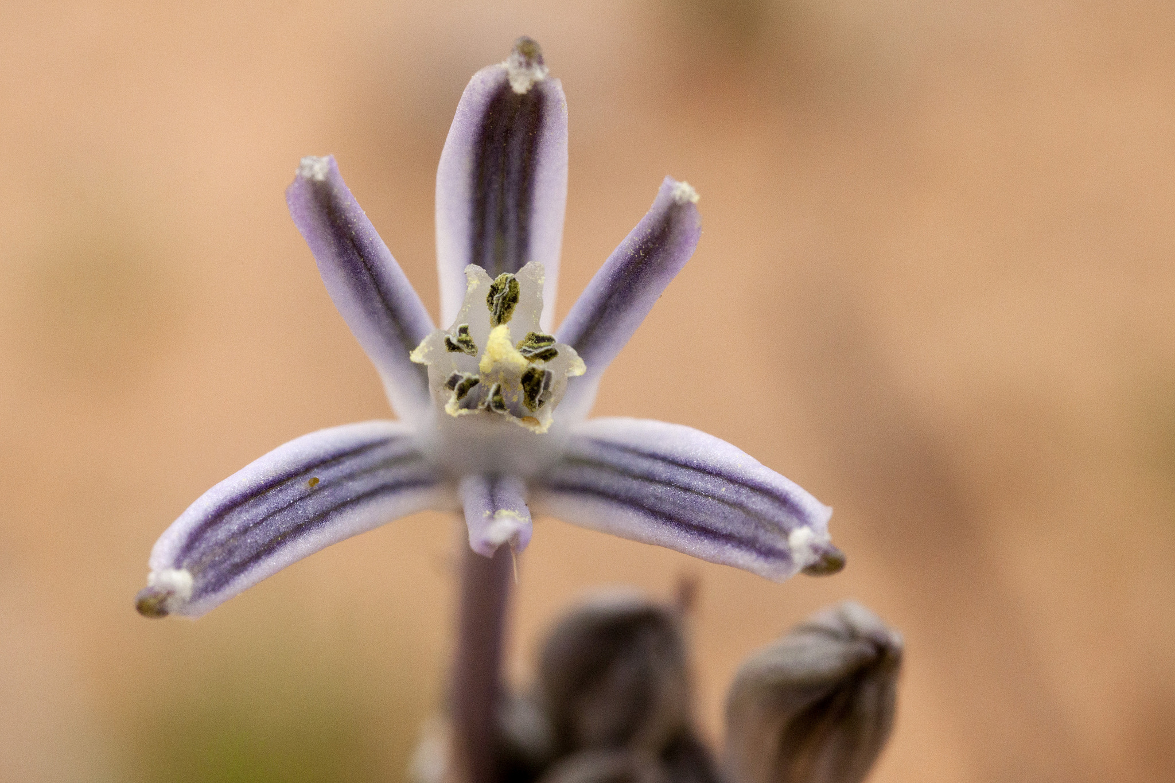
Notes:
This year, I was in Arizona and happened on Androstephium breviflorum. I double-checked my ID a few times, and that’s definitely what this is. It sure doesn’t look like my 2015 “Androstephium breviflorum”, though, so what gives?

Slide 39
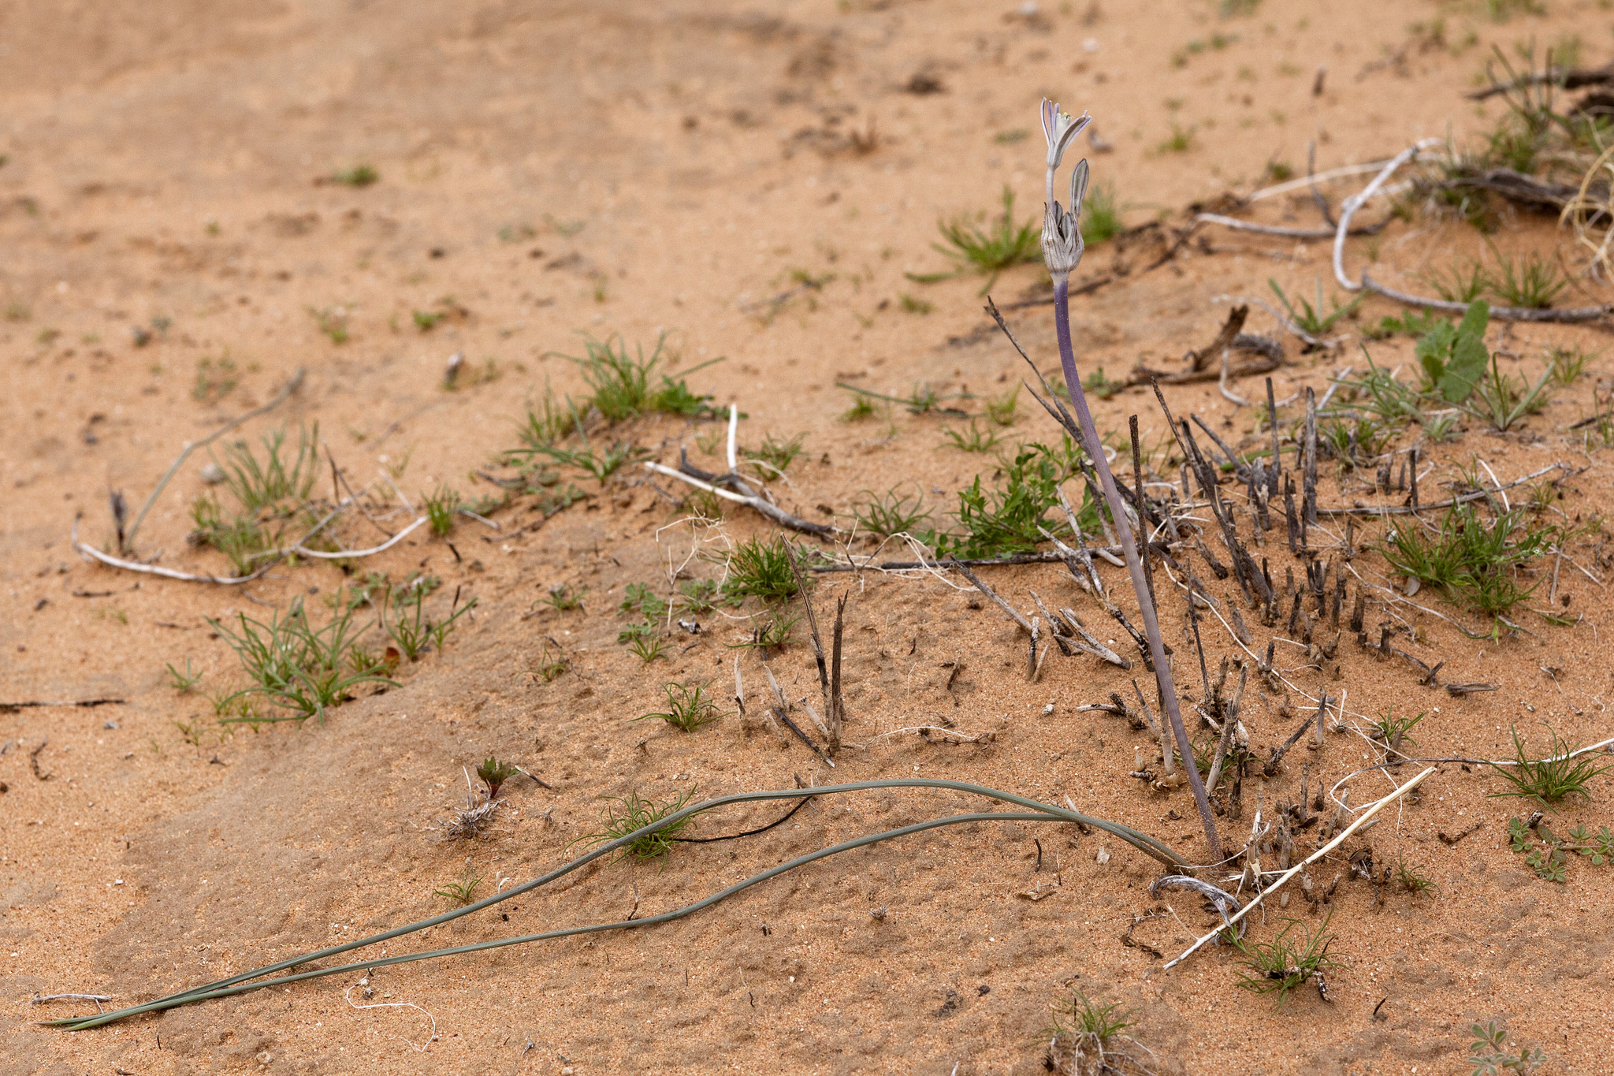

Slide 40
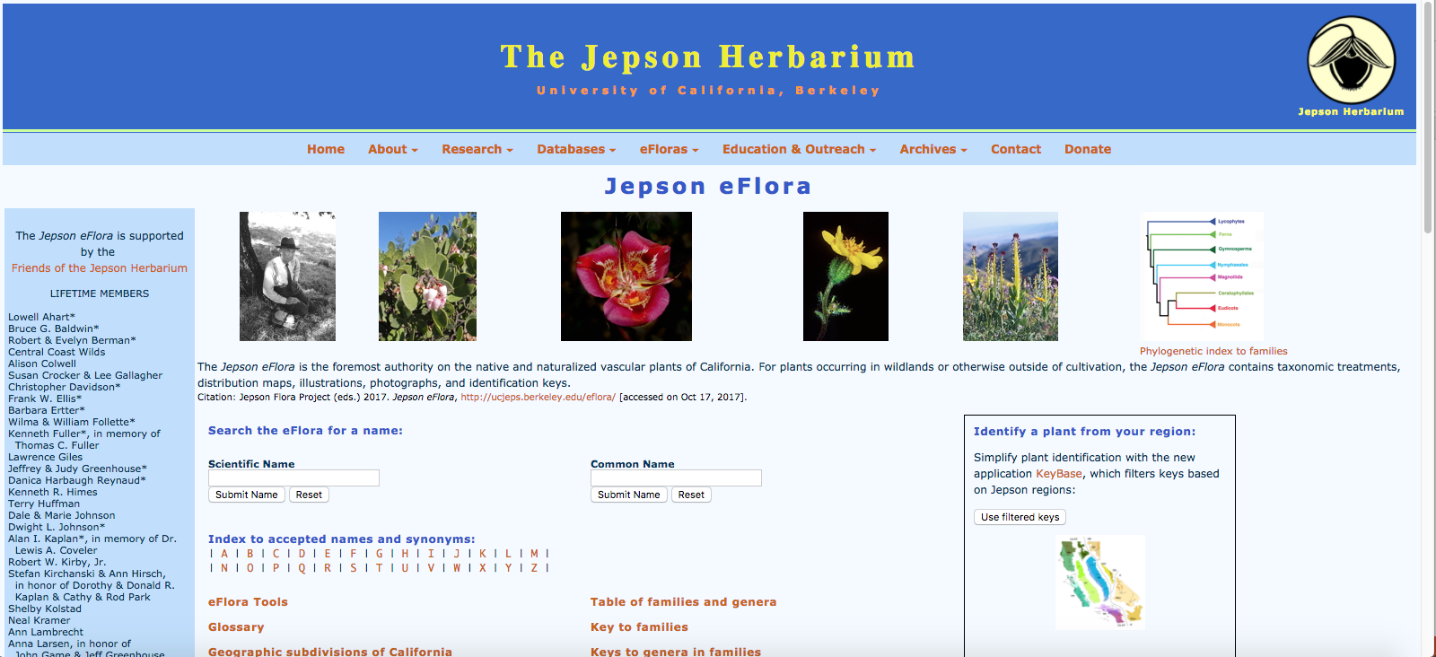
Notes:
Well, I checked Flora Neomexicana III again. Yup, I just end up back at Androstephium breviflorum, but now I know that isn’t right. I check the Correll & Johnston flora of Texas. No luck there. I check the Kearney and Peebles flora of Arizona, same thing. Then I check the Jepson eFlora. It keys straight to Muilla coronata.

Slide 41
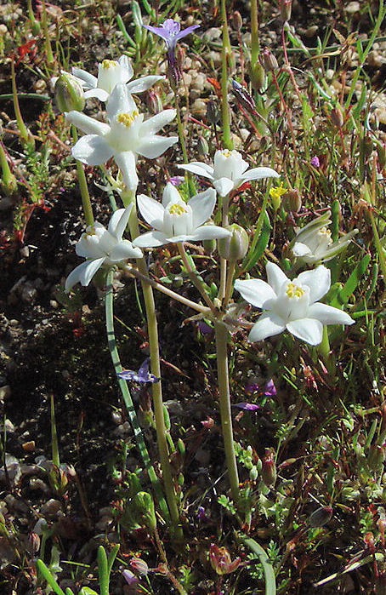
Gordon Snelling
Notes:
And Muilla coronata sure looks right, too!

Slide 42
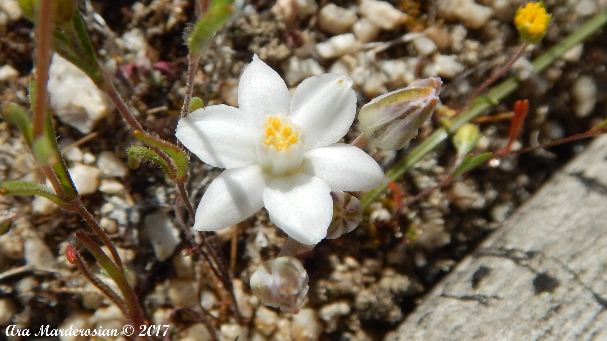

Slide 43
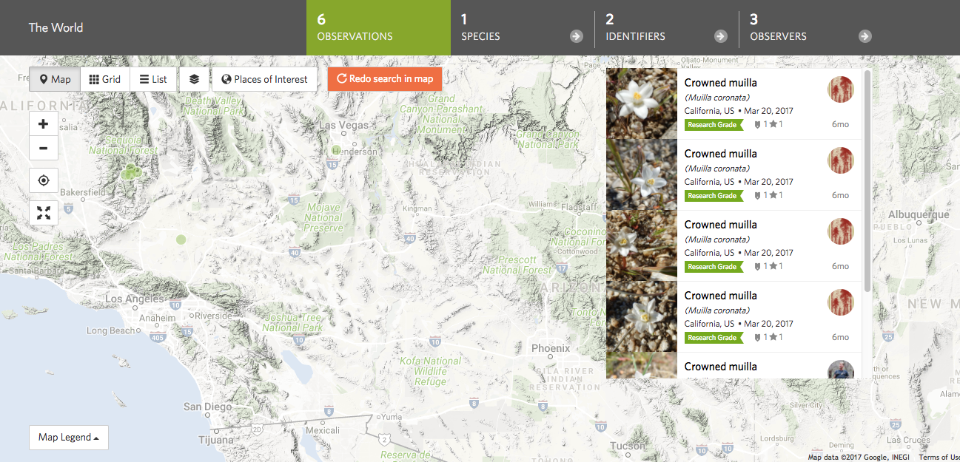
Notes:
However, Muilla coronata is over in the Mojave Desert, from near Bakersfield to the southwest side of Las Vegas. So that’s odd. Clearly my plants are closely related to Muilla coronata… but are they the same species?

Slide 44
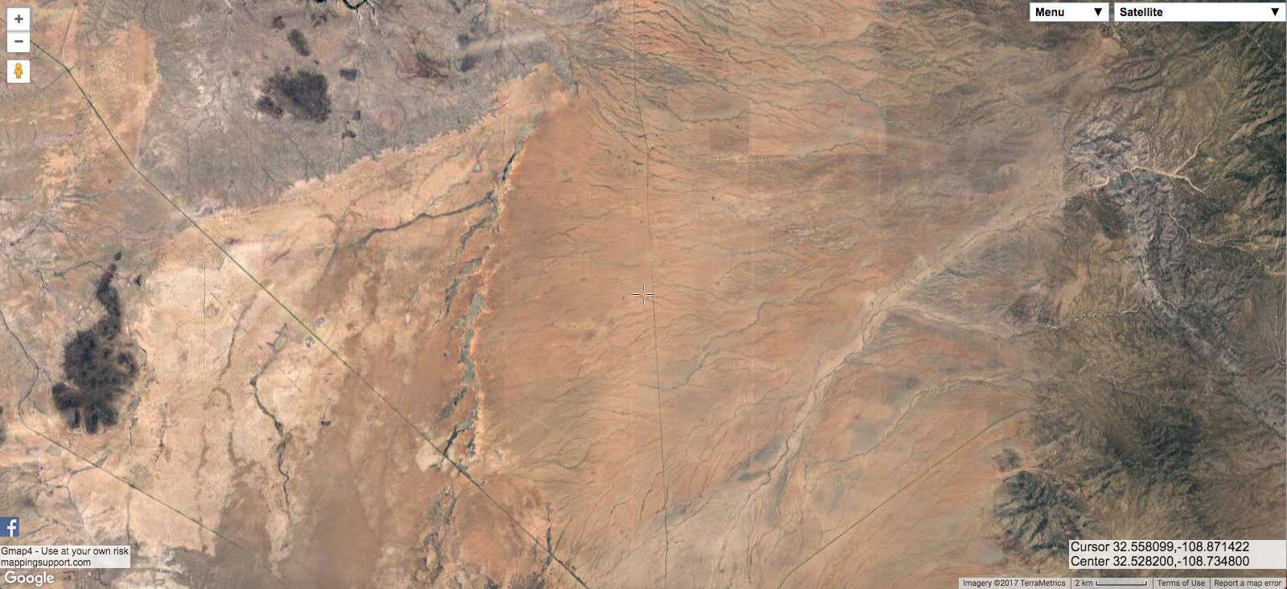
Notes:
Well, to find that out, I need to go find more plants. All I have at this point is three photos from 2015. So, where is my Muilla going to be?

Slide 45
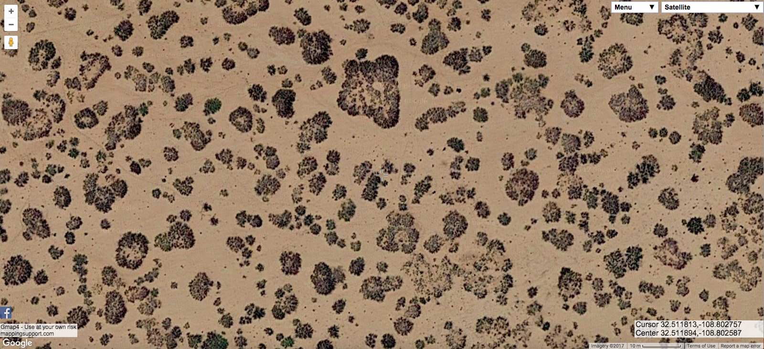
Notes:
West of the spot I visited in 2015 is a bunch of mesquite coppice dunes. I’ve spent a lot of time in mesquite dunes, and actually walked through this area. I really doubt there’s going to be something new in such a common and familiar habitat.

Slide 46
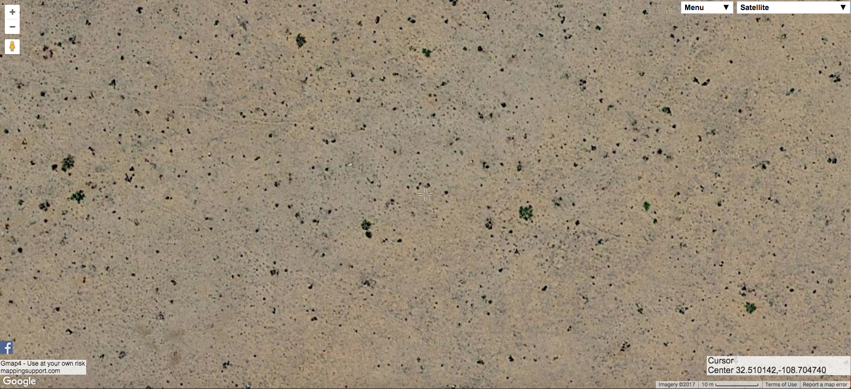
Notes:
East of the site, it looks like this. This is interesting. These kinds of annual-dominated habitats aren’t all that common and often have other fun stuff in them.

Slide 47
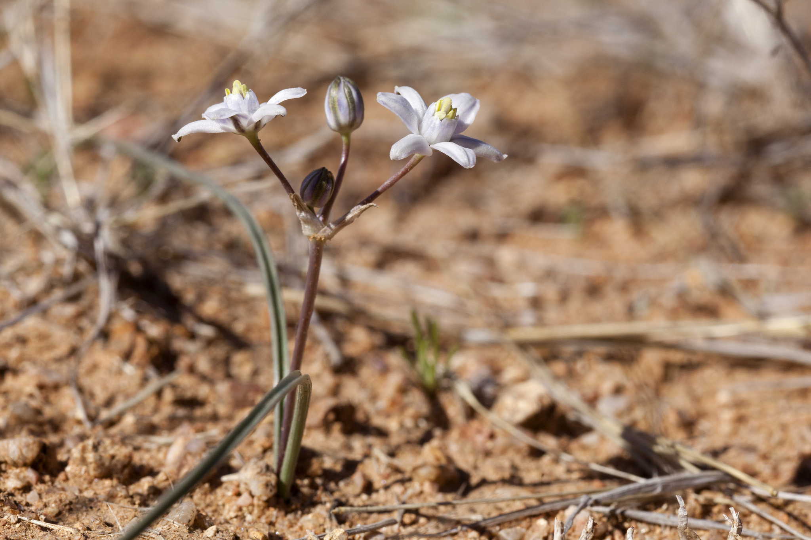
Notes:
So, I go out to the annual-dominated stuff and, yup, there are my plants.

Slide 48
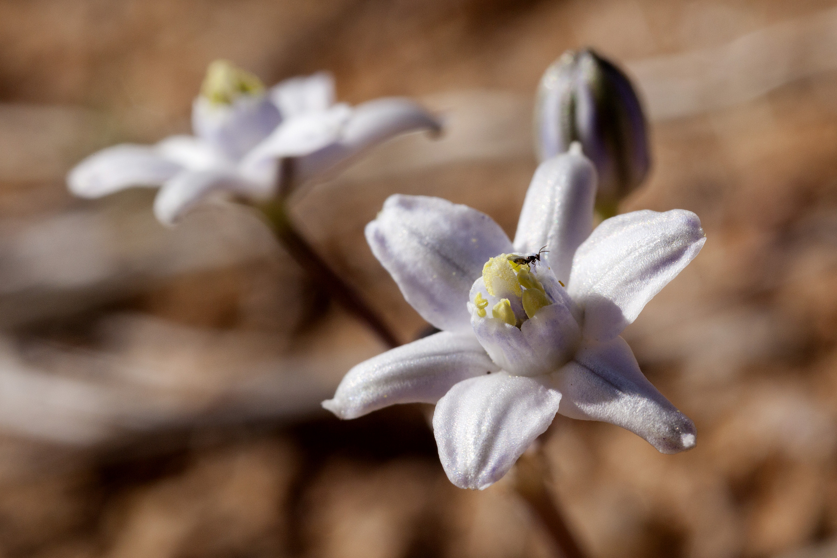

Slide 49
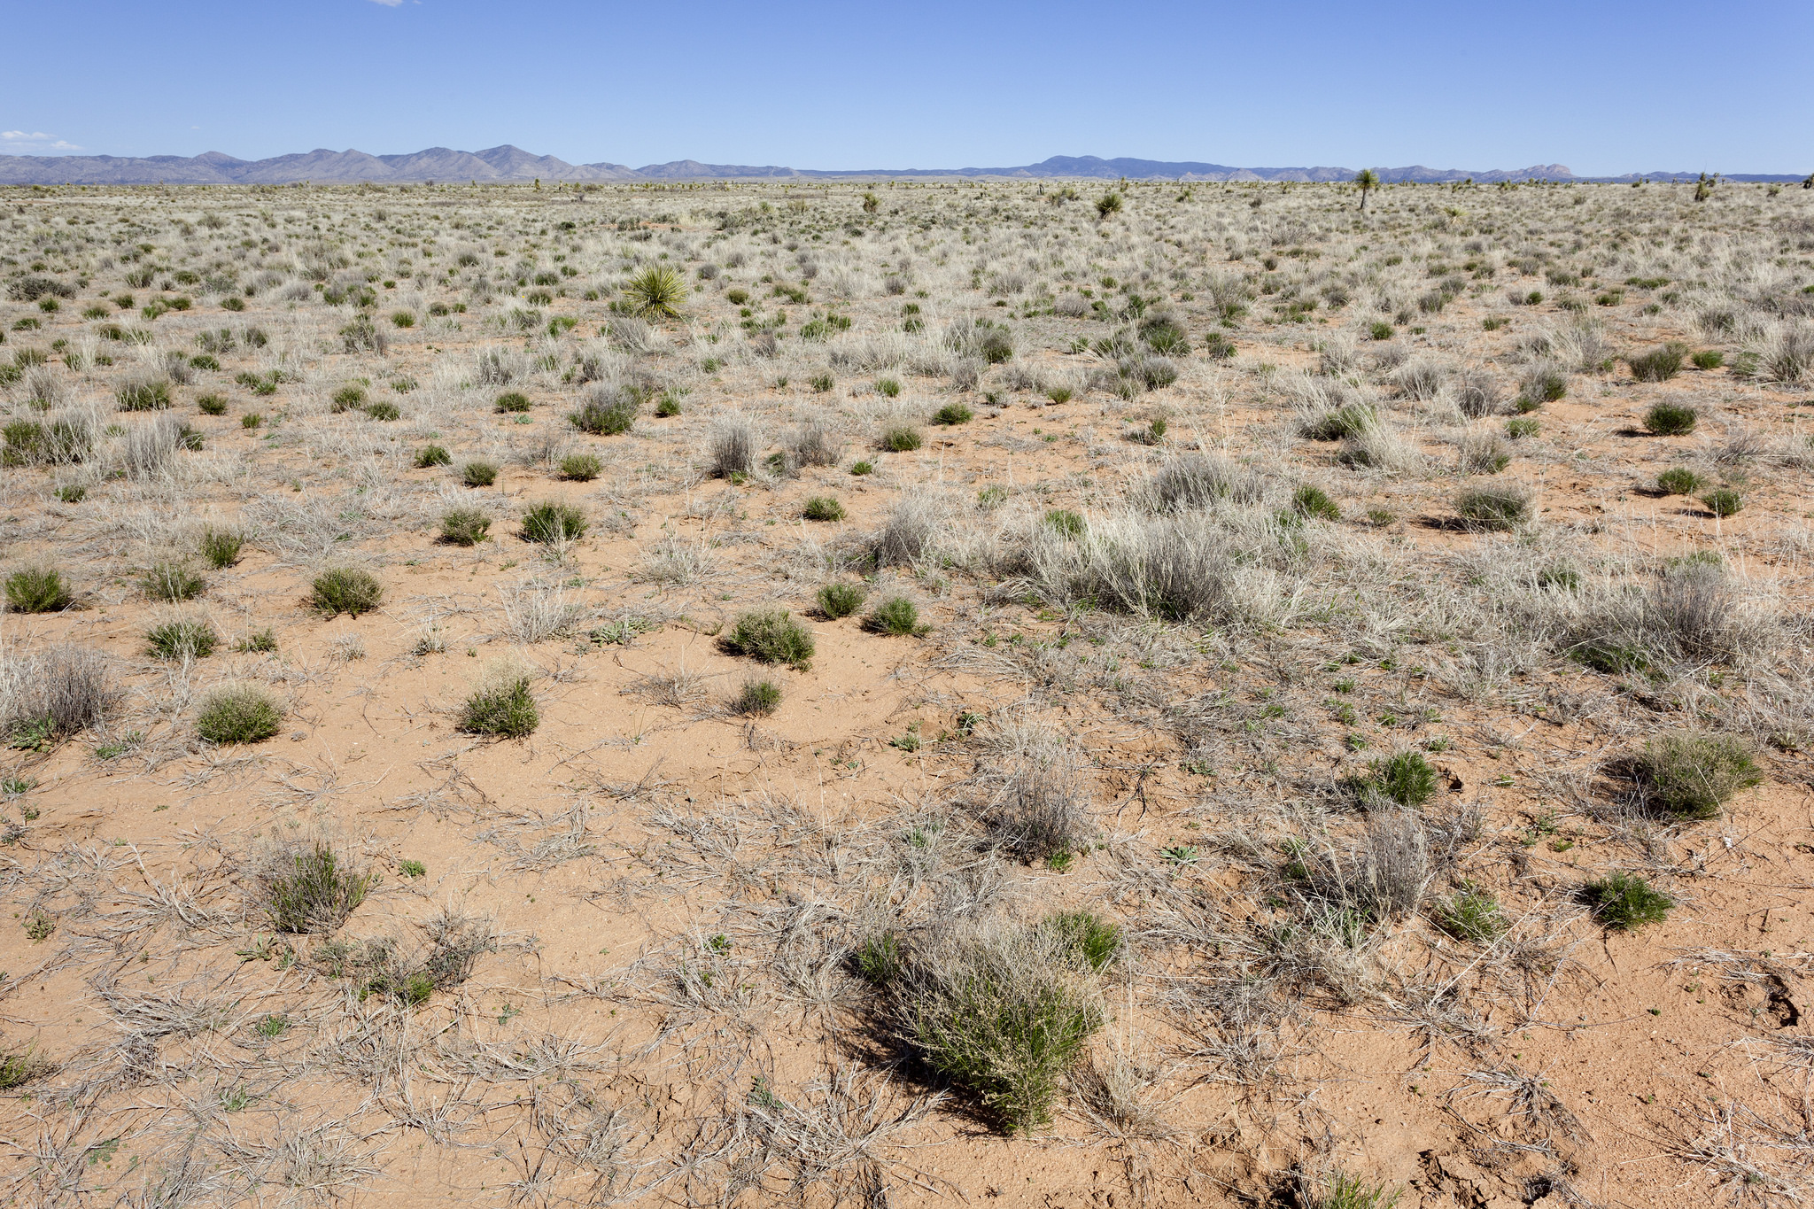
Notes:
Here’s Muilla habitat on the ground.

Slide 50
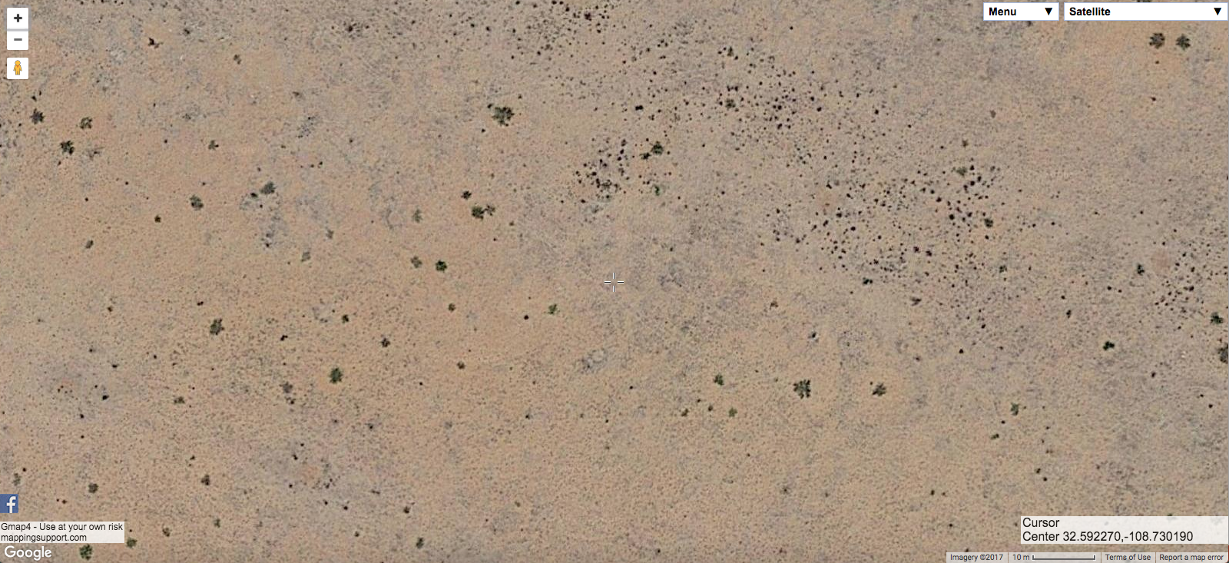
Notes:
And here’s another aerial.

Slide 51
Notes:
So, I checked as much of that habitat as I could, collected some plants, took a lot of pictures, including longitudinal sections like this.

Slide 52
Notes:
And I checked all the literature I could find on Muilla, and contacted California botanists who are familiar with Muilla coronata. Long story short: both the filaments and anthers are longer, with no overlap between the Lordsburg Muilla and Muilla coronata. Combined with the large geographic separation, I think this is enough to name it as a new species. So, I am in the process of doing so. It will be called Muilla lordsburgana.

Slide 53
Notes:
Here’s the map of where I found it, with three sites where I collected herbarium specimens marked.

Slide 54
Notes:
And let’s end with some other cool plants in that habitat with Muilla. Pectocarya platycarpa.

Slide 55
Notes:
And let’s end with some other cool plants in that habitat with Muilla. Pectocarya platycarpa.

Slide 56
Notes:
And let’s end with some other cool plants in that habitat with Muilla. Pectocarya platycarpa.

Slide 57
Notes:
And let’s end with some other cool plants in that habitat with Muilla. Eriogonum thurberi.

Slide 58
Notes:
And let’s end with some other cool plants in that habitat with Muilla. Eriogonum thurberi.

Slide 59
Notes:
And let’s end with some other cool plants in that habitat with Muilla. Plagiobothrys arizonicus.

Slide 60
Notes:
And let’s end with some other cool plants in that habitat with Muilla. Plagiobothrys arizonicus.

