Slide 1
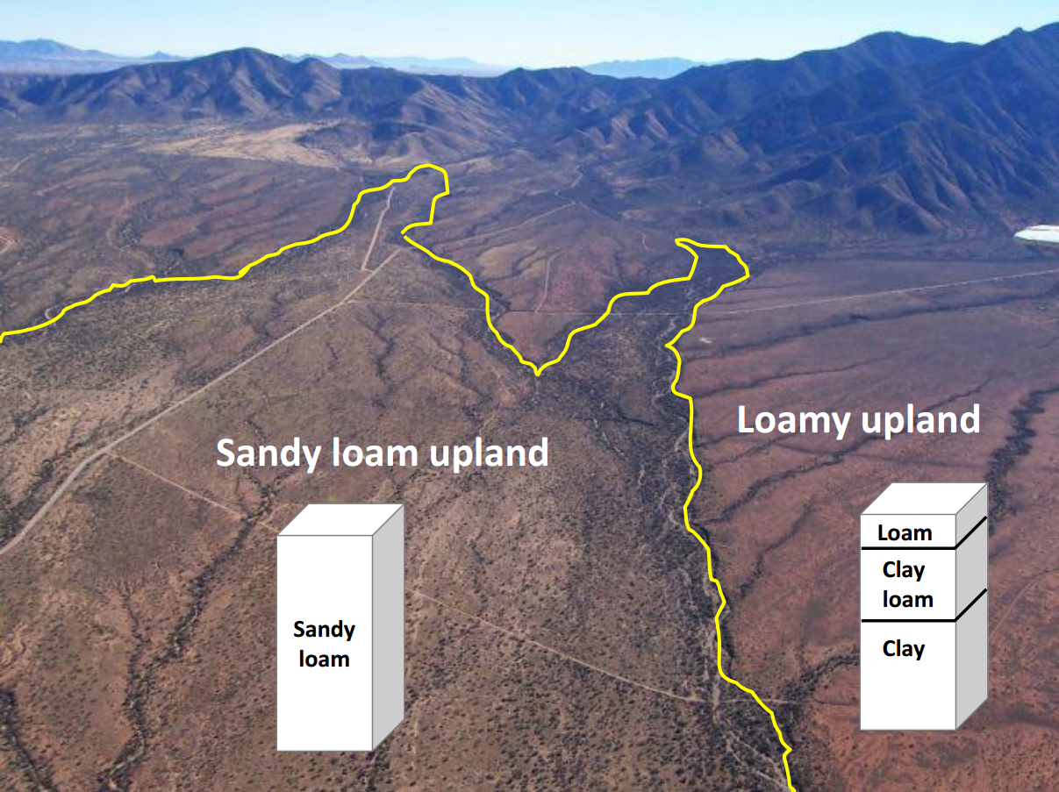
Ecological sites: why botanists care about soil.

Slide 2
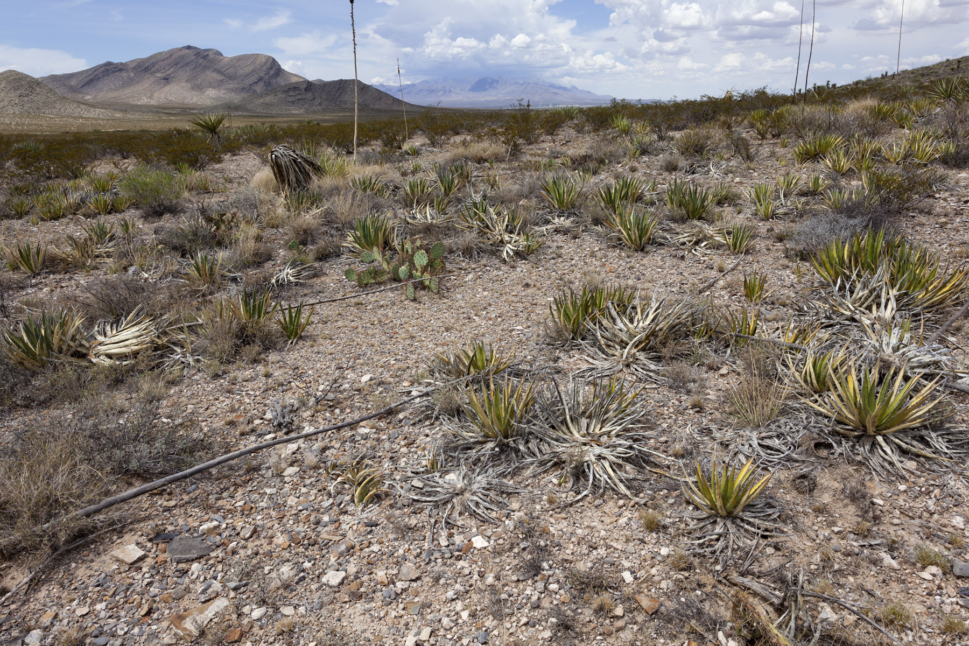
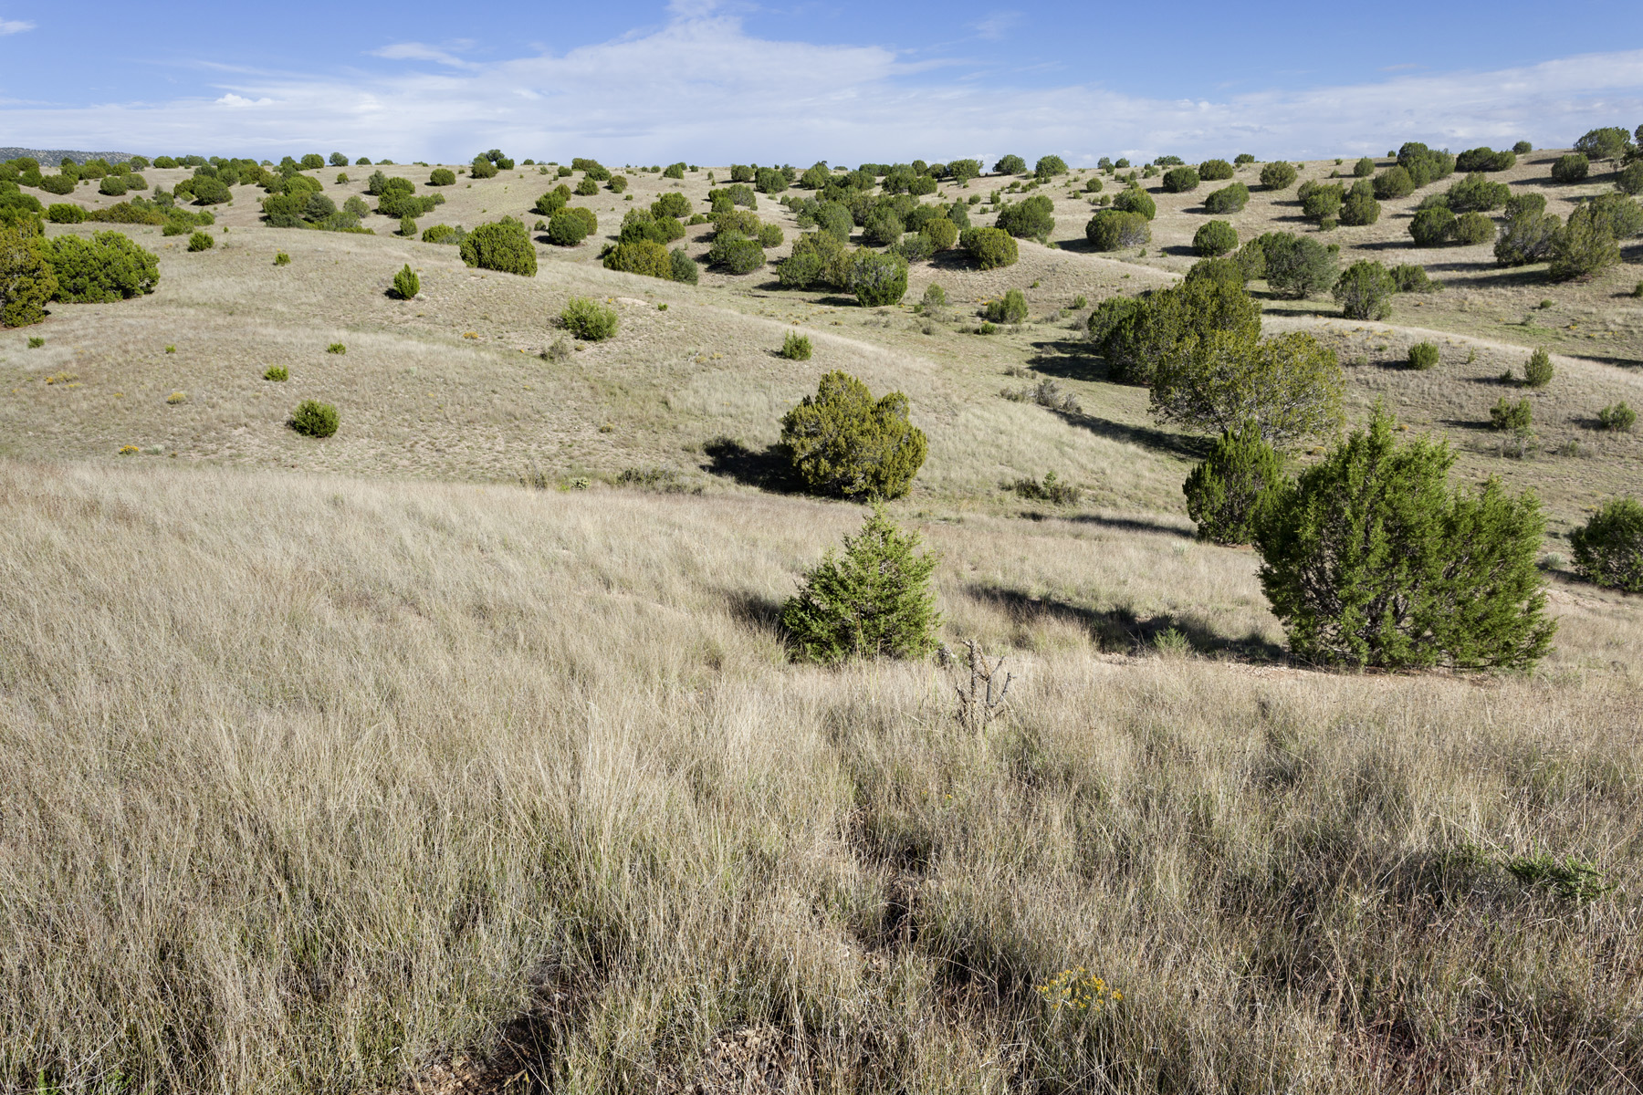
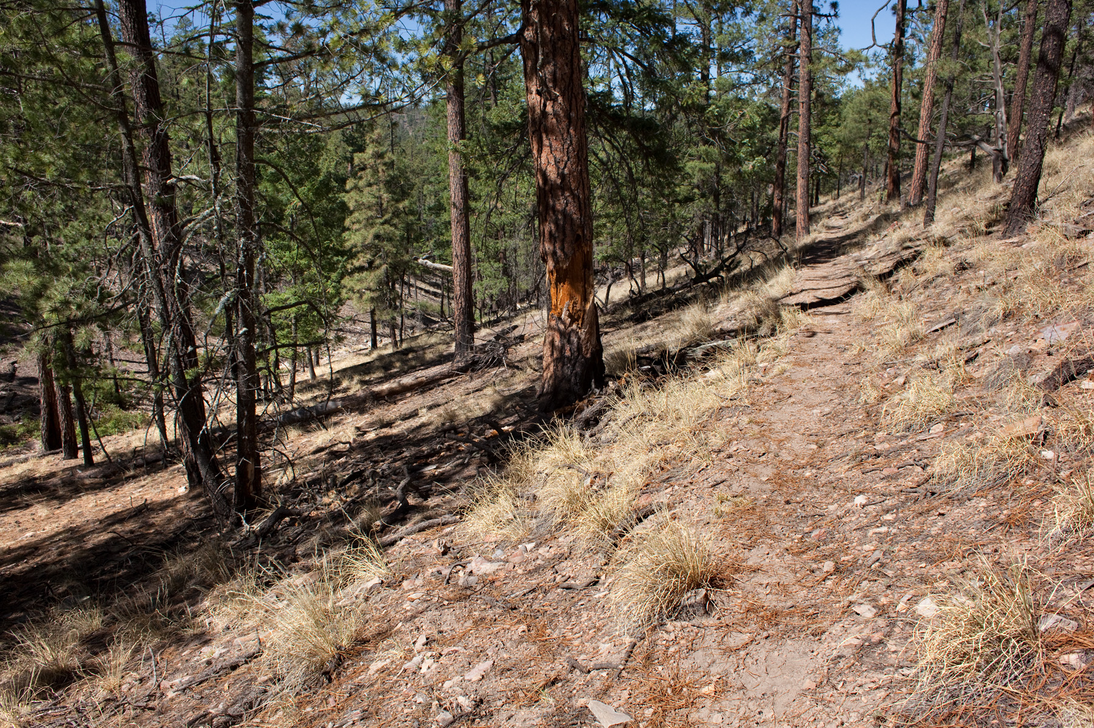
Vegetation varies with:
temperature
precipitation

Slide 3
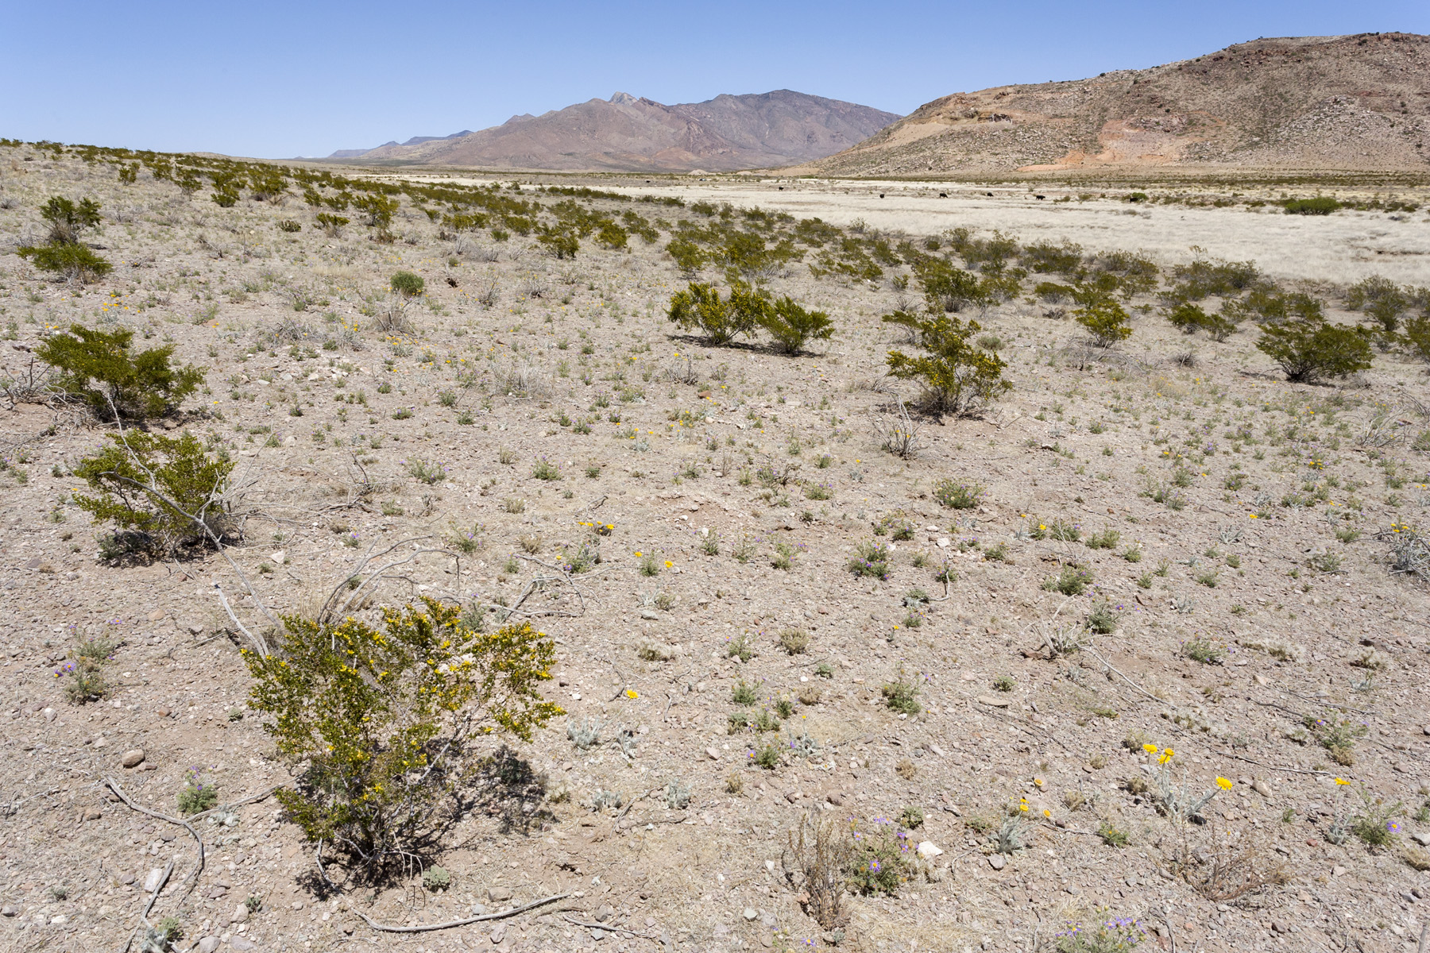
Vegetation varies with:
temperature
precipitation
geomorphology

Slide 4
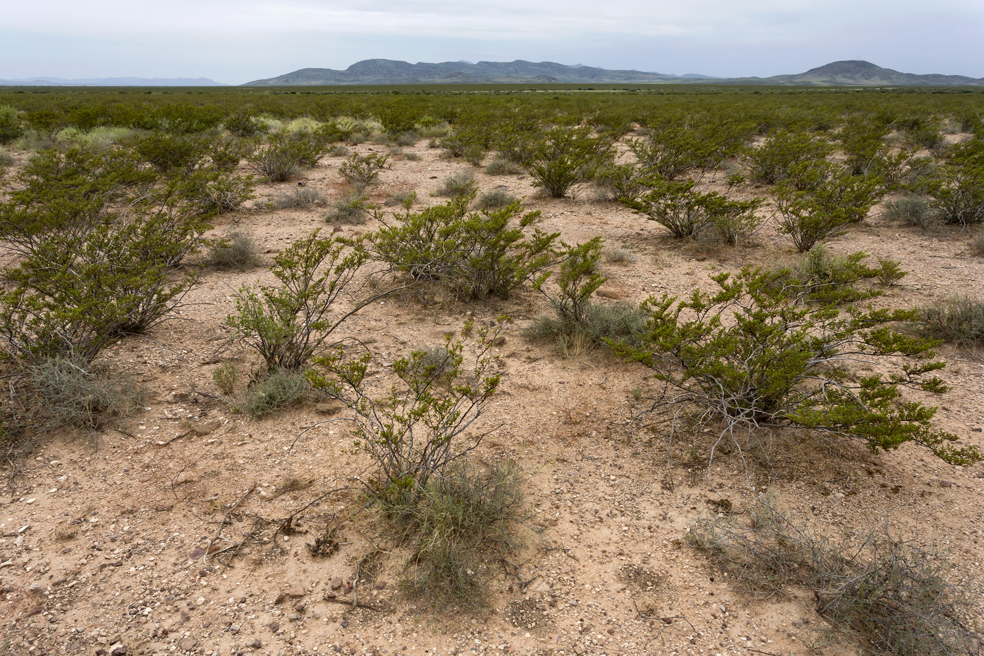
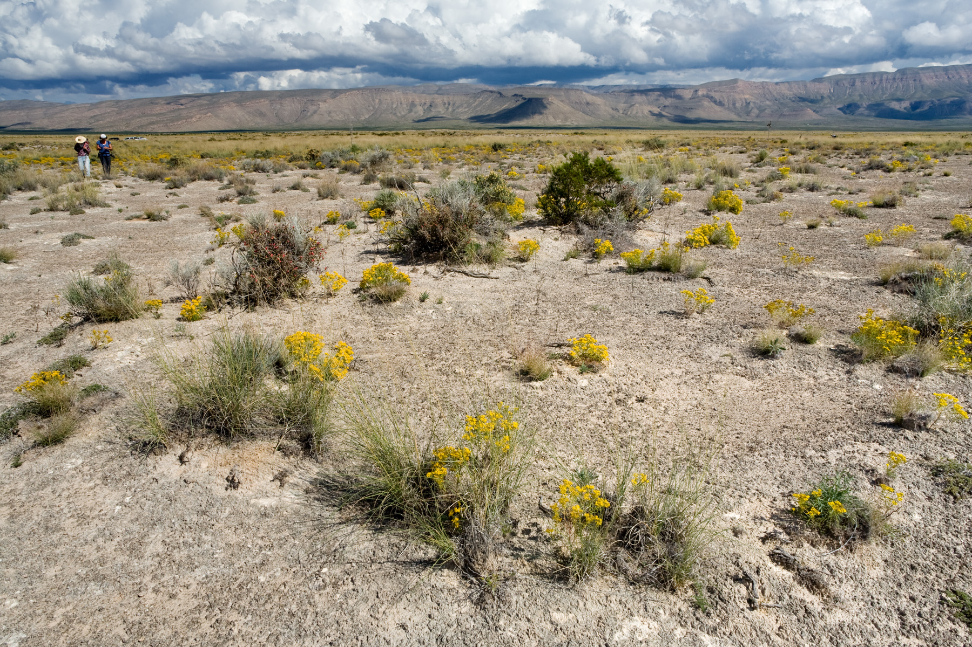
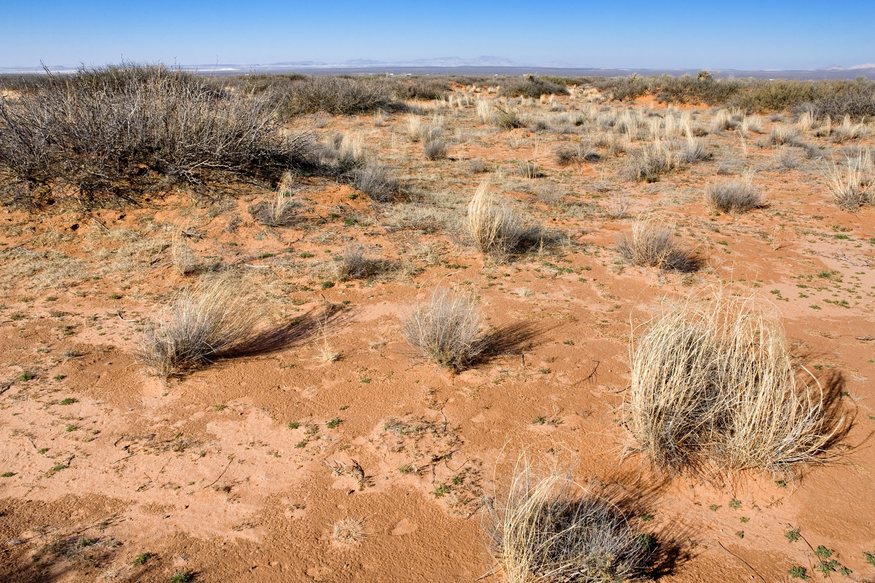
Vegetation varies with:
temperature
precipitation
geomorphology
soils

Slide 5
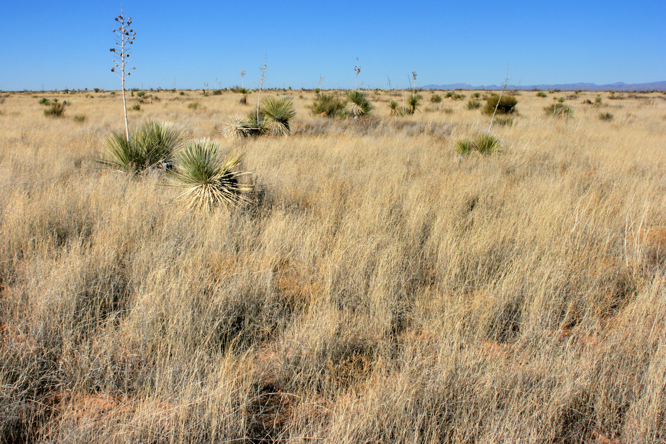
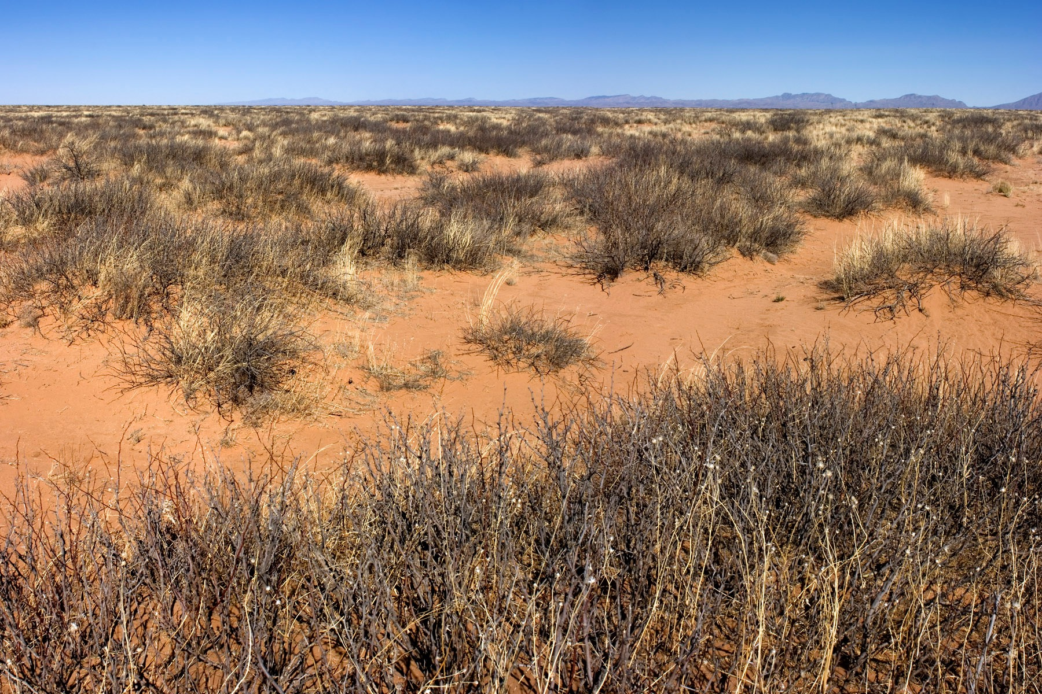
Vegetation varies with:
temperature
precipitation
geomorphology
soils
disturbance:
grazing
fire
roads
recreation
oil / gas
wildlife
drought

Slide 6
Ecological site:
“… a distinctive kind of land with specific soil and physical characteristics that differ from other kinds of land in its ability to produce a distinctive kind and amount of vegetation and its ability to respond similarly to management actions and natural disturbances.”
Interagency Ecological Site Handbook for Rangelands

Slide 7
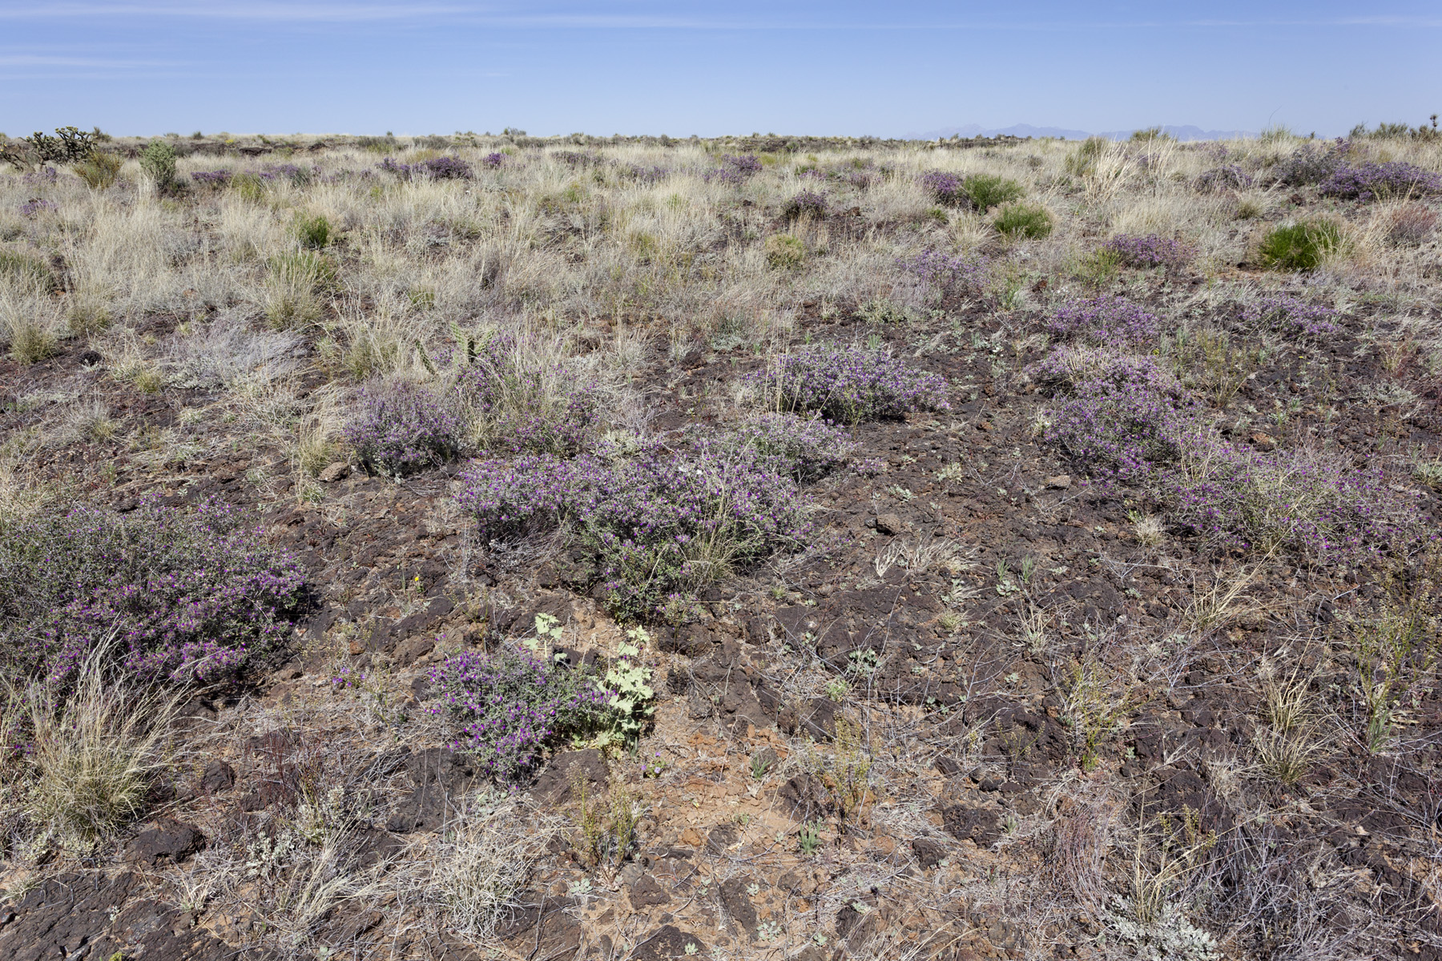
Ecological sites
classify the land to account for variation in:
temperature
precipitation
geomorphology
soils

Slide 8
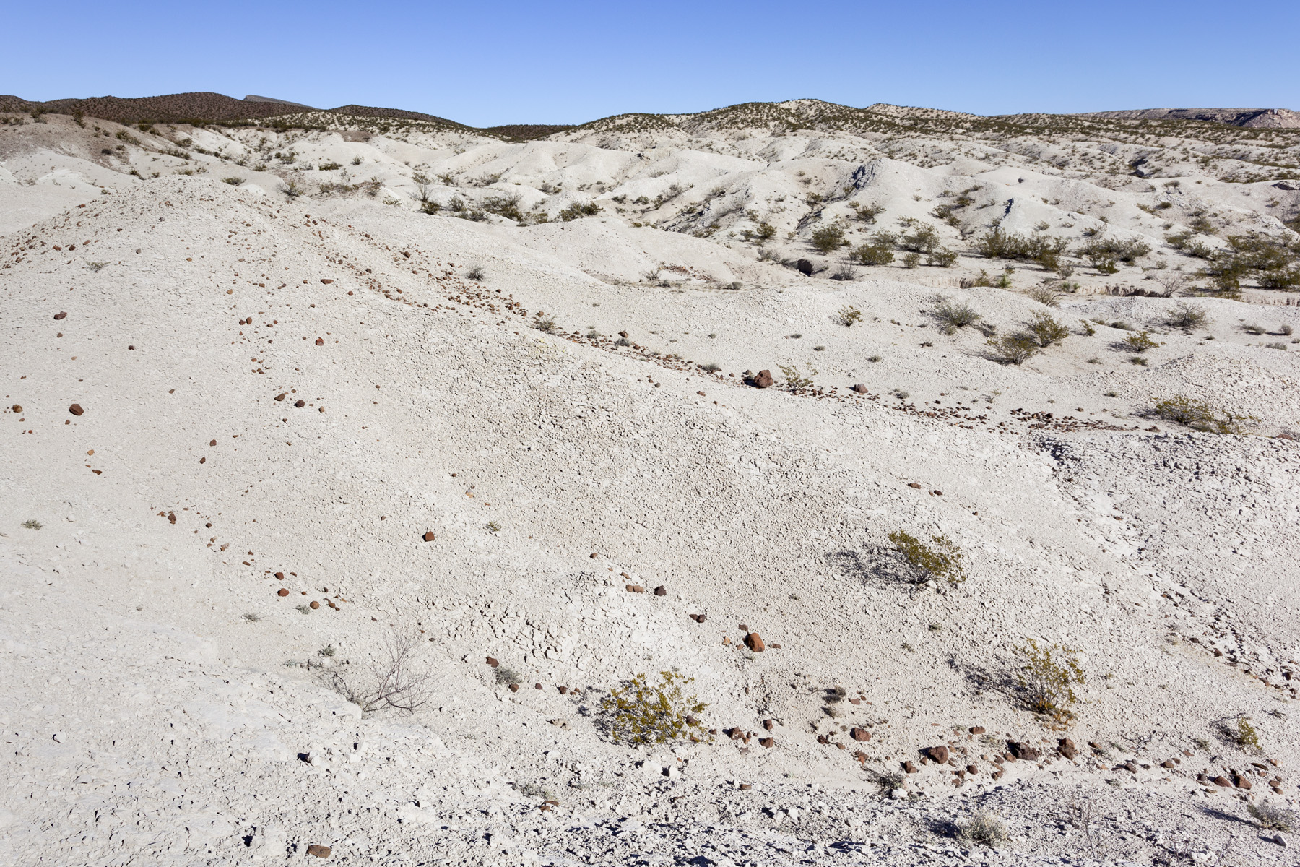
Ecological sites
so that the residual variation is due to disturbance:
grazing
fire
roads
recreation
oil / gas
wildlife
drought
MANAGEMENT

Slide 9
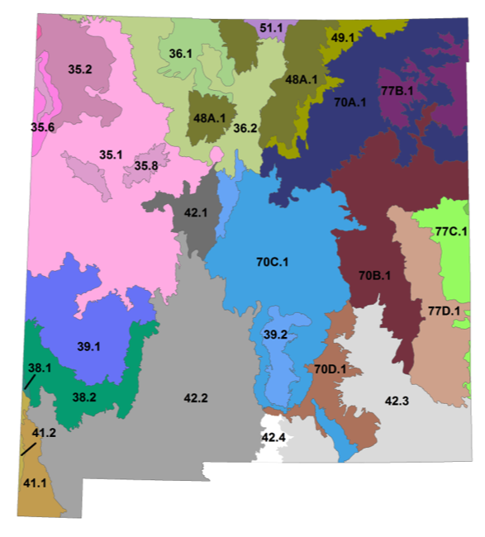
Identifying ecological sites:
What MLRA / LRU are you in?
Each LRU is divided into ecological sites.
Gravelly
R042XB010NM
R042XC001NM
Notes:
MLRA: major land resource area
LRU: land resource unit

Slide 10
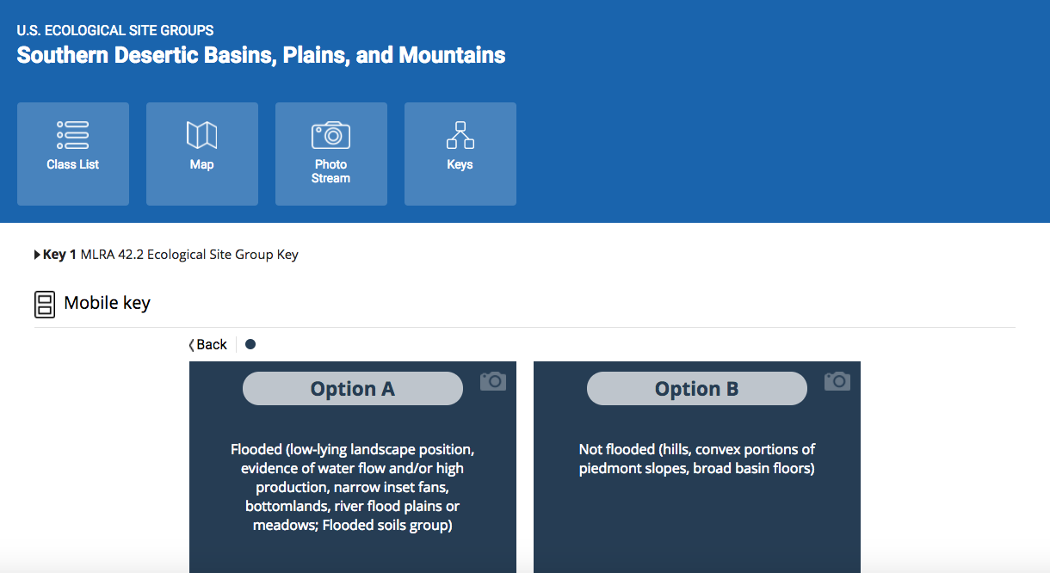
Identifying ecological sites:
If possible, find & use ecological site keys.
Notes:
Most of the decision points are going to be based on geomorphology and soils, at least in our area (MLRA 42). Most of the variation in climate is accounted for by MLRA / LRU boundaries.
The only EDIT interface only goes to ecological site groups.

Slide 11
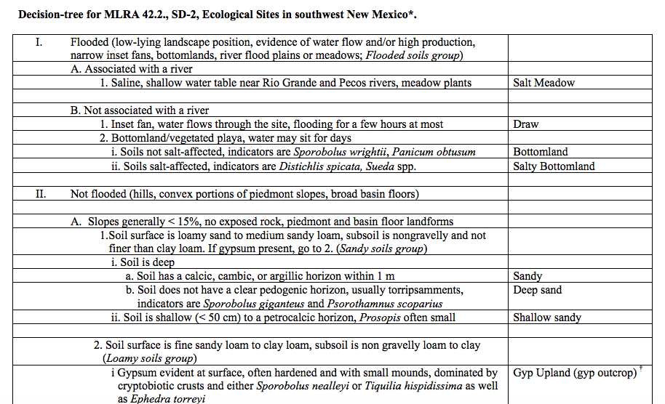
Identifying ecological sites:
Most couplets are based on geomorphology and soils.
Plot characterization data sheet!
Notes:
This one goes all the way. And you can print it out!

Slide 12
Identifying ecological sites:
Most areas don’t have ecological site keys, unfortunately.
Alternate approach:
use soil survey data to find potential eco. sites;
compare soil pit and vegetation to ESD
Notes:
ESD: ecological site description.

Slide 13
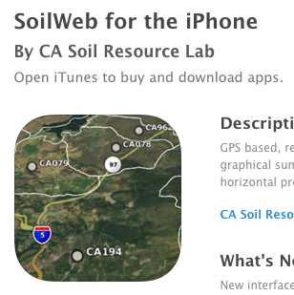
Identifying ecological sites:
In office:
get soil map / soil map unit descriptions;
print relevant ecological site descriptions.
SoilWeb app will do both all this in the field, if there is cell service!
Otherwise Web Soil Survey or SoilWeb.
Notes:
There’s an Android version, too.

Slide 14
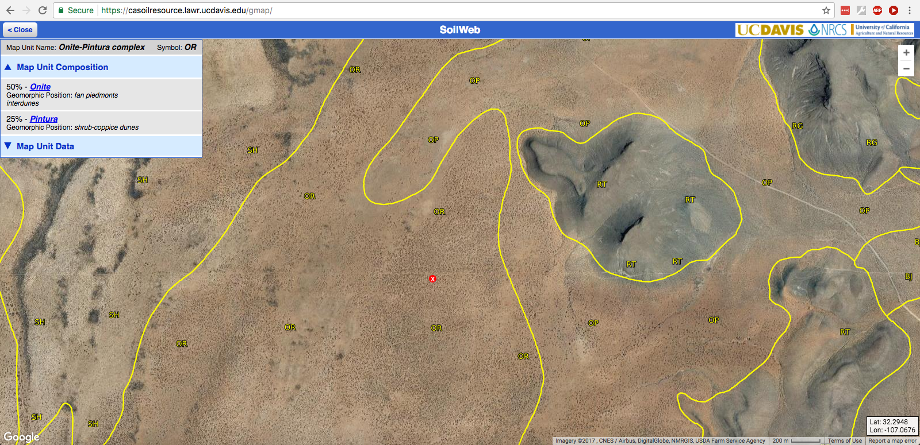
SoilWeb

Slide 15
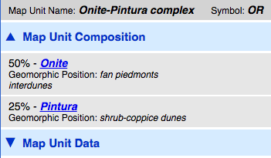
SoilWeb

Slide 16
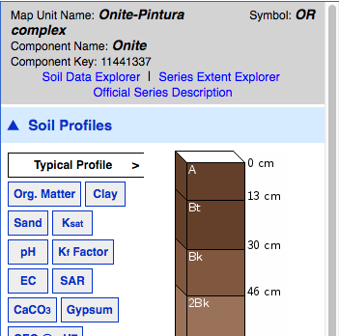
SoilWeb

Slide 17
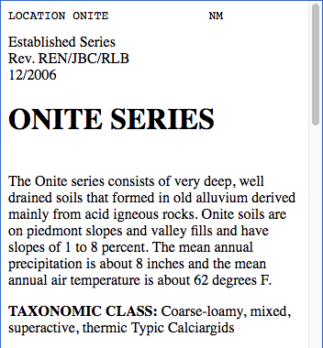
SoilWeb

Slide 18
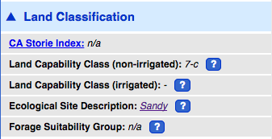
SoilWeb

Slide 19
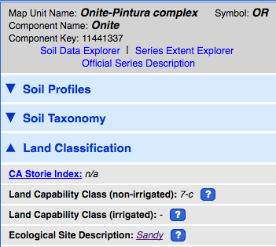
SoilWeb

Slide 20
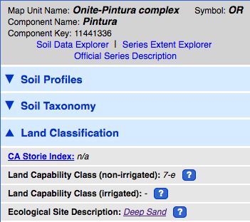
SoilWeb

Slide 21
SoilWeb

Slide 22
Identifying ecological sites:
In field:
dig a soil pit and compare soils to possible ecological sites;
compare vegetation to the ESDs.

Slide 23
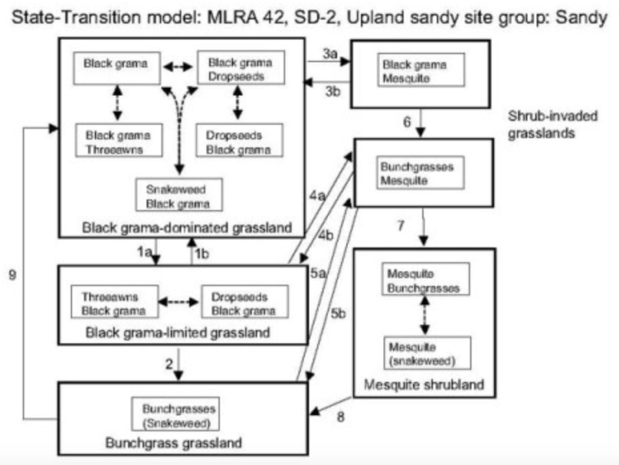
Notes:
There’s an Android version, too.

