Slide 1
Test Review

Slide 2
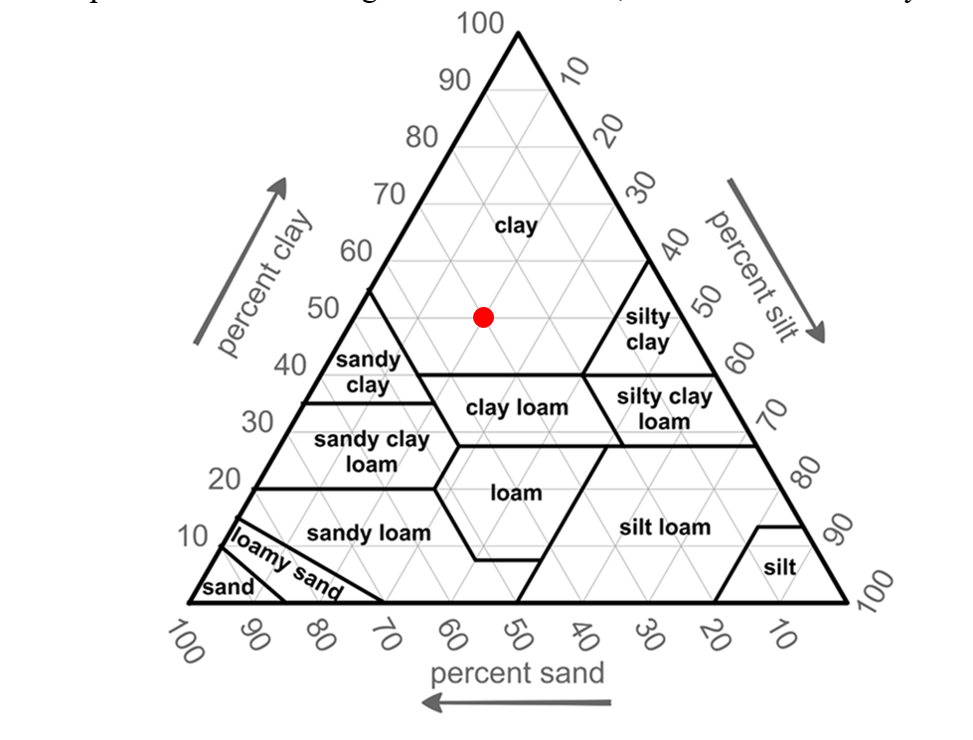
12. Mark the point on the soil triangle that is 30% sand, 20% silt and 50% clay

Slide 3
24. Which of the following is the correct entry for canopy gap using the illustration below?
Reminders!
What stops a gap?
What is the minimum gap size?
What is the “minimum” canopy size?
Rooted alive OR dead vascular plant material. NOT rocks, litter or nonvascular plants
20cm!
Less than half of 3cm (1.5cm)

Slide 4
There is canopy from 46 to 47cm = 1cm which is less than 50% of 3cm, too small to stop a gap!
There is canopy from 67 to 83cm and 89 to 104cm
There is canopy from 4 to 26cm
Rocks do not stop a gap
Canopy gap starts at 104cm and stops at 150cm
This gap is too small at 2cm
Canopy gap starts at 26cm and stops at 67cm
This gap is too small at 6cm

Slide 5
24. Which of the following is the correct entry for canopy gap using the illustration below?

