Slide 1


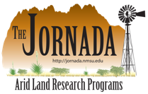

Monitoring for Adaptive Management
BLM’s National Assessment, Inventory, and Monitoring Strategy
Photo: Sarah McCord
Notes:
Part information, part soapbox, part sales pitch

Slide 2
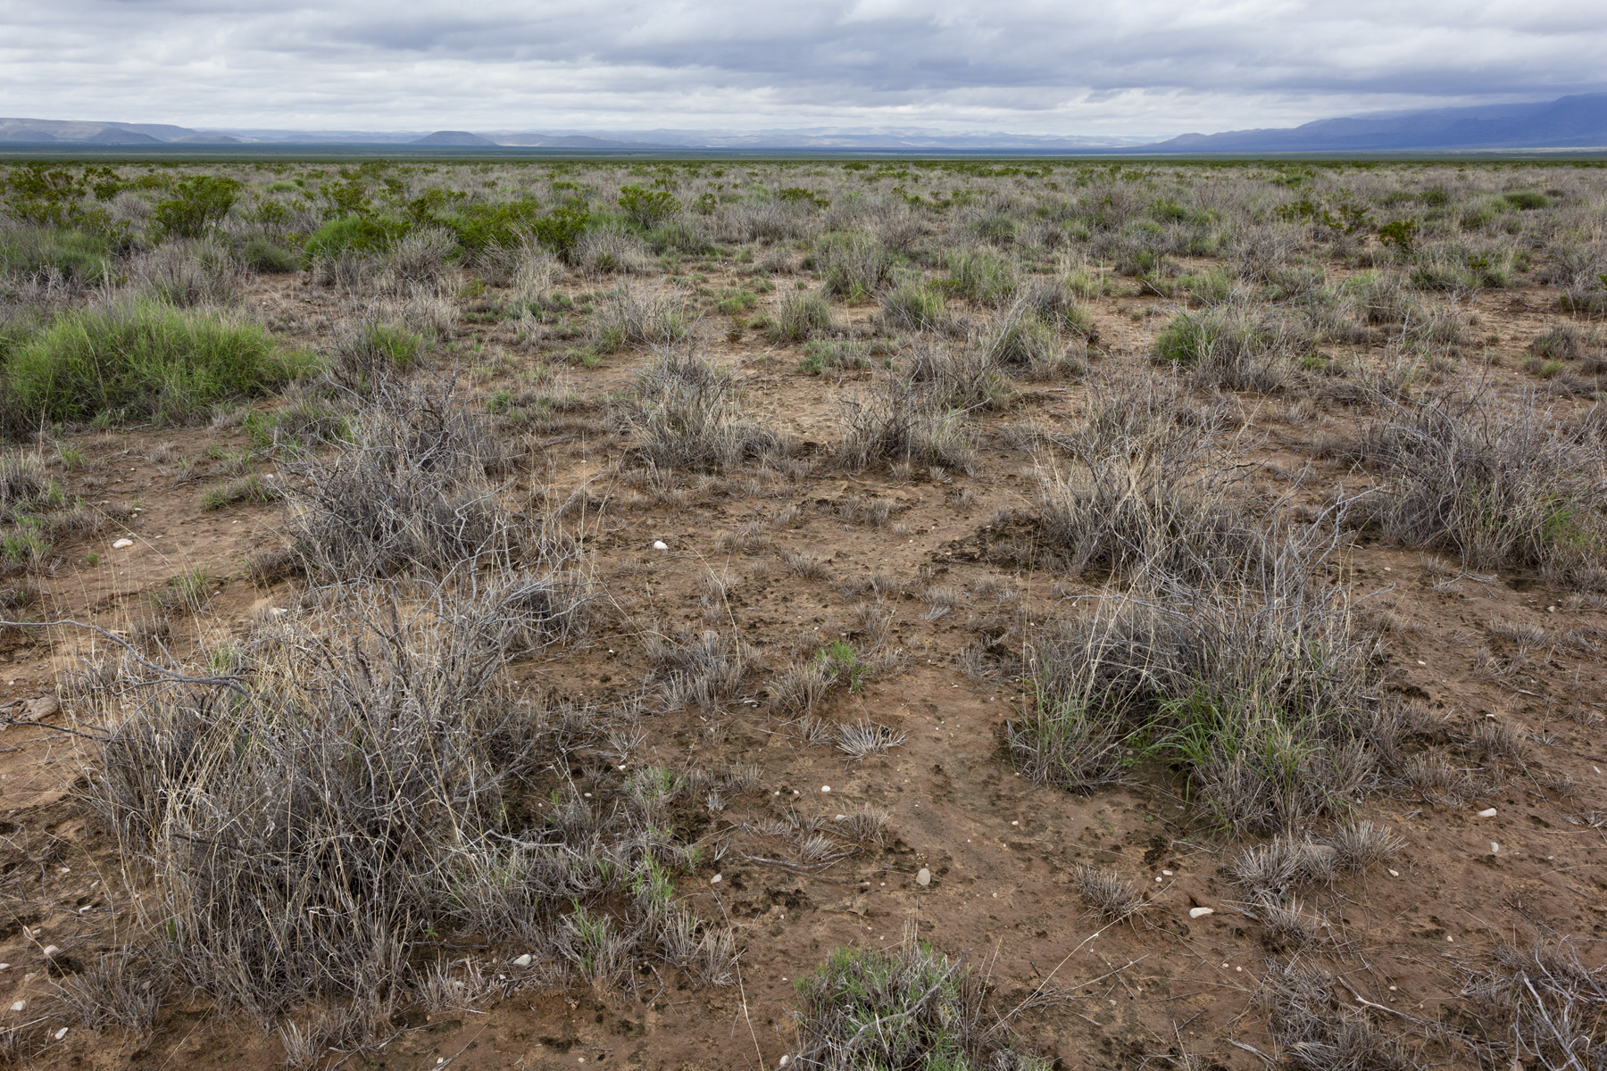
LEARN
PLAN
ADJUST
DO
Notes:
Herbicide treatment, LCDO Box Canyon allotment; trt 2010, phot 2016.

Slide 3
LEARN
PLAN
MONITORING!
ADJUST
DO
Notes:
Herbicide treatment, LCDO Box Canyon allotment; trt 2010, phot 2016.

Slide 4
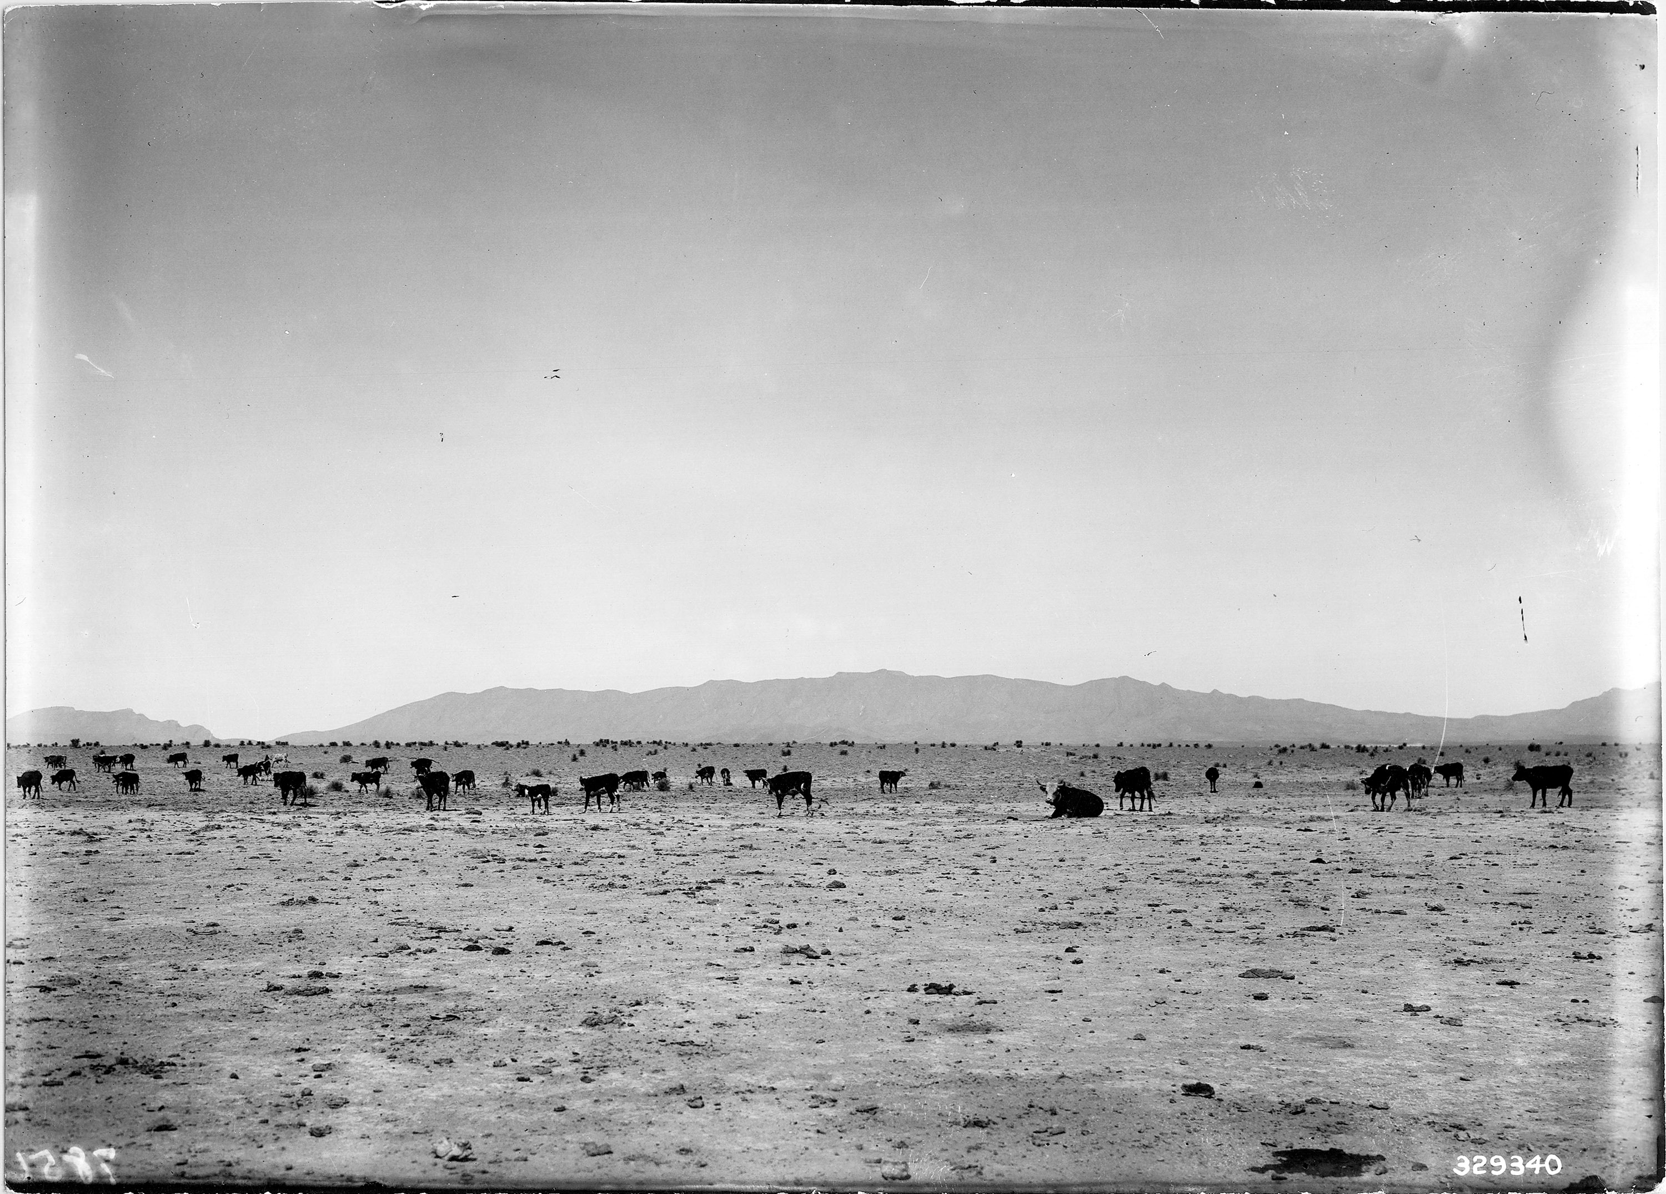
A Brief History of Rangeland Monitoring
Concern about rangeland conditions in the western U.S. in 1880’s / 1890’s.
Subjective assessments!
Experimental ranges established:
  Santa Rita, 1904
  Jornada, 1912
Cattle on Jornada Experimental Range, 1912

Slide 5
A Brief History of Rangeland Monitoring
Sampson (1923) promoted “a systemized study, designed to secure the data that will lead to permanent improvement in management and to increased profits from the lands.”
Jornada cattle 1932
Veg sampling on the Jornada 1928
Notes:
Sampson is the “first range scientist”; Utah; focused primarily
Historically, rangeland monitoring focused on determining impacts of and maximizing productivity related to land use – typically grazing
Monitoring designed around specific land uses or program objectives

Slide 6
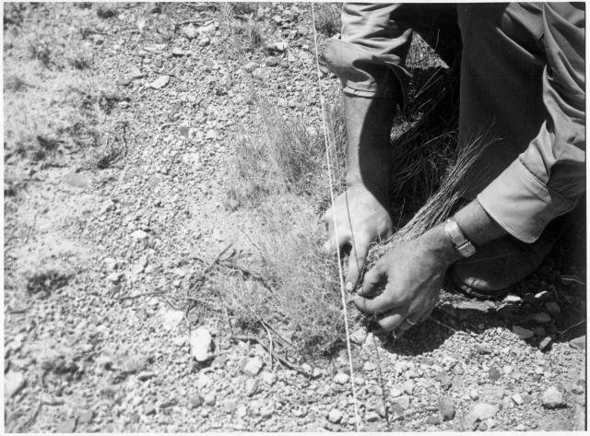
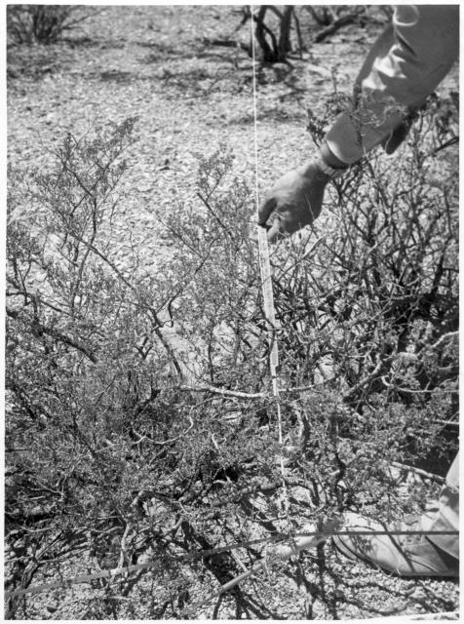
A Brief History of Rangeland Monitoring
Taylor Grazing Act (1934): establishes federal oversight of grazing on lands now overseen by BLM:
  grazing allotments;
  grazing permits;
  allowed stocking rates.
Measuring grasses and shrubs, Jornada
Notes:
At the time, it was the Grazing Service; BLM created 12 years later.

Slide 7
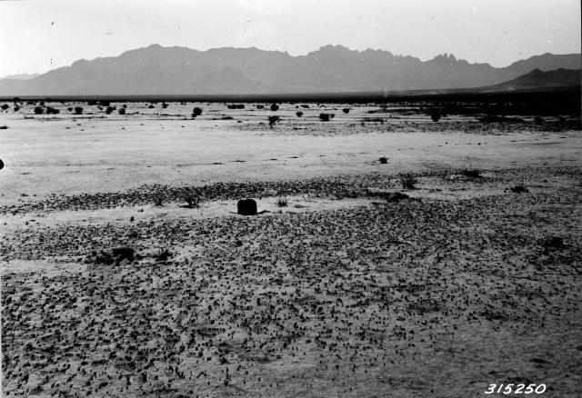
A Brief History of Rangeland Monitoring
The Western Range (1936) was the first national-level quantitative report on rangelands.
It was based on grazing capacity, “the number of acres required to support one unit of domestic livestock”.
Cox Ranch, photo JER
Notes:
The methods aren’t clearly described in The Western Range, that I can tell. It must have been something generally analogous to our forage production methods, but I have no idea what the specific protocol or sample design might have been...

Slide 8
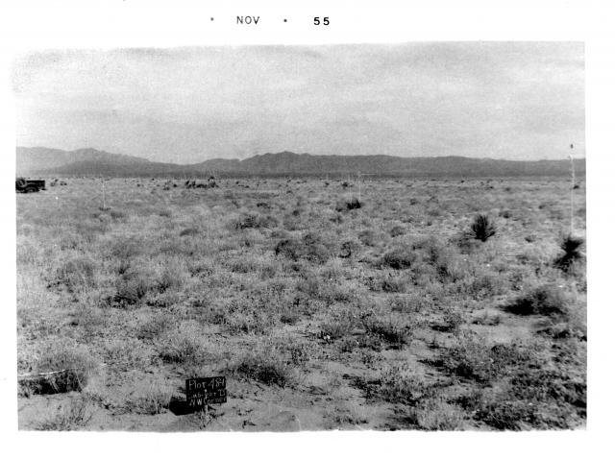
A Brief History of Rangeland Monitoring
1950’s and 1960’s: Collaboration with the Soil Conservation Service and development of the Range Site concept;
one-off inventories that didn’t really go anywhere.
1950s vegetation plot, JER
Notes:
SCS is now NRCS; Range Sites to be revisited.

Slide 9
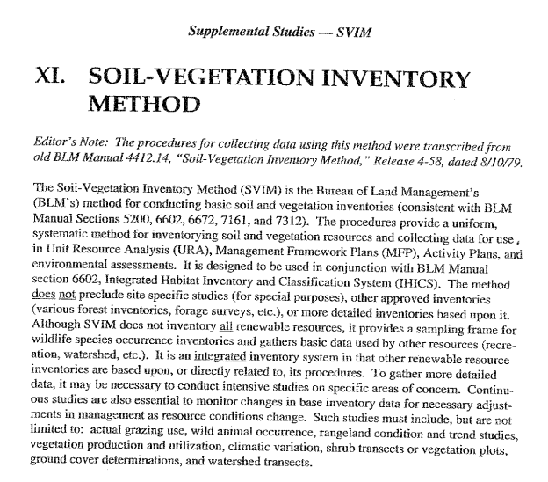
A Brief History of Rangeland Monitoring
1970: NEPA! This created a requirement for federal agencies to document how / why they make decisions and what impacts are likely.
Late 1970’s to 1983: SVIM! A consistent quantitative monitoring program across all BLM (“AIM 1.0”), developed for NEPA documentation related to grazing.
Notes:
SVIM – Soil Vegetation Inventory Method. Killed for political reasons...

Slide 10
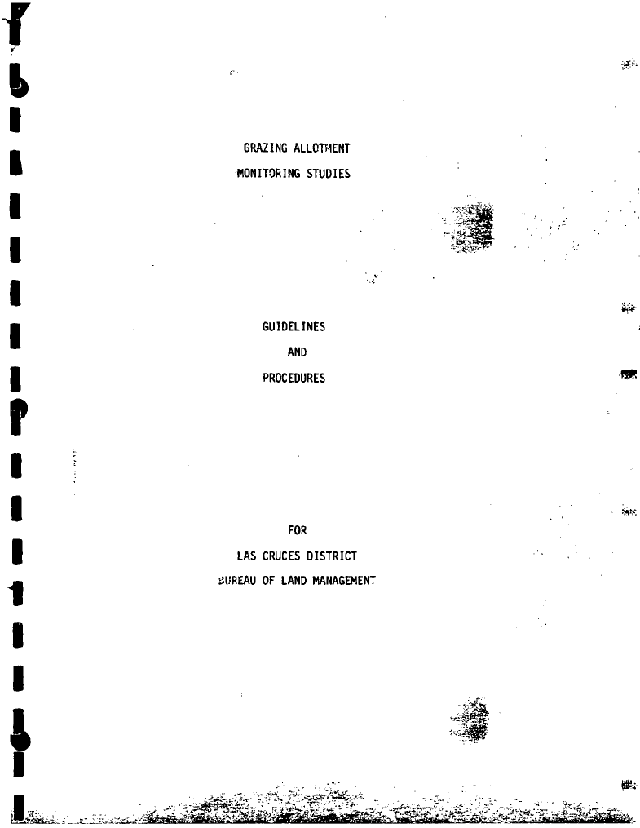
A Brief History of Rangeland Monitoring
1980’s to 2000’s: BLM district / field offices implement their own monitoring programs, resulting in a patchwork of inconsistent and sometimes good, sometimes bad methods.
Monitoring is program-specific.
Notes:
The LCDO monitoring manual for grazing, written by Tom Birch ca. 1985.

Slide 11
The AIM “Origin” Story
2004 OMB programmatic review of BLM’s monitoring activities:
found the BLM collects a large amount of information, but cannot report ecological condition above the project level;
directed the BLM to develop a cohesive monitoring strategy.
Wendy’s ad from 1984
Notes:
OMB: Office of Management and Budget.

Slide 12
BLM Local Workgroup Summary
“None of these findings are particularly surprising as the BLM’s data collection activities have evolved over time in response to changing user needs for specific resources, specific new program statutory and judicial mandates, and new scientific understandings. The BLM’s data collection and analysis activities were not designed to answer many of the performance and landscape level questions currently being asked.”
Local Workgroup Report, 2007

Slide 13

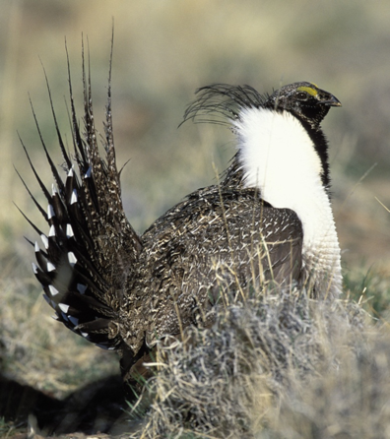
Changing uses/values of rangelands

Slide 14
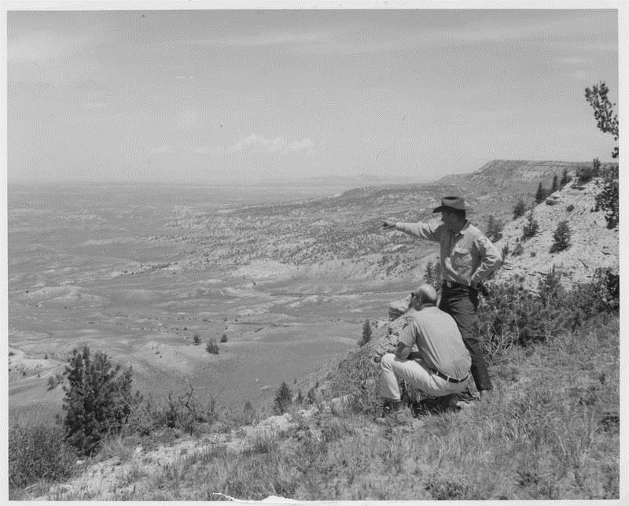
Multi-scale land management
National condition of rangelands
Range-wide sage-grouse Habitat
Land Use Plan effectiveness
Horse and burro management
Post-fire seedings (ESR)
Grazing permit renewals
Recreation management
Reclamation after oil/gas and mining
Restoration treatment effectiveness
SCALE
Source: NOC Collection

Slide 15
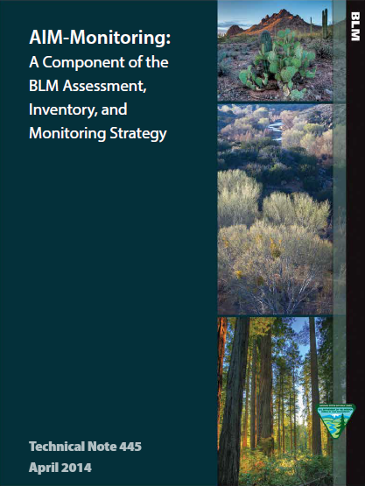
The Five Principles of AIM:
consistent indicators and methods;
statistically valid / scalable sample design;
integration with remote imagery;
electronic data capture and management;
structured implementation.
Notes:
Assessment, Inventory, and Monitoring Monitoring is part of the Assessment, Inventory, and Monitoring Strategy.

Slide 16
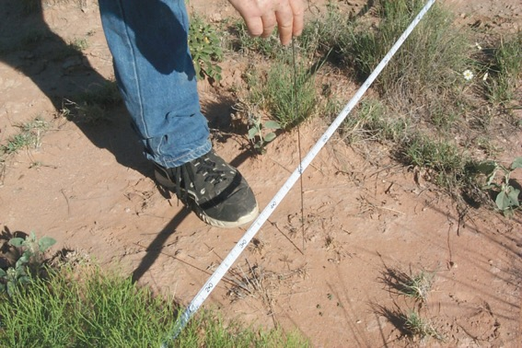
“Lack of consistent and comparable monitoring procedures within and between the federal management, advisory, and regulatory agencies has made it impossible to conclude reliably what the overall condition and trends in conditions of our public rangelands are.” West (2003)
  Consistent core indicators and methods:
  measurable ecosystem attributes;
  applicable across many different ecosystems;
  informative to many different management objectives;
  standardized methods;
  minimal set, supplemented as necessary.
Notes:
Advantages
Combining data across areas
“Scaling up” data to larger extents
Reuse of data for other purposes
Disadvantages
“Every system is unique”
Efficiency within a single program
Inability to craft methods to a specific purpose
“Pet methods”

Slide 17



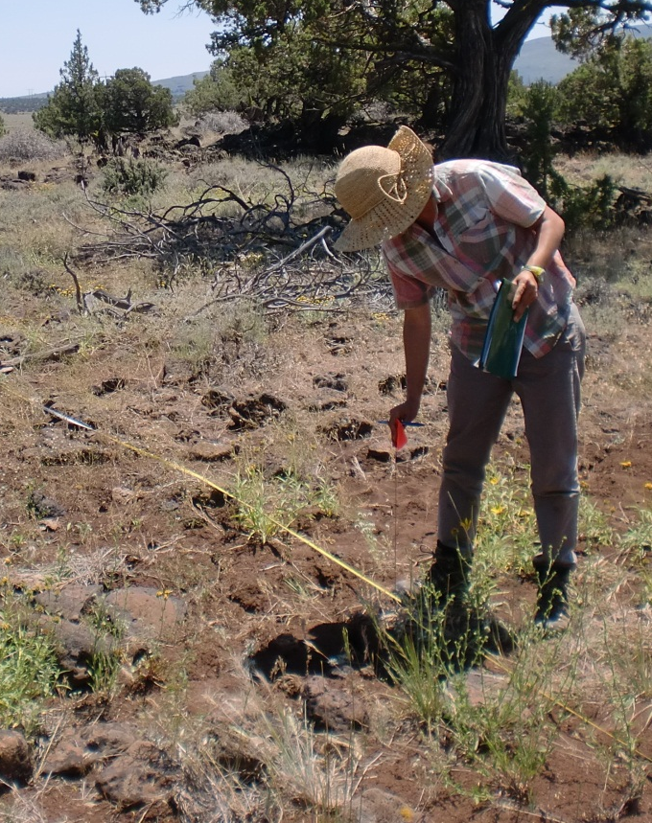
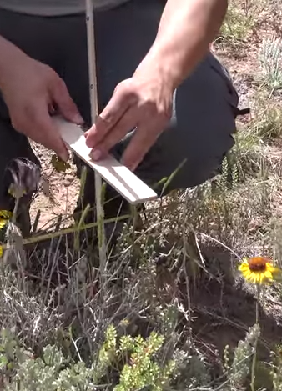
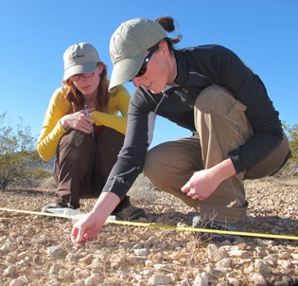
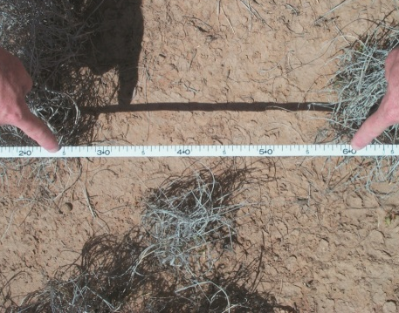



AIM Core Terrestrial Indicators
bare ground
vegetation composition
plants of mgmt. concern
soil stability
canopy gaps
invasive species
vegetation height
Notes:
There are also aquatic indicators, but we don’t care about them.

Slide 18
AIM Core Terrestrial Methods
plot characterization
line-point intercept
vegetation height
plot-level species inventory
canopy-gap intercept
soil aggregate stability
Rationale:
quantitative;
straightforward to teach and implement;
allow observer calibration;
consistently measure indicators across ecosystems;
used by other national monitoring programs.

Slide 19
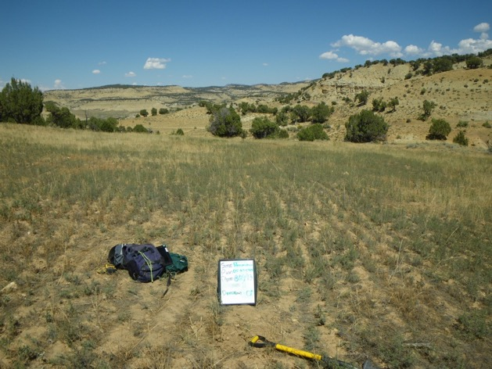
Supplemental Indicators/Methods
Additional indicators to evaluate to meet a local or resource specific objective
EXAMPLE:
In reclamation monitoring, density of seeded species is an important indicator
Notes:
For LCDO folks, plant production is a supplemental indicator...

Slide 20


AIM is…
…managed data
Enterprise
databases
BLM National Operations Center

Slide 21
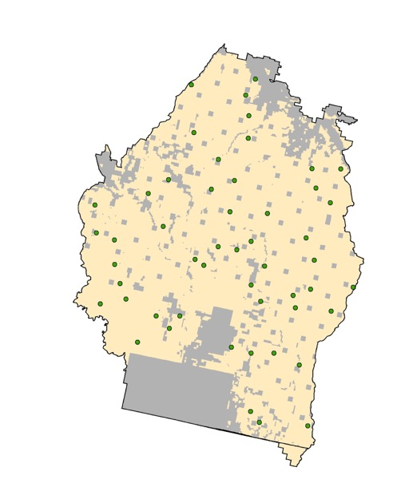
Scalable Sampling Designs
Sampling design includes where you are going to monitor.
Diversity of land uses/impacts + budgetary restrictions are driving need for sampling designs that can:
  address multiple objectives;
  provide information at multiple scales.
Statistical (i.e., probability-based) approaches
provide this foundation:
  can be defined according to objectives or generally;
  flexible and unbiased;
  can be combined and “scaled up”;
  quantifiable uncertainty.

Slide 22
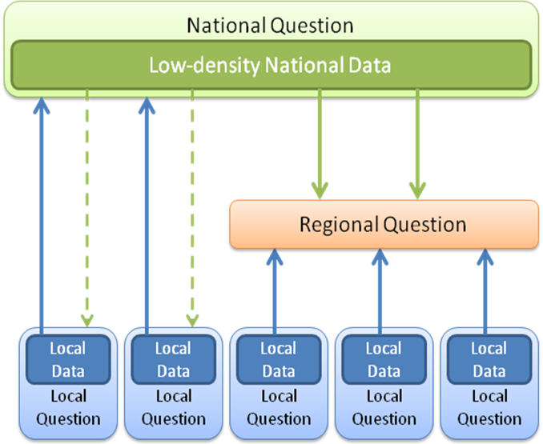
Scales of AIM Implementation
National
  Landscape Monitoring Framework (LMF)
Regional
  E.g., state assessments
Local
  AIM projects with BLM offices

Slide 23
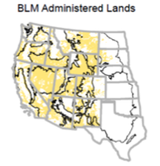
BLM Landscape Monitoring Framework
Percent of BLM Rangelands with Canopy Gaps > 2m
Extension of NRCS NRI onto BLM lands;
separate sample frame so data can be shared;
started in 2011;
~7,000 sites visited so far;
target sample of 10,000 sites.
Source: 2011 BLM Rangeland Resource Assessment (in press)

Slide 24
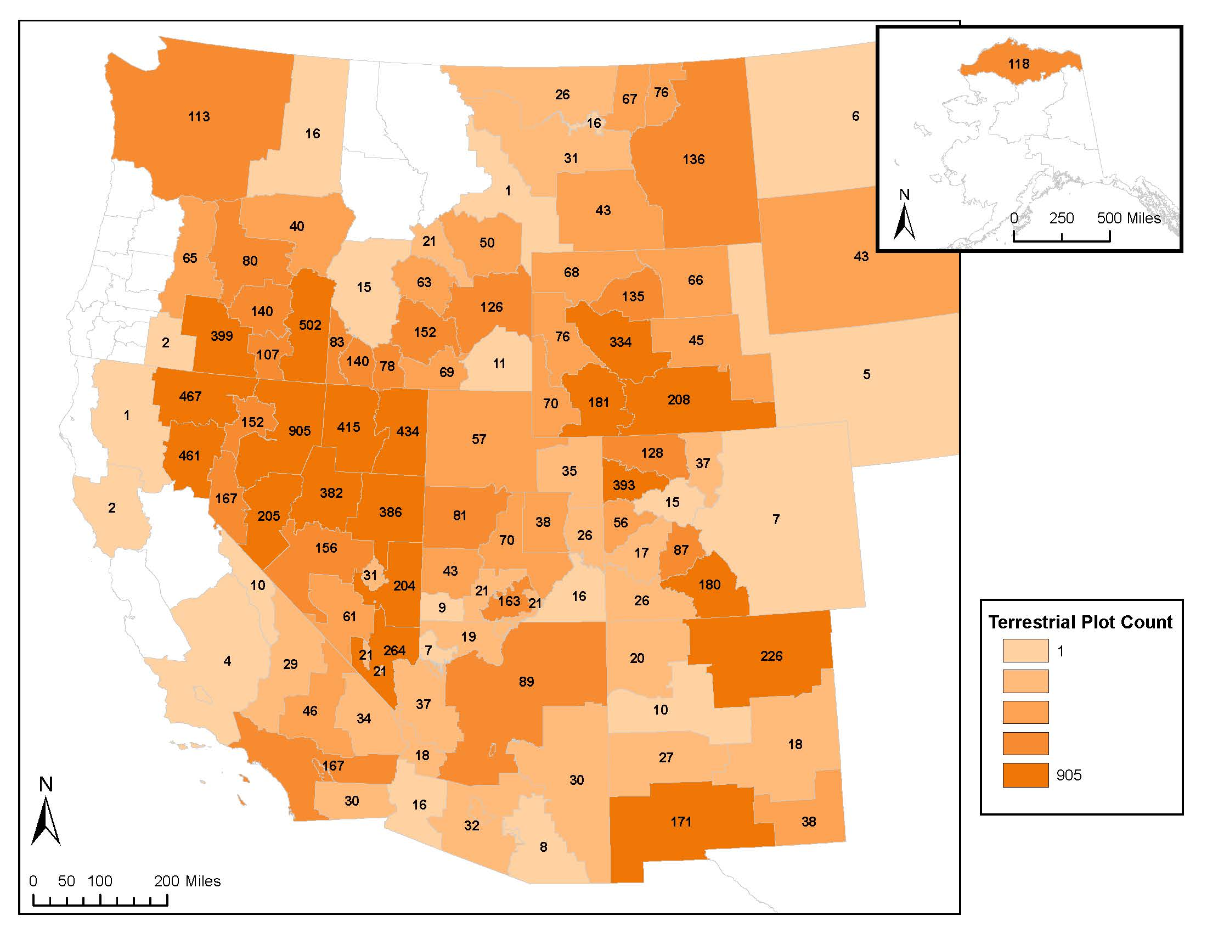
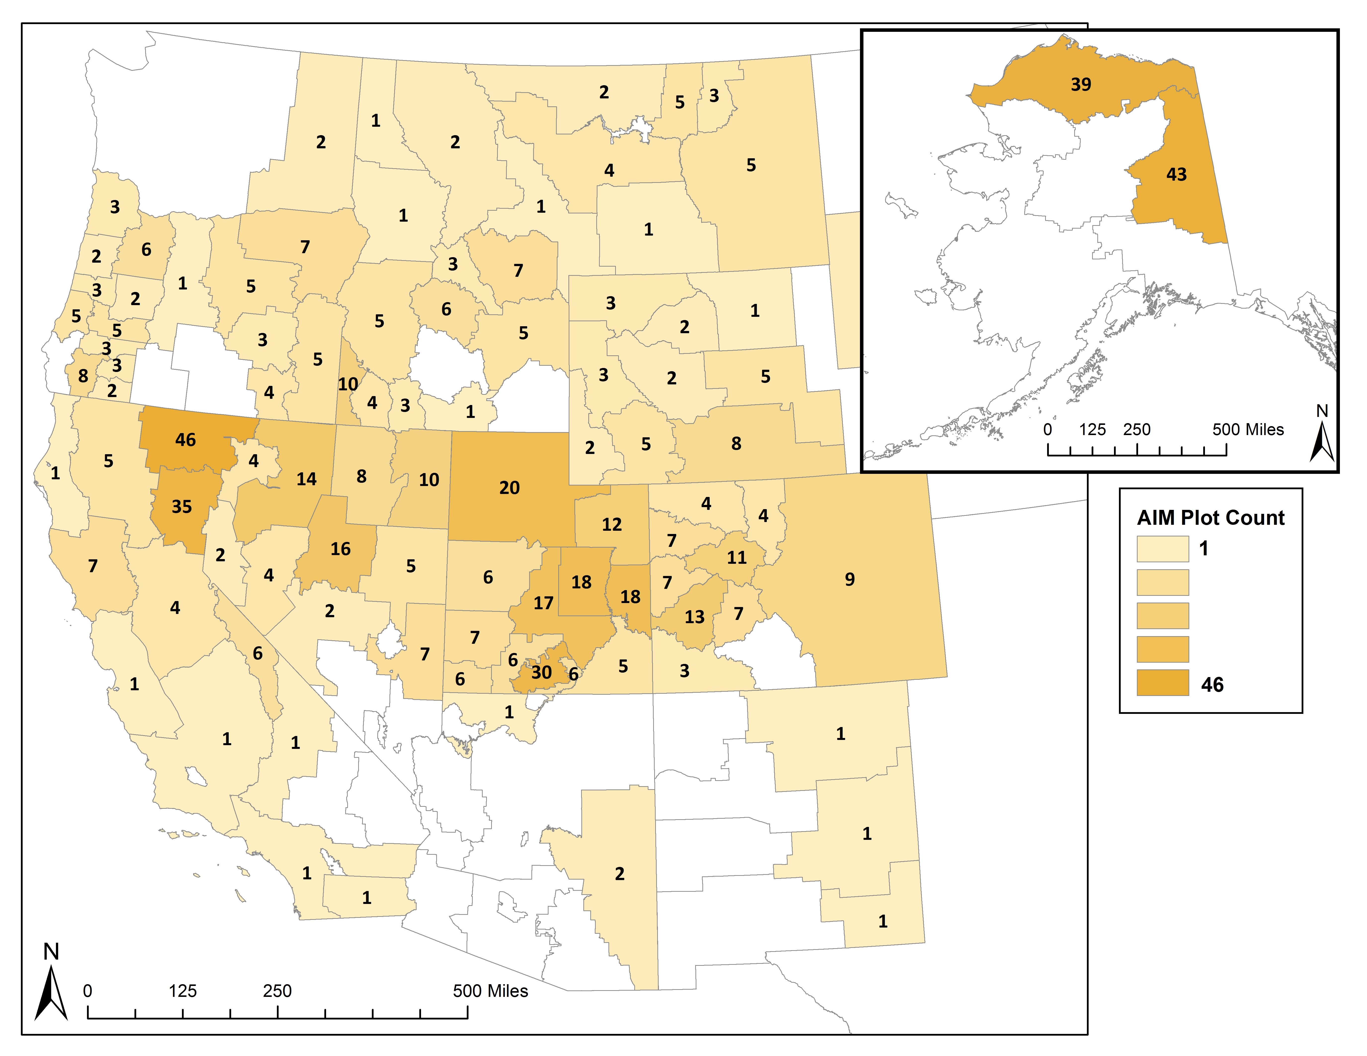
BLM Local Monitoring Projects
Designed to support local management/ monitoring objectives;
locally-staffed field crews;
rotating panel designs – annual sampling;
core + supplemental methods;
design/analysis support.
Terrestrial Data February 2017
Aquatic Data September 2016

Slide 25
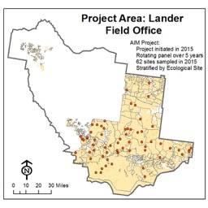
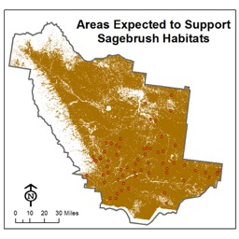
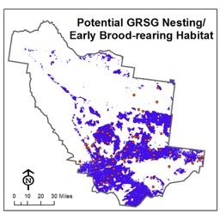
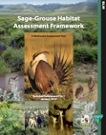
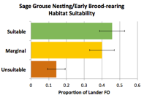
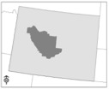
Select project area & reporting units
Identify lands that can produce GRSG Habitat
Define or map GRSG
seasonal habitats
Gather/evaluate sample data & point weights
Determine Habitat Suitability
Define habitat
indicator
objectives
Calculate indicator
values for sample
locations
Determine suitability
for individual indicators
Determine overall habitat suitability by sample location
Summarize by reporting unit

Slide 26

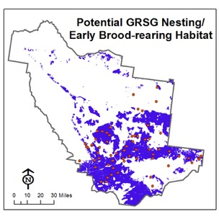
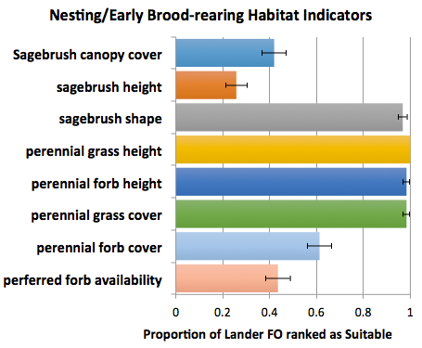
Sage-grouse nesting/early brood-rearing habitat

Slide 27


