Slide 1
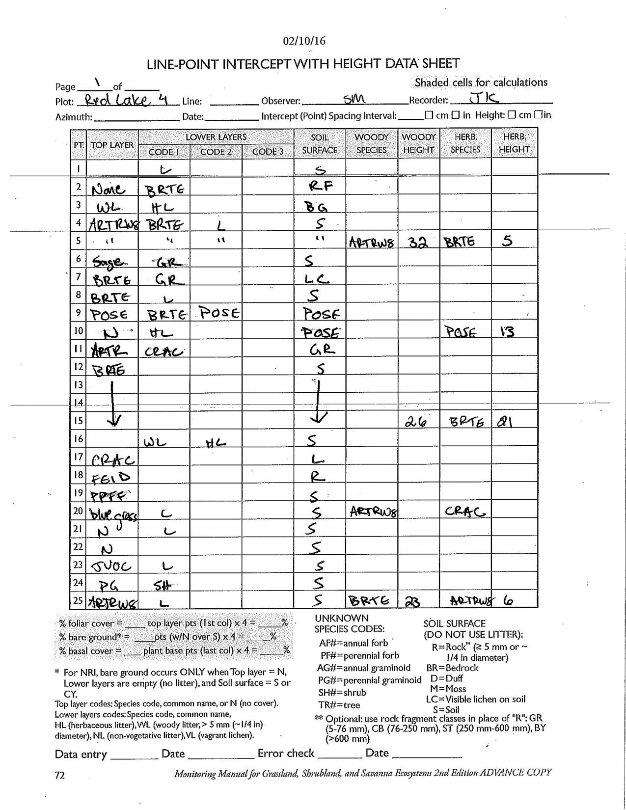
There are about 40 to 45 errors in this data form, depending on how you count
How many can you find?

Slide 2
Notes:
CRAC → CRAC2; ARTR → ARTR2 (and it is odd, but not necessarily wrong, to have ARTR2 and ARTRW8 on the same sheet); use of “R” is incorrect on related consistency grounds, since there is prior “GR”; NONE → Notholaena neglecta; SAGE → Sabatia gentianoides.

