Slide 1
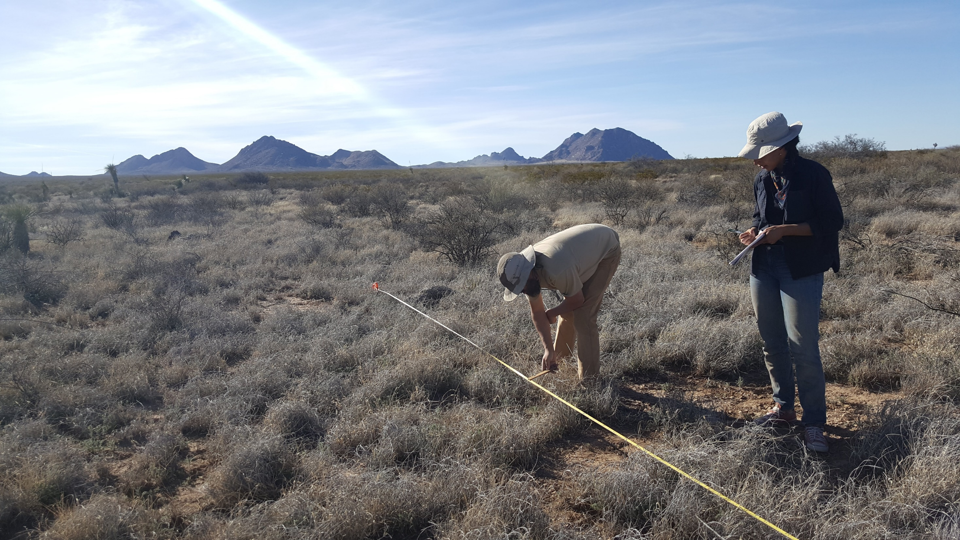
Calibration

Slide 2
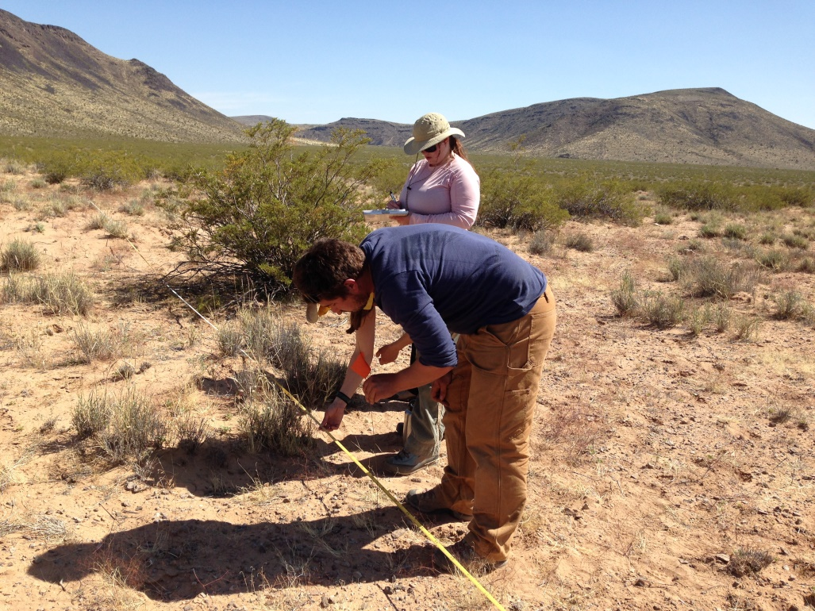
Calibration
Comparison between data collectors
Training
Whichever occurs sooner
Monthly
New ecosystem
NEW PILOT THIS YEAR: Includes soil texture calibration
Notes:
Calibration ensures that data collectors are on the same page. It is a comparison between data collectors to a known standard (if possible) or to make sure they are within a given range. In addition to training, data collectors should calibrate monthly or when they enter a new ecosystem, whichever occurs sooner.

Slide 3
Calibration
LPI & Gap intercept: Indicator absolute difference ≤ 10%
Height: Absolute difference of heights records in each category ≤ 2
Absolute difference of # of species present in the area ≤ 2 species
You don’t calibrate with soil stability but verify that all crew members are collecting uniform peds
Soil texture calibration against known texture samples (PILOT)
Accurate within one adjacent class (relative to texture triangle) at least 80% of the time (4 of 5 samples)
Accurate texture class at least 40% of the time (2 of 5 samples)
REMEMBER: 10 2 2

Slide 4
Calibration
Each group will layout 1 25-m transect
Each person in the group will read each method along the transect
Remember! Protect the left side of the transect for other observers!
Calculate the indicators on the calibration worksheet
Compare results.
Goal: <10% absolute difference between all observers.
0 m
25 m

Slide 5
Compare Results
LPI & Gap intercept: Indicator absolute difference ≤ 10%
Height: Absolute difference of heights records in each category ≤ 2
Absolute difference of # of species present in the area ≤ 2 species
You don’t calibrate with soil stability but verify that all crew members are collecting uniform peds
Soil textures can be calibrated against a known lab sample (PILOT)
Near class accuracy: 80%
Absolute class accuracy: 40%
REMEMBER: 10 2 2

Slide 6
Setting Up Calibration in DIMA
Set up a new plot in DIMA for each calibration exercise with a stratum name followed by an underscore and the date
A “C_” before the stratum name is for plots with calibrated method(s) and “NC_” for plots that did not reach criteria on method(s)
C_LOAMY_20190123_1
NC_LOAMY_20190123_1
A LINE is made for each crew member, in the SAME PLOT, who then will complete LPI and Gap, Sp. Inventory
A report can be generated to compare indicators (you won’t have to do the math in the field)!

Slide 7
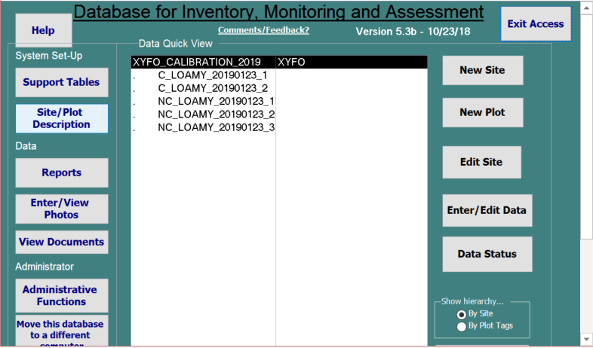
Site ID
Site Name
Plot ID

Slide 8
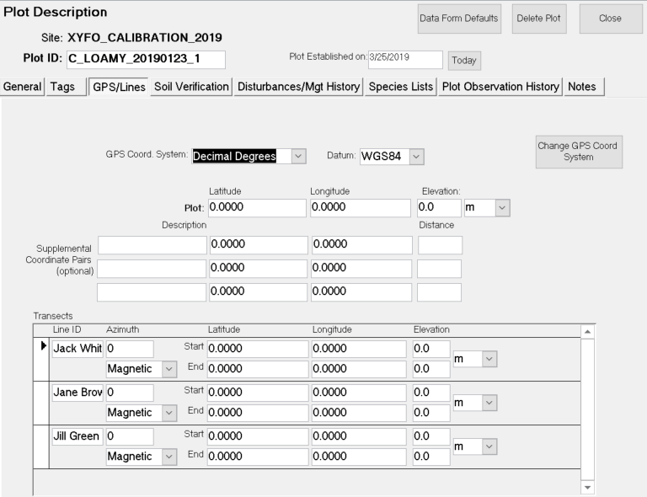
Setting Up Calibration
THE SAME PLOT
Notes:
Ex: 2 person crew with Jane and Jill. Jane is line 1 for all methods, and Jill is line 2.

