Slide 1
MANAGING AIM DATA
Terrestrial AIM
2019

Slide 2
Learning Objectives
Learning Objectives
Review expectations for AIM Data Management
Look at resources to better understand Data Management practices
Point out common mistakes with Data Management to avoid

Slide 3
WHAT DO WE MEAN BY DATA MANAGEMENT?
Data management is the process and means of organizing, and storing data so that these data can be used appropriately to create information and guide sound management decisions.
Data are the infrastructure of science. Sound data are critical to form the foundation for good scientific decisions on adaptive management.
Notes:
Big thoughts to highlight here are to empower crews. They have the control over how good this data is, let them know that their data is some of the best data collected and that the management and QA and QC ing of data really falls on the shoulders of field crews and we rely heavily on them to collect good data.

Slide 4
DATA MANAGEMENT PROTOCOL V3.0
Notes:
Have them pick it up – walk through the sections – have everyone take note of the sections that are important to them, etc.
Page 8 is where the information for field crews begin. They should be referencing this section for QA and QC procedures throughout the season.

Slide 5
THE DATA
NOC Required Data | Data Management Tool
1. AIM Field Data | DIMA (all Project, Targeted, and Intensification plots)
2. AIM Calibration Data | DIMA (calibration data maintained in separate DIMA database)
3. Plot Status (sample design and plot rejection) | Plot Tracking Excel
4. Missing data (errors in dataset) | Missing Data/Known Errors template
5. Photos | Photo Naming Convention (see 3.2.2 for details)
6. Description of the project, issues/concerns, successes, etc. | Implementation Summary Template
Notes:
At the end of the season the NOC will require six pieces of data. Who can tell me what they are?
* Click the slide 6 times to make them all appear

Slide 6
DIMA Database for Inventory, Monitoring, and Assessment
Purpose: to collect all core indicator data (and some supplemental indicator data) during your field season. Also used to collect calibration data (in separate DIMA).
Common pitfalls:
Species identification: each unknown species encountered needs to be identified using the unknown species protocol on page 14 of the Monitoring Manual.
Only standard unknown plant codes will be accepted such as PF01 or SU98
Dead beyond recognition can be assigned a standard generic code (i.e. PF00) and used throughout the season.
Growth Habit and Durations: every species encountered needs to have the growth habit, duration and invasiveness filled in
Many more common issues and tutorials can be found on landscapetoolbox.org.
Notes:
We’ve heard the about DIMA a few times now. To reiterate, DIMA stands for the Database for Inventory Monitoring and Assessment. It runs on Microsoft Access so is only compatible with Windows operating systems.
The two major pieces of data required at the end of the season are DIMAs. We require two DIMAs per project; the project DIMA and the calibration DIMA.
DIMA isn’t perfect so there are a couple things to watch out for such as; species identification. You will likely need to input plants that you can’t identify. Make sure to use the correct naming protocol.
In some states there growth habitat and duration will come filled in if there is a standard state species list. Check with the project lead and/or state lead on this. Some folks will need to manually enter all of these.

Slide 7
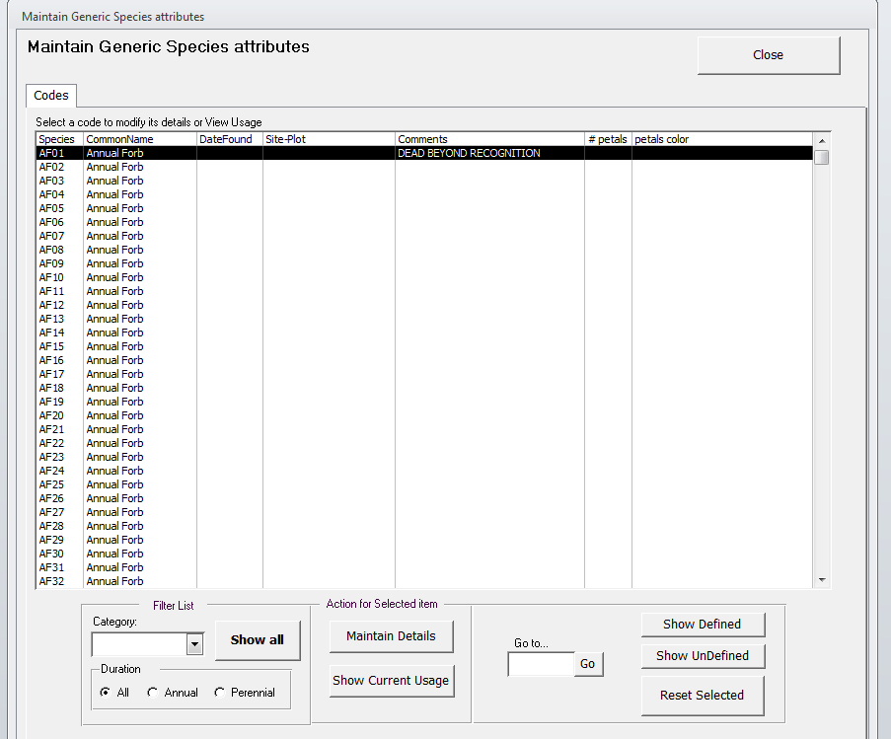
DIMA Database for Inventory, Monitoring, and Assessment
New unknown species tracking functionality is available in DIMA.
Notes:
Another thing to note is the unknown plant tracking function. This is not a requirement but may be helpful in keeping track of which codes are in which plots.
Questions about DIMAs?

Slide 8
Plot Tracking Excel
Purpose: to track the status of plots in a sample design, to help field crews implement their sample design, and to track information about your design – plot locations, associated project, revisit information, etc.
Common pitfalls:
Plot locations should be taken from your GPS unit not your DIMA
Any plots added to your design (intensification plots, targeted, etc.) should be added to the Plot Tracking Excel file.
Each plot should have a status by the end of the season (rejected, sample, or not sampled).
Design stratum should never be changed – that is how your plot proportions are calculated – instead you can note what strata the plot actually fell into in the actual stratum column.
Notes:
The next piece of data required is the plot tracking excel. This should come with your sample design and will be a semi-filled in Microsoft excel. This sheet has all of your plots and plot names in it – DO NOT CHANGE THE NAMES. It is helpful to fill this in throughout the season. The excel is a helpful tool to help keep track of how many plots per strata you have completed to ensure that the sample design stay balanced.
Questions?

Slide 9
Missing Data/Known Errors
Purpose: to track any data that is missing from a plot (i.e. half of one line of LPI data was collected on paper and subsequently lost , etc.) or known errors in your dataset.
Common pitfalls:
All missing data needs to be tracked in the Missing Data/Known Errors document – data not tracked in this document will not be accepted at the NOC at season end.
The more information the better – SO MUCH BETTER TO TRACK ERRORS THAN TRY AND COVER THEM UP, OR PRETEND THEY AREN’T THERE!
Notes:
Who here has made a mistake when collecting data? *presenter raise your hand cause you know it’s true. Who here has tried to cover up your mistake? *raise hand again.
Mistakes are ok! But covering it up is not. If this data goes to court for whatever reason and they find that someone tried to cover something up then all of the data could be potentially falsified.
All you need to do is track known errors or missing data in this template and turn in with your data.
Questions?

Slide 10
Photos
Photos
Purpose: to give photo representation of each transect and soil pit within a plot. Photos can give meaning to data and explain differences between different year’s data.
Common pitfalls:
Incorrectly named photos are extremely time consuming to fix. Refer to Section 3.2.2 in the Data Management Protocol for correct naming.
Photos not taken at the correct height , distance from transect or orientation make for inconsistent interpretation.
Notes:
Photos can be the most important piece of information to resource specialists when trying to piece all of the data together. Do your best to take quality photos! Even if it may seem like a small detail, having the correct naming convention and location for photos makes data interpretation MUCH easier.
*If time allows, ask class correct orientation for transect and soil pit photos (landscape for transects and portrait for soil pit) and the correct height/distance from transects (1.5m above soil surface and at plot center so 5m away from transect start)
Questions?

Slide 11
Implementation Summary
Implementation Summary
Purpose: to record information from the season like planning, funding, design, etc. to know what to expect for next year. This document may assist future crew and project leads to correct errors and hit the ground running.
Common pitfalls:
Not filling it out ☺
Notes:
The Implementation Summery is a helpful tracking document that should be filled out by both the project and crew lead. It can help out the next season by serving as a reminder for things to looks out for for the coming season.
The document is straightforward but can easily be forgotten.
Questions?

Slide 12
DATA MANAGEMENT TAKE AWAY(S)
Consult the Data Management Protocol
Contact me if you have questions!
Sarah Burnett (AIM Data Manager)
303-236-2716
sburnett@blm.gov
Notes:
This has been a fly by description of the data management steps you need to take, but all of the things I’ve talked about can be found in the Data Management Protocol and I am always around to answer questions!

