Slide 1
IMPLEMENTING AN AIM SAMPLE DESIGN
Terrestrial Core Indicator Training
2019

Slide 2
LEARNING OBJECTIVES
Understand the basic concepts of sampling (population, bias, etc.)
Office rejection
Field Rejection
Hitch Planning
Balancing a design
Review updates for 2019

Slide 3
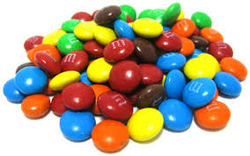
SAMPLING 101
We can’t measure everything, everywhere.
Sampling – using selected members to estimate attributes of a larger population.
If sampling is “statistically valid”
Gives unbiased estimates of the population
Notes:
The reason why we sample is that we can’t complete an ‘inventory’ – meaning we can’t get information about all pieces of land everywhere. So, we sample a subset of the area we are interested in a way that lets us talk about the whole area - this is sampling. In order to truly be able to sample an area, you have to reduce or eliminate any bias in the sampling effort which is what you all can help us control and is going to be the main focus of this talk.

Slide 4
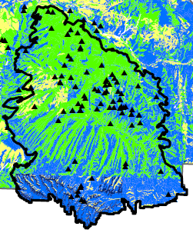
CONCEPTS – POPULATION
The entire “universe” to which the results of sampling apply
Also called inference area or sample frame.
Oftentimes in AIM – sample frame/population is BLM land within a Field Office Boundary or other meaningful boundary.
Landscapetoolbox.org: Inference Space – What it is and why it’s important
Notes:
The larger area we would like to say something about – the land area we are sampling portions of, is called the population – this is also referred to as your inference area or your sample frame. For many AIM projects the sample frame or population is all BLM land within a field office or other meaningful boundary like Land Use Plan or GRSG habitat boundary.

Slide 5
DEFINING THE POPULATION
If you need to make conclusions about an area, it should be in your population
Target population
The population that you intend to draw conclusions about
Sampled population
That portion of the target population that you could actually sample
Be careful not to unnecessarily restrict the population
Reductions of target population related to land use can bias results!
Notes:
The are we are trying to make inference to – our sample frame – is also called our target population. For your area this work should have been done for you already. Your project area and sample frame should already be defined. The part that you have control over is what the sampled population is – what parts of the design is actually sampled and where in your sample frame you actually collect data. The big picture concept to take home is that it is really important to complete the whole sample design, to collect data on the whole sampled population. If you don’t, if there are strata omitted or plots ignored, then you could be unintentionally limiting your target population or reducing the amount of area you can make inference to. This means that based on where you collect data on the landscape, you could make it so that there are parts of your sample frame you actually can’t say anything about.

Slide 6
BIAS DEFINED
The difference between the reported indicator and the true value of the indicator
Sampling goal: reduce bias (especially systematic) wherever possible
Notes:
I’ve been talking a lot about BIAS, so let me take a minute and describe what I mean. In this diagram if the true value of the indicator is in the orange dot in the middle of the target, the goal would be to get the farthest right result. You want to be collecting the true value with the least amount of variance because the average of samples would not only be right on the true value, there would also be less spread – which means more assurance that your average is the correct value. The only way to reduce variance (the spread of values) is controlled by how many plots you sample and the sample design – this portion is taken care of for you in the sample design process. What you guys have control over is bias, that is what other errors are introduced in the way that you are sampling both in QA and in what we are talking about today – implementing your sample design.

Slide 7
SO YOU HAVE SOME POINTS…
Step 1: Office Rejection
Step 2: Hitch planning
Step 3: Sampling, Field Rejection, and Plot Tracking
Notes:
Like I said, you should have a sample design created for you, with the sample frame and strata determined by the project lead in your area. You will be in charge of implementing that sample design. These are the general steps for implementing a sample design for an AIM project. First you will take a look at your plots in the office and apply some rejection criteria. The next step will be to plan your sample efforts or your hitches. A hitch generally speaking, is the group of plots you will collect in one period of data collection, or the order in which you will sample your plots in your area. There is then a second round of potential plot rejection. Regardless of what happens at a plot – if you collect data or reject it – we need to know what the ‘fate’ of that plot was, or what happened to that plot. If it’s rejected you need to track that it was and why. If it was sample you need to track that as well as when and exactly where the data was collected. And if it wasn’t sampled then we need to know that as well.

Slide 8
OFFICE REJECTION
First things first:
Sample points should be reviewed against rejection criteria in the office using ancillary data sources (e.g., ownership maps, topographic maps, and aerial or satellite imagery).
Notes:
The first step in implementing a design is office rejection. To step back a minute lets real quick talk about plot rejection. So for both in the office prior to field visits and in the field, we have a list of reason that a crew could potentially reject a plot. These are things that either make plot visiting challenging or unsafe and there is some wiggle room among projects as to what is on the list rejection criteria. However, rejection needs to be decide long before field visits ever take place, to reduce bias!
So in order to complete office rejection, you are going to plot your field sites along with ancillary data that will allow you to determine if you can/should office reject a plot. The rejection information from this step should be tracked in the Plot Tracking excel.

Slide 9
OFFICE REJECTION
Rejection Criteria | Rejection Description
Office - Unsafe to sample | Office Rejection Criteria: Sample point is unsafe to sample.
Office - > 3 miles walking distance | Office Rejection Criteria: Sample point is >3 miles walking distance from the closest point accessible by a vehicle.
Office - Non-BLM land | Office Rejection Criteria: Sample point falls on non-BLM land.
Office - Slope > 50% | Office Rejection Criteria: Slope of sample point exceeds 50%
Office - Access Denied | Office Rejection Criteria: Access to the point was denied: (Information below should be put in Rejection Criteria Comments field) Access route unsafe Access required passage through non-BLM land, access was denied Owner contacted on _______________________. Locked gate Access denied but visit rescheduled for ___________________________.
Office - Transect crosses boundary | Office Rejection Criteria: (Optional, determined by the monitoring objectives) The sample point transect crosses a boundary between different management units (e.g., in an allotment-scale monitoring project, the sample point intersects two allotments). ONLY USE THIS REJECTION CRITERIA IF INSTRUCTED BY YOUR PROJECT LEAD.
This information should be stored in the Plot Tracking excel file (more information to come in Data Management talk).
Notes:
Read through the list of office rejections.
Office - >3 miles walking distance: make sure you have accurate road layer or confer with folks in your office to make sure you aren’t rejecting points because of distance that could be accessible via a road that is missing from the map. Office rejection should lean heavily on local expertise, odds are there is someone in your office who knows this land pretty well and can help you determine if a plot is actually inaccessible, or you are simply missing a data layer.
Office – slope>50%: This is actually a really hard one to reject in the office. Oftentimes a Digital Elevation Model (DEM) is used to measure the slope and is fairly imprecise, so a plot that you may be able to sample – especially if you implement the moving criteria as we’ll discuss in a minute – could be rejected based to imprecise base data. Plots should be rejected for slope in the office only if it’s painfully obvious that they can’t be sampled – very steep cliffs with no adjacent mellower slopes, etc.
Non-BLM land: even though most of our designs use a land ownership layer, there is a possibility that the ownership in your office has changed since we did the big draw in 2015. Keep this in mind and look for more local land ownership layers from your state/office.

Slide 10
HITCH PLANNING
Maintaining Statistic Validity:
Within each stratum, you should visit the plots in order.
For example: Plots SH-001, SH-002, and SH-003 should be visited in that order, but you can add in plots from another stratum between the plots (SH-001, BA-024, SH-002).
Optimizing each hitch and attempting to limit travel time between plots each day is also important.
You shouldn’t travel 100 miles across your project area to ensure that you sample SH-002 directly after sampling SH-001 if you are certain that you will sample SH-002 during the field season.
The goal is to find a balance between going in strict plot order and being efficient, with the emphasis being on maintaining plot order. Going out of order can introduce bias in a number of ways.
Notes:
Hitch planning is the most creative you will probably get when implementing a terrestrial AIM sample design. There are some rules to follow, but it also requires forethought and strategizing and should be revisited often. One of the most important aspects of hitch planning is maintaining the order of plots within a stratum. You will have a list of plots, each with a couple characters that correspond to the stratum. Here is an example you could have SH-001 through 003. These should be sample in order within that stratum, but don’t have to be back to back. You could put a plot from a different stratum in between 001 and 002. This is important because if you run out of field season and you’ve visited SH-003 but not SH-002, then you’ve just hand selected which plots from your design you’ve sampled and you’ve introduced bias.
The second suggestion and one your project lead will find important is that you don’t travel back and forth across your project area and waste a lot of time and resources. This is where the creativity comes into play. The goal is to balance these two ideas with the emphasis really being on maintaining plot order.

Slide 11
Examples of Introducing bias into hitch planning:
Visiting plots most easily accessible first could mean that your crew never gets to the least accessible plots.
Not spreading out your hitches geographically, could mean that the plots sampled are aggregated in one spatial area.
Going out of order within a stratum removes the statistically valid nature of your design – you could be introducing bias and not even know it!
Notes:
These are example of ways you could be introduce bias, systematic or random, into your dataset with the way in which you implement your sample design. If you start your design by simple ticking off the plots that are most accessible, the potential exists that you would never get to the more inaccessible plots. The more accessible plots to you are also more accessible to everyone else, so these plots could be the most damaged by anthropogenic effects (people) and may not give you a true representation of the landscape.
If you start on one side of your field office and work to the other side, you could end up missing whole chunks of your project area. What if there is an invasive species that only occurs in one portion of you project area? If you miss it by not visiting that area, or oversample it by not visiting additional areas in the project area, your data could be unrepresentative of the whole project area.
Then again, the random ordering saves you from bias that you might not even be aware of!

Slide 12
FIELD REJECTION
Rejection Criteria | Rejection Description
Field - Unsafe to sample | Field Rejection Criteria: Sample point is unsafe to sample (e.g., unstable soil surface, cliffs, hazardous wildlife, law enforcement concerns).
Field - >3 miles walking distance | Field Rejection Criteria: Sample point is >3 miles walking distance from the closest point accessible by a vehicle.
Field - Slope > 50% | Field Rejection Criteria: Slope of sample point exceeds 50%.
Field - Access Denied | Field Rejection Criteria: Access to the point was denied: (Information below should be put in Rejection Criteria Comments field) Access route unsafe Access required passage through non-BLM land, access was denied Owner contacted on _______________________ Locked gate Access denied but visit rescheduled for ___________________________
Field - Intersects wetland, riparian, or aquatic feature | Field Rejection Criteria: (Optional, determined by the monitoring objectives) Sample point transect intersects wetland, riparian or aquatic feature.
Field - Intersects Road | Field Rejection Criteria: Sample point transect intersects a road or primitive road.
This information should be stored in the Plot Tracking excel file (more information to come in Data Management talk).
Notes:
Once you’ve gotten through the initial steps of hitch planning – you will have another compounding factor, which is field rejection. Like I said before, there are some of the rejection criteria that you just can’t know until you get into the field. If your plot has a herd of wild horses stamping around on it– you might want to reject it because it’s unsafe to sample. If you thought your plot fell on an area of less than 50% slope, but you get there and you can’t actually get to the spot because everything around it is extremely steep cliffs – then you might reject it based on slope or safety. Once again, all of this information should be documented in the Plot Tracking Excel. The other option is to move the plot – which we have a protocol for!

Slide 13
MOVING A PLOT!
From the original plot center point, move 50 m North. With this location as the center of a new potential plot, evaluate the rejection criteria. If the new plot is not rejected, sample that plot.
If it is rejected, move 50 m East of the original plot center point and evaluate the rejection criteria again.
Each time the new plot is rejected, repeat for the remaining cardinal directions--South then West.
If 50 m in all 4 cardinal directions of the original plot center point are rejected, reject the plot. If not, record the reason for the original rejection, this procedure and the outcome in your plot notes and then in the Plot Tracking excel.
Notes:
By the time you hike all the way out to a plot, odds are that you aren’t going to want to reject it, especially for something like a big ol rattlesnake in the middle of it, or because it cross a road. In this scenario, the best option will probably be to implement the moving procedure. This is outlined here, but is based around moving the center plot 50m in the cardinal directions until you find an area you can sample. There is a place in the Plot Tracking excel to note that you moved the plot. Hopefully, the moving protocol means you can sample the plot! Also, this is something to keep in mind during office rejection – a lot of the rejection criteria can be eliminated once you implement the moving protocol.

Slide 14
SO YOU REJECTED A PLOT NOW WHAT
After you have attempted to move a plot and were unable to successfully sample, the time has come to REJECT the plot.
This rejected plot will need to be replaced in order to complete your sample and obtain the information necessary for that year.
Select the first plot within that strata from the next year and add it to the end of the strata.
For example: Original order SH-001_2019, SH-002_2019, SH-003_2019; reject plot SH-002_2019 add in a plot from next year; new order is SH-001_2019; SH-003_2019, SH-014_2020.
A key thing here is that the new plot is sampled after ALL of the original plots are sampled

Slide 15
EXAMPLE!
The original design has points spread throughout the strata ‘Sage-Steppe’ and ‘Salt Desert’
Sage-Steppe
SS-001_2019
SD-012_2019
SS-003_2019
SD-014_2019
SS-004_2019
SD-013_2019
Salt Desert
SD-010_2019
SD-015_2019
SS-002_2019
SD-011_2019
Sage-Steppe
Notes:
Let’s work through an example showing what the sample design will look through after a couple plots are rejected and moved
Just read through the slides!

Slide 16
Plot SS-004_2019 is rejected in the field after it is determined that the slope is unsafe to sample
Plot SD-011_2019 is rejected in the office after the land owner declines access permission
Plot SD-012_2019 is moved in the field 50m to the south after attempting sample and then attempted to move to the north and east
Sage-Steppe
SS-001_2019
SD-012_2019
MOVED –
50m to South
SS-003_2019
SD-014_2019
SS-004_2019
REJECT – Slope >50%
SD-013_2019
Salt Desert
SD-010_2019
SD-015_2019
SS-002_2019
SD-011_2019
REJECT – No landowner permission
Sage-Steppe
Notes:
Just read through the slide!

Slide 17
The final design that you are left with has
SD-012_2019 moved 50m to the South
SS-004_2019 rejected and replaced with SS-023_2020
SD-011_2019 rejected and replaced with SD-062_2020
Sage-Steppe
SS-001_2019
SS-003_2019
SD-012_2019
SD-014_2019
SD-013_2019
Salt Desert
SD-010_2019
SD-015_2019
SS-002_2019
SS-023_2020
Sage-Steppe
SD-062_2020
Notes:
Just read through the slide!

Slide 18
REVIEW HITCH PLANNING
At the end of the season you should have the same proportion of plots per strata that you started with.
Started with 25% in FOREST; 50% in SHRUBLAND; and 25% in GRASSLAND – should end season with similar percentages.
For each plot that you reject, continue on to the next BASE plot for that year until you have gone through all that are sampleable. If you have had to reject plots, move on to the next year’s BASE plots until you have sampled the full number that you started with.
You should adjust your hitch planning to maintain both of these concepts.

Slide 19
EXAMPLE!
Project Area
Field Office
SH -023
SH - 016
Shrubland
FO - 007
FO - 003
SH - 013
Forest
SH - 015
SH -025
Strata
FO - 001
FO - 005
FO - 009
SH - 018
SH - 020
SH - 021
SH - 012
SH - 022
FO - 002
SH - 019
SH -011
FO - 008
SH - 024
SH - 014
FO - 004
FO - 006
SH - 017
FO - 010
Forest
25 total ‘BASE’ plots
Original Design: 10 Plots in FOREST (40%) and 15 plots in SHRUBLAND (60%)
Notes:
Another example to show the importance of sampling in order
Just read through the slide!

Slide 20
Field Office
FO - 007
FO - 003
FO - 001
FO - 005
FO - 009
SH - 021
SH - 012
SH - 019
FO - 008
SH - 024
SH - 014
FO - 004
FO - 006
SH - 017
FO - 010
DESIGN IMPLEMENTATION 1: Unexpectedly short season meant only 15 ‘Base’ plots sampled.
The crew initially decided to start furthest from the Field office and work their way closer to the office – regardless of strata.
New Proportion of plots is 9 plots in FOREST (60%) and 6 plots in SHRUBLAND (40%)
Notes:
Just read through the slide!

Slide 21
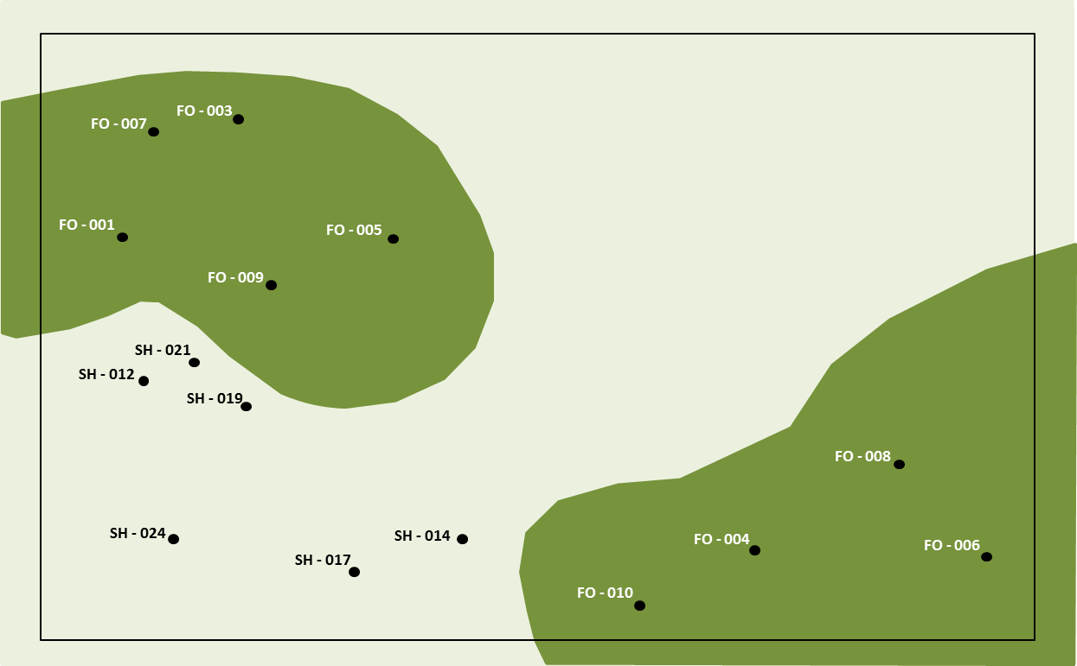
Field Office
Where BIAS was introduced:
Because plots are aggregated in one area of the Field Office, even if they are able to sample the other section of the field office next season, varying rainfall may bias the results in one geographic region over another (i.e. this field season was very rainy and next year was dry – results will imply the northwest section of the FO is in worse shape than the south east!)
Shifting the proportion of plots – 60% Shrubland plots in the design compared to 40% Shrubland in the implementation mean that less variability is captured in this strata than according to the original design.
Notes:
Just read through the slide!

Slide 22
Field Office
SH - 016
FO - 003
SH - 013
SH - 015
FO - 001
FO - 005
SH - 018
SH - 012
FO - 002
SH - 019
SH -011
SH - 014
FO - 004
FO - 006
SH - 017
DESIGN IMPLEMENTATION 2: HOW YOU SHOULD SAMPLE!
Sampled 15 ‘Base’ plots out of the 25 plots
Balanced plot sampling between strata and went in order within strata.
6 plots in FOREST (40%) and 9 plots in SHRUBLAND (60%) (same proportion as original design).
Plot sampled in order means that the sample plots were spread throughout the field office.
Notes:
Just read through the slide!

Slide 23
New in 2019:
Continued from 2018: If your design has two years worth of base plots- for instance in the Panel field of your shapefile, there are plots from 2018 AND 2019, the rules are that you should sample the 2018 first, then move onto the 2019 plots, keeping in mind the ruleset from before!
Instead of using oversamples when you reject a plot, you will sample the next panel (2020 plots if you are currently sampling panel 2019 plots)
You will be provided with the entire sample design (all 5 years instead of just the current year). So be extra careful to stay in order and sample all possible plots from the current year (and previous years) before moving to any of the next year
Notes:
A change that went into effect in 2018 years is that if you are in year 2, 3, 4, or 5 of your sample design, you may be picking up (or sampling) plots from previous years that were missed. This is based on information from our NOC biostatistician and is to ensure that gaps in the order – plots that add to the amount of land we can’t say anything about – are minimized in the final implementation of the design. This may mean that you have plots from previous years in the design for 2018. The general rule is that you want to pick up plots from the previous years, or prioritize those, above the current year. If we end up with plots not sampled at the end of the 5 year panel, they should be at the end, not in the middle – so all our rulesets focus on that!
One of the changes in 2019 is that when a plot is rejected, we will no longer be using oversample plots! Instead you will take the next plot from that stratain the following year and add it to the end of the current year’s design. The final change is that all 5 year’s worth of plots will be provided so be vigilant when sampling to not accidentally jump ahead!

