Slide 1
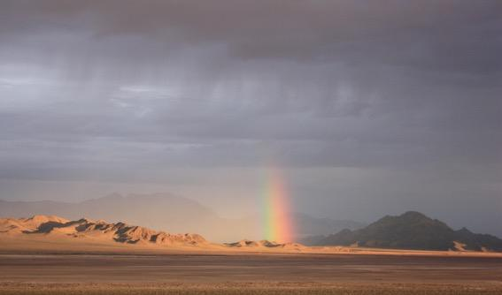
Monitoring for Adaptive Management BLM’s National Assessment, Inventory, and Monitoring Strategy
Photo: Sarah McCord
Notes:
Part information, part soapbox, part sales pitch

Slide 2
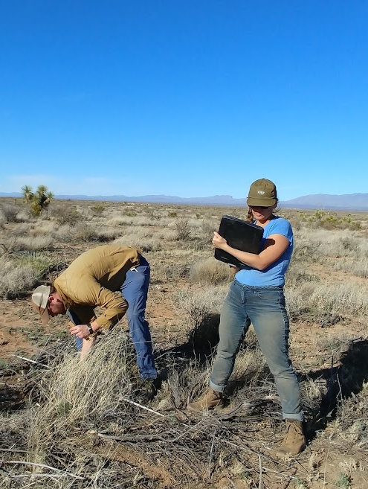
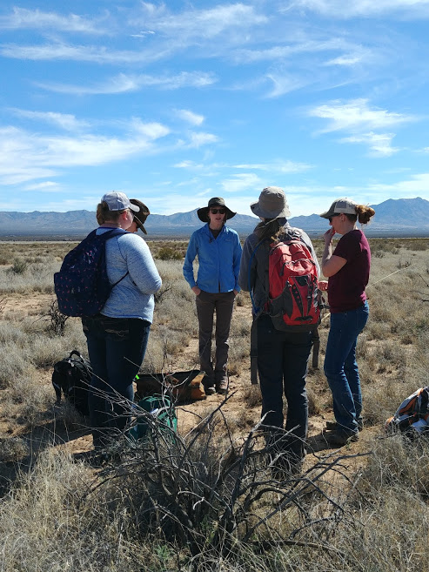
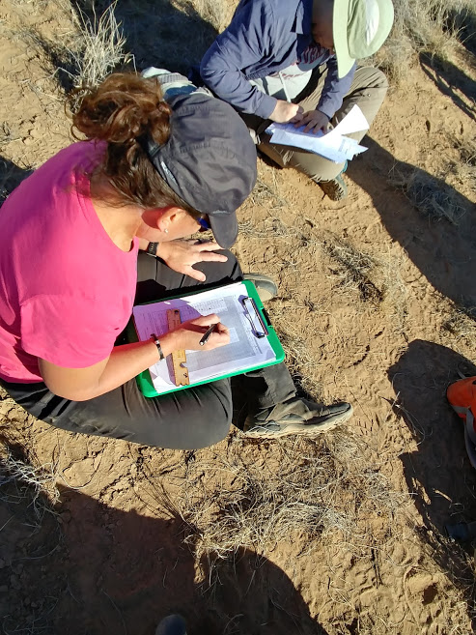
Course Objectives
Familiarity with the background and history of AIM
Learn and practice terrestrial core method protocol
Understand how to implement a sample design
Electronic data capture practice
Familiarity with all components of AIM data
Understanding the components of QA and QC throughout the data collection process
Method calibration
Notes:
Before we begin, let’s go over the overall course objectives. The purpose of this course is to teach terrestrial AIM data collectors the appropriate techniques for implementing an AIM sample design. Our target audience in this course is all AIM data collectors for the 2019 season. Additional information on AIM data use and analysis can be found on aim.landscapetoolbox.org or by attending the AIM Project Leads training. We will take this week to meet the objectives listed here. Please try to keep all questions focused on attaining these course objectives.

Slide 3
Course Expectations
Participants must attend the entire course – if you have concerns with this, see an instructor on the side
This training is a safe space
Raise your hand with questions and do not talk over one another
Show up on time and be prepared
Stay mentally and physically present
Listen with an open mind
Any other ground rules for this week?
Notes:
Let’s also take this time to layout some ground rules for the week.
*Instructor either read these aloud or have people in the class read them. Allow for class to add additional ground rules and write them on a white board.

Slide 4
Presentation Objectives
A foundation for AIM and the five principles
Knowledge of the history of the program
The current status of AIM (how much data and how is it used)
Future of AIM and any changes for the season
Notes:
Now we will narrow down our focus to the objectives of this particular presentation. By the end of this presentation the participant should know the foundation for AIM and the five principles; the history of the program; where we are now and where we are going. The trainee should be comfortable talking about AIM to interested parties and be able to generally explain what AIM is.

Slide 5
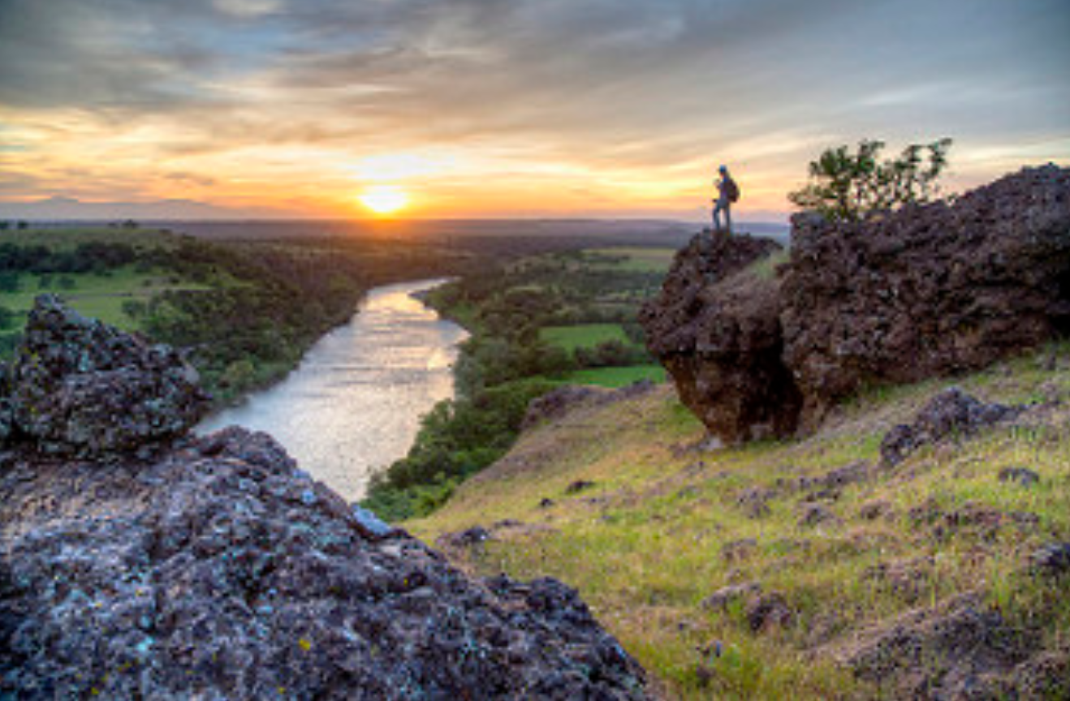
What is the BLM?
BLM Mission
“To sustain the health, diversity, and productivity of the
public lands for the use
and enjoyment of
present and future
generations”
Formed in 1946 by Harry Truman
General Land Office
U.S. Grazing Service
The BLM manages one in every 10 acres of land in the United States
There are BLM managed lands and/or minerals in every state though land is more prevalent in the western states.
BLM is in dept or interior
Notes:
Before we dig into AIM, let’s do a quick history of the BLM. BLM was created in 1946 by Harry S Truman and was formed by combining the General Land Office and the U.S. Grazing Service, two agencies that played a big role in the settlement of the western US. BLM manages one in ten acres of land in the US. These lands have a variety of resources including wild horses and burros, vegetation, grazing, wildlife habitat, fire, energy, minerals, and cultural resources. (Broad and general, nothing controversial.)
Recommend reading Opportunity and Challenge: The Story of the BLM to learn more.
Do folks have BLM specific questions?

Slide 6
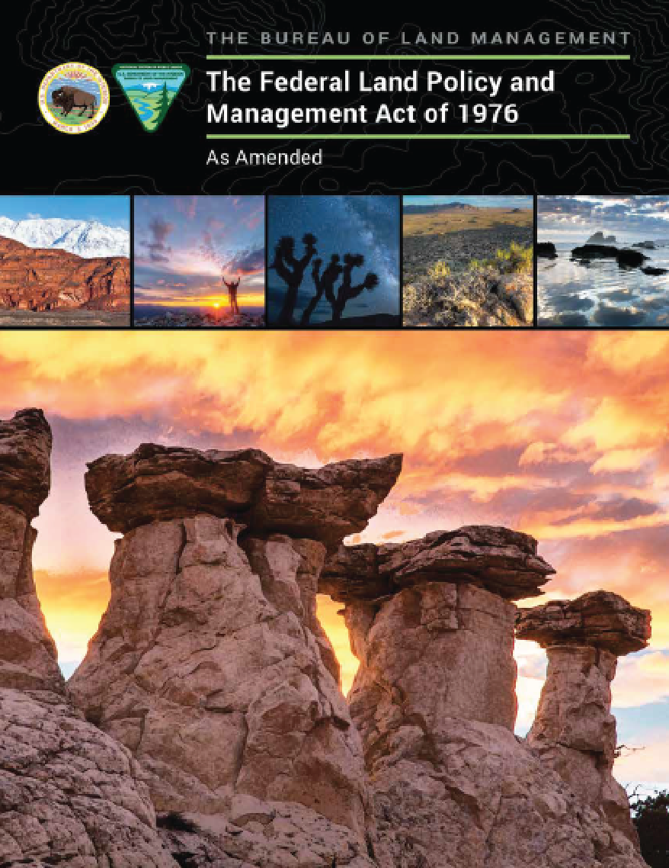
BLM’s Organic Act: FLPMA
BLM – AIM
Periodic and systematic inventory (section 201)
Use projected through coordinated land use planning (section 202)
Goals and objectives based on multiple use and sustained yield (section 302 – admin.)
Prevent undue and unnecessary degradation (section 302 – admin.)
Notes:
BLM’s Organic Act, the Federal Land Policy and Management Act (FLPMA), proscribes that we manage lands for multiple uses and sustain the health and productivity of the land in the future. The way that we do that is through a periodic and systematic inventory (monitoring) coupled with a land use planning process that will help us watch out for and prevent undue and unnecessary degradation of BLM lands.

Slide 7
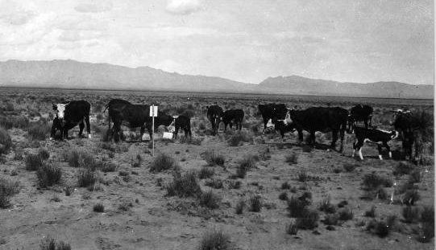
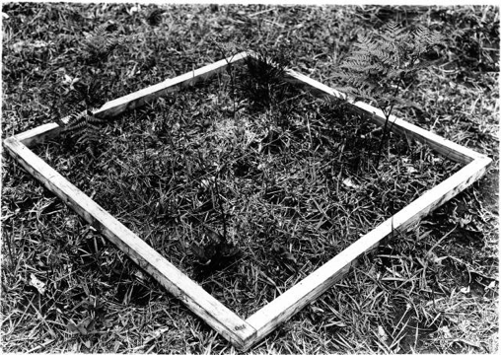
A Brief History of Rangeland Monitoring
Sampson(1923) promoted the idea of “a systemized study, designed to secure the data that will lead to permanent improvement in management and to increased profits from the lands.”
Historically, rangeland monitoring focused on determining impacts of and maximizing productivity related to land use – typically grazing
Monitoring designed around specific land uses or program objectives
Jornada cattle 1932
Veg sampling on the Jornada 1928
Notes:
History of Monitoring Rangelands: Monitoring has been an important component in rangeland management, including in BLM, for a very long time. The concept is not new; however the reasons for monitoring have changed. Historically monitoring was often motivated by a specific use, especially grazing – how many cows can we put on the land and still sustain the health of the land?

Slide 8
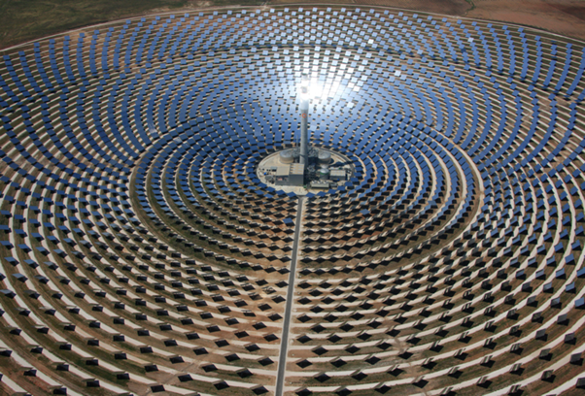
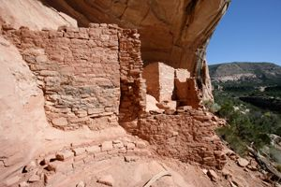
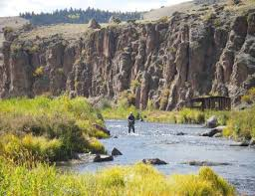
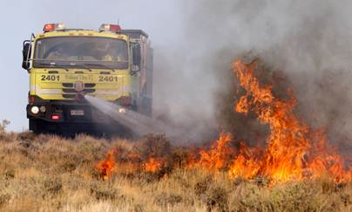
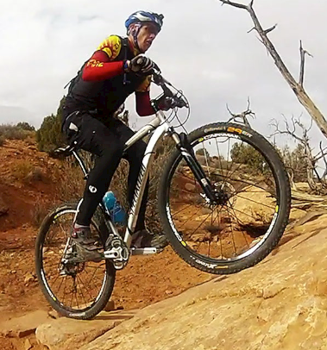
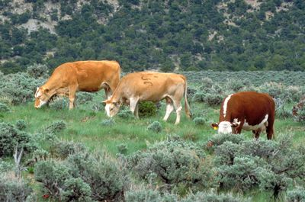
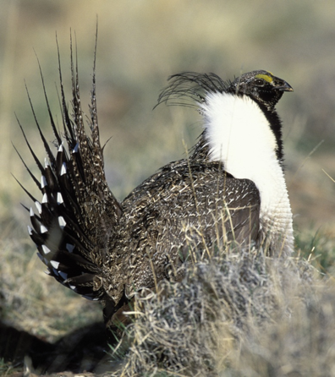
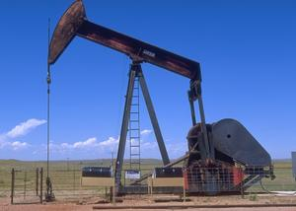
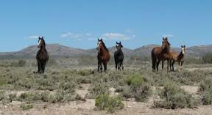
Changing uses/values of rangelands
Changing uses/values of rangelands
Notes:
Increasingly, society expects more out of rangelands than grazing (including the uses and values pictured here). BLM’s mandate from our organic act, FLPMA, is to manage the lands for multiple uses and to sustain those uses over time. A key challenge for BLM land managers is to achieve balance among these uses while maintaining and sustaining the health of the land. It’s not easy -- often the uses may be in conflict!

Slide 9
Resource Monitoring in the BLM: the AIM “Origin” Story
2004 Office of Management and Budget (OMB) programmatic review of BLM’s monitoring activities
Found the BLM collects a large amount of information, yet cannot determine effectiveness of actions above the project level, as required
Directed the BLM to analyze “Monitoring Activities” and develop a cohesive monitoring strategy
Wendy’s ad from 1984
Notes:
We know that monitoring has been a part of the BLM for almost a century but how exactly did AIM come to be the BLM’s standardized approach to monitoring? The agency responsible for issuing budgets (the OMB) reviewed BLM’s monitoring budget in 2004 and asked BLM to report on the national status of rangelands – essentially they asked BLM “where’s the beef”. Unfortunately the BLM had been monitoring at the project level and was unable to report on the status of rangelands nationally. OMB then requested that BLM develop a cohesive monitoring strategy, or else funding for monitoring would be reevaluated. This triggered an agency-wide process of self-reflection and conversations on how we monitor and use monitoring information.

Slide 10
BLM Local Workgroup Summary
“None of these findings are particularly surprising as the BLM’s data collection activities have evolved over time in response to changing user needs for specific resources, specific new program statutory and judicial mandates, and new scientific understandings. The BLM’s data collection and analysis activities were not designed to answer many of the performance and landscape level questions currently being asked.”
Local Workgroup Report, 2007
Notes:
One of the working groups assigned to address this issue also agreed that BLM monitoring has been specific to specific management concerns and the information was relevant at those scales. However, questions at broader scales were going unanswered

Slide 11
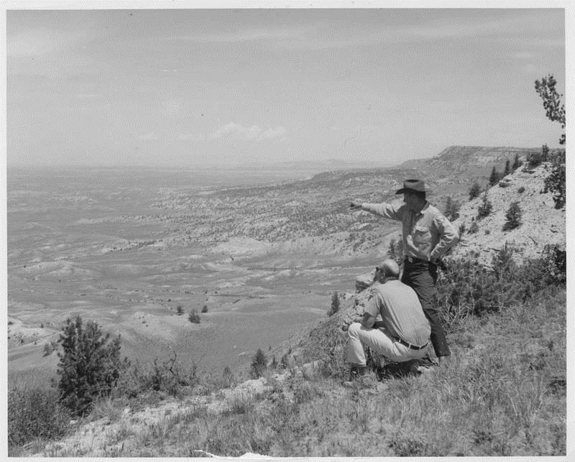
Multi-scale land management
National Condition of Rangelands
Range-wide Sage Grouse Habitat
Land Use Plan Effectiveness
Wild Horse and Burro Management
Post-Fire Seedings (ESR)
Grazing Permit Renewals
Recreation Management
Reclamation after Energy Devp. and Mining
Restoration Treatment Effectiveness
SCALE
Source: NOC Collection
Notes:
The working group also concluded that a standardized monitoring program was needed that could answer the broad variety of questions that BLM faces from small restoration treatment effectiveness like reclaiming an oil well pad all the way up tp the national condition of rangelands.

Slide 12
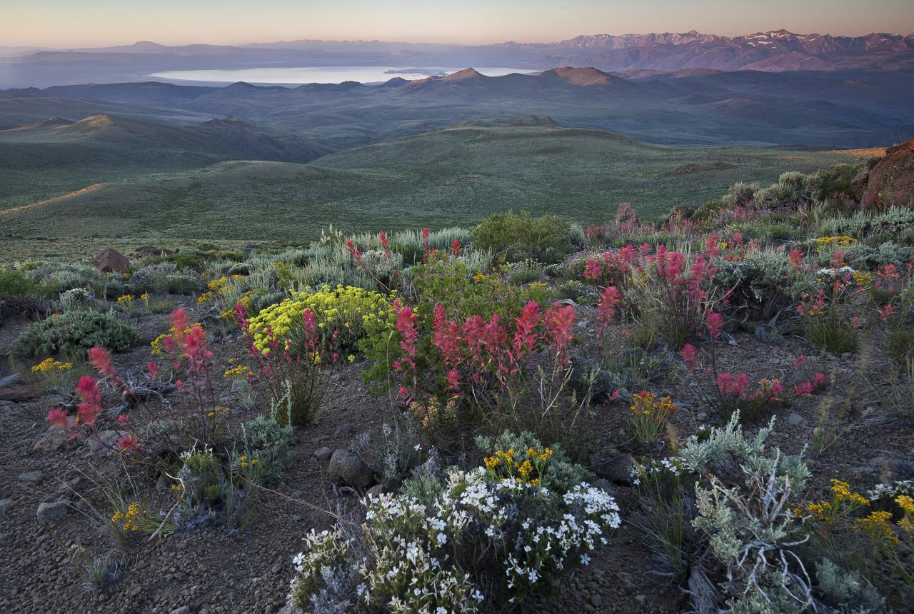
The AIM Strategy
The goal of the AIM Strategy is to report on the status and trends of public rangelands at multiple scales of inquiry, to report on the effectiveness of management actions, and to provide the information necessary to implement adaptive management.
Notes:
The AIM strategy was created as the solution to these questions. *read the goal of the AIM strategy to help in sink in.
Any questions about the AIM strategy as a whole? We will be getting into the specifics after this.

Slide 13
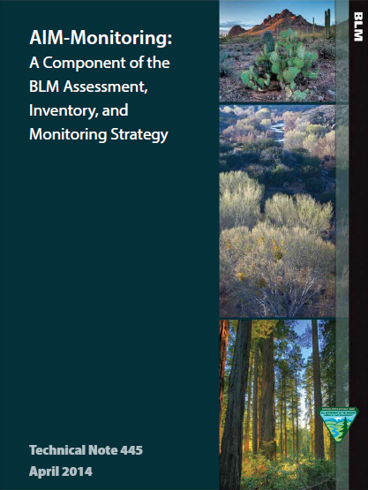
The Five Principles of AIM
Quantitative core indicators and methodologies
What to measure and how to measure it
Statistically valid sampling frameworks, when appropriate
Where and how to locate sample sites
Integration of remote sensing technologies
How to obtain spatially explicit resource information
Electronic data and data management plans
How to increase data quality, availability and usability
Structured implementation
Thoughtful, integrated approach to monitoring
Notes:
Summary Slide - more detail in following slides….AIM is built on 5 key principles *read the principles but do not go into detail as you will do that in the coming slides

Slide 14
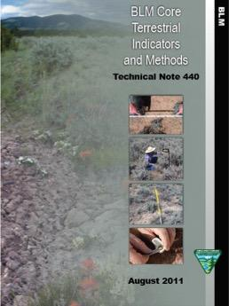
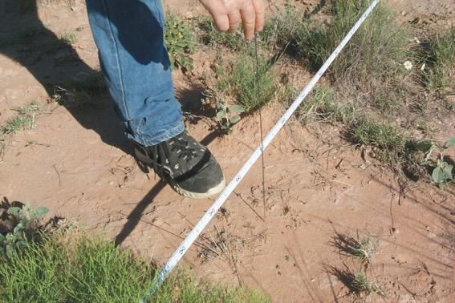
Core Indicators and Methods - Selection Process
Measurable ecosystem components
Applicable across many different ecosystems
Informative to many different management objectives
Minimal set that should be measured in all monitoring programs.
Standardized methods
Supplemented as necessary
Notes:
The first principle of AIM is to collect data using set of standard core indicators and methods. The core methods and indicators were selected for their applicability across different ecosystems and ability to inform multiple components of those ecosystems. The core methods collect the minimum amount of information that is needed to make decisions across multiple management objectives. These indicators and methods were chosen by surveying resource specialists and researchers across the rangeland science field to get at what the commmunity finds to be the most robust, consistent methods that yield the most useful information.

Slide 15
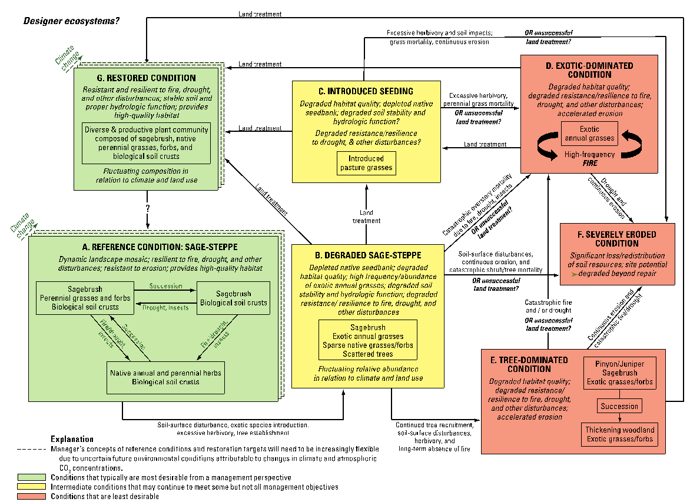
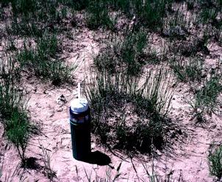
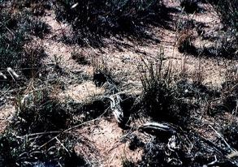
Core Indicators and Methods: Functional Indicators of Land Health
Indicator - aspect of an ecosystem or process that can be observed or measured and provides useful information about the condition of the system being monitored
Focus on indicators describing processes related to land health
E.g., bare ground, canopy gaps, functional group diversity
Conceptual models embody knowledge and can be useful for selecting indicators
Bare Ground
Flow Pattern
Notes:
An indicator is some part of the ecosystem or process that can be observed or measured. These were developed by focusing on big picture indicators that tell us multiple things about the ecosystem like bare ground and canopy gaps. Various conceptual models were important in this selection process.

Slide 16
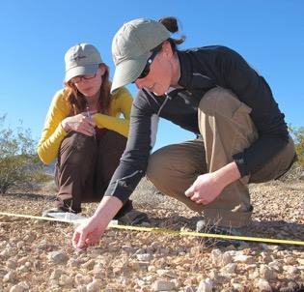
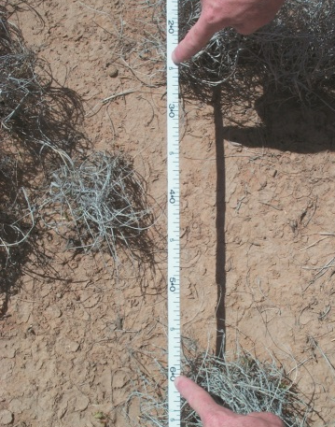
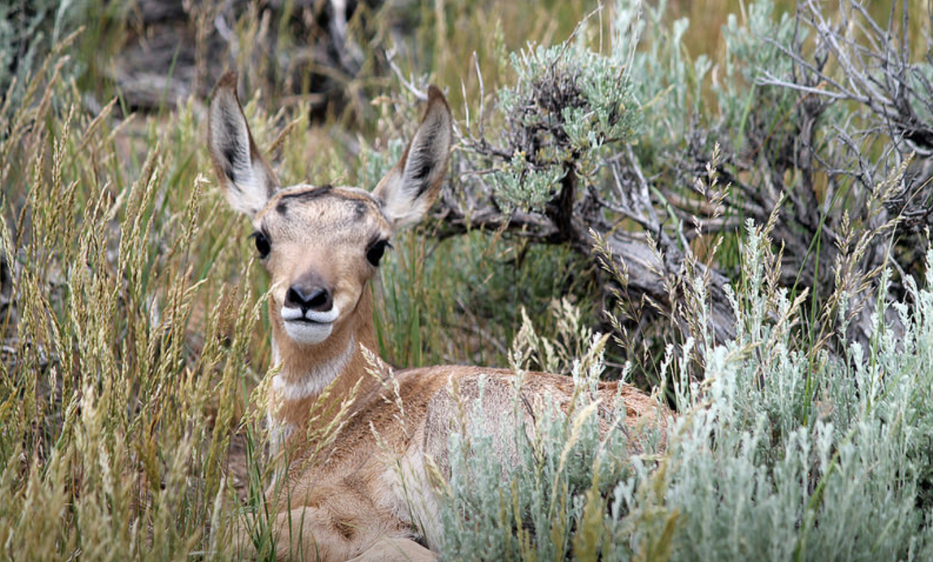
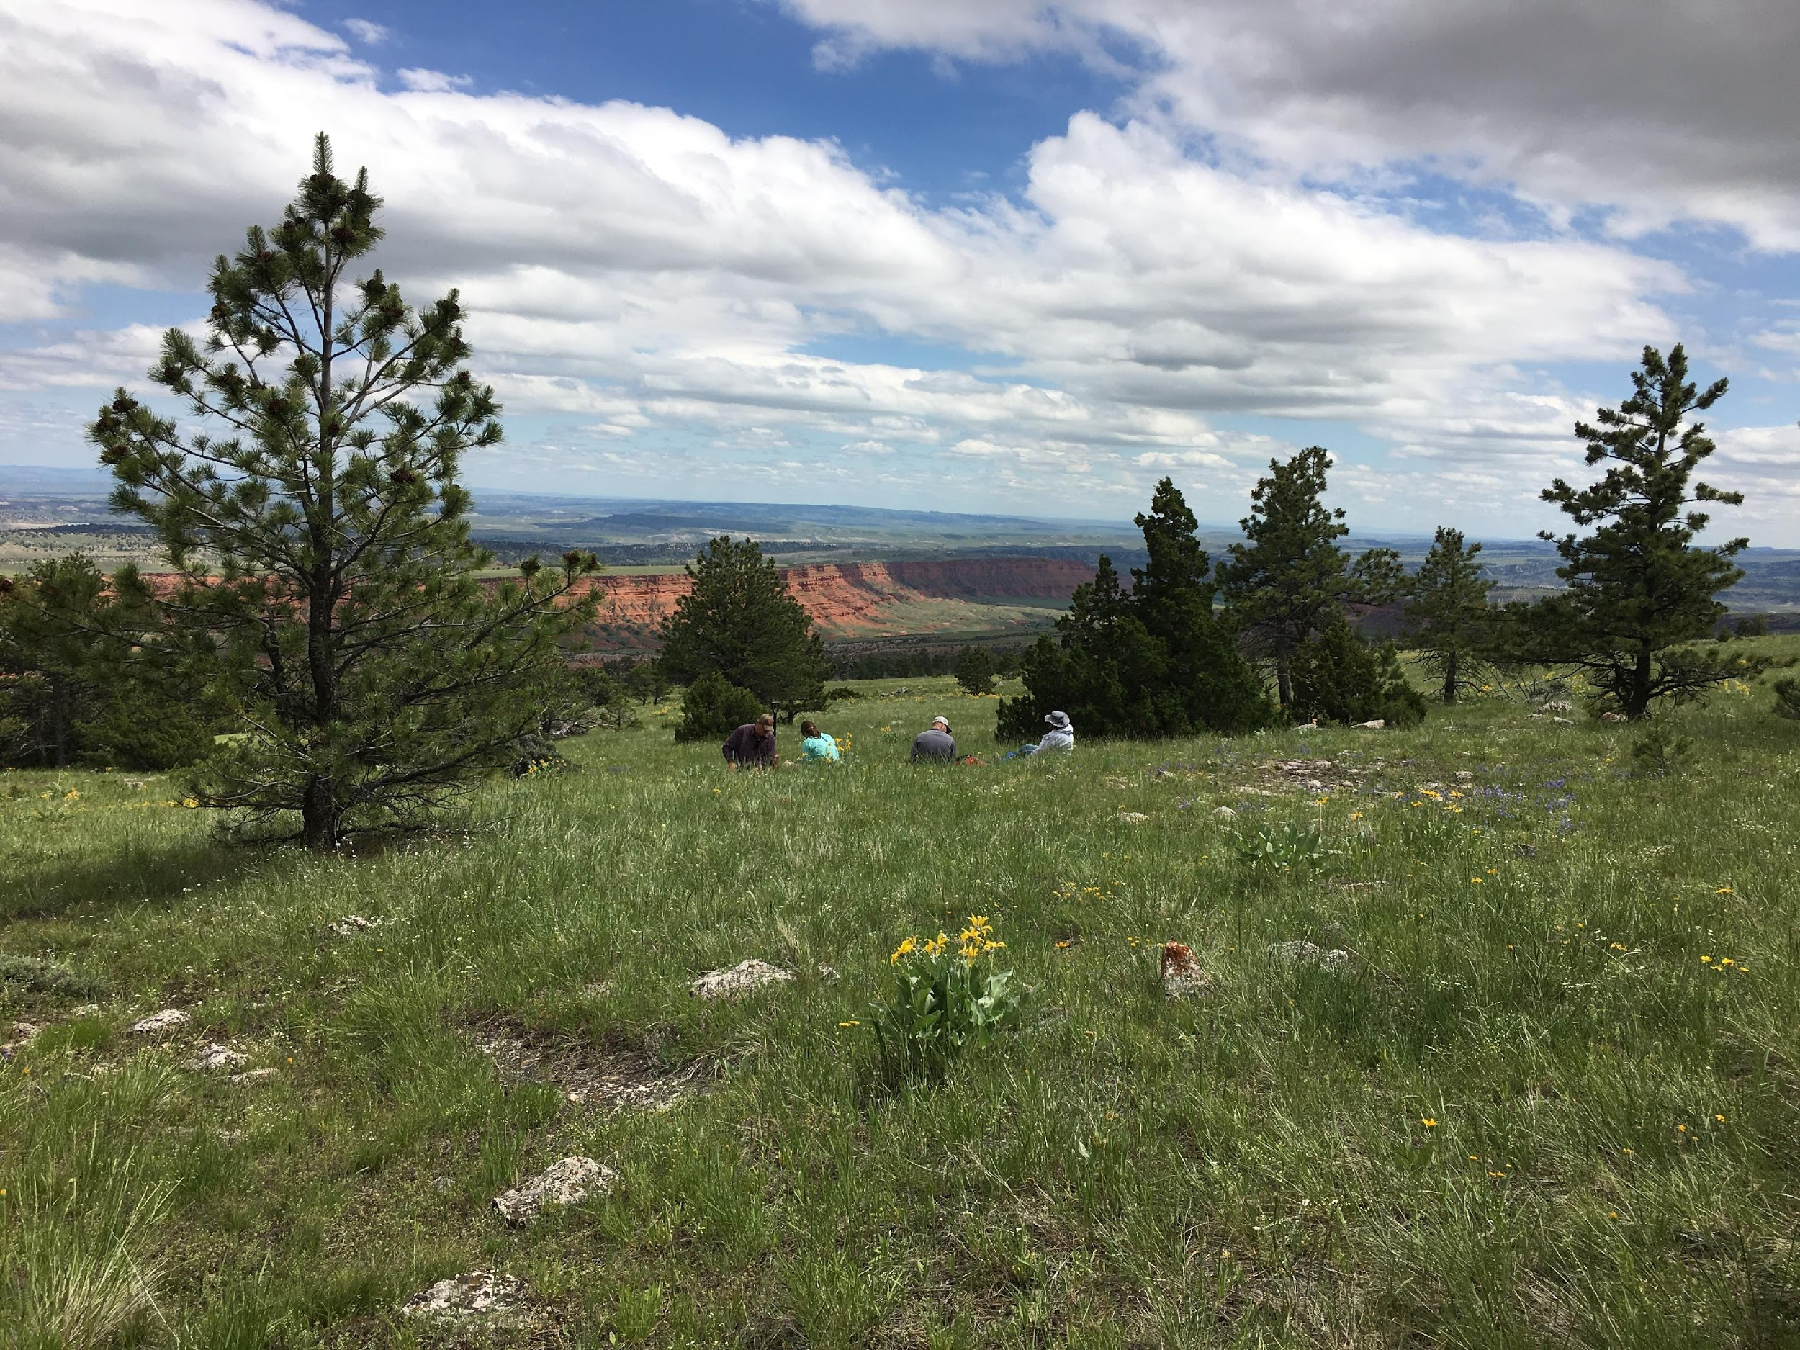
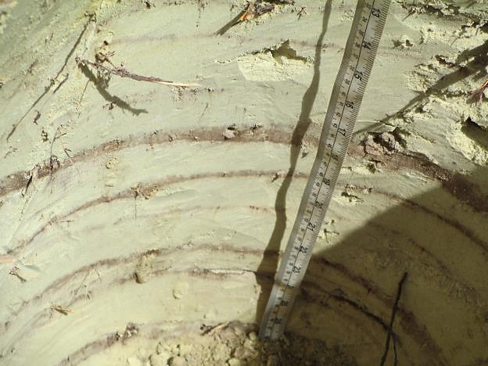
Core Indicators and Methods- AIM Terrestrial Methods
Soil aggregate stability
Canopy Gaps
Height
Plot Observation
Bare Ground
Vegetation Composition
Plants of Mgmt. Concern
Nonnative Invasive Sp.
Species Richness
Plot Characterization
Notes:
During this week, we will be focusing the majority of our time learning, practicing and calibrating on these methods. Line point intercept is collected along 3 transects to gather information on bare ground, vegetation compositions, plants of management concern (like special status plants) and nonnative invasive species. While collecting line-point intercept, woody and herbaceous vegetation height is also collected. Canopy gap information is collected on the same transects to find size and distribution of gaps. Soil aggregate stability is the last indicator collected along the transects at various intervals. Plot observation, characterization and species richness are a plot wide synopsis.

Slide 17
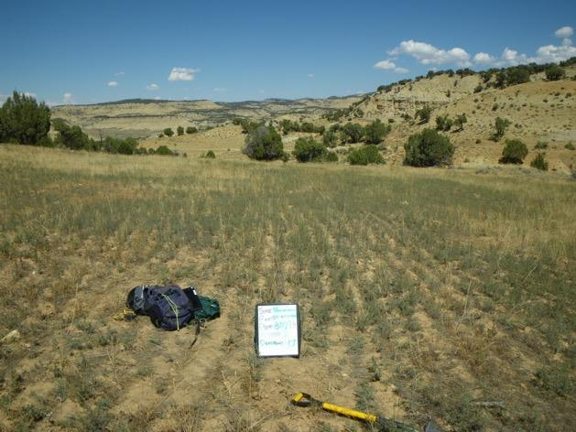
Core Indicators and Methods- Supplemental Indicators/Methods
Additional indicators to evaluate to meet a local or resource specific objective
EXAMPLE:
In reclamation monitoring, density of seeded species is an important indicator
Notes:
Some specific sites or projects may require additional information, and that is where supplemental methods come in. Therefore some crews will be asked to collect additional supplemental data to the core methods. An example of this may occur on plot that have been reclaimed where crews collect the density of seeded species.
Any questions about the terrestrial core methods or supplemental indicators?

Slide 18
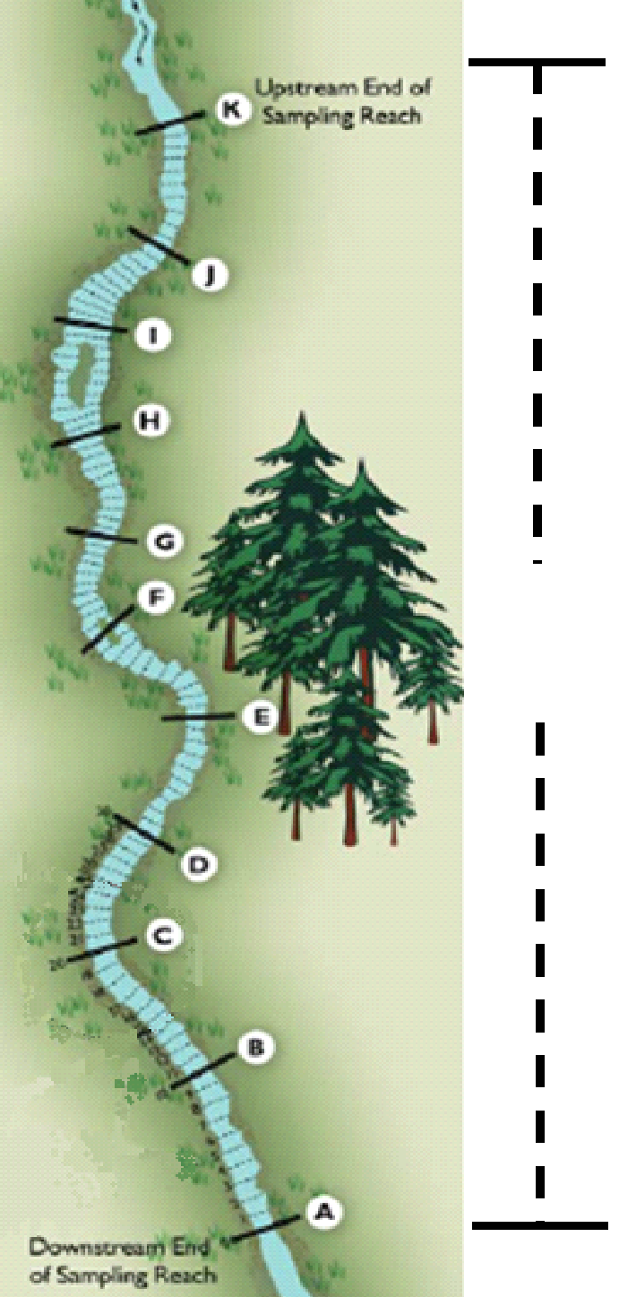
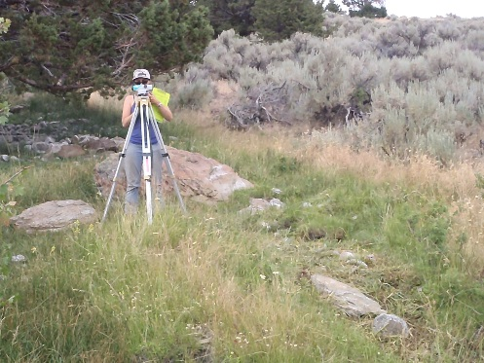
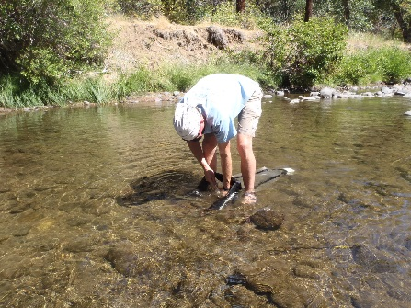
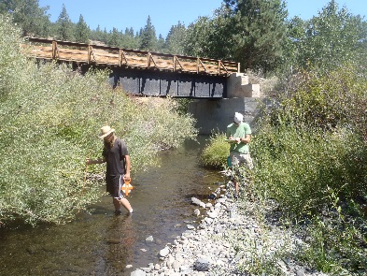
AIM Core Aquatic Indicators
Physical
Temperature
Substrate
Pool dimensions
Floodplain connectivity
Bank angle/stability
Instream habitat complexity¹
Biological
Macroinvertebrates
% overhead cover
LWD
Riparian veg. cover
Chemical
Conductivity
pH
TN & TP¹
Turbidity¹
Stream Covariates
Flood-prone width
Bankfull width
Slope
Notes:
The training this week is focused on the terrestrial indicators and methods but know that there is a whole aquatic AIM program that looks at wadeable streams -- specifically physical and biological characteristics and stream covariates. Are there any aquatic specific questions?

Slide 19
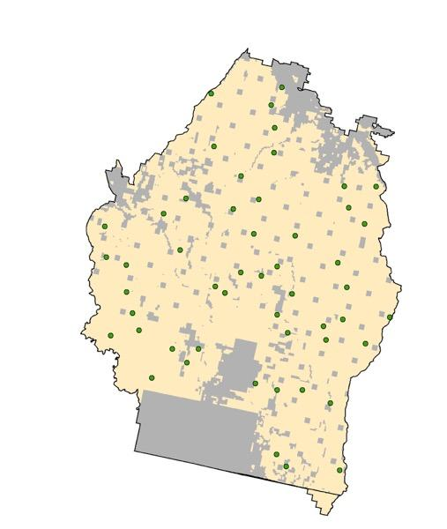
Statistically Valid, Scalable Sampling Designs
Sampling design includes where you are going to monitor
Diversity of land uses/impacts + budgetary restrictions are driving need for sampling designs that can
Address multiple objectives
Provide information at multiple scales
Statistical (i.e., probability-based) approaches provide this foundation
Can be defined according to objectives or generally
Flexible and unbiased
Can be combined and “scaled up”
Quantifiable uncertainty
Notes:
The second principle of AIM is to use statistically valid sample designs, where appropriate to answer your questions. Having a random design enables us to report out across larger areas and at multiple scales, be it a large grazing allotment, a wilderness area, or a land use planning area. Random designs help help eliminate bias and can provide information which can be used across resource concerns. This does not totally replace targeted sampling because there are times when plots in specific locations are more appropriate for a particular resource/management need. For example, a targeted point might be placed on an oil/gas pad that is being reclaimed. The AIM core methods can still be collected in such plots.
Don’t sweat the particular statistical language that shows up sometimes, we’ll try to provide accessible explanations

Slide 20
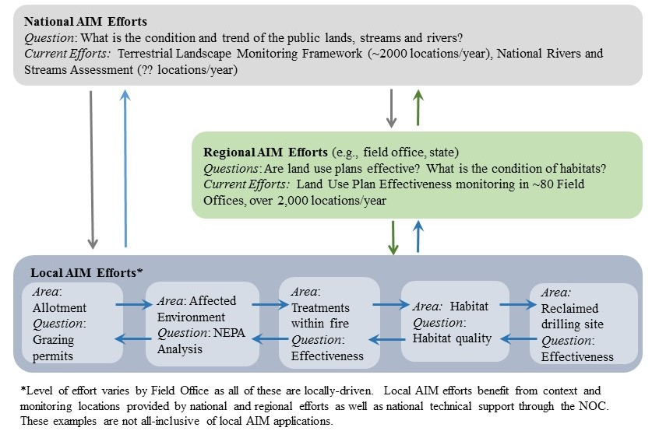
Scales of AIM Implementation
National
Landscape Monitoring Framework (LMF)
Regional
E.g., state assessments
Local
AIM projects with BLM offices
Notes:
What does it mean to have a monitoring program that addresses multi-scale information needs?
At the national level, BLM needs to know the condition of lands (the question OMB asked us and FLPMA requires). That’s addressed through national level monitoring efforts including LMF (see next slide)
At the regional level, BLM managers have questions like, are land use plans effective? what is the condition of habitats? The way that we answer those is through Land Use Plan-scale monitoring efforts that are based out of a field office or district.
At the local level, BLM managers have questions about all kinds of different uses for decision-making and NEPA analysis -- grazing, land treatment effectiveness, reclamation effectiveness. Many of the field office level monitoring efforts also include local monitoring efforts (intensifications or targeted points.
Through the AIM approach (esp. standard methods and statistically valid designs), national data can inform local questions, and local data can also inform national questions. Scalable sampling approaches with data that can be used to calculate the same indicators.

Slide 21
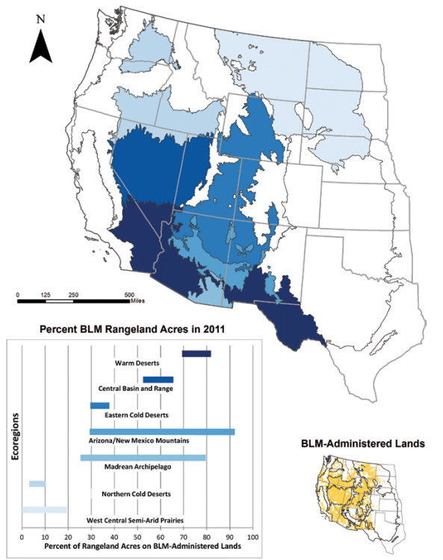
BLM Landscape Monitoring Framework
Percent of BLM Rangelands with Canopy Gaps > 2m
Extension of NRCS Natural Resource Inventory (NRI) onto BLM Lands
Separate sample frame so data can be shared
Started in 2011
~9,000 sites visited so far
Target sample of 10,000 sites
Source: 2011 BLM Rangeland Resource Assessment (in press)
Notes:
Who here has heard of the NRI or LMF? *PRESENTER: If anyone has heard of NRI or LMF, you can ask them to explain it.
The LMF uses the core methods and is collecting the same data as local AIM projects just at a really large scale.
PRESENTER: The map is a quick example, don’t get bogged down in it
This map is an example of using LMF data to, for different thematic areas in the US, calculate what percent of BLM rangelands’ area is made up of gaps greater than 2 m long in vegetation canopy. Darker is more of the landscape being made of gaps. The smaller figure shows the distributions

Slide 22
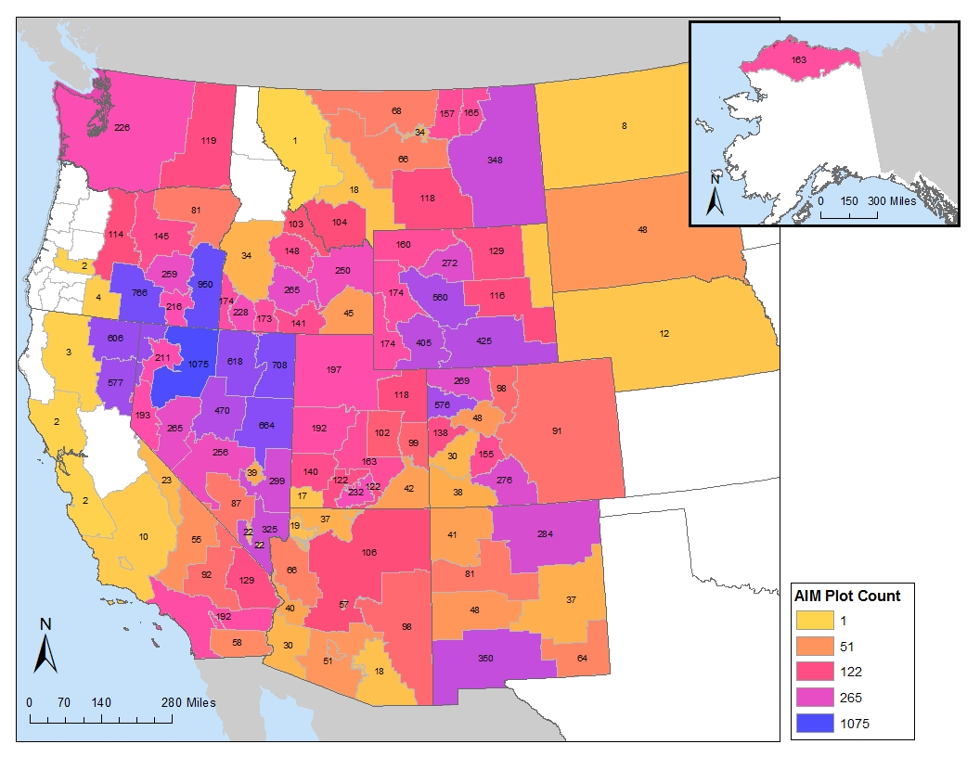
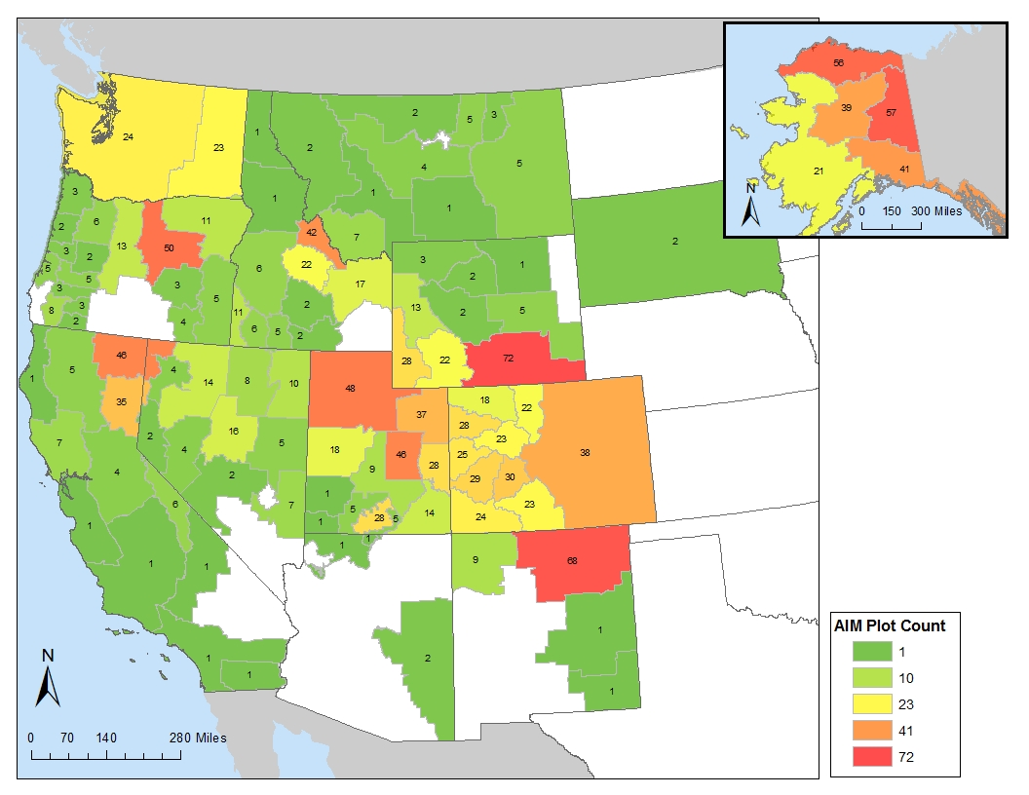
BLM Field Office Monitoring Projects
Designed to support local and regional management/ monitoring objectives
Locally-based field crews (depending)
Rotating panel designs – annual sampling
Core + supplemental methods
Design/Analysis support
Terrestrial Data February 2019
Aquatic Data February 2019
Notes:
The majority of AIM crews work on regional/field office monitoring projects. These happen at the scale of groups of allotments or treatments up to the size of BLM districts.
The BLM NOC and their partners at the USDA ARS Jornada Experimental Range provide support for sample design and data anlaysis

Slide 23
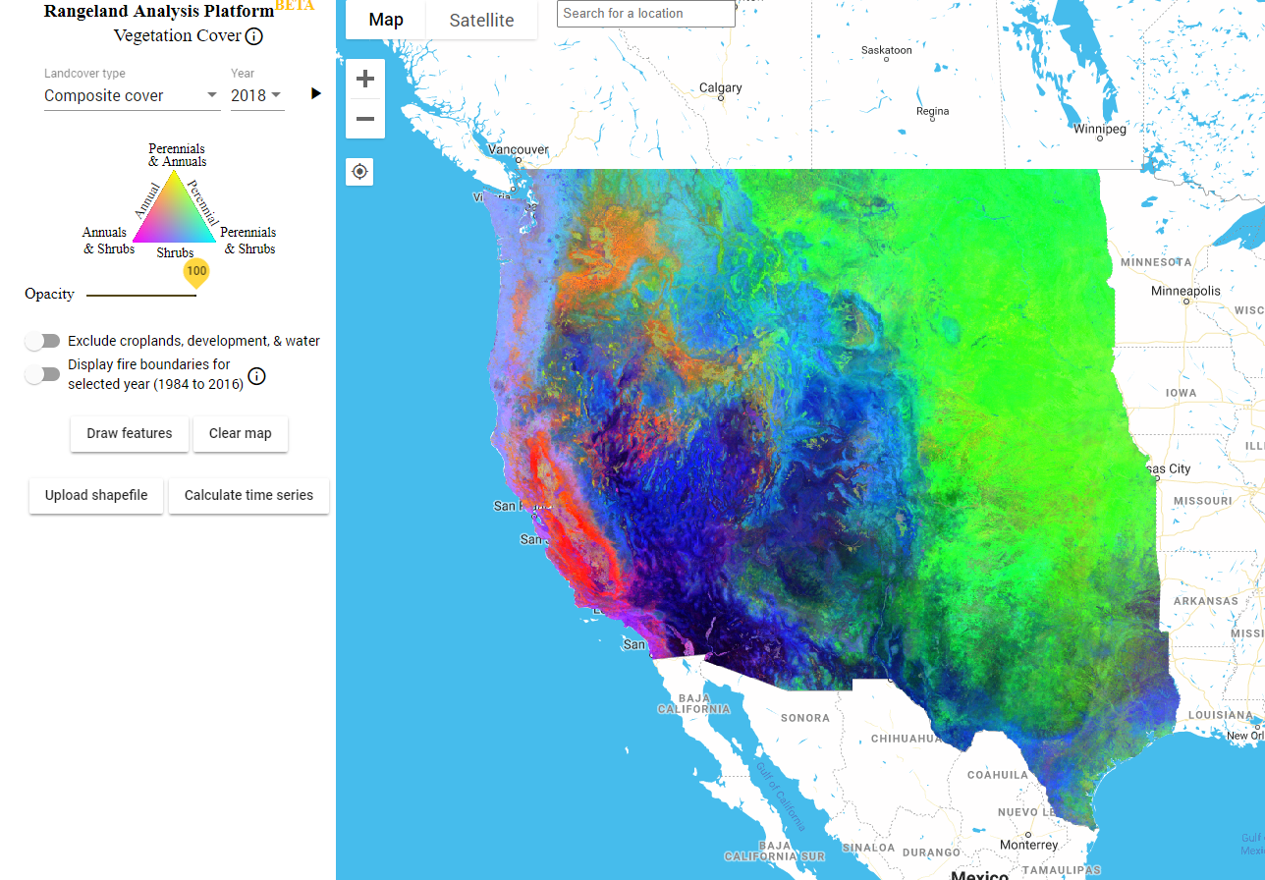
Integration with Remote Sensing
Shrub Cover
Sagebrush Cover
Big Sagebrush Cover
Wyoming Sagebrush Cover
Herbaceous Cover
Shrub Height
Bare Ground
Litter Cover
Map Products:
Notes:
The third component of AIM is integration with remote sensing. This is coming to the surface more an more as we share AIM data and various scientists are using it to answer questions. Some examples of this are mapping projects that show shrub cover and more specifically, sagebrush cover which is very useful for wildlife biologists interested in wildlife habitat. These maps are created using information collected in shrub height, and the cover/bare ground/ litter methods. Rangeland Analysis Platform (RAP) Tool and Homer Grass/Shrub product -- both are fractional cover products.

Slide 24
Electronic data capture and management
Enterprise
databases
BLM National Operations Center
Notes:
The fourth principle in AIM is electronic data capture and management. In the past, data lived entirely on paper and had a tendency to get filed away, never to be used again or to succumb to things like rot/fire/flood, reorganization, or loss of institutional awareness as people left or retired
Managing data electronically means that it’s backed up and also that there’s access through the internet to the BLM NOC Terrestrial and Aquatic AIM databases (TerrADat and AquADat). An AIM crew’s part in this is to ensure that all data is collected in DIMA which we will get into later in the week.

Slide 25
[INSERT 1 OR 2 SLIDES DEMONSTRATING LOCAL AIM DATA USES]

Slide 26
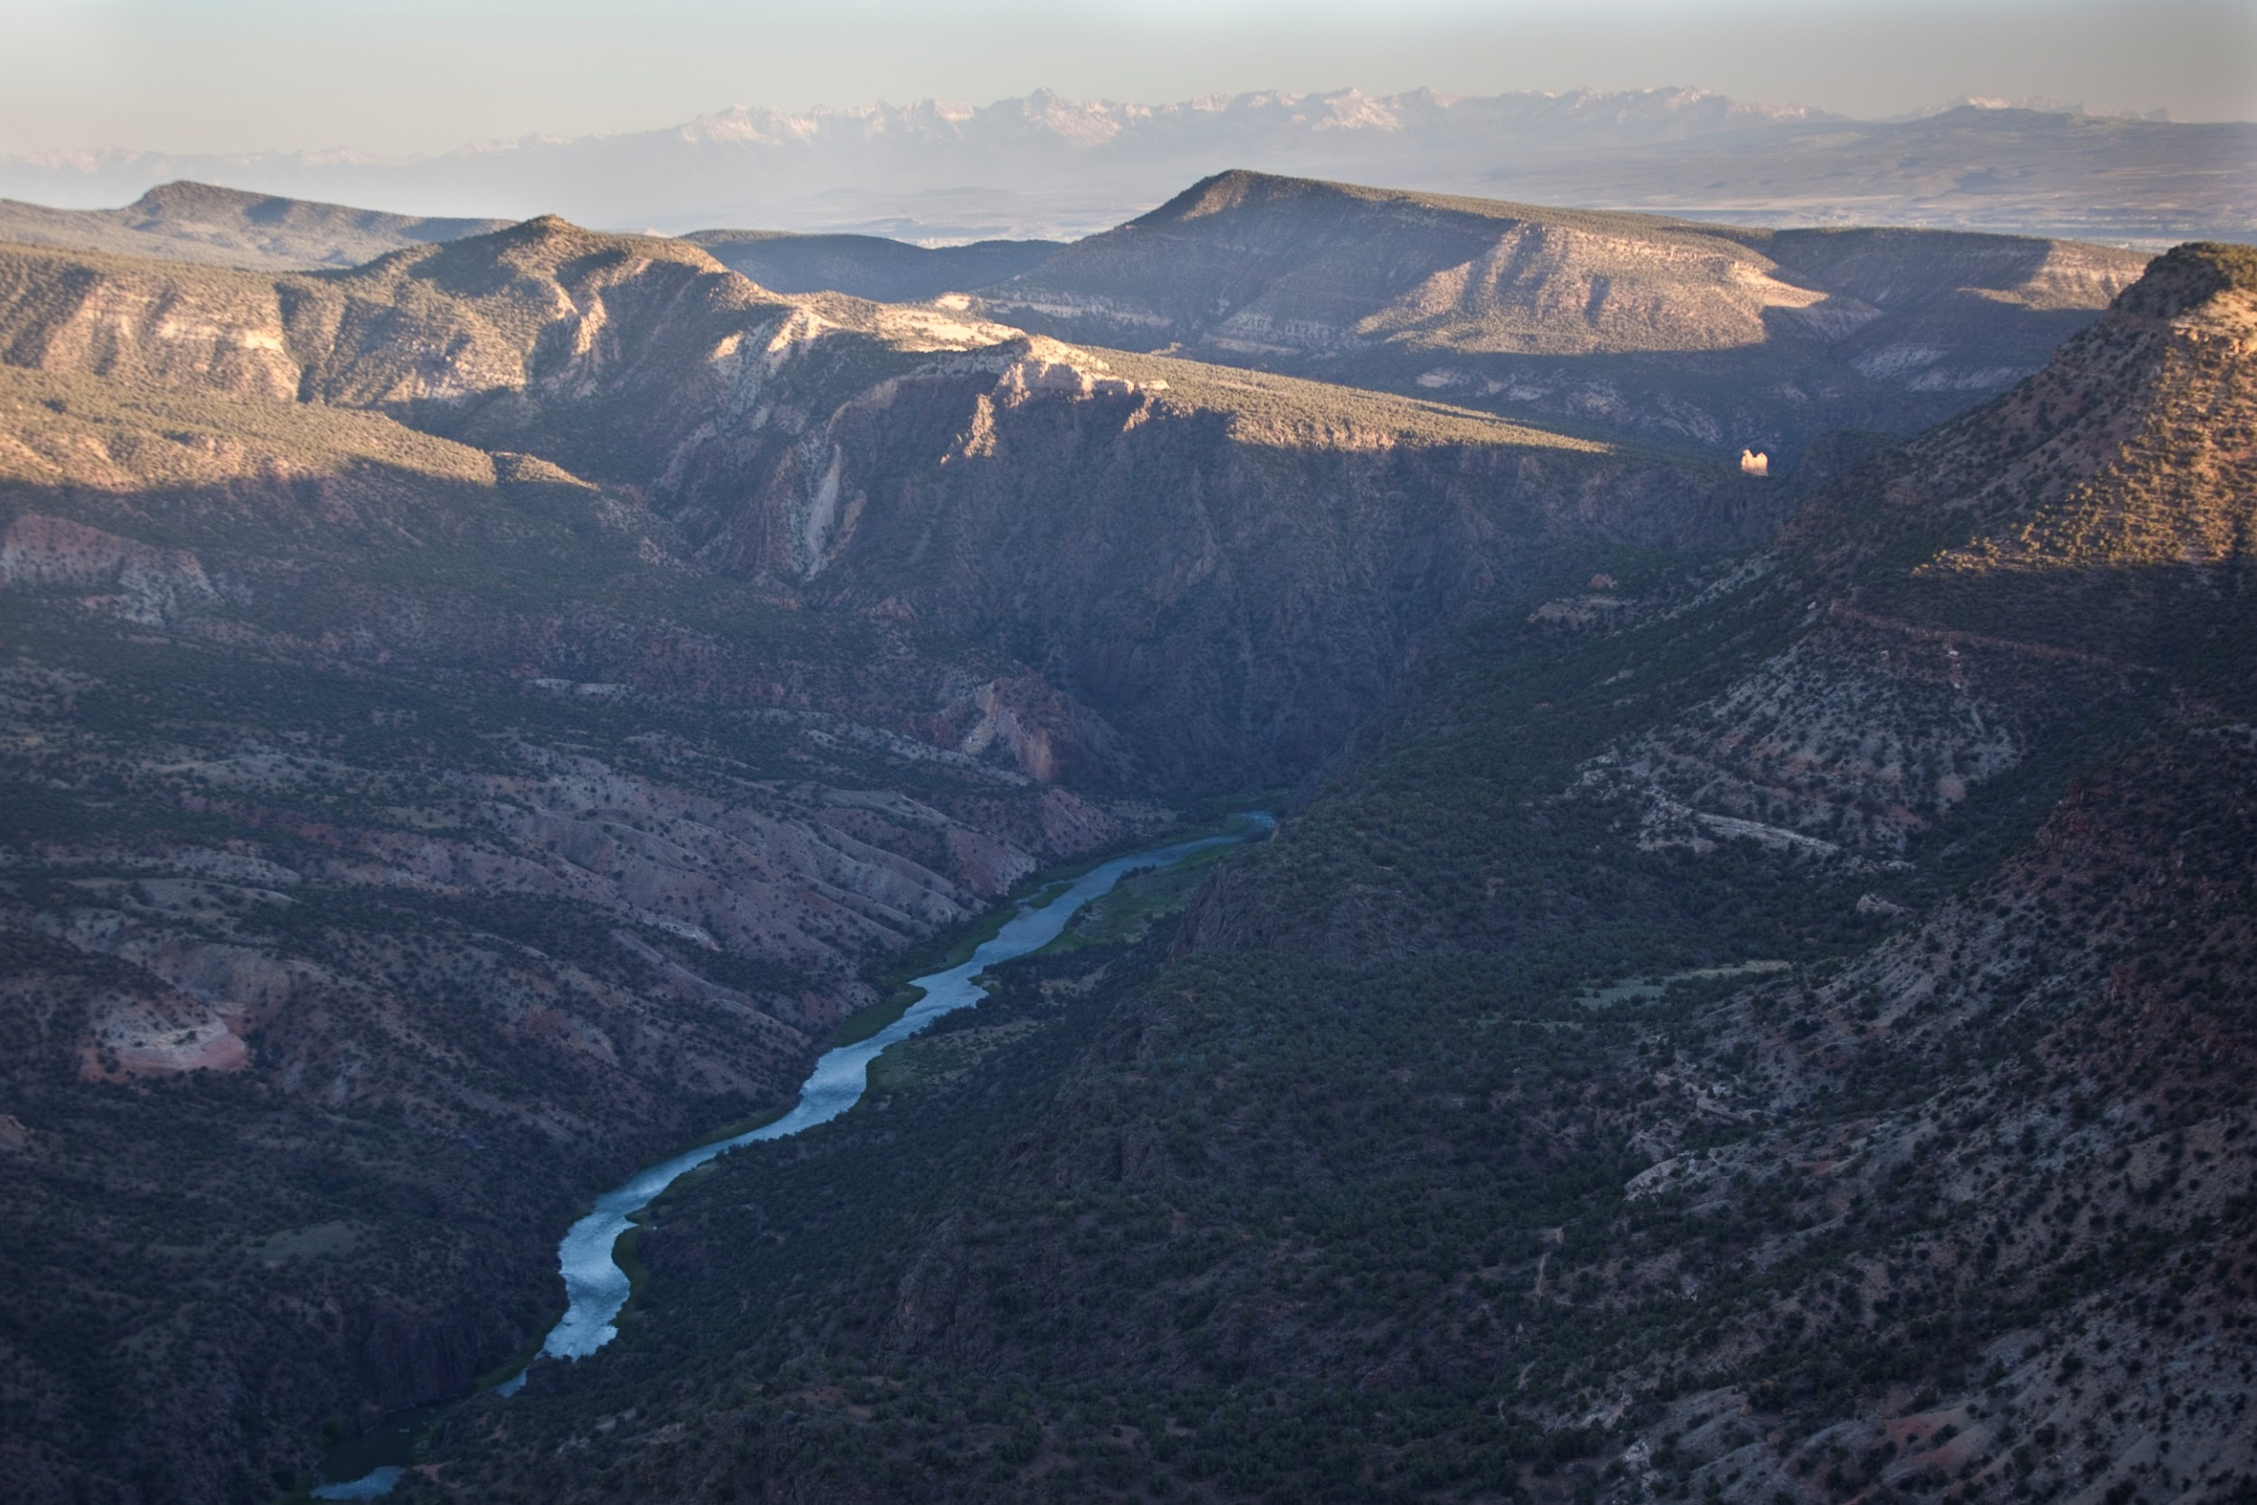
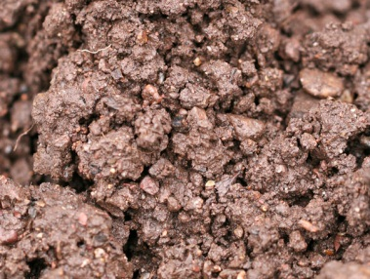
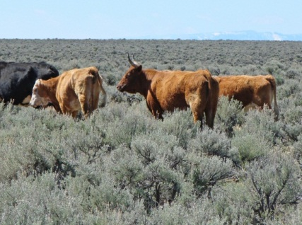
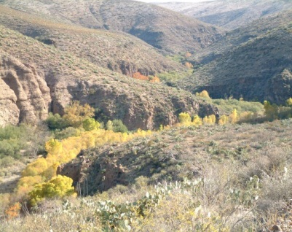
Structured Implementation for Adaptive Management
Objectives based on BLM Land Health Fundamentals
PLAN
Monitoring
ADJUST
LEARN
DO
Notes:
The final principle of AIM is structured implementation -- being thoughtful about your approach to monitoring such that it addresses your objectives for the land. The national AIM team and state leads play a vital role in supporting this process. Structured implementation is important in keeping the program consistent across states and regions. The Arctic office in Alaska is collecting and storing AIM data the same way as the Las Cruces, NM office.
Structured implementation keeps the adaptive management process going through tool development, training, planning and analysis.

Slide 27
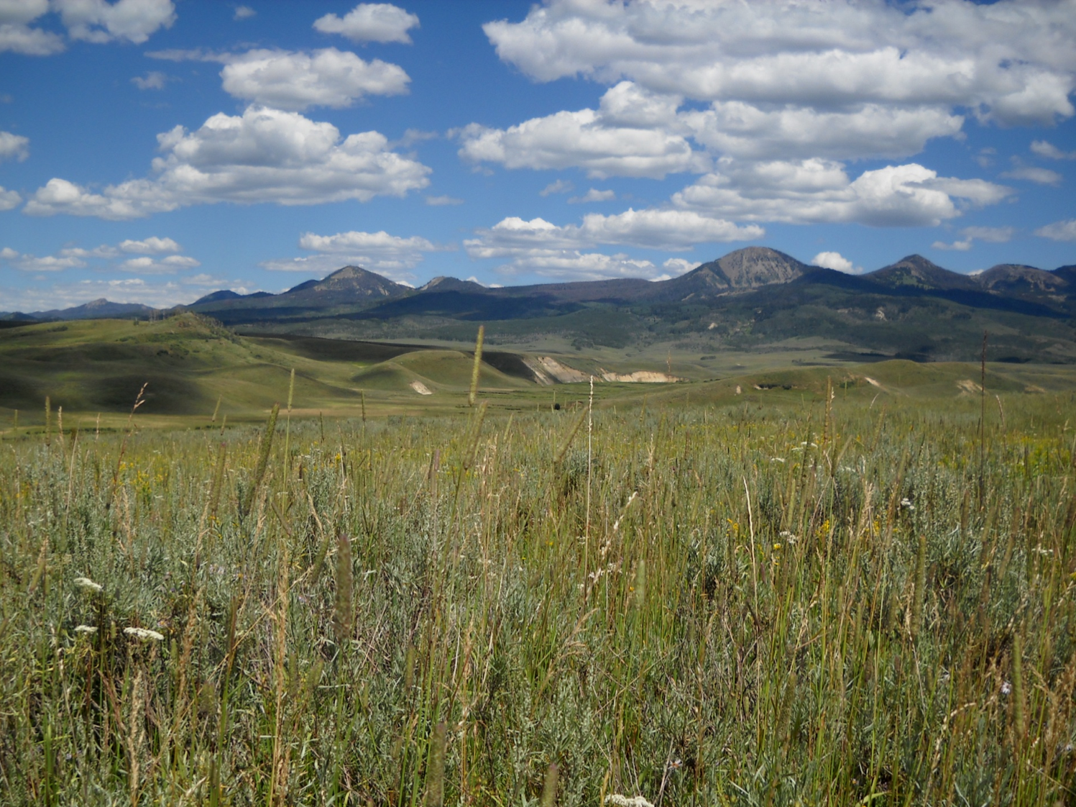
Information for Informed Decisions
Thank you
Notes:
In conclusion, AIM is all about collecting high-quality information so that BLM can make well-informed land management decisions -- and y’all play a crucial role in that. Thank you.

