Slide 1
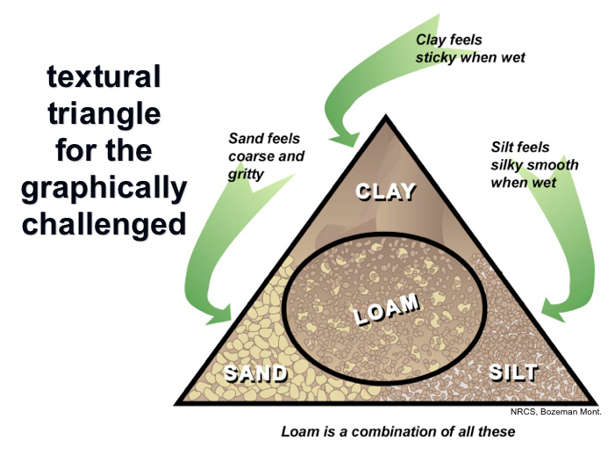
Soil Texture
Percent soil particles of different sizes (sand, silt, and clay)
Affects all soil processes
Estimate texture by feel
Notes:
Soil texture refers to the percent soil particles of different sizes. The three major size classes are sand, silt, and clay. Sand is the largest at 0.05 to 2 millimeters; silt is intermediate size at 0.002 to 0.05 millimeters; and clay is the smallest at less than 0.002 millimeters. The amounts of sand, silt, and clay can be used to assign texture classes to soils according to the soil texture triangle pictured here.
Texture affects all soil processes and is one of the most important soil properties. For example, we have already discussed how water dynamics can differ in a loamy or coarser-textured soil versus a clayey or finer-textured soil.
In the Plot Characterization protocol from the Monitoring Manual for Grassland, Shrubland, and Savannah Ecosystems, texture is estimated for each horizon using the texture by feel method. A spray bottle is used to wet a soil sample and the sample is manipulated by hand in various ways to determine the broad texture classes pictured in the texture triangle. Detailed information can be found in the protocol.
While this is a quick and reliable method with experience, it is a good idea to practice with soils of known texture each season before going out in the field. You can also perform quality control by determining texture in the lab using the hydrometer method for a subset of samples.
Equipment needed: spray bottle, your hand, & soil triangle/chart
Image source: NRCS

Slide 2
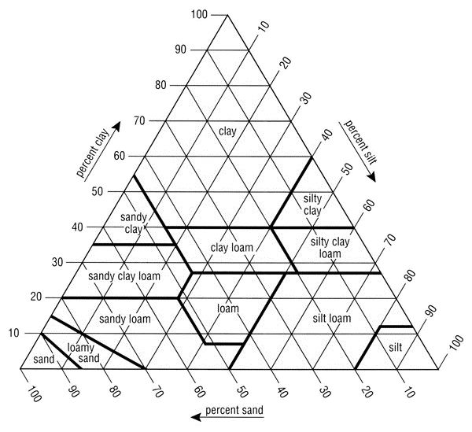
Reading a Soil Texture Triangle
Clay is read horizontally
Silt is read from right to the bottom
Sand is read from the bottom to the left
Notes:
Animation on this slide!!!!
Soil texture triangle can be found on page 62 of the Monitoring Manual

Slide 3
Reading a Soil Texture Triangle
Clay is read horizontally
Silt is read from right to the bottom
Sand is read from the bottom to the left
Notes:
Animation on this slide!!!!
Soil texture triangle can be found on page 62 of the Monitoring Manual

Slide 4
Example
Now You Try!
Notes:
Animation on this slide!!!!

Slide 5
Example
Now You Try!
Clay: 25%
Silt: 30%
Sand: 45%
Total=100%
Notes:
Animation on this slide!!!!

Slide 6
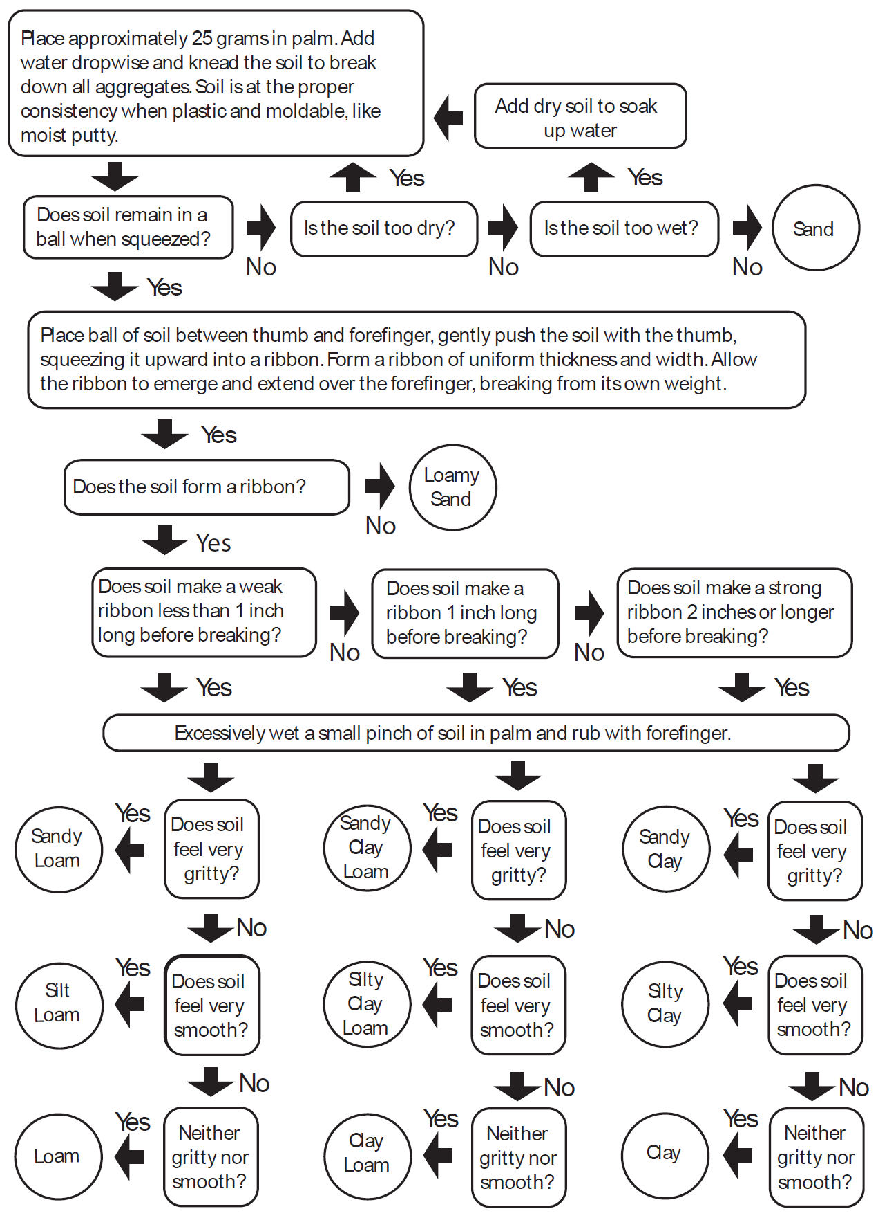
Soil Texture Flowchart
Notes:
Found on Page 61 of the Monitoring Manual
Call out texture chart since we’ll be calibrating ourselves with texturing soils after this presentation.

Slide 7
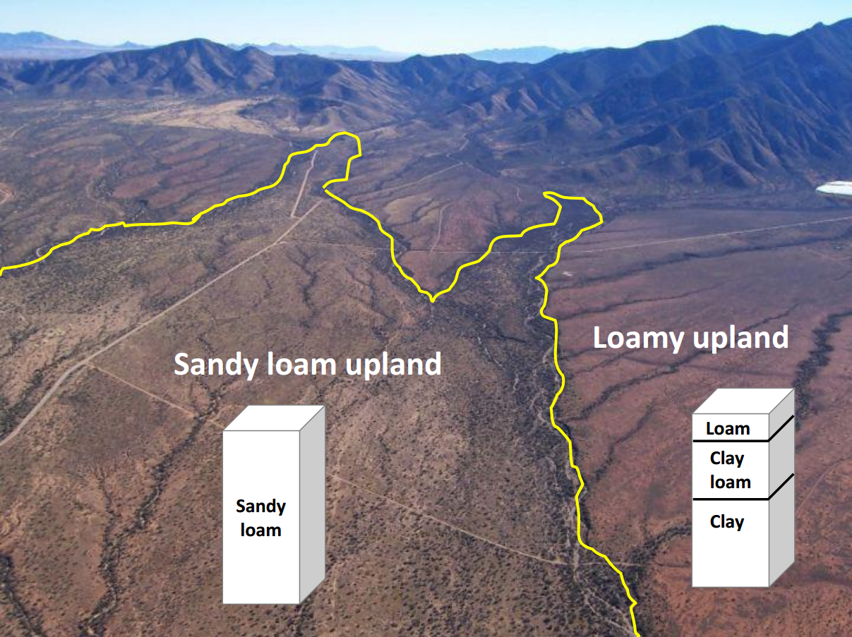
Ecological sites: why botanists and land managers care about soil.

Slide 8
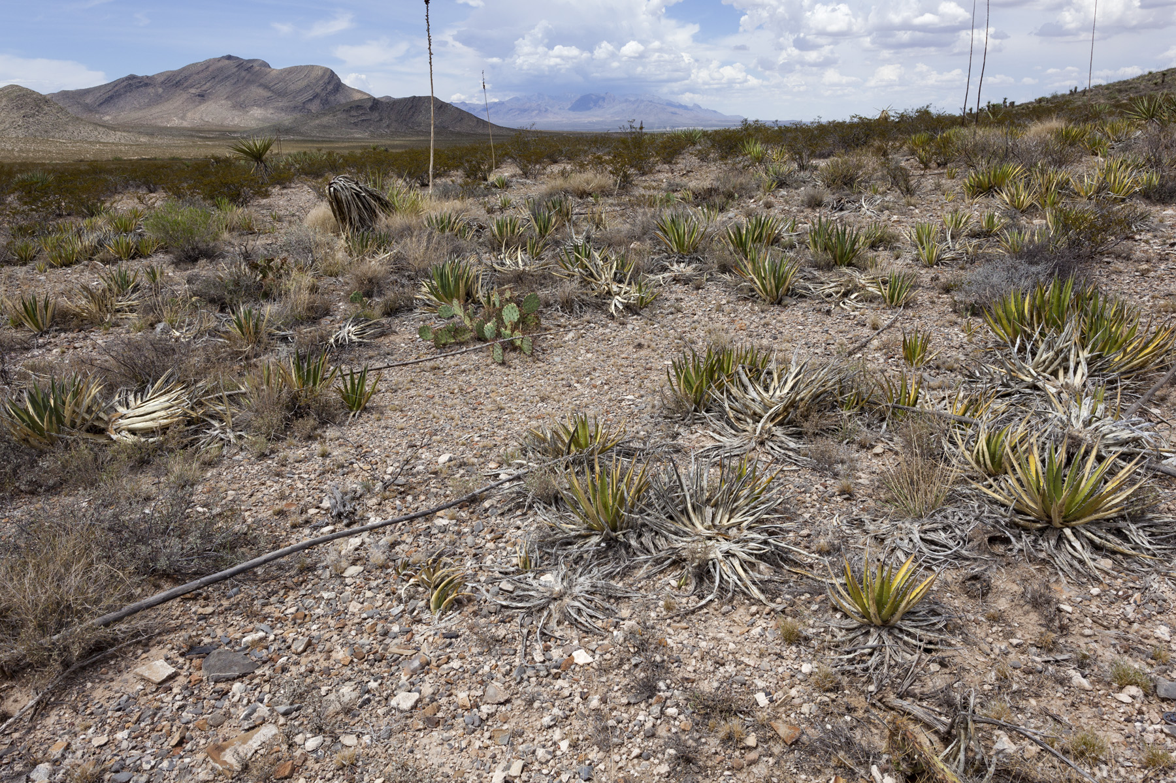
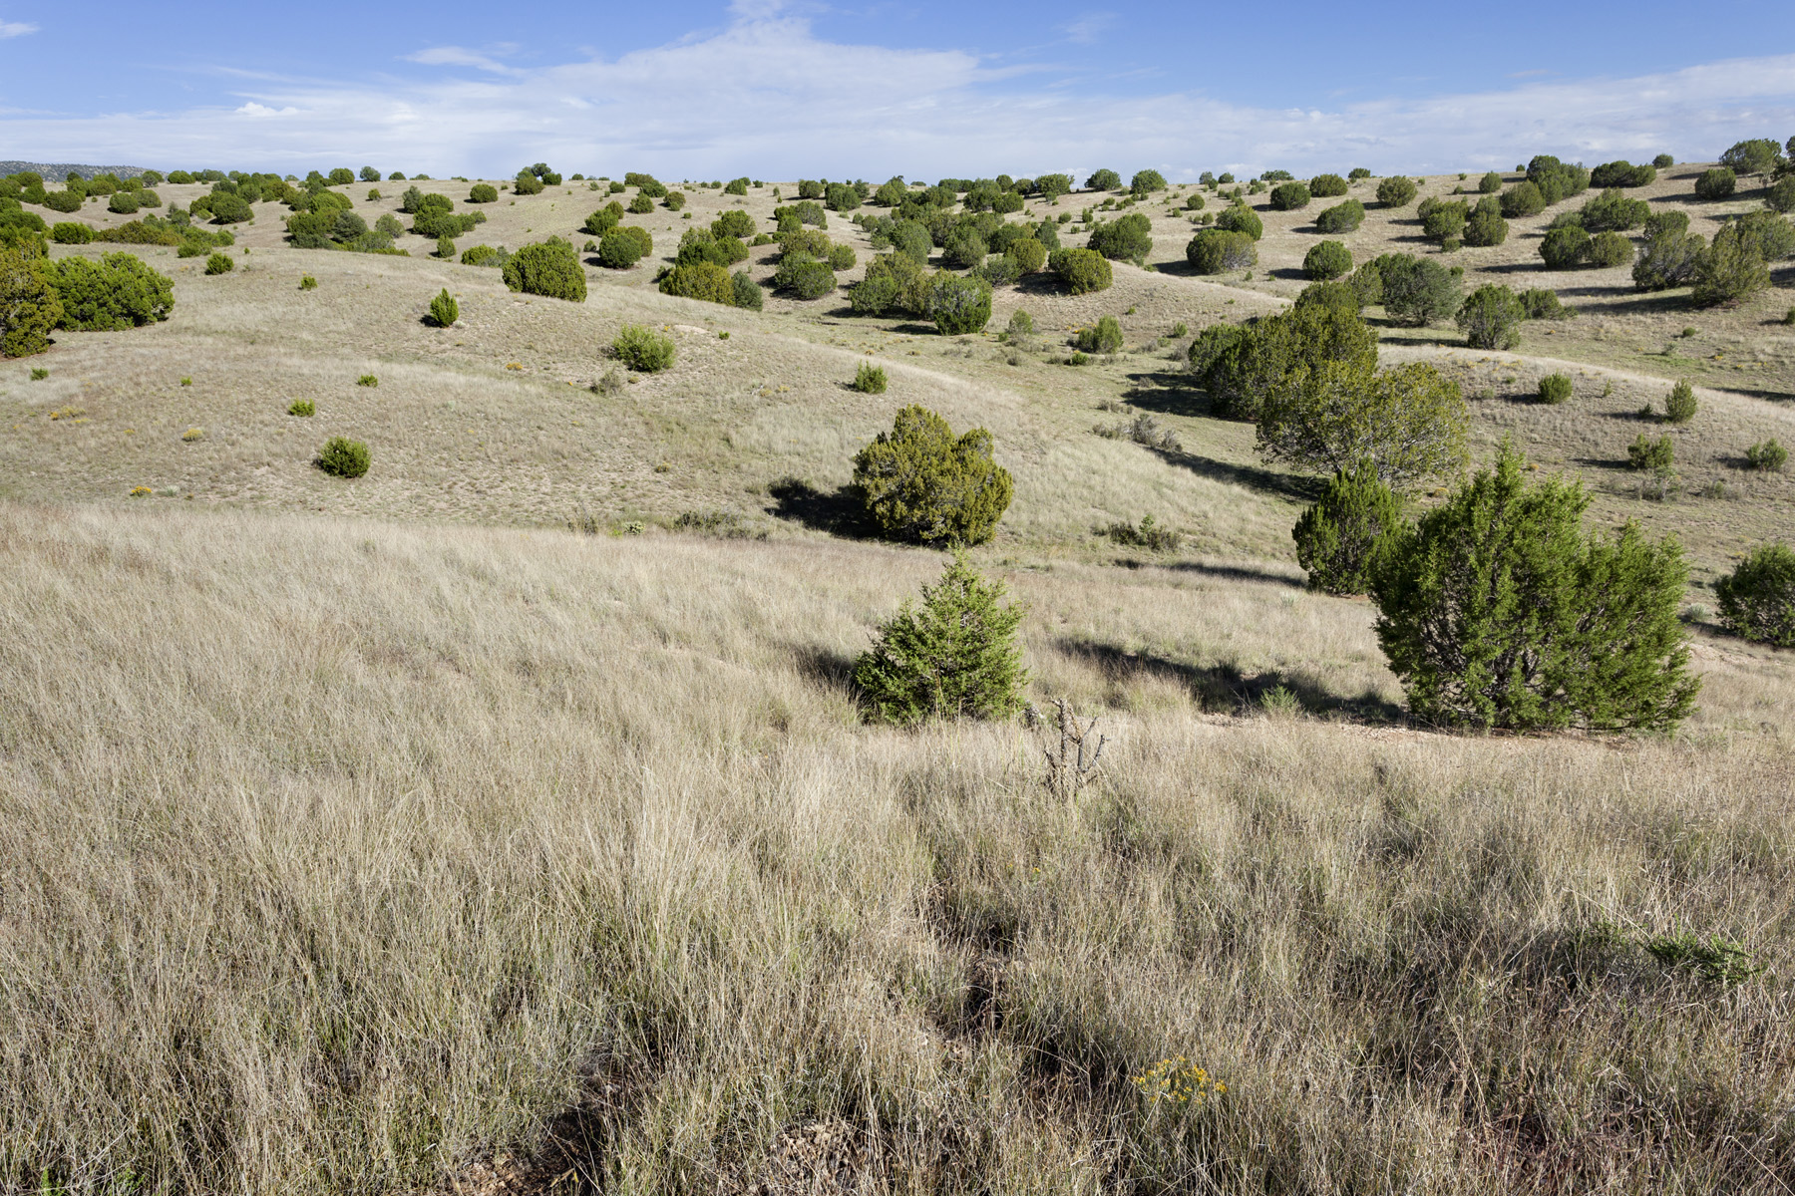
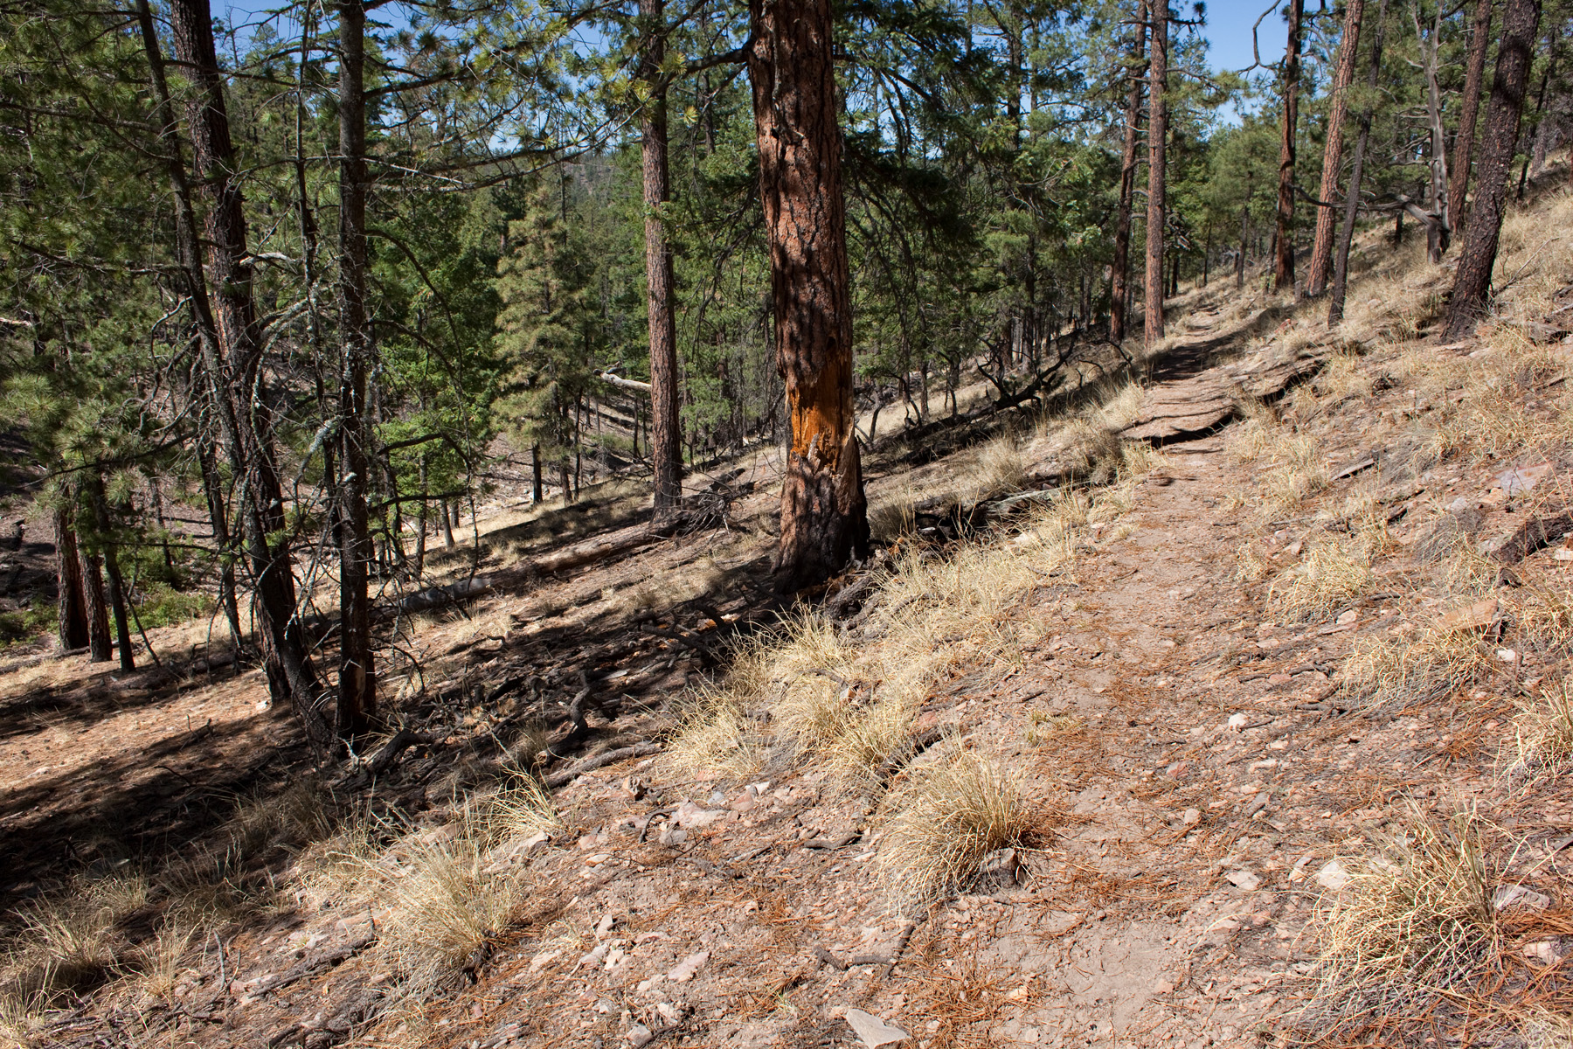
Vegetation varies with:
temperature
precipitation

Slide 9
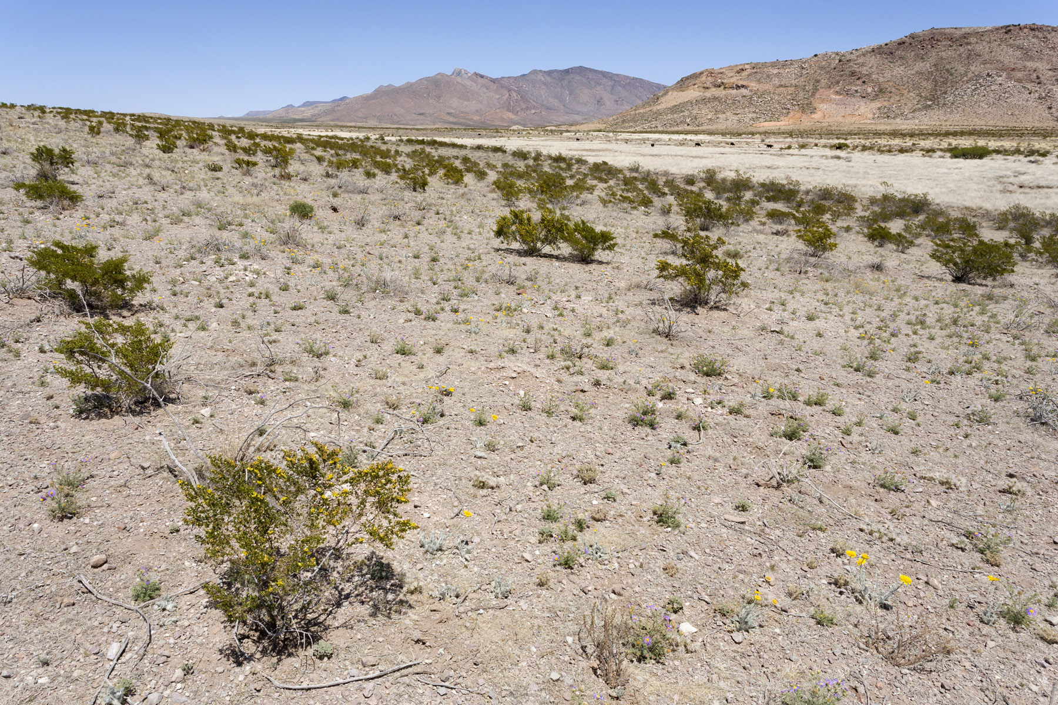
Vegetation varies with:
temperature
precipitation
geomorphology

Slide 10
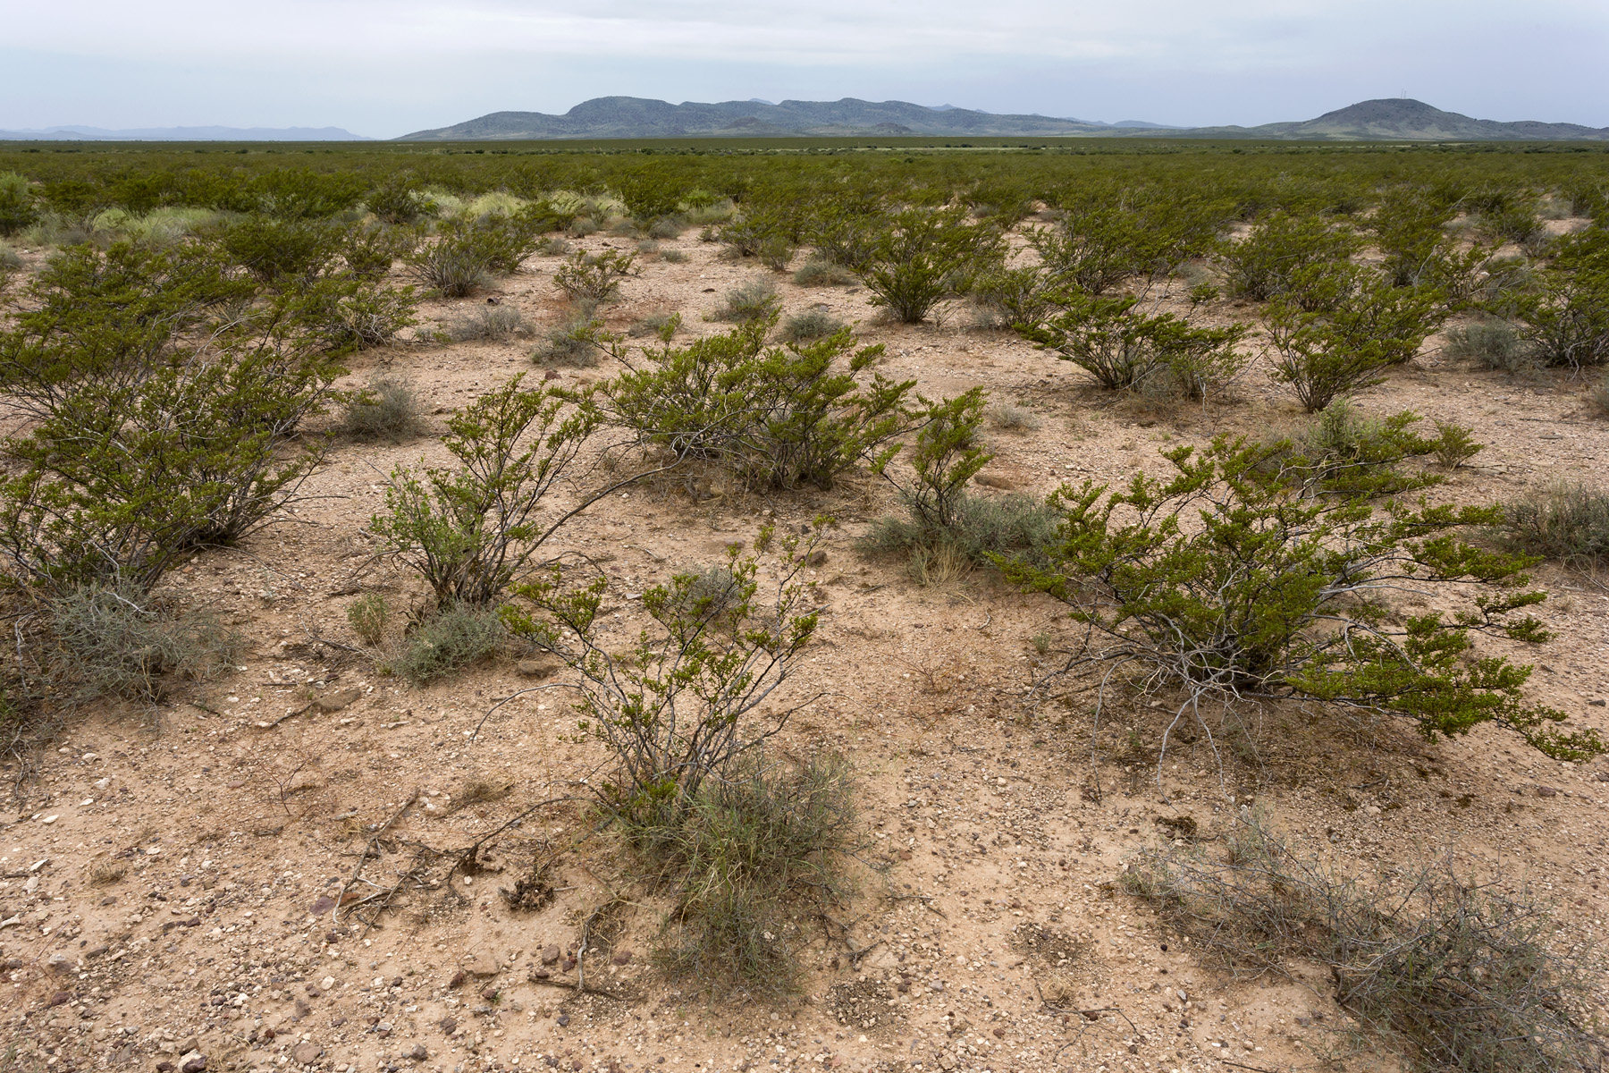
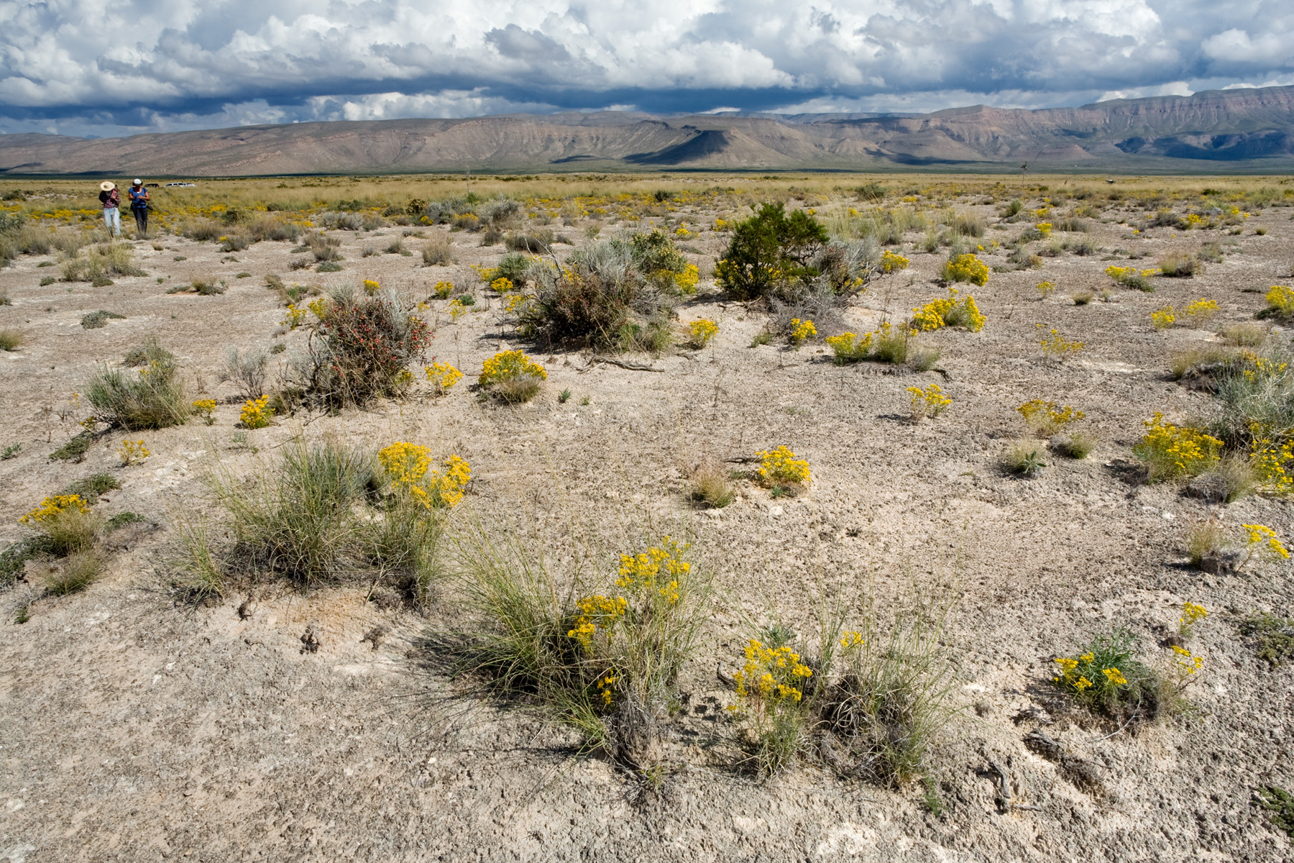
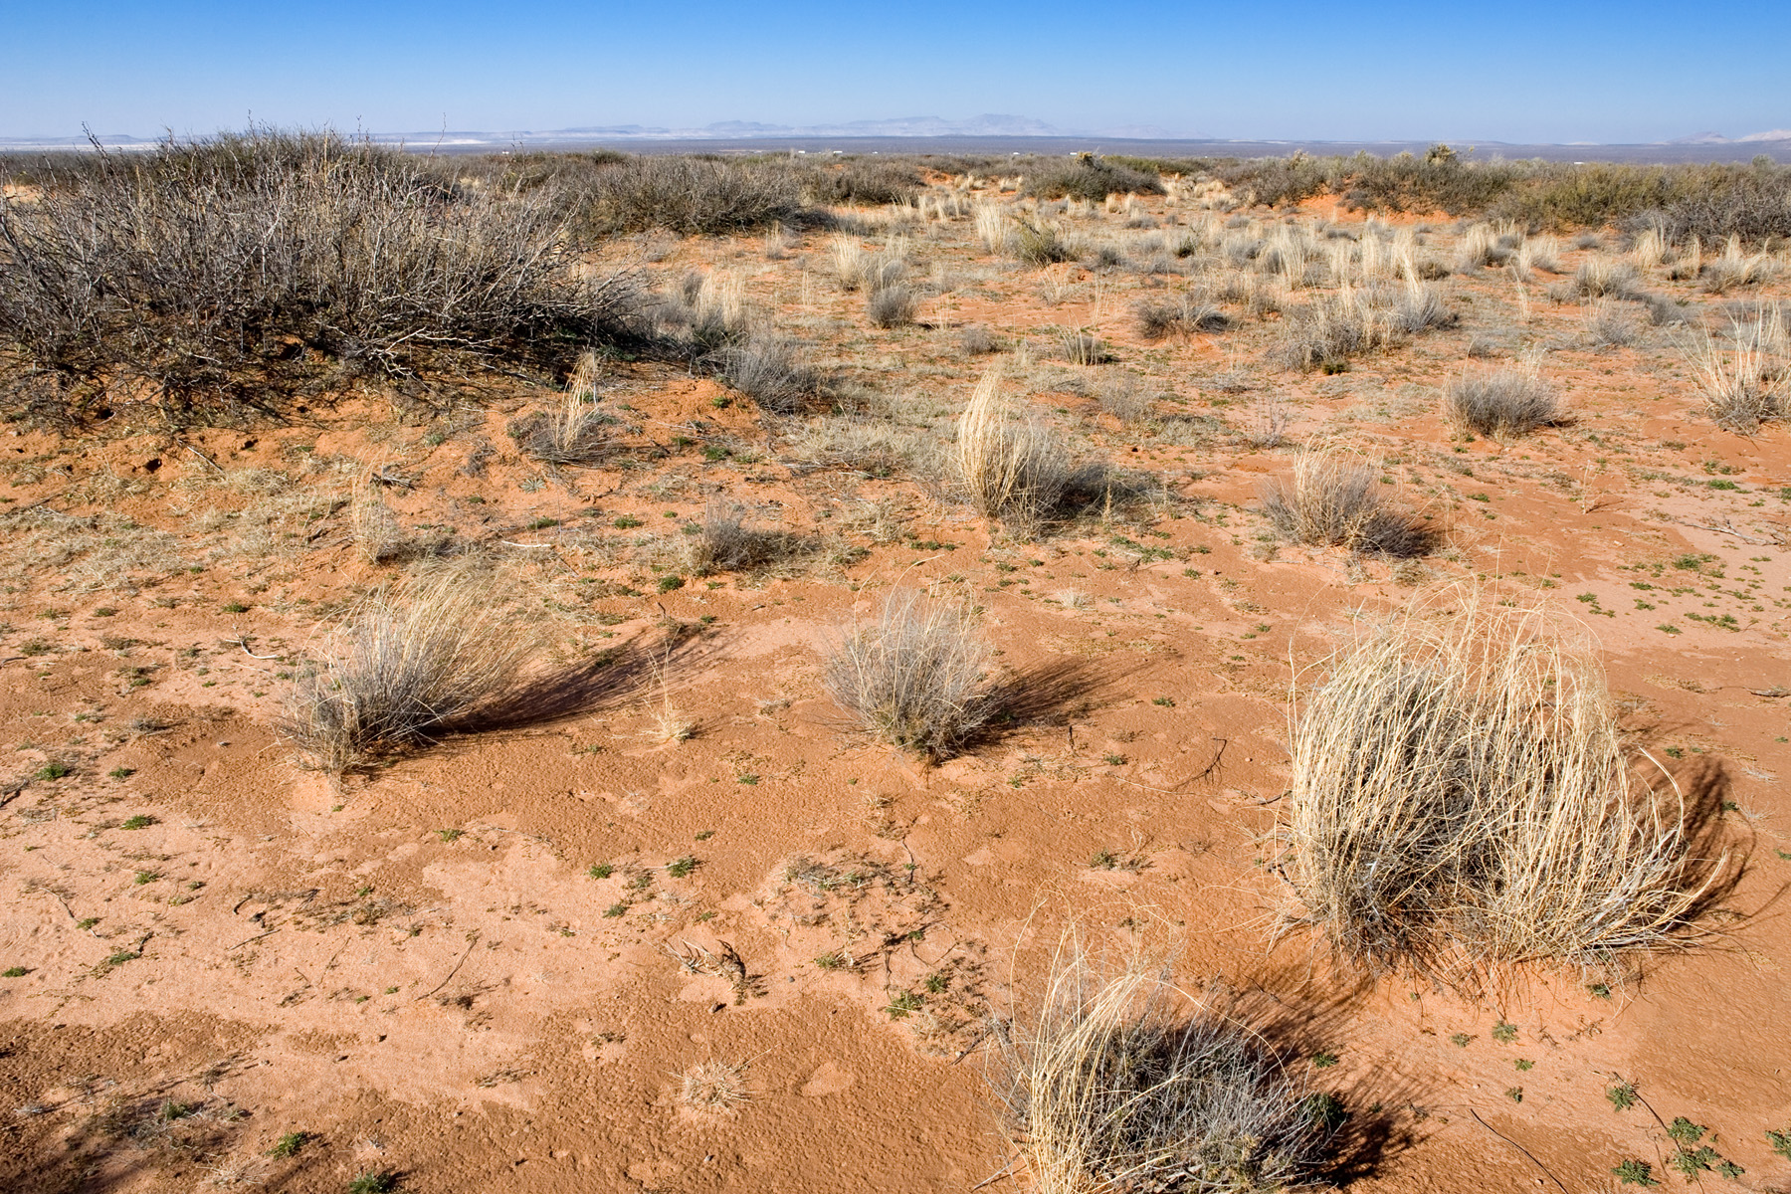
Vegetation varies with:
temperature
precipitation
geomorphology
soils

Slide 11
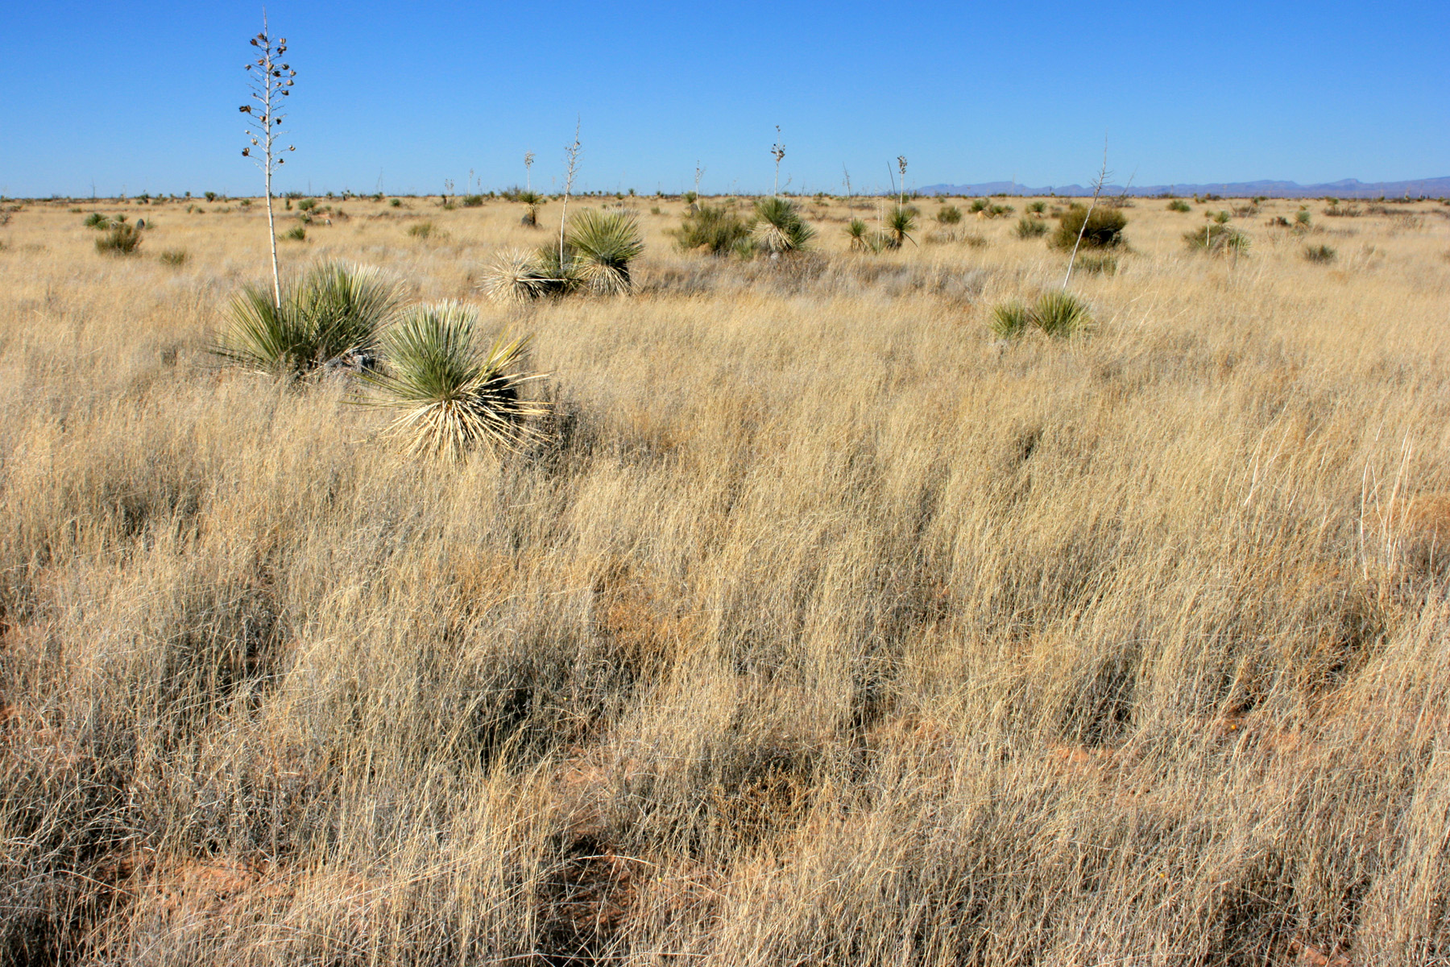
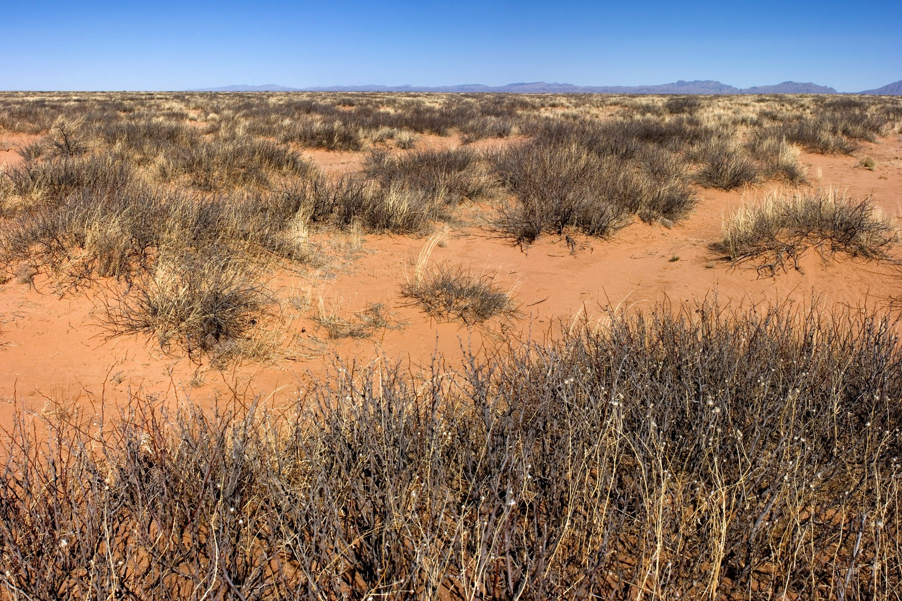
Vegetation varies with:
temperature
precipitation
geomorphology
soils
disturbance:
  grazing
  fire
  roads
  recreation
  oil / gas
  wildlife
  drought

Slide 12
Ecological site:
“… a distinctive kind of land with specific soil and physical characteristics that differ from other kinds of land in its ability to produce a distinctive kind and amount of vegetation and its ability to respond similarly to management actions and natural disturbances.”
Interagency Ecological Site Handbook for Rangelands

Slide 13
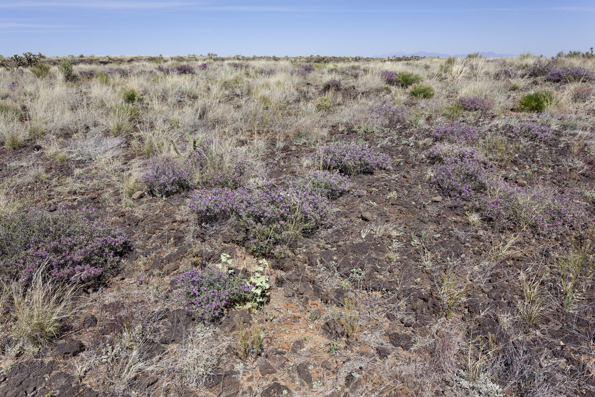
Ecological sites
classify the land to account for variation in:
  temperature
  precipitation
  geomorphology
  soils

Slide 14
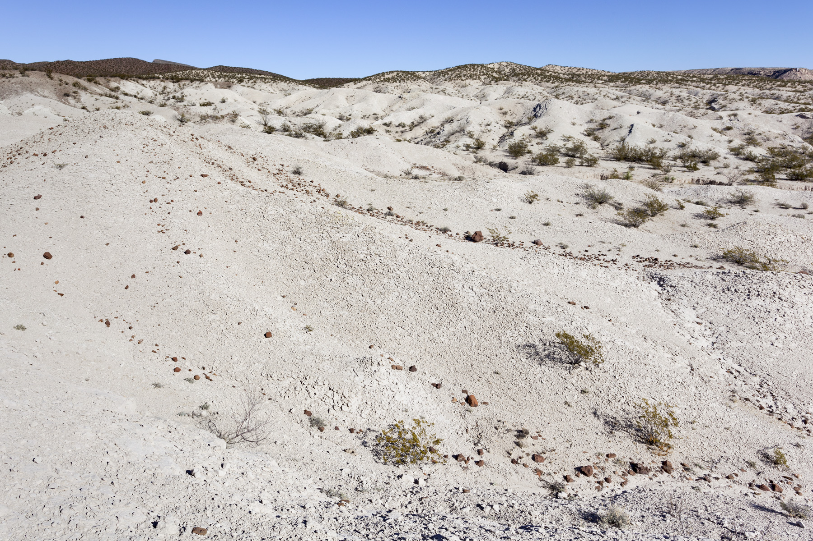
Ecological sites
so that residual variation is due to disturbance:
  grazing
  fire
  roads
  recreation
  oil / gas
  wildlife
  drought
MANAGEMENT

Slide 15
Ecological sites
As land managers, we want: serenity to accept the things we cannot change,
courage to change the things we can, and wisdom to know the difference.
Ecological sites help with the last part.

Slide 16
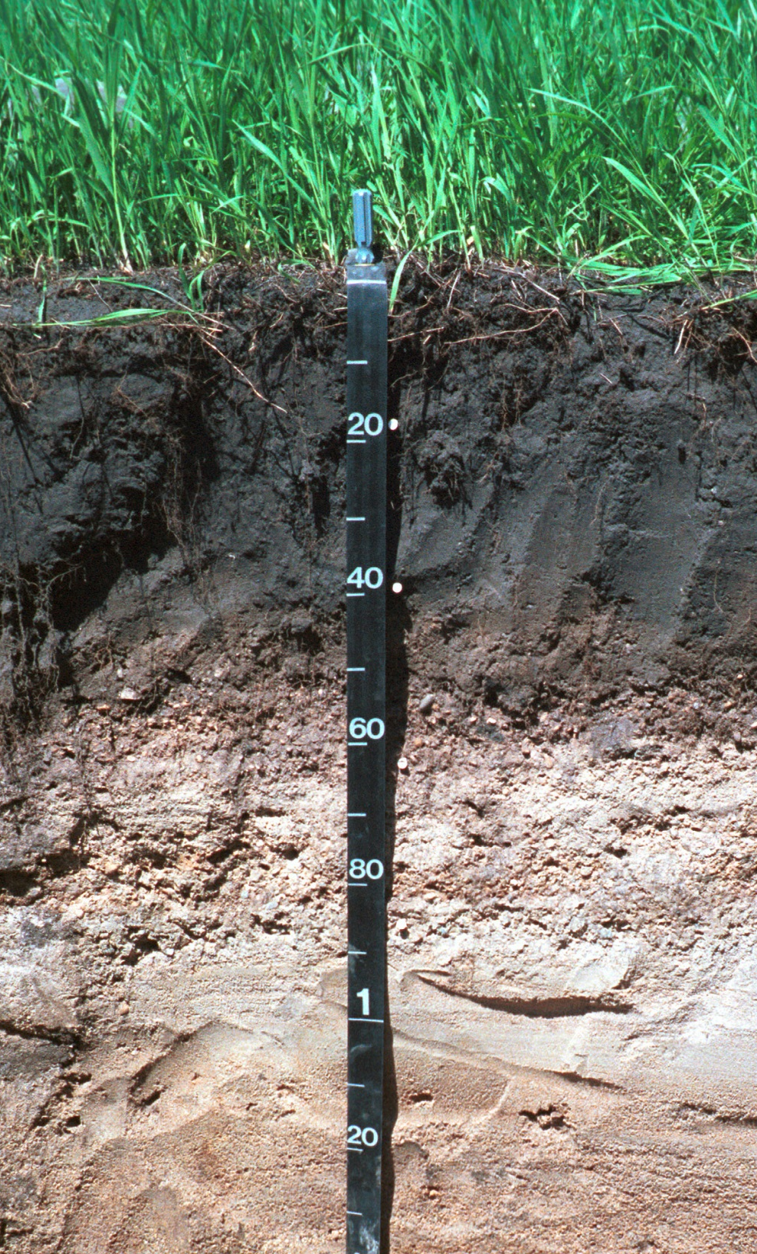
Introduction to Plot Characterization
Including Collecting Soil Info and Determining Ecological Sites
Terrestrial Core Methods Training
February 26-March 1, 2019
Notes:
To the presenter: feel free to use this Tips & Tricks document on Google Drive https://docs.google.com/document/d/1t0o-wTmO-0rUY4DImmxhmsFc0poWE0zOdgwPGFxEjSI/edit?usp=sharing
It gives good ideas about how to present the plot characterization information while out in the field
Have ready for the presentation:
Field bag with all soils equipment so you can display what equipment is needed for each soil property when you get to those slides
Homework that should’ve been done:
Webinars: Ecological Concepts & Stratification and Introduction to Plot Characterization
Reading: Monitoring Manual for Grasslands, Shrublands, and Savanna Ecosystems (Vol. I)
Additional: NRCS Ecological Site Description Webinar, Intro to Ecological Sites video, How to Identify Soil Horizons in the field

Slide 17
Objectives
1) Fill out the Plot Characterization data sheet
2)Identify landscape positions
3) List best practices for digging a soil pit
4) Describe soil properties collected on AIM plots
  Soil Coarse Fragment Content
  Soil Texture
  Percent Clay
  Effervescence
  Soil Structure
  Soil Color
5) Describe the process of ecological site identification
Notes:
By the end of this presentation, you should be able to…

Slide 18
Plot Characterization Data Sheet
Notes:
Have attendees look at pages 16 through 20 in their Monitoring Manuals. This screen shot is the top half of the Plot Characterization datasheet (bottom half is the soils info)
Explain we’ll be going over this part of the datasheet in more detail in the field and going through each of the steps (i.e., slope, aspect, landscape position, slope shape, etc.)

Slide 19
Plot Characterization Data Sheet
Notes:
This is page 20 in the Monitoring Manual
There can be a lot of confusion in regards to landscape position – it’s where most crews have difficulty. It’s easier to see differences in landscape position when physically out in the field rather than just looking this figure
Common mistakes are if you’re on a terrace vs. flow/low rolling plain – lots of times if you’re confused, you can rely on the soils to tell you where you might be on a landscape

Slide 20
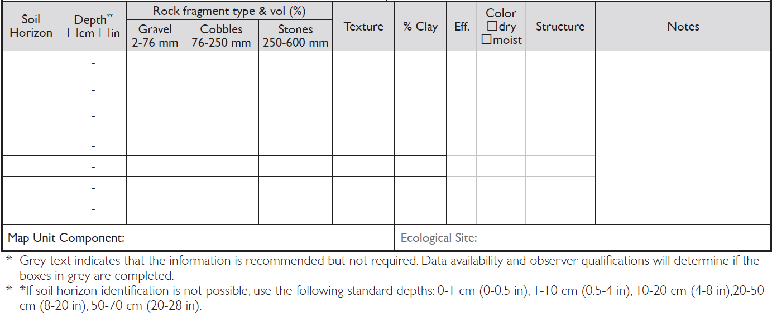
Soil Profile Data Sheet
Part of Plot Characterization Data Sheet
Notes:
The soil profile data sheet is part of the bottom half of the plot characterization data sheet – this is what it looks like. We do have effervescence, color and structure down on the data sheet in case you are able to collect those properties.
We’ll be filling out the entire plot characterization datasheet this afternoon in the field.
First we’ll go over each of the soil properties we collect on all AIM plots

Slide 21
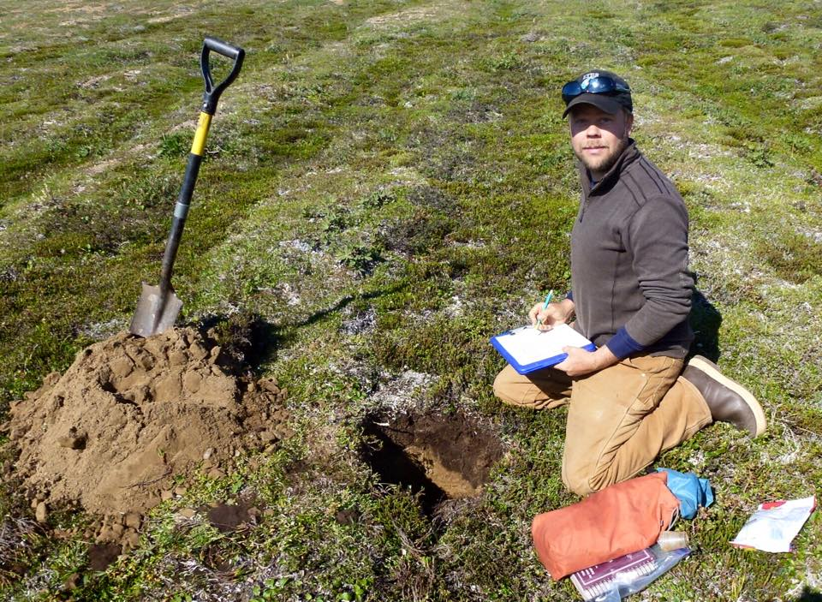
What goes in to digging a soil pit?
Notes:
Animation no longer on this slide!!!
It’s great having a soil scientist to help the field crews. Luckily, we’ll be joined by a soil scientist this afternoon to help us work through characterizing our AIM plots. If you have the personnel, it’s nice if a soil scientist can go out into the field with a crew.

Slide 22
Digging a Soil Pit
Be active, not passive…and stay motivated!
Select a representative, undisturbed location (avoid water flow patterns, ant hills, burrows, etc.)
Dig to 70+ cm, rectangular shape
Pay attention to changes in properties as you dig
Cut a clean profile face: DO NOT STEP ON PIT FACE!!
Use soil knife and brush to clean pit face
Notes:
Describe slide

Slide 23
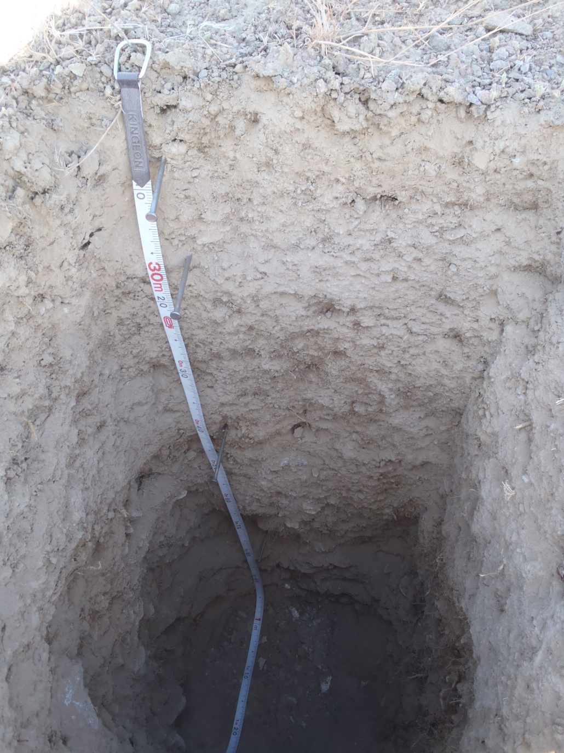
Soil Profile Photos – The Good
Soil surface is visible and sharp
Pit face is square and clean
Photo is taken in all shade so horizons are more clear and visible
Roots are trimmed
Tape is flat and on the left side
Notes:
You’ll hear “all sun” or “all shade”. The gist is... You want to be able to see the face, so you want lighting to be consistent across the whole thing.

Slide 24
What soil properties does AIM require you to measure?
Texture
Coarse Fragments
Color
Color
Percent Clay
Effervescence
Effervescence
Structure
Structure
Bulk Density
Bulk Density
Soil Horizon Depth
Notes:
There’s animation on this slide – Color, Structure, and Effervescence turn green (since they are contingent soil properties – you collect them if you can) and Bulk Density is greyed out since we don’t collect it.
It’s important to note that Color, Structure, and Effervescence are not required but if you have access to a Munsell Color Book or feel comfortable enough collecting structure data, we ask that you PLEASE collect these data as they are vey important soil properties.

Slide 25
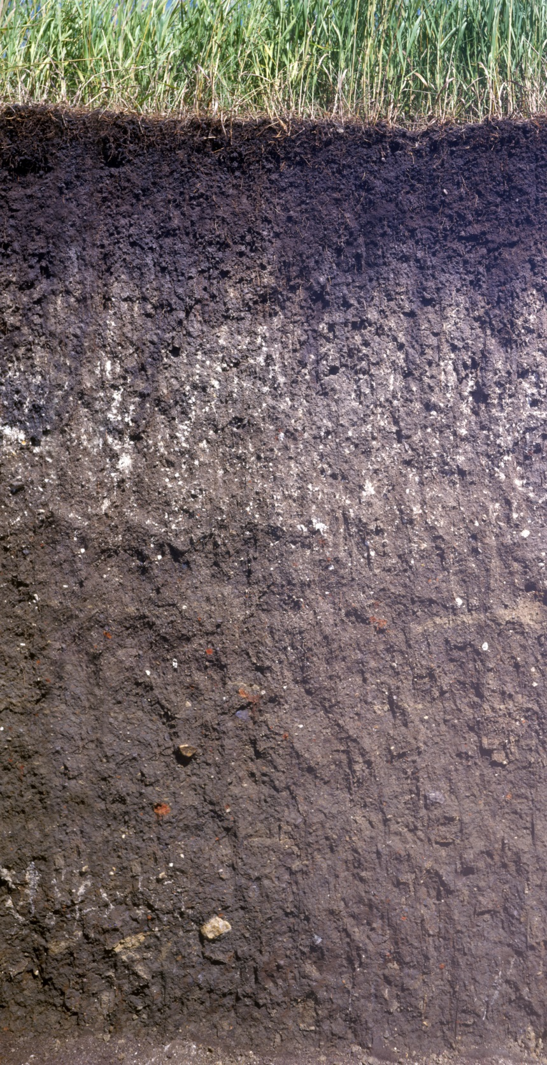
How many horizons do you see?
What are the differences in soil properties between horizons?
Notes:
Animation on this slide!!!
How many horizons do you see? What differences in soil properties do you see between the two pits?
Let’s go through what soil properties you’ll need to measure out in the field.
Rock Fragment Content, Texture, Clay Content, Effervescence, Soil Color, Soil Structure

Slide 26
How many horizons do you see?
What are the differences in soil properties between horizons?
Notes:
Animation removed from this slide!!!
How many horizons do you see? What differences in soil properties do you see between the two pits?
Let’s go through what soil properties you’ll need to measure out in the field.
Rock Fragment Content, Texture, Clay Content, Effervescence, Soil Color, Soil Structure

Slide 27
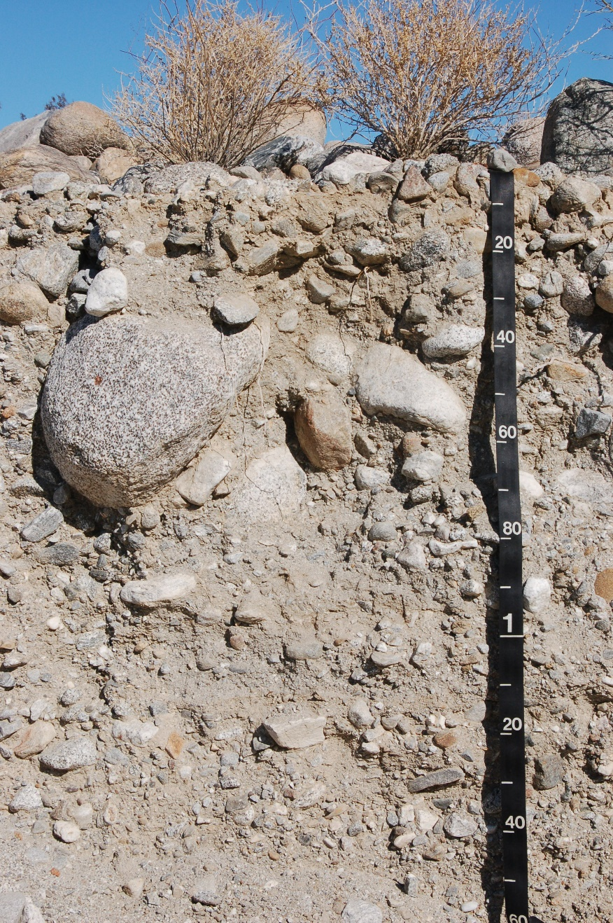
Soil Coarse Fragment Content
Percent rocks (>2 mm) by volume
Affects soil water availability through infiltration, storage and evaporation
Measure by sieving and comparing soil volume with and without rocks
Notes:
Animation on this slide!!!!
Soil coarse fragment content is the percent rocks (defined as particles greater than 2 millimeters) by volume within the soil. Coarse fragment content affects soil water availability through its effects on infiltration rates, storage, and evaporation.
An example of this is that in arid regions, trees often grow better than grasses in soils with lots of coarse fragments in the top meter. Why do you think that might be? A hint is to compare tree roots to grass roots. Water drains quickly through soils with a lot of rock content and so is often stored deeper in the soil profile. Tree roots are longer and can reach pockets of soil where water collects. In contrast, grass roots are short and concentrated near the soil surface, so they cannot access deeper soil water.
You can measure soil coarse fragment content by gathering some soil from the horizon in a measuring cup, recording the total volume with rocks and smaller particles, sieving the soil through a 2 millimeter sieve to remove the rocks, and then recording the volume of soil left without the rocks. The percent coarse fragment content is the total volume minus the volume without rocks, divided by total volume.
Equipment needed: measuring cup & sieve

Slide 28
Soil Coarse Fragment Content
Desert Pavement
Percent rocks (>2 mm) by volume
Affects soil water availability through infiltration, storage and evaporation
Measure by sieving and comparing soil volume with and without rocks
Weak structure
Large Cobbles
Medium Gravelly
Notes:
Animation on this slide!!!!
Soil coarse fragment content is the percent rocks (defined as particles greater than 2 millimeters) by volume within the soil. Coarse fragment content affects soil water availability through its effects on infiltration rates, storage, and evaporation.
An example of this is that in arid regions, trees often grow better than grasses in soils with lots of coarse fragments in the top meter. Why do you think that might be? A hint is to compare tree roots to grass roots. Water drains quickly through soils with a lot of rock content and so is often stored deeper in the soil profile. Tree roots are longer and can reach pockets of soil where water collects. In contrast, grass roots are short and concentrated near the soil surface, so they cannot access deeper soil water.
You can measure soil coarse fragment content by gathering some soil from the horizon in a measuring cup, recording the total volume with rocks and smaller particles, sieving the soil through a 2 millimeter sieve to remove the rocks, and then recording the volume of soil left without the rocks. The percent coarse fragment content is the total volume minus the volume without rocks, divided by total volume.
Equipment needed: measuring cup & sieve

Slide 29
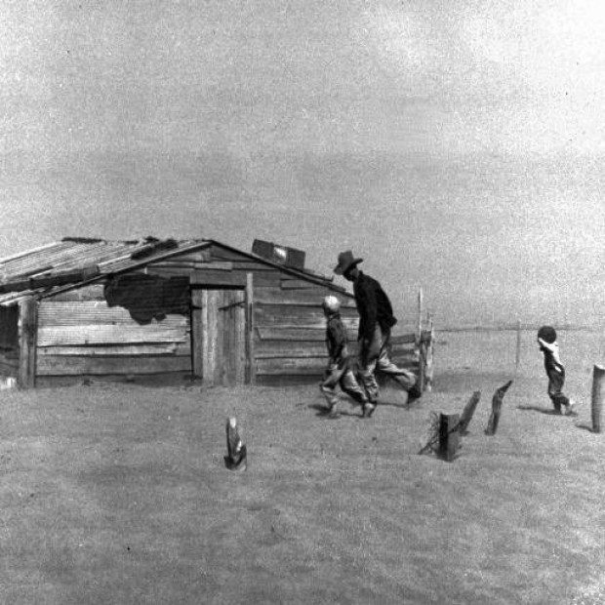
Percent Clay
Smallest soil particle size (<2 micrometers)
Amount of clay especially important for:
  Infiltration and water availability
  Soil stability and erodibility
  Plant rooting
Estimate percent clay by feel
  How do you think soil texture and clay content influence wind erosion?
Notes:
Percent clay is a particularly important aspect of soil texture. Clay, again, is the smallest soil particle size at less than 0.002 millimeters (or less than 2 micrometers). The amount of clay in the soil is especially important for understanding the processes of water infiltration and availability, soil stability and erodibility, and plant rooting.
Look at the picture from eastern Colorado during the Dust Bowl, a major wind erosion event. How do you think soil texture and clay content influence wind erosion potential? Coarser textured soils (more sand, less clay) are significantly more erodible by wind.
Similar to soil texture, the method for estimating percent clay is by feel, using the same flowchart.
Equipment needed: spray bottle, your hand, & soil triangle

Slide 30
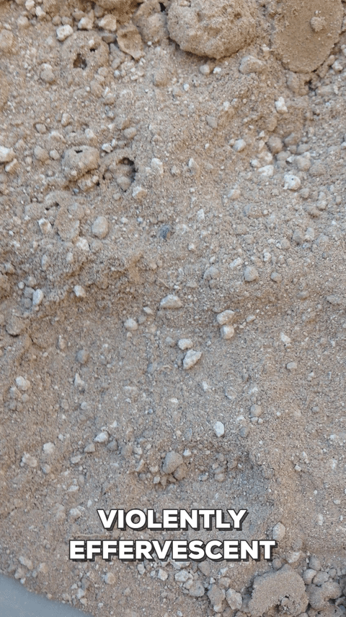
Effervescence
NRCS Field Book, pg. 2-87
Indicator of calcium carbonate content
Tested by dropping weak hydrochloric acid on soil and looking at how many bubbles are produced
*If HCl is unavailable, this method is optional
Notes:
Animation on this slide!!! And video!!!!
The next soil property is effervescence, which is an indicator of calcium carbonate content. Calcium carbonate often accumulates in soils in arid areas. Large amounts of calcium carbonate appear as white specks, nodules, or even a cemented horizon in the soil like the one in the picture.
How do you think this cemented calcium carbonate horizon might affect plant growth? For one, it physically stops many plant roots from growing past it. However, it can be beneficial also. Water often collects along the surface of a cemented calcium carbonate horizon, and is available to plant roots.
Calcium carbonate amount is estimated by dropping a weak hydrochloric acid solution on a piece of soil and rating how “effervescent” the response is. A violent foam of bubbles means that there is a high concentration of calcium carbonate.
No effervescence means that there is no calcium carbonate.
Equipment needed: weak solution of HCl

Slide 31
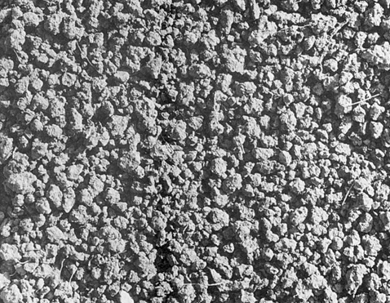
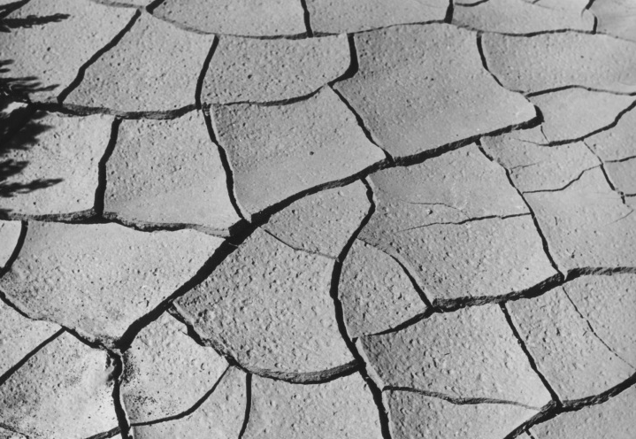
Soil Structure
NRCS Field Book, pg. 2-53 to 2-61
Description of the size, shape, and strength of soil peds or pieces
Affects soil water availability through the depth that water can penetrate and residence time that water is available to plants
*If the NRCS Field Books is unavailable, this method is optional
  Which surface structure is better for seed germination -- granular (left) or platy (right)?
Notes:
ANIMATION REMOVED FROM THIS SLIDE!
The next property is soil structure. Structure is a description of the size, shape, and strength of soil peds or pieces. You would describe it in the field by matching the soil structure to one of several classes: for example, granular in the left hand picture versus platy on the right. Soil structure affects soil water availability through the depth that water can penetrate and residence time that water is available to plants.
In the example, which surface structure do you think is superior for seed germination—granular or platy? In general, granular structure is better for seed germination. It provides better seed to soil contact and does not present a barrier to buried seeds trying to push up through it.
A recent paper in Landscape Ecology found this is true for the success of sagebrush seedings as well – soil aggregates (which usually have granular surface structure) was a significant predictor of sagebrush seeding success in the Soda Fire in Idaho
Describing structure is optional in the protocol described by the Monitoring Manual for Grassland, Shrubland and Savannah Ecosystems. However, it is easy and quick to measure once trained.
Equipment needed: Field Book for Describing and Sample Soils
Images: NRCS;

Slide 32
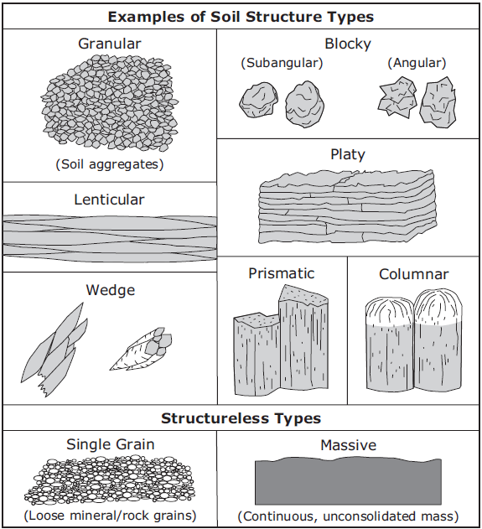
Soil Structure
Type (shape), grade (strength), and size
Notes:
Page 2-54 from Field Book for Describing and Sampling soils: explain this is a very helpful field book!
Images: NRCS;

Slide 33
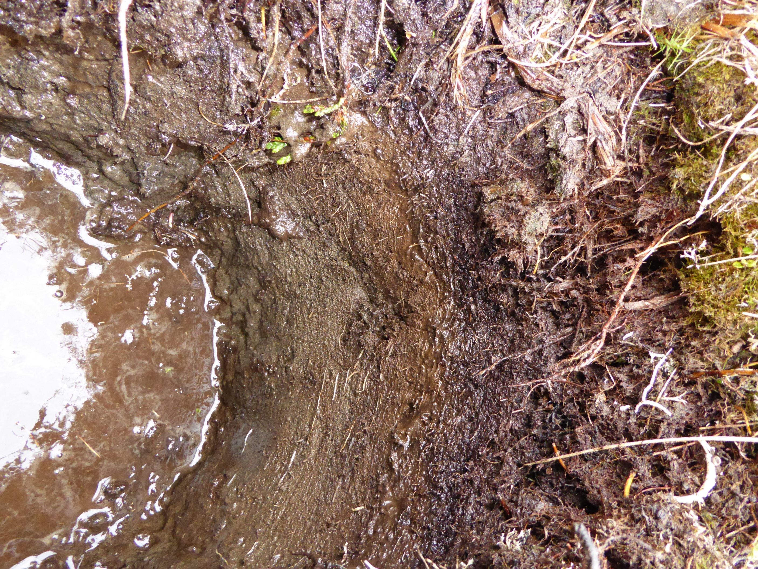
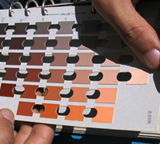
Soil Color
Munsell Color Chart
Indicator of the amount of organic matter in the soil, which is important for water holding capacity and nutrient availability (darker→more organic matter)
Match the soil with a color on the Munsell Color Chart
*If Munsell Color Chart is
Unavailable, this method is
optional
Notes:
Soil color is an indicator of the amount of organic matter in a soil, which is important for other processes like water holding capacity and nutrient availability. Darker colors generally indicate more organic matter.
Soil color often gets lighter with depth. What does that mean for organic matter content? That’s right, organic matter content often decreases with depth, as you get further from the plants and plant roots that are contributing to that organic matter.
Soil color is measured by matching the soil with a color on a Munsell Color Chart, as shown in the picture. Describing color is optional in the protocol described by the Monitoring Manual for Grassland, Shrubland and Savannah Ecosystems. However, it is easy and relatively quick to measure once you are trained.
Equipment needed: Munsell Color Book
Image Source: ARS image library; NRCS

Slide 34
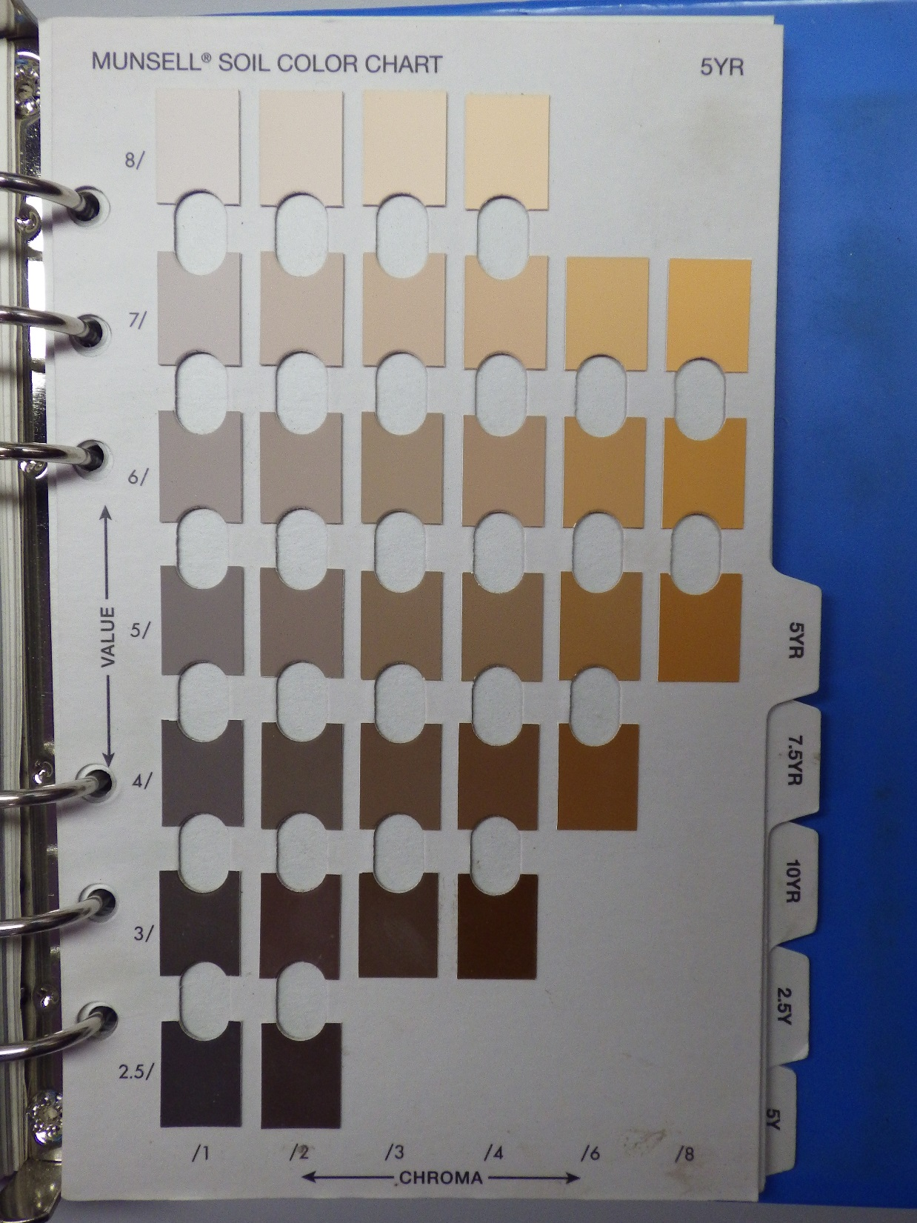
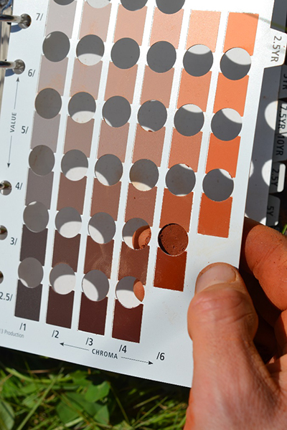
2.5YR 4/5
5YR 5/3
Notes:
Slide has animation!!!
Soil color is determined by Hue, Value, and then Chroma. So if you were to record this color, what would it look like on the datasheet?
Image Source: ARS image library; NRCS

Slide 35
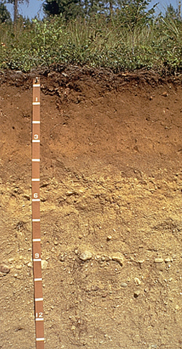
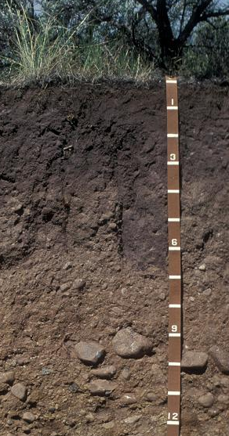
How many horizons do you see in each soil pit?
Notes:
Slide has animation!!!!
How many horizons do you see? What constitutes a break in a horizon?

Slide 36
What differences in soil properties can you see?
TEXTURE
ROCK FRAGMENT CONTENT
CLAY CONTENT
SOIL COLOR
EFFERVESCENCE
SOIL STRUCTURE
Notes:
Go through the different soil properties of the two soil profiles. What are the differences?
Texture: hard to determine in a picture but is likely different throughout the profile
Rock Fragment Content: More rocks as you go deeper in the profile
Clay Content: Again, hard to determine in a picture
Soil Color: lighter as you go deeper in the profile
Effervescence: likely the last horizon on the left profile will be violently effervescent since it’s a petro calcic layer
Soil Structure: hard to see in a picture but granular at the top and then blocky and/or platy as we get further into the profile

Slide 37
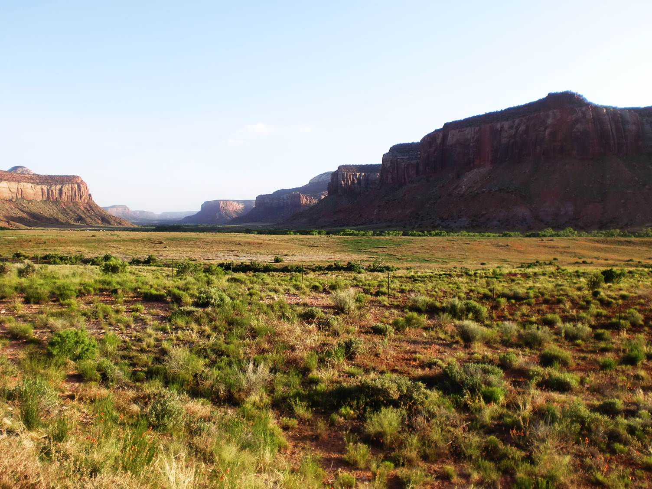
So what are the steps in identifying ecological sites?
Gather information in office
Go to the field
Compare physical characteristics (soil)
Compare vegetation
Notes:
Describe slide

Slide 38
1. Gather information in office
Key to Ecological Sites
Topographical Map
Soil Map
Soil Map Unit Descriptions
Ecological Site Descriptions (ESD’s)
Climate information
Notes:
First, obtain (in the office) necessary background materials such as the ecological site key for your state (if available), a topographical and soil map of the area, and the associated soil survey descriptions and the most common ecological sites as well as climate information.

Slide 39
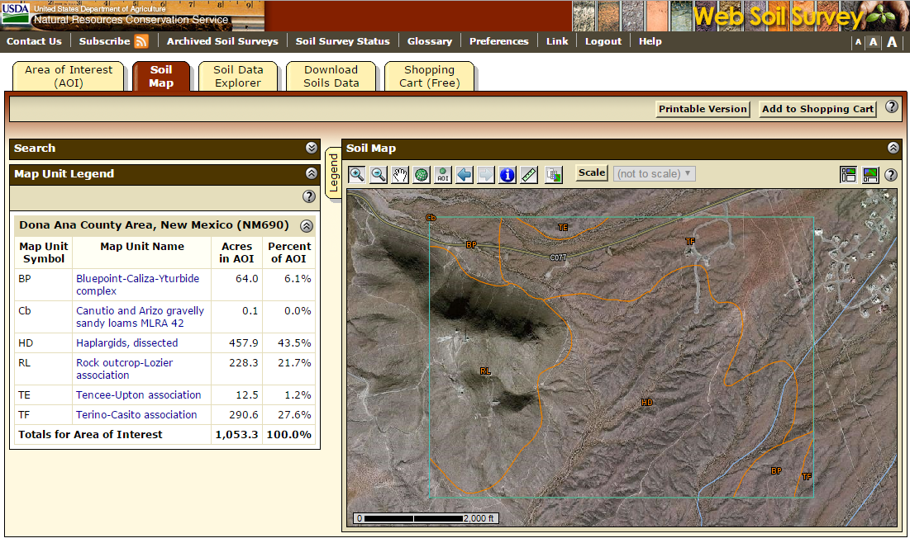
Web Soil Survey
Notes:
Animation on this slide!!!!
In order to get soil map unit information, you can use Web Soil Survey (link at the end of the presentation) – hopefully most people are familiar with this. Web Soil Survey is an online tool that enables you to view and download soil maps and related information.
Soil map units were created using soil pit info, aerial photography and GIS
Each soil series is named (e.g. Terino-Casito association) and has particular properties—similar to a species
Map units and their descriptions refer to a particular instance of that soil—like an individual of that species
No map is accurate at small scales

Slide 40
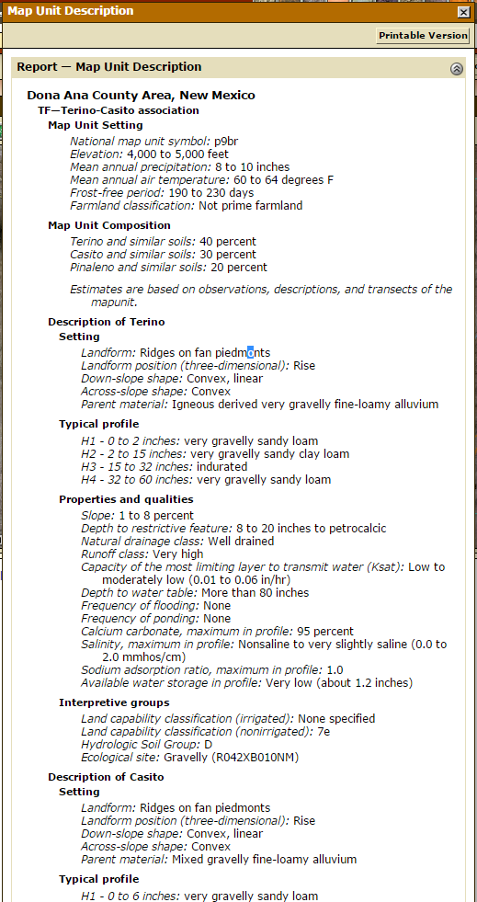
Web Soil Survey
Notes:
After you select an area of interest, multiple map units are displayed
If you click on the map unit, a window appears

Slide 41
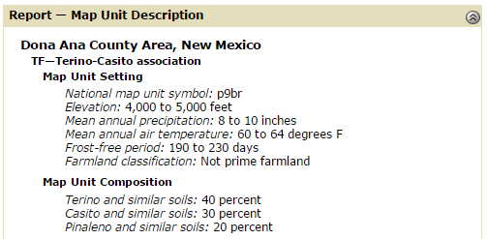
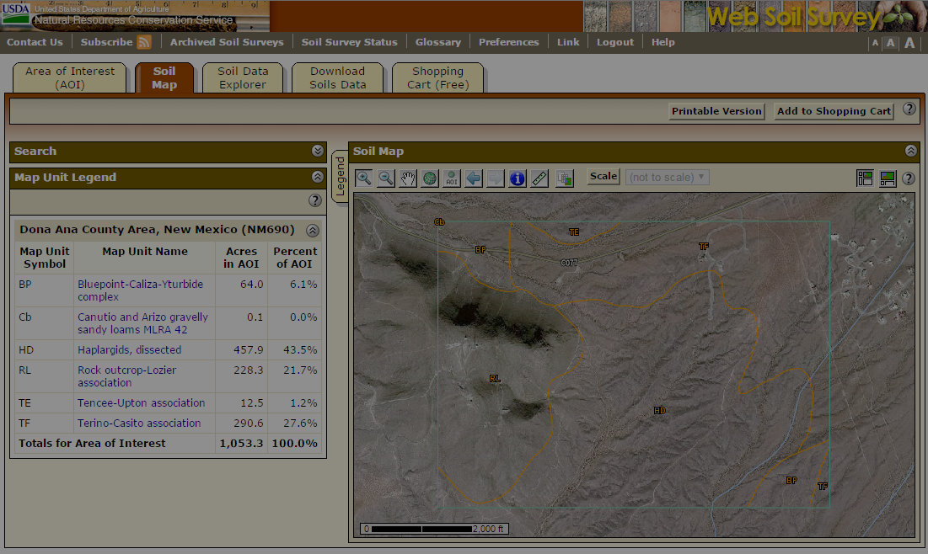



Terino:
Casito:
Pinaleno:
Notes:
Under “Map Unit Composition”, you’ll see what types of soils make up that map unit. Sometimes it’s only one but many times it’s multiple
When you scroll down to the bottom of this page that pops up, you’ll see “Interpretive Groups” and then underneath that heading are the Ecological Site reference numbers

Slide 42
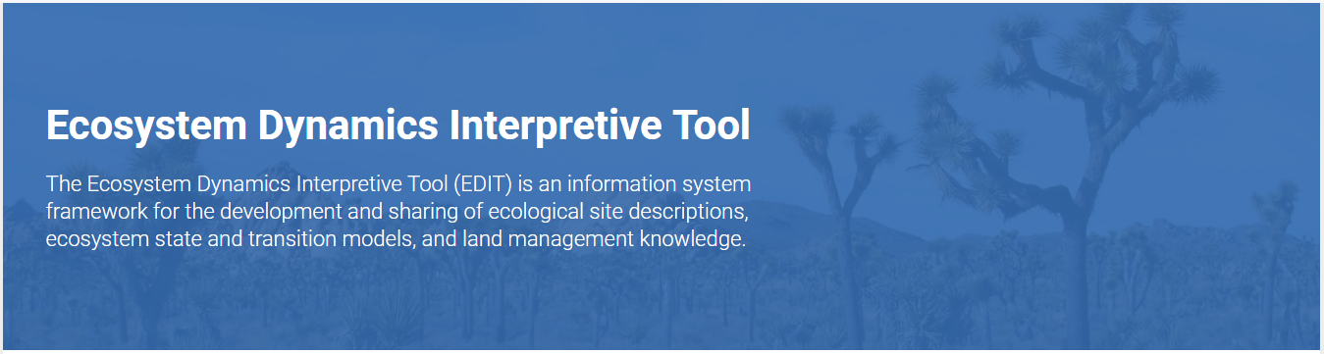

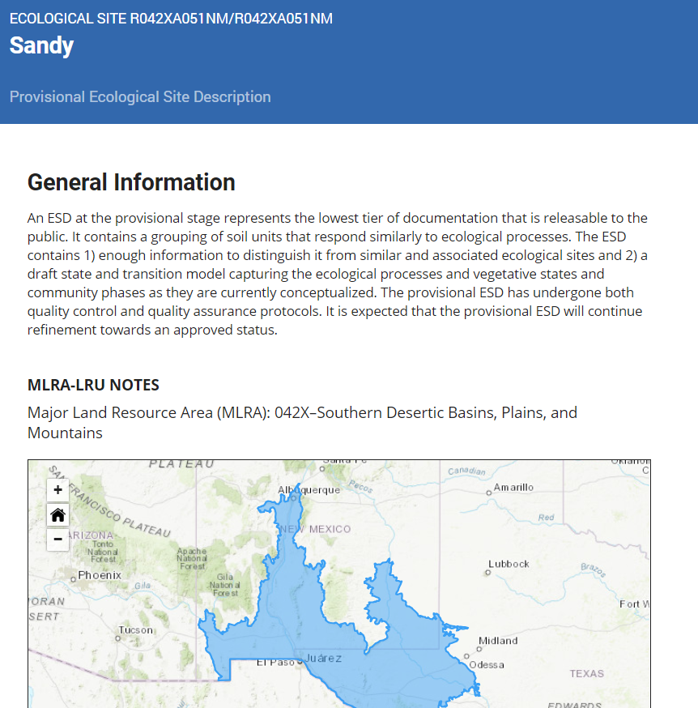
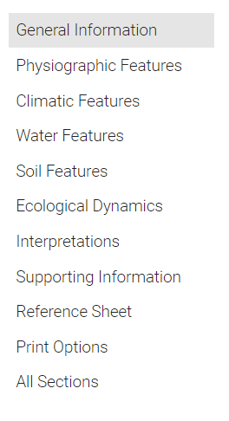
ESIS
Notes:
Example of ESD – found on the NRCS/Jornada EDIT (Ecosystems Dynamics Interpretive Tool) website (https://edit.jornada.nmsu.edu/page?content=catalog&catalog=3)
You’ll print out the relevant ESDs for your site ahead of time, or have them electronically on your tablet. Bring surrounding ESDs since the maps aren’t accurate to the scale we need it at.

Slide 43
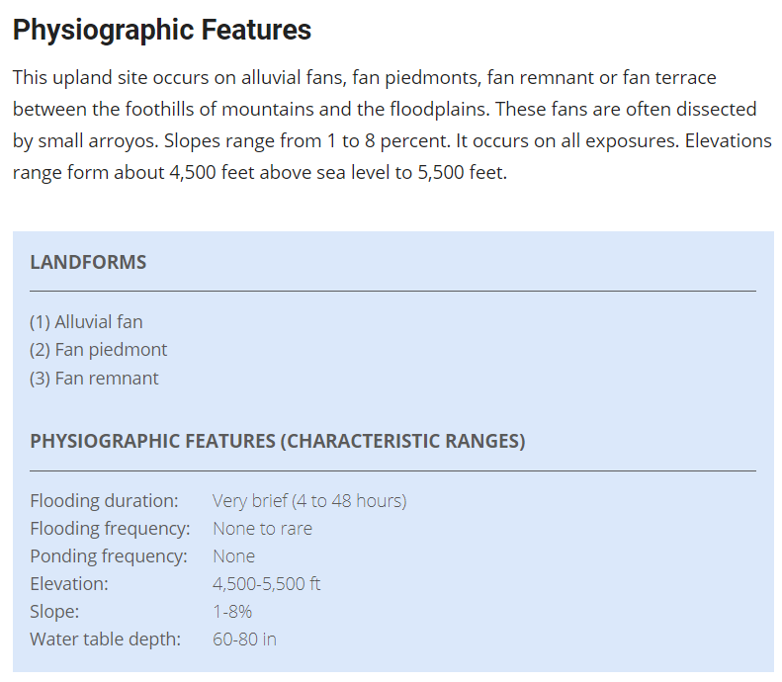

Notes:
Animation removed from this slide!!!
On the left hand side of the webpage, click on Complete Report (you can save this as a PDF)
Good sections to look at in an ESD in order to compare to your field data are:
Physiographic Features
Representative Soil Features
Plant Communities
Supporting Information

Slide 44
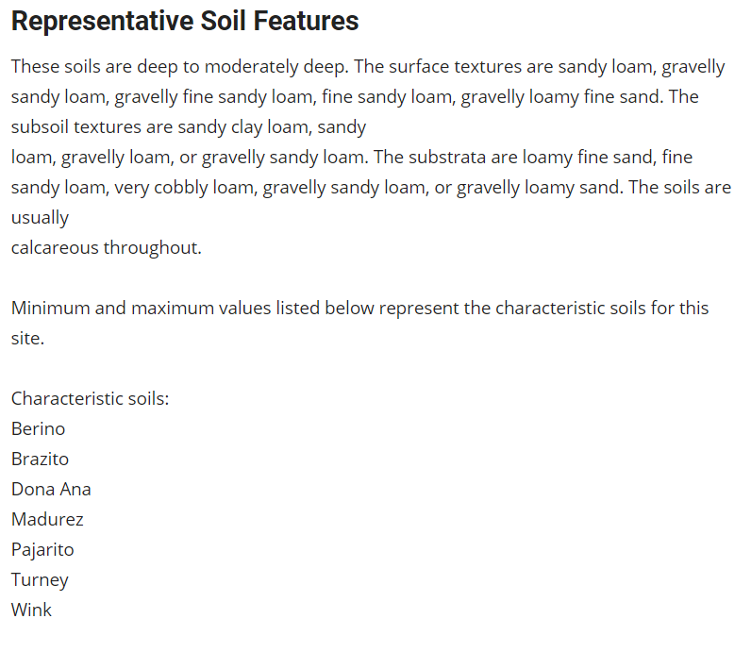
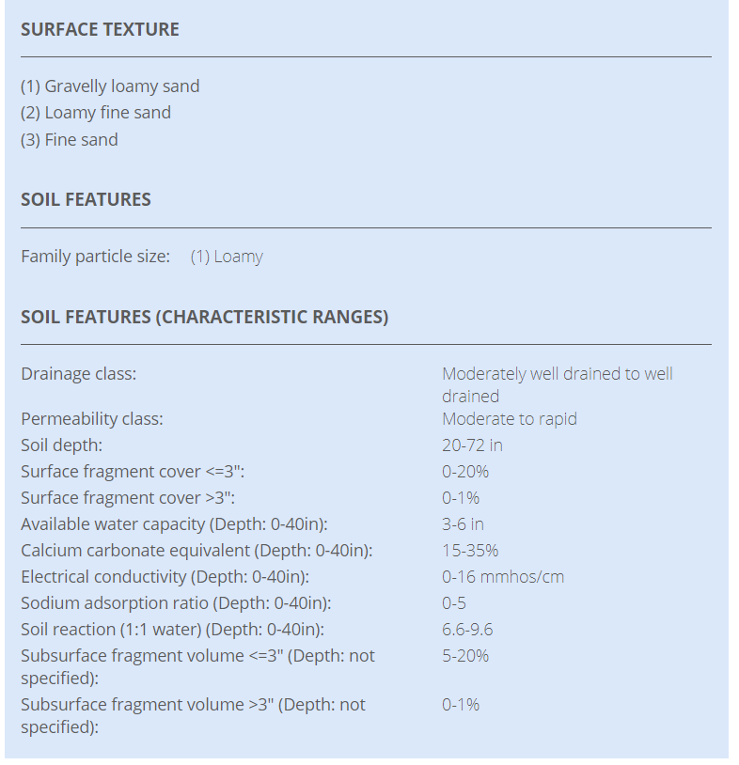
Notes:
Animation on this slide!!!
On the left hand side of the webpage, click on Complete Report (you can save this as a PDF)
Good sections to look at in an ESD in order to compare to your field data are:
Physiographic Features
Representative Soil Features
Plant Communities
Supporting Information

Slide 45
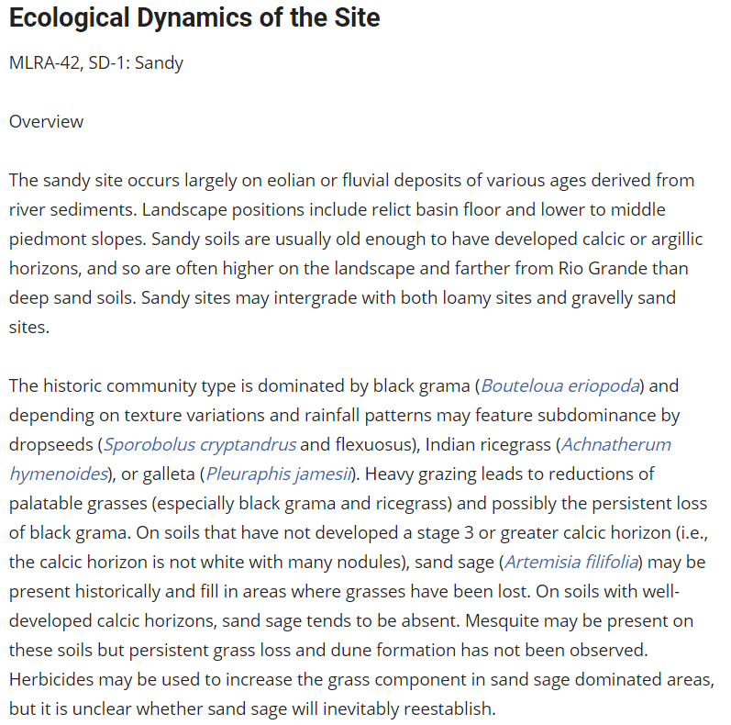
Notes:
Animation on this slide!!!
On the left hand side of the webpage, click on Complete Report (you can save this as a PDF)
Good sections to look at in an ESD in order to compare to your field data are:
Physiographic Features
Representative Soil Features
Plant Communities
Supporting Information

Slide 46
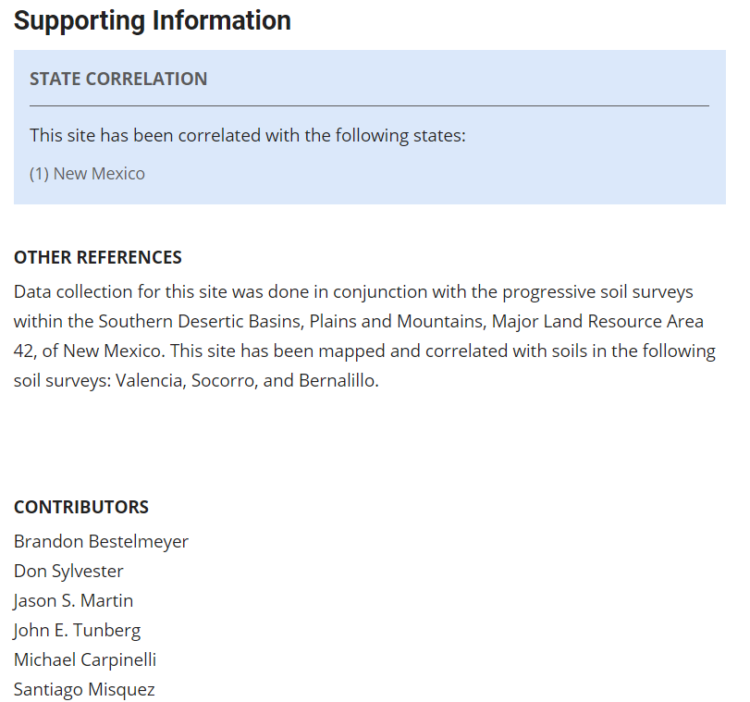
Notes:
Animation on this slide!!!
On the left hand side of the webpage, click on Complete Report (you can save this as a PDF)
Good sections to look at in an ESD in order to compare to your field data are:
Physiographic Features
Representative Soil Features
Plant Communities
Supporting Information

Slide 47
2. Go to the field
Navigate to your site.
Find out where you are on the maps.
According to the soil map units in the area, what ecological site(s) could you be on?
Notes:
Next, you go to the field. What are the very first steps when you go to the field?
Take the maps with you on the land and see what soil and ecological site they predict for the spot you are standing on.

Slide 48
3. Compare physical characteristics – DIG A PIT!
Do you have the same topography as the ESD?
Are you at the same elevation as the ESD?
Are the soil properties (esp. texture) the same as described in the soil map unit component and associated ESD?
Notes:
Describe slide

Slide 49
4. Compare vegetation
What plants are on the site?
Which state or community are you in?
Notes:
Compare the plant species from your ESD to those onsite. Do they match up?

Slide 50
4. Ecological Site Identification
Based on multiple lines of evidence
Reference material, site topography, elevation, soil properties and plant community
Notes:
Emphasize that ecological site identification should be done using multiple lines of evidence, as

Slide 51
Soil and ecological site resources
Web Soil Survey: websoilsurvey.sc.egov.usda.gov
SoilWeb App: https://casoilresource.lawr.ucdavis.edu/
Soil Series Descriptions: https://www.nrcs.usda.gov/wps/portal/nrcs/detailfull/soils/home/?cid=nrcs142p2_053587
Published Soil Surveys: https://www.nrcs.usda.gov/wps/portal/nrcs/soilsurvey/soils/survey/state/
Approved Ecological Site Descriptions:
https://edit.jornada.nmsu.edu/page?content=about
LandPKS App for Site Characterization: www.landpotential.org
Notes:
Soil series descriptions enables you to view detailed descriptions for each individual soil series.
The list of published soil surveys gives a state-by-state look at what soil survey information is available and when it was completed.
The SoilWeb smartphone app brings soil survey information to your phone, with the ability to pull soil information for your current location
Approved Ecological Site Descriptions contains all of the up-to-date ecological site descriptions that are available
Finally, the Land PKS App enables you to collect site characterization information, including soils, using your smartphone.

Slide 52
For more soil background info:
Field Book for Describing and Sampling Soils – plus video on how to use it
Factors of Soil Formation – classic book by Hans Jenny available online
The Nature and Properties of Soils – book to purchase that provides a clearly written, general overview
Soils: Genesis and Geomorphology – textbook to purchase
Notes:
Obviously, soil science is a much broader topic than we were able to cover in this brief module. Here are some resources for learning more about soil science and soil description.
The Field Book for Describing and Sampling Soils is extremely useful for understanding and describing soil properties. All of the properties we described in this module are treated with much more detail in this book.
Factors of Soil Formation is a short, classic book by one of the fathers of soil science, and provides a nice overview of the factors that influence the soil properties we discussed today
Finally, Soils: Genesis and Geomorphology is a more detailed textbook on soil science and a helpful reference book.

Slide 53
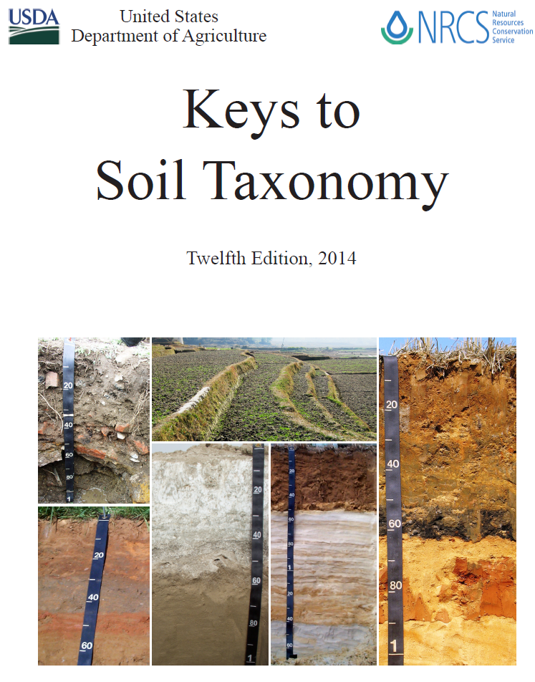
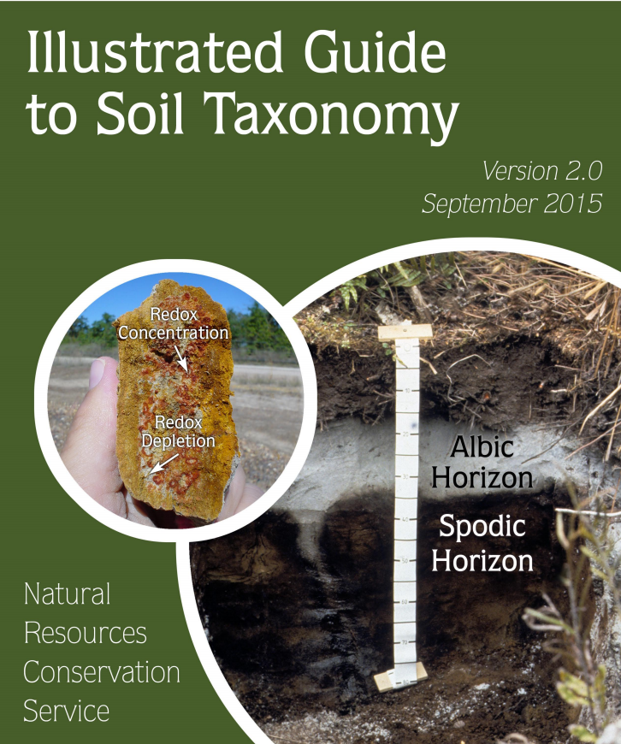
Notes:
There are also more in depth guides for soil taxonomy if you are interested

Slide 54
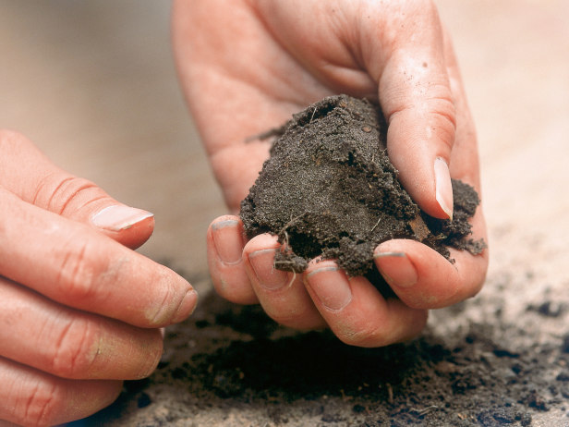
Time to Practice!
Questions?
Notes:
And with that, I’ll open it up to questions. We’ll be heading out into the field after this to do some soil texture calibration as well as digging a couple soil pits and describing the soil profile with a soil scientist.

Slide 55
Landscape position: examples!
Notes:
And with that, I’ll open it up to questions. We’ll be heading out into the field after this to do some soil texture calibration as well as digging a couple soil pits and describing the soil profile with a soil scientist.

Slide 56
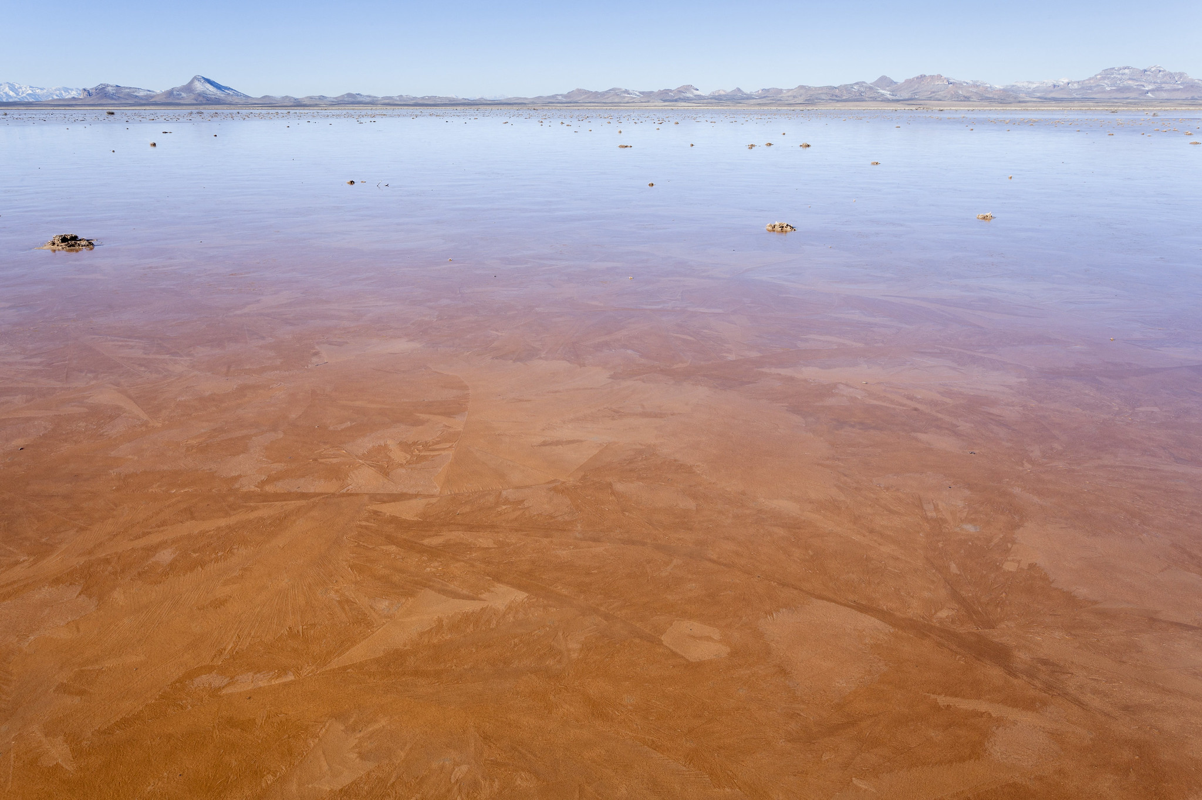
Notes:
It’s a playa. Pretty sure on this one.

Slide 57
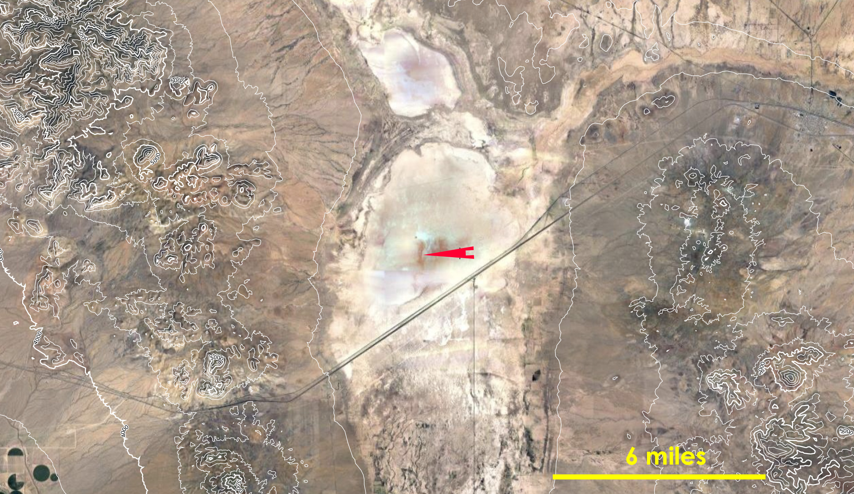
Notes:
It’s a playa. Pretty sure on this one.

Slide 58

Notes:
It’s a plane! Or a plain!

Slide 59

Notes:
I can’t complain.

Slide 60

Notes:
Mountain / hill: backslope (nearing shoulder).

Slide 61

Notes:
Mountain / hill: backslope (nearing shoulder).

Slide 62

Notes:
Alluvial... collar.

Slide 63

Notes:
Alluvial... collar.

Slide 64

Notes:
I think you could go a few ways with this one. Interesting to hear Mike’s opinion. I think it’s a ”mini-plain”... “plainlet”...

Slide 65

Notes:
I think you could go a few ways with this one. Interesting to hear Mike’s opinion. I think it’s a ”mini-plain”... “plainlet”...

Slide 66

Notes:
Fun with scale. On a very fine scale, you might call this a “hill” or “hillock” next to a “floodplainlet”. At a wider and more realistic scale, I think you’re on an alluvial fan that is dissected by draws...

Slide 67

Notes:
Fun with scale. On a very fine scale, you might call this a “hill” or “hillock” next to a “floodplainlet”. At a wider and more realistic scale, I think you’re on an alluvial fan that is dissected by draws...

Slide 68

Notes:
I believe this is a Terrace: Tread.

Slide 69

Notes:
I believe this is a Terrace: Tread.

Slide 70

Notes:
I believe this is a rattlesnake that indicates the end of the powerpoint.

