Slide 1
QA, QC, DIMA
The quiz….
Notes:
*For the instructor - the format of this presentation should be more of a dialogue rather than a typical powerpoint. Ask the class to answer each question before going over the answers to maintaining all QA/QC. It is helpful to have some sort of motivator (like candy) to increase participation

Slide 2
Learning Objectives
Highlight quality assurance and quality control in all aspects of AIM data collection
Review AIM methods and determine possible errors that may be introduced
Notes:
*Read the objectives to the class

Slide 3
Important Definitions
Quality Assurance:
proactive process to minimize the chance of an error being inserted into your data
GOAL: to improve error prevention and
checking processes so that problems/errors do
not arise when the data are being collected.
Notes:
*Ask class the definition of quality assurance – note for instructor that there is an animation on this slide

Slide 4
Quality Control
Quality Control:
reactive process is to detect, note, and if possible fix, errors which occurred in the data collection and storage process
GOAL: to identify errors/problems after data
are collected and before they are released.
Notes:
*Ask class the definition of quality control – note for instructor that there is an animation on this slide

Slide 5
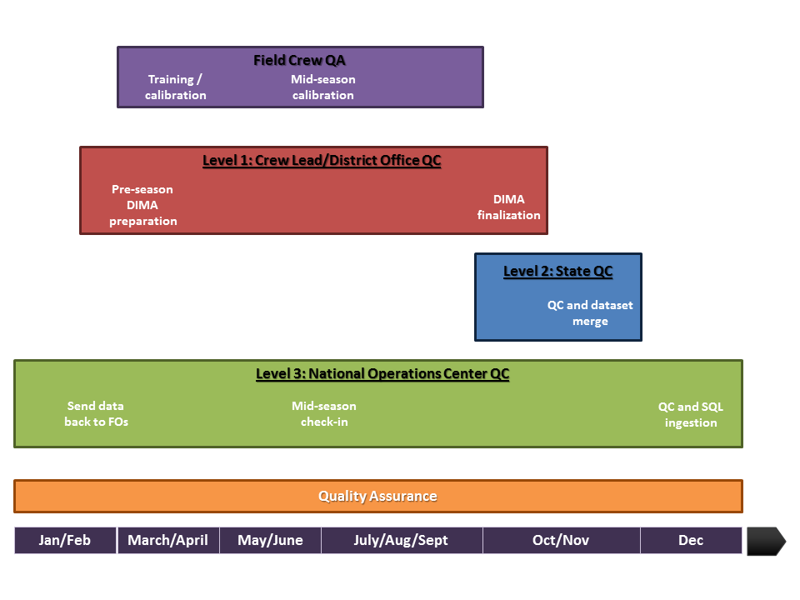
QA and QC Timeline
Notes:
The QA/QC process is iterative and ongoing. Right now we are working on QA through this training! And QC through DIMA preparation. Something to note is that the field crew is ultimately responsible for the entirety of quality assurance as they are the only people who interact with the actual data collection.

Slide 6
General
Be alert
Ask “does this make sense”?
Follow proper technique. When in doubt, read the manual
Use electronic data capture and fill out datasheets completely
Notes:
Quality assurance isn’t an overly complicated process. It is as simple as, does this make sense? Run quick DIMA reports to see if the numbers are adding up. Do you really have 100% bare ground?
Never be ashamed to go back to the manual with questions. We all do!

Slide 7
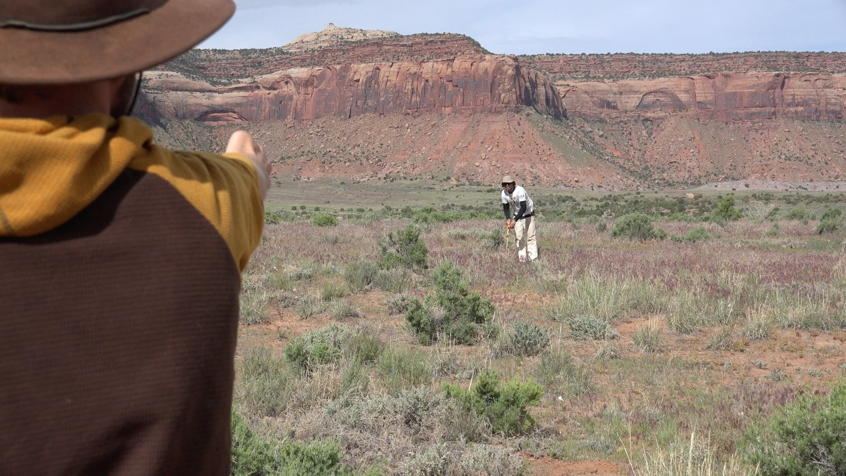
The QA and QC Rules of Thumb
Completeness
Correctness
Consistency
Notes:
QA and QC can be summarized in to three rules of thumb: completeness, correctness and consistency.
Do we have all of the data? – 4 photos, plot characterization, plot observation, lpi, height, gap, soil stability, species richness?
Is the data correct? Have you run the quick reports in DIMA to make sure the data matches what you are seeing?
Are you being consistent in how you are recording unknown plant codes? Are you identifying plants the same way? Are you reading gap with the leading or trailing edge?

Slide 8
DIMA
Upgrading your DIMA to the most up-to-date
See AIM.LandscapeToolbox.org
Keep an eye on Microsoft updates
Maintain a consistent structure and nomenclature for sites and plots
Back up regularly
Archive old copies
Maintain and organize all paper datasheets
Keep track of unknown results or missing data whatever that may be in a word document
Notes:
Here are a few more helpful QA tips. These are all great so write them down if you have to! If a new version of DIMA comes out before the season is over, you will need to update to that version.
You will save yourself a lot of time by keeping up with proper naming for sites, plots and photos
Back up whenever possible, Have a copy of your data on the BLM network, DIMA and an external drive if possible
Keep a folder of archived DIMAs as you go. You may need these before the season is over as merging can go wonky sometimes
Try to get a filing cabinet and hanging folders to organize your paper data sheets. Have a consistent way of keeping track of what has been entered and checked
Keep up with missing/unknown data and the plot tracking excel

Slide 9
QA: Determining error in the field
Use the computations/notes sections of the data forms to verify that the end calculations are in line with your ocular observations (Does % bare ground + % foliar cover + between plant cover % = 100%? )
Verify that you have collected all data and taken three photos
Verify that GPS coordinates make sense
Notes:
After the data is collected, these reports only take a couple seconds to run and can be super helpful

Slide 10
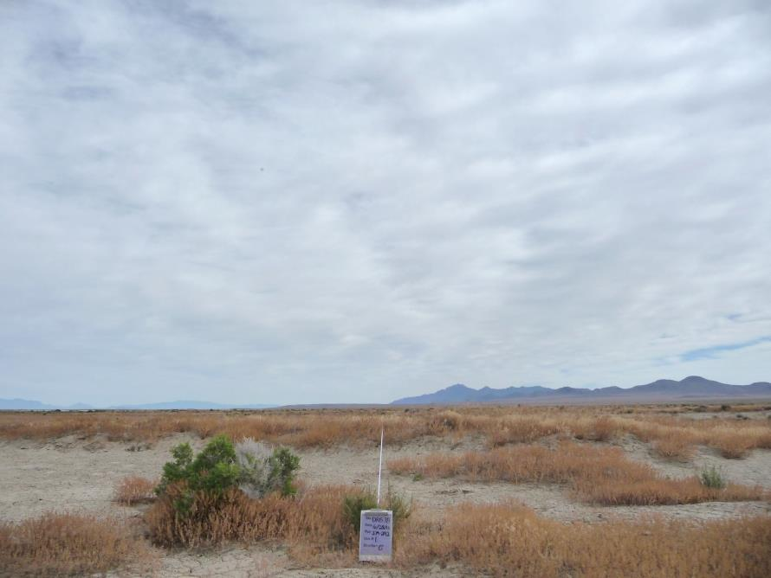
Photo Point QA
Notes:
*Ask the class the things to keep in mind when taking photos. Have them list everything

Slide 11
Photo Point QA
Are your photos in landscape, with the horizon in the background?
Is a photo board in the photo to describe the photo area? Is the photo board in the bottom center? Can you read it?
Is the photo in focus?

Slide 12
Plot Characterization and Observation
Notes:
*Ask class to list things to keep in mind

Slide 13
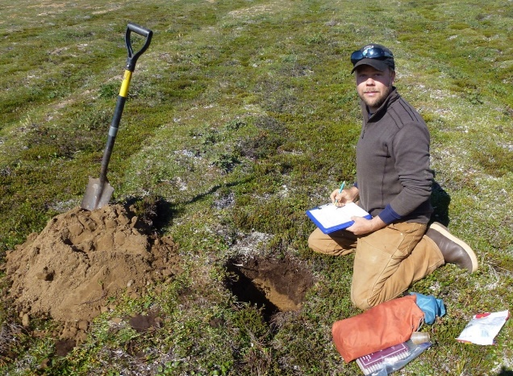
Plot Characterization and Observation
GPS Coordinates correct and complete
Decimal Degrees, NAD83
Soil horizon descriptions match plant communities
Notes descriptive and complete
Landscape unit and position
Slope and aspect
Pit fully characterized

Slide 14
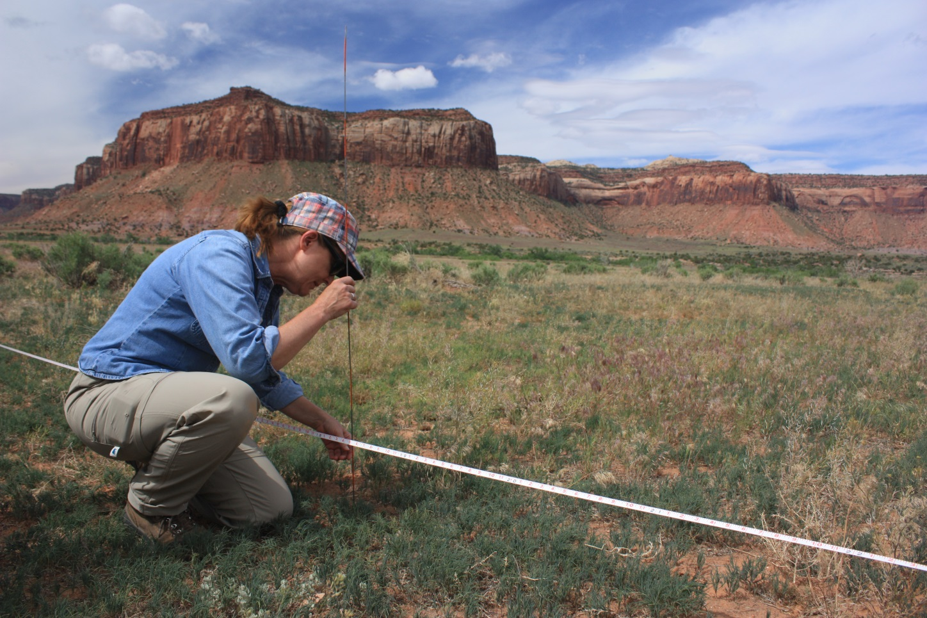
Line-point Intercept
Notes:
*Ask class what to keep in mind for LPI

Slide 15
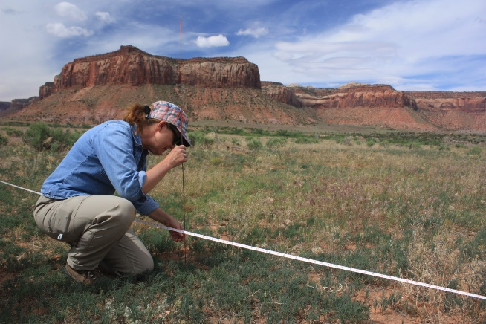
Line-point intercept
Pin drop is as vertical as possible (avoid parallax)
% bare ground+ % foliar cover+ % between plant ground cover = 100%
Cover values are consistent with plot observations
Using correct plant codes

Slide 16
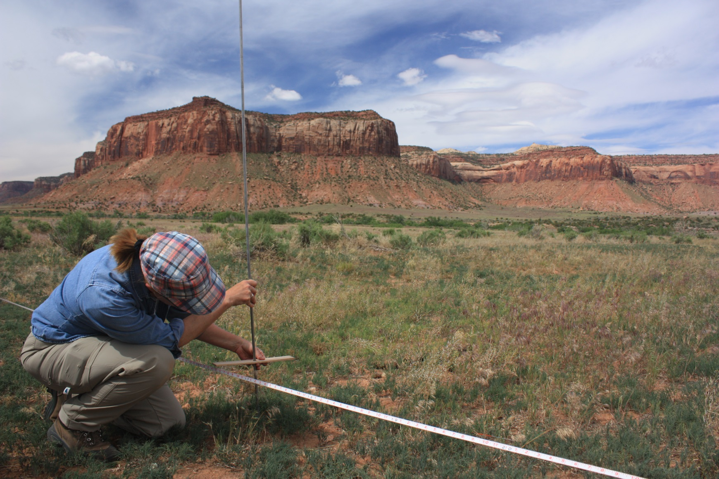
Vegetation height
Notes:
*Ask class things to keep in mind for height

Slide 17
Vegetation height
Heights are recorded at the correct intervals
Measure height at droop height
Only measure tallest part of plant within the 30cm diameter
Measure both woody and herbaceous heights
Be sure to enter “none” if no plants within the 30cm

Slide 18
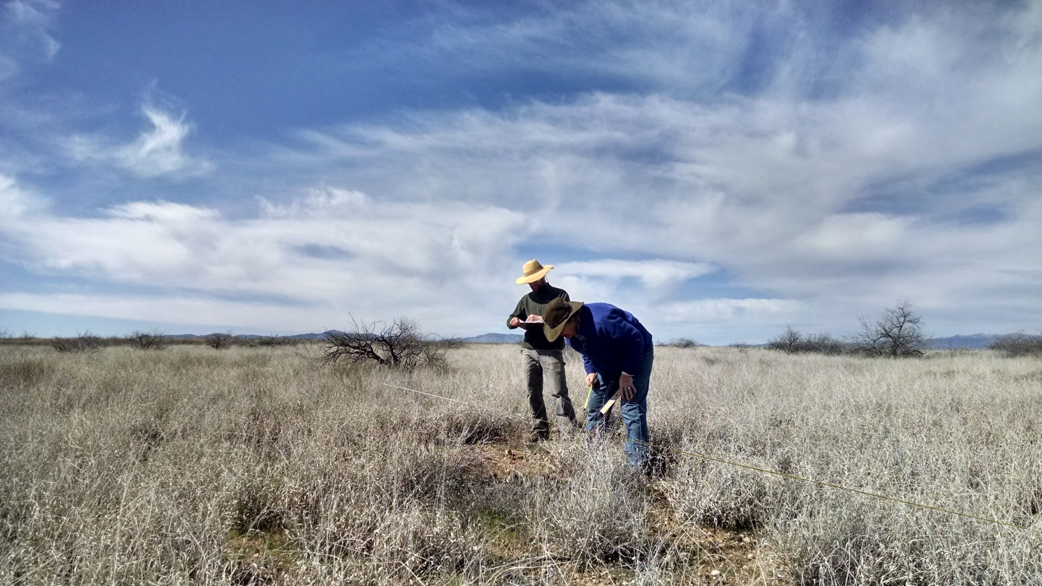
Gap Intercept
Notes:
*Ask class what to keep in mind for gap

Slide 19
Gap Intercept
While collecting data are you standing perpendicular to the transect tape looking straight down the pin?
Are all gaps >20 cm?
Is each data sheet complete-observer, recorder, date, plot name?
Are the number of gaps in each size class (25-50 cm; 51-100 cm 100-200 cm, >200 cm) consistent with your observations of the plot?

Slide 20
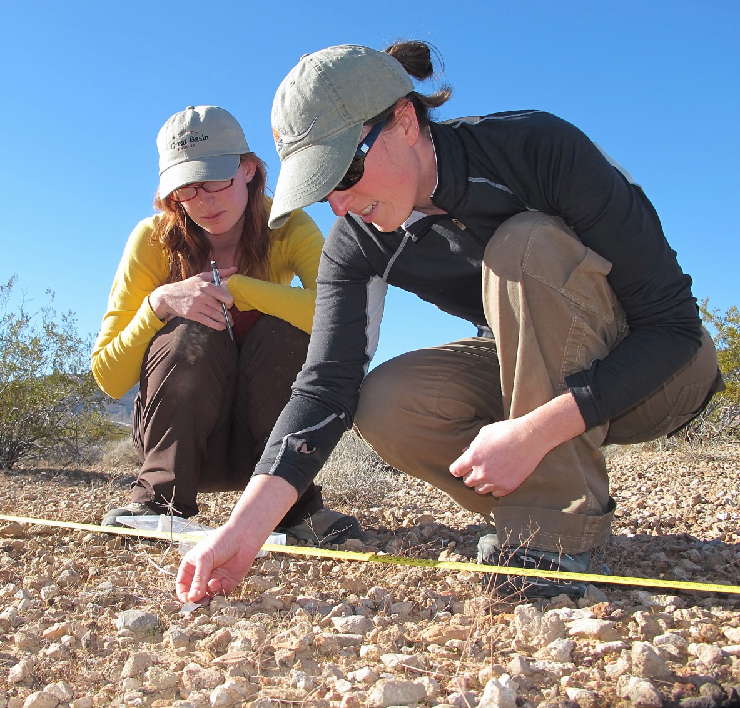
Soil Stability
Notes:
*Ask class what to keep in mind for soil stability

Slide 21
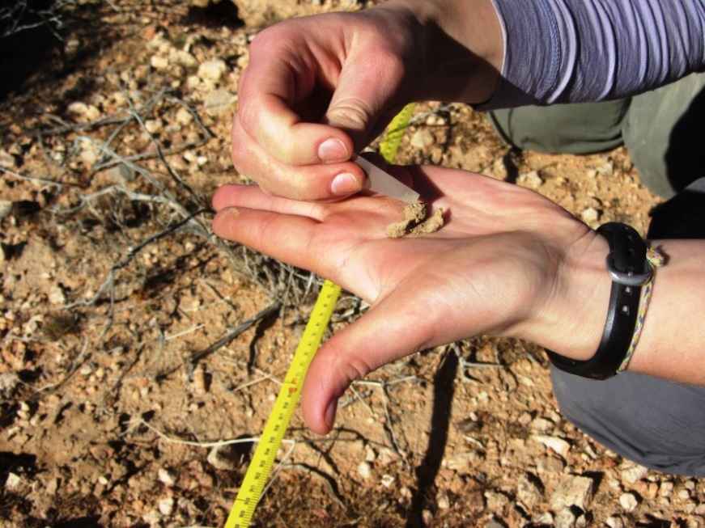
Soil Stability
Is each soil ped in the correct size range (6-8 mm x 2mm)?
Did you record the vegetation cover of each ped?
Are peds fully dry?
Are you using DI water and is the box completely filled with water?

Slide 22
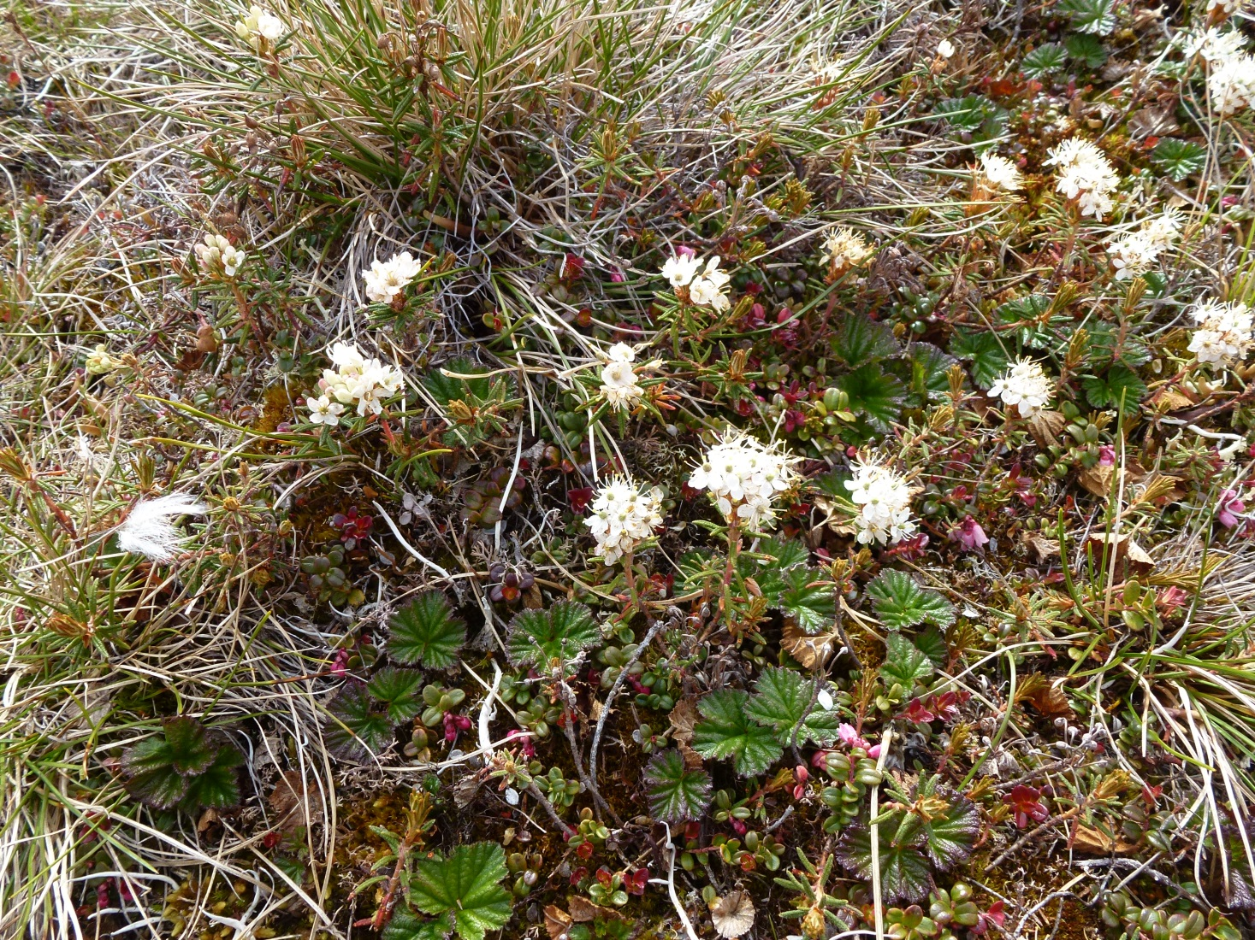
Plot Level Species Inventory
Notes:
*Ask class what to keep in mind for species richness

Slide 23
Plot Level Species Inventory
Did you search the plot for the full 15 minutes?
Are species recorded according to your known and unknown plant protocols?
Did you stay within the plot?

Slide 24
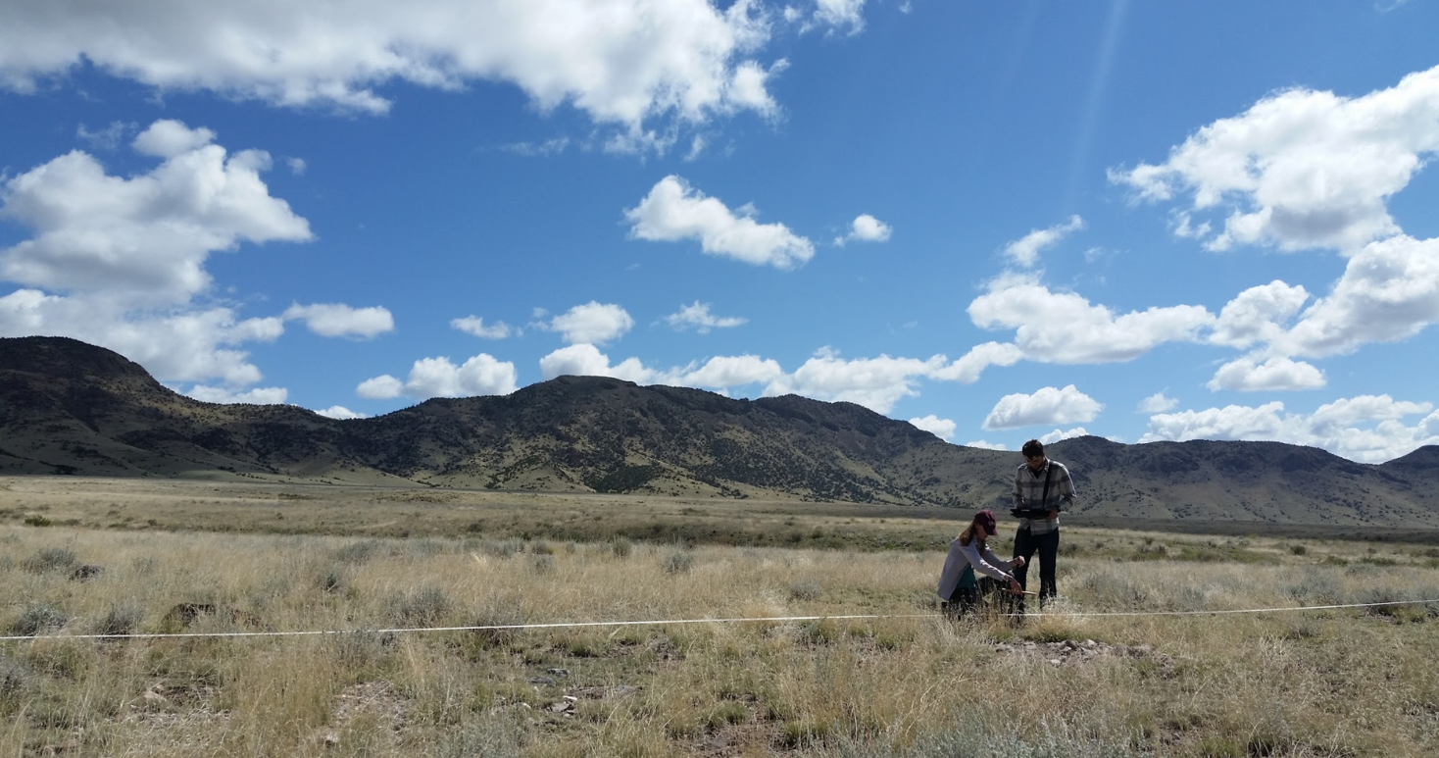
Quality Control
What are some common QC steps?
Notes:
*Ask the class to list QC steps

Slide 25
Quality Control
Inspect DIMA forms
Run reports
Plot and map data

Slide 26
Almost Done!

