Slide 1
SAFETY!
DO IT
Notes:
*Technically we can’t ask if people have medical issues so the best way to bring up the topic with crew members is to ask whether there is anything that you would like me to know before heading out into the field?

Slide 2
Safety Concerns
Distracted driving
Rugged, uneven terrain
Weather related
Heat stress
Dehydration/or hyponatremia
Flash floods
Lightning
Wildfire
Abandoned mines
Biting/stinging insects
Wildlife encounters

Slide 3
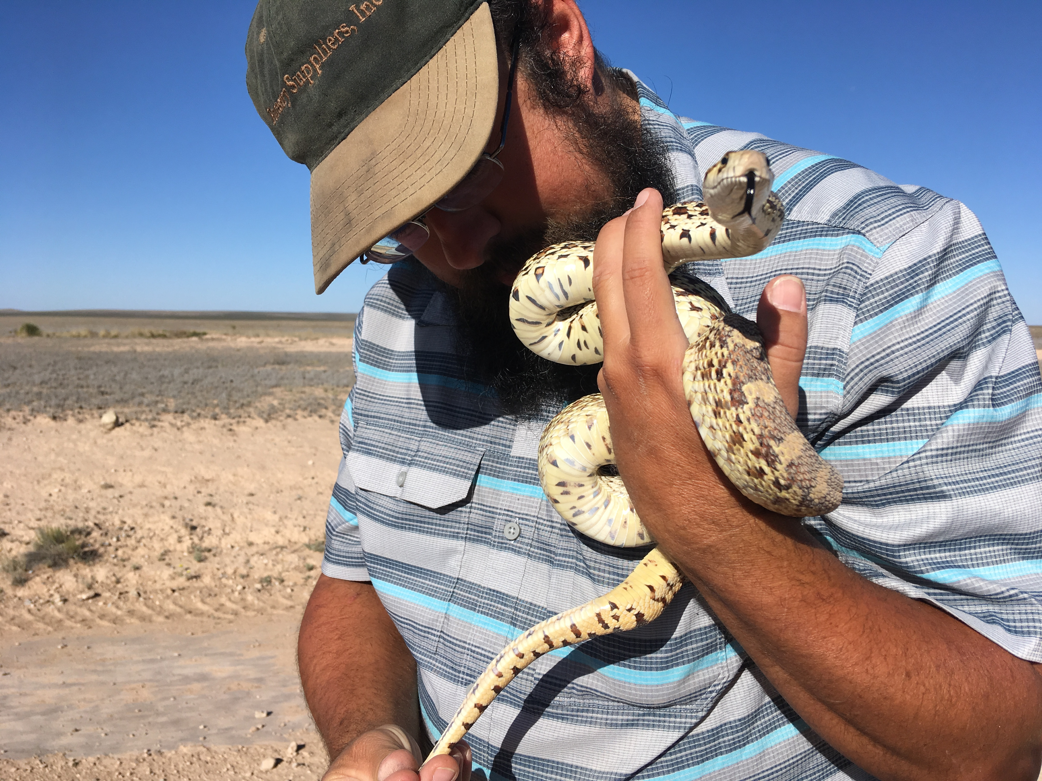
Do these on your own time…
Climb rocks
Play with venomous snakes
Talk to strangers
Walkabouts
Get that perfect selfie on the edge of a cliff

Slide 4
Road Safety

Slide 5
Follow the rules of the road.
Follow speed limit, consider weather, go an appropriate speed on gravel/dirt & know when 4wd will work versus when you need to turn around!
Make sure all objects are secured and that you and your crew know how to use tie-downs, ratchet straps, etc.
Check your tires regularly
Take your time
Use a spotter
DO NOT TEXT AND DRIVE

Slide 6
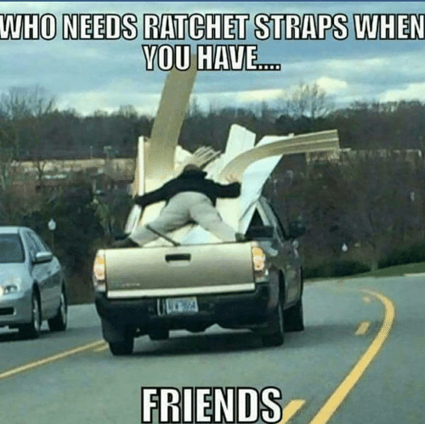
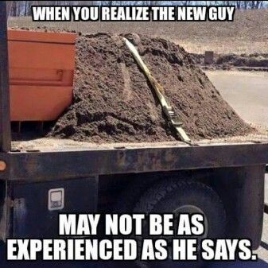

Slide 7
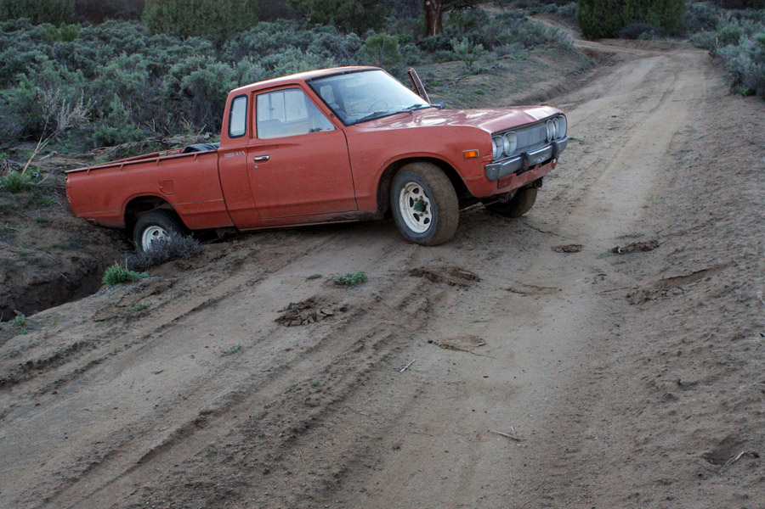

Slide 8
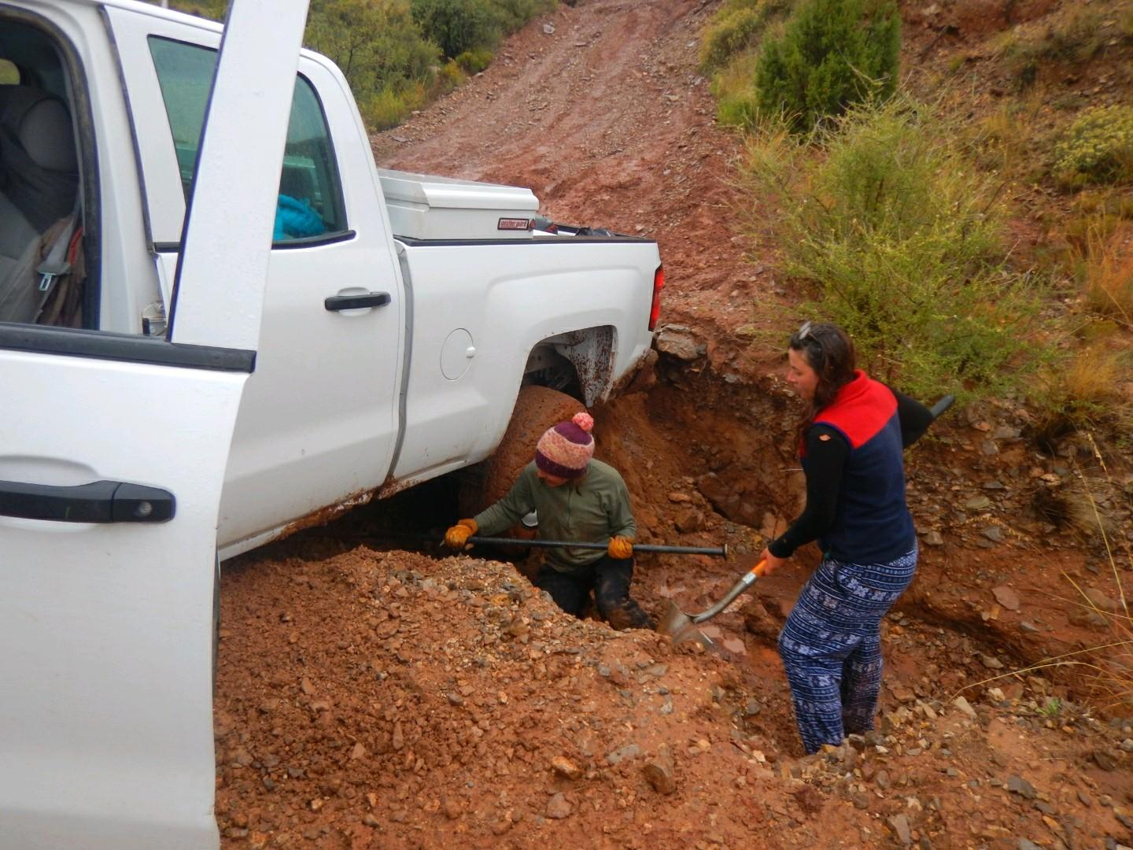

Slide 9
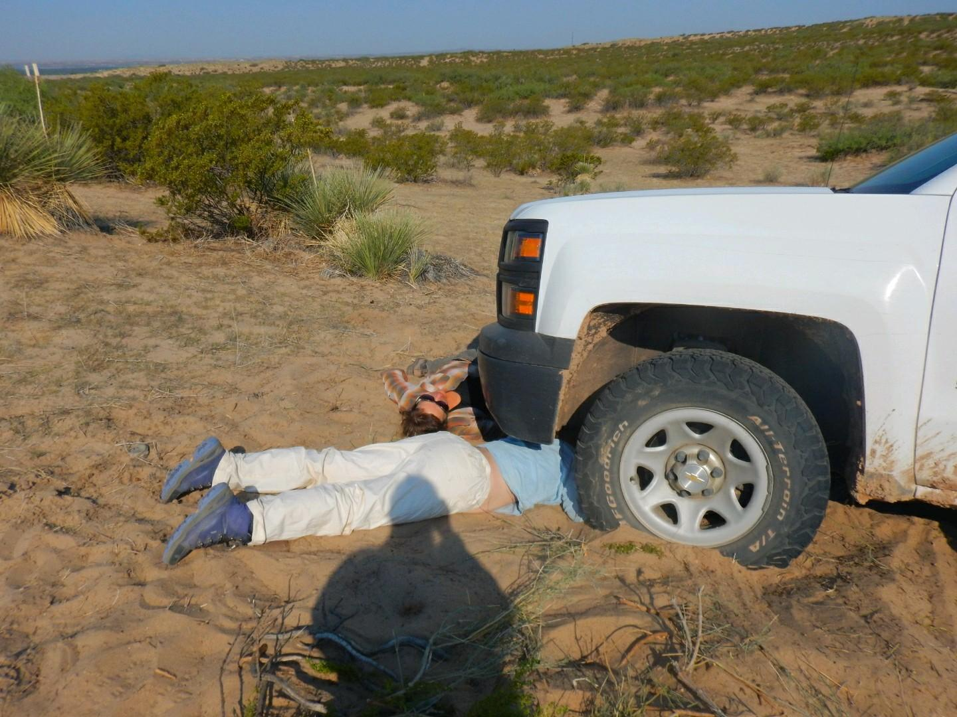

Slide 10
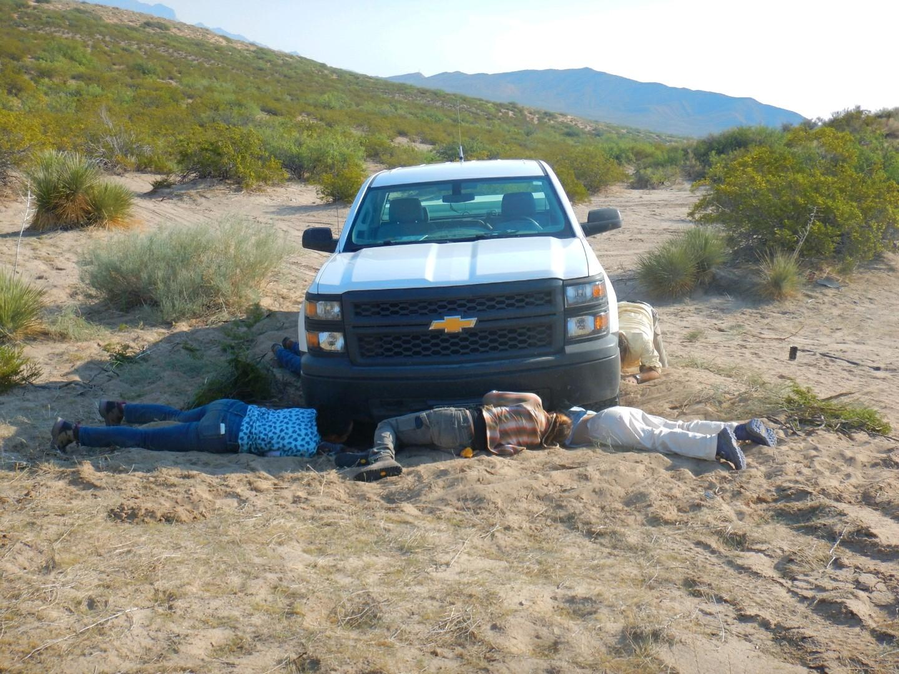

Slide 11
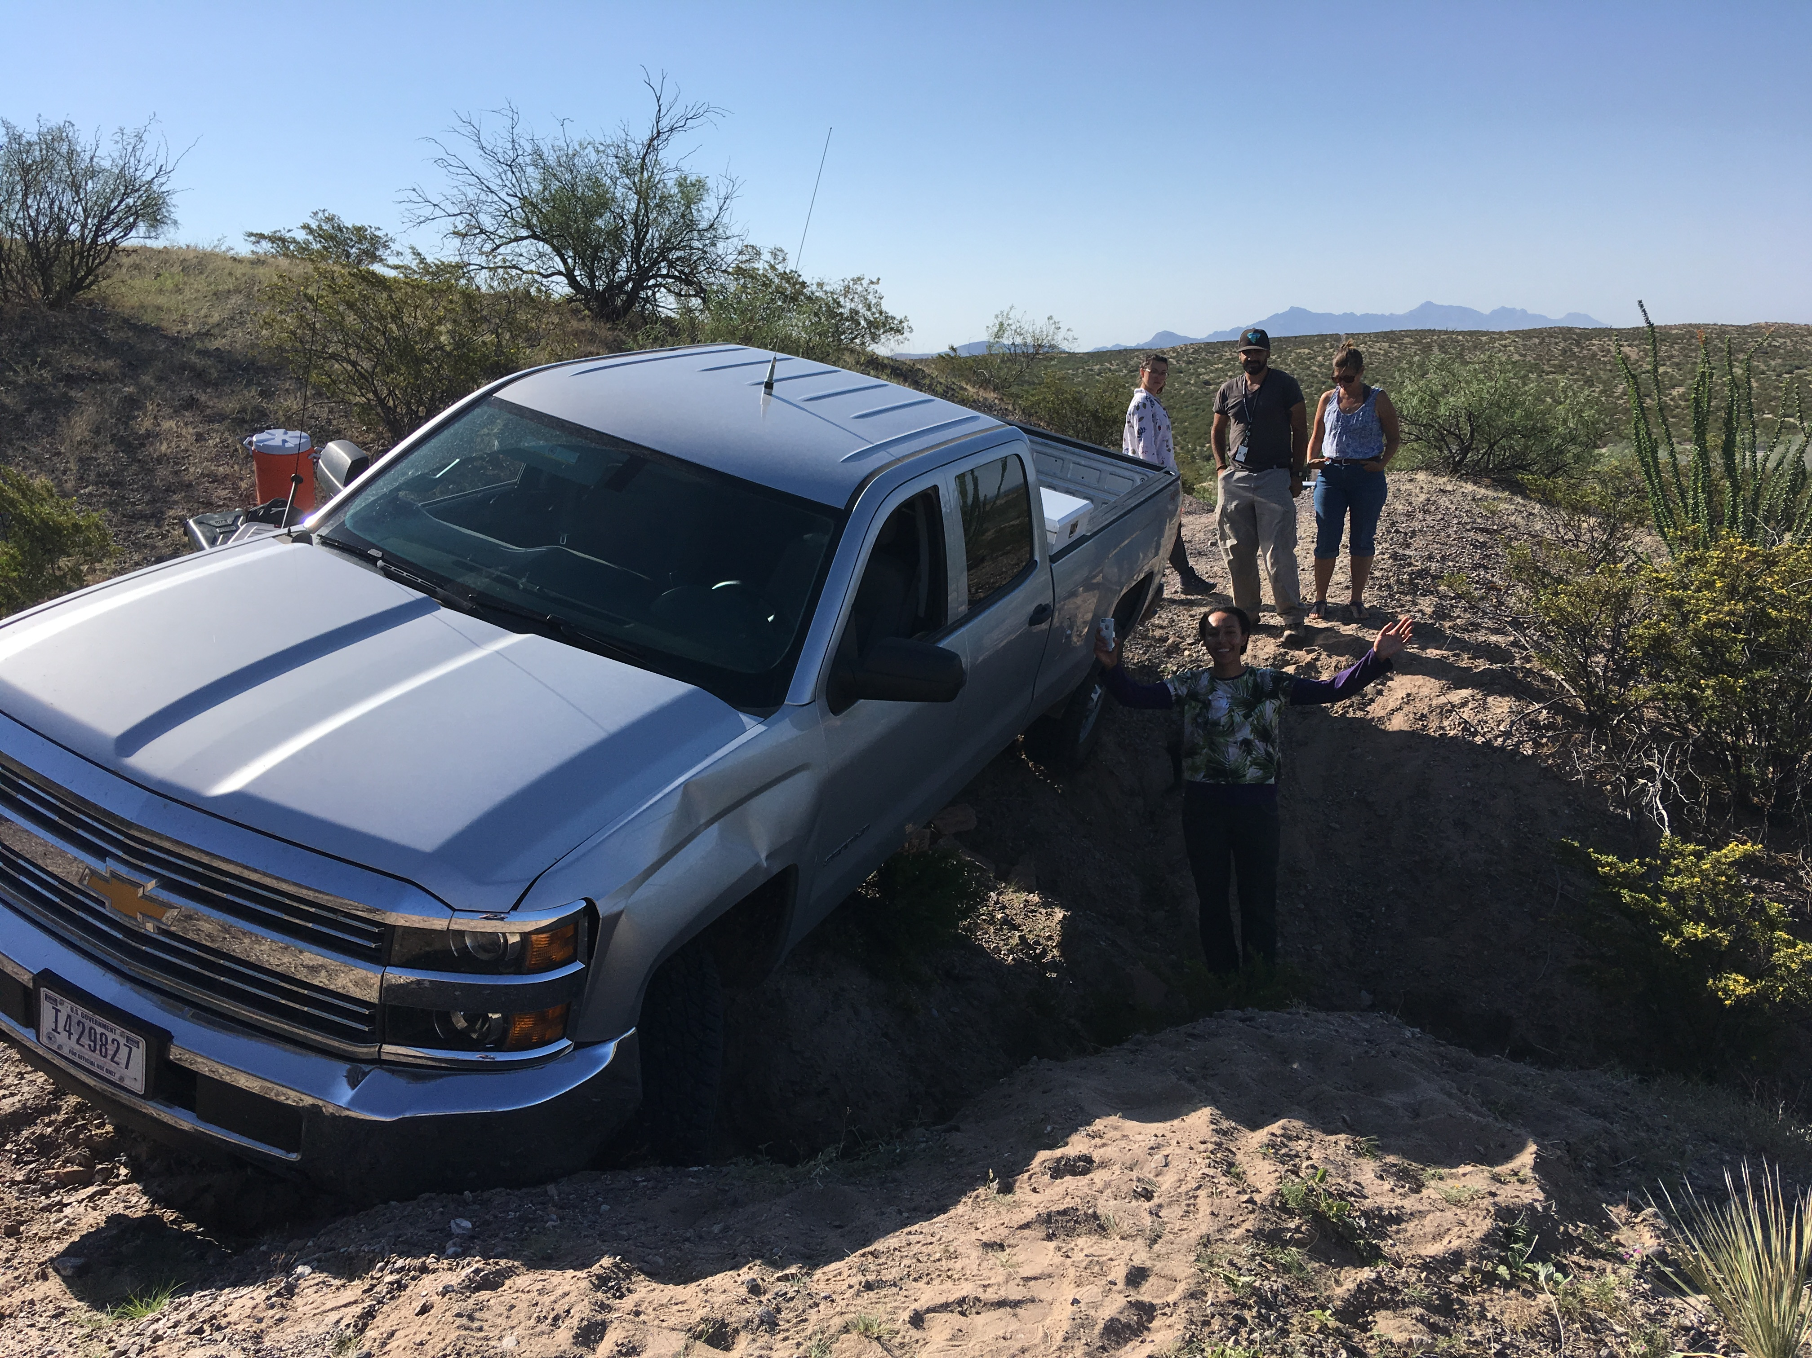

Slide 12
Weather Hazards

Slide 13
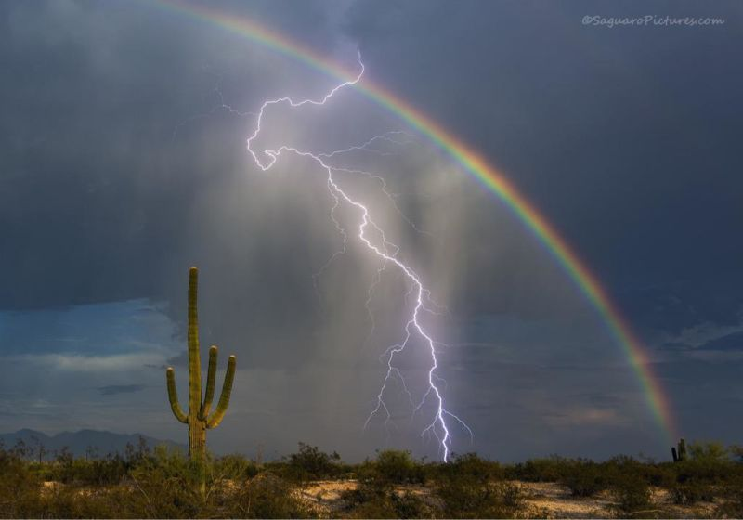
Flash floods
Lightning
Heat Stress
Wildfire

Slide 14
So what do I do?
Eat salty snacks!
Drink water frequently
Dilute gatorade/powerade
Wide brimmed hats/sunscreen
Wear appropriate field clothing
Take a siesta!
Situational awareness

Slide 15
Abandoned Mines

Slide 16
Just Say No

Slide 17
Wildlife Hazards

Slide 18
Large animals
Black bears
Mountain Lions
Wolves
Stray dogs/unfriendly dogs
Cows
People

Slide 19
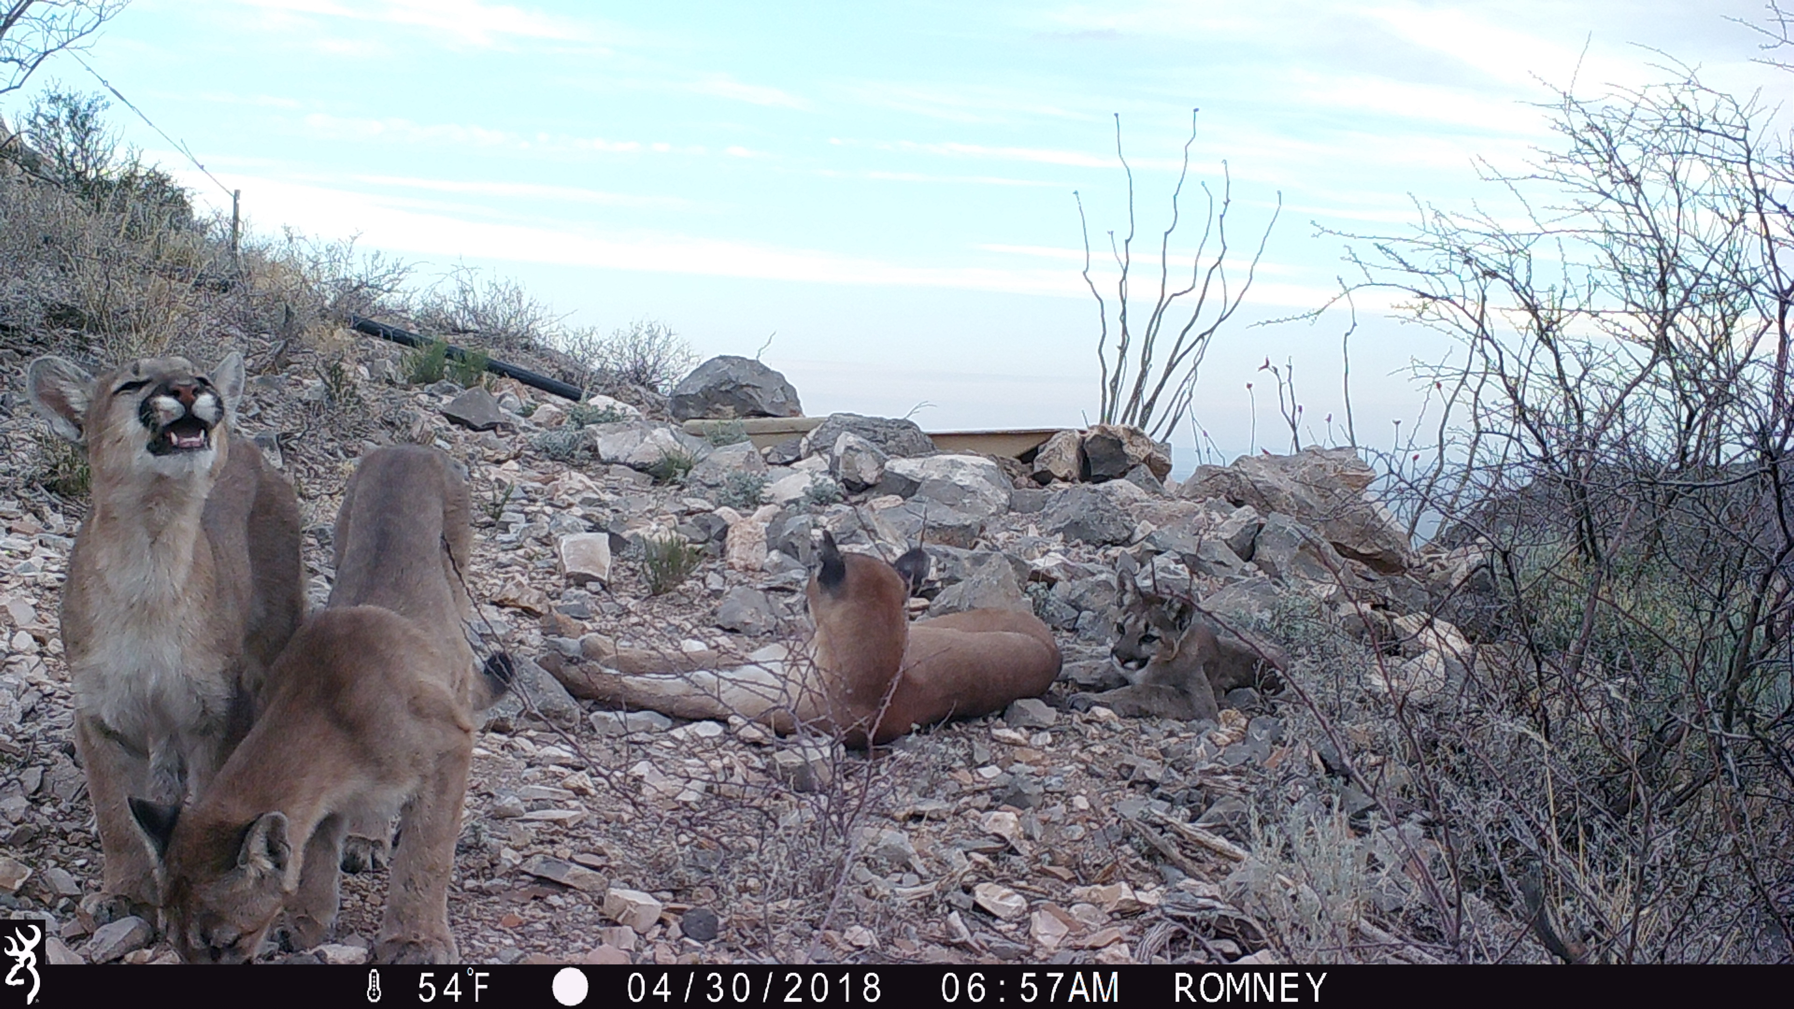

Slide 21
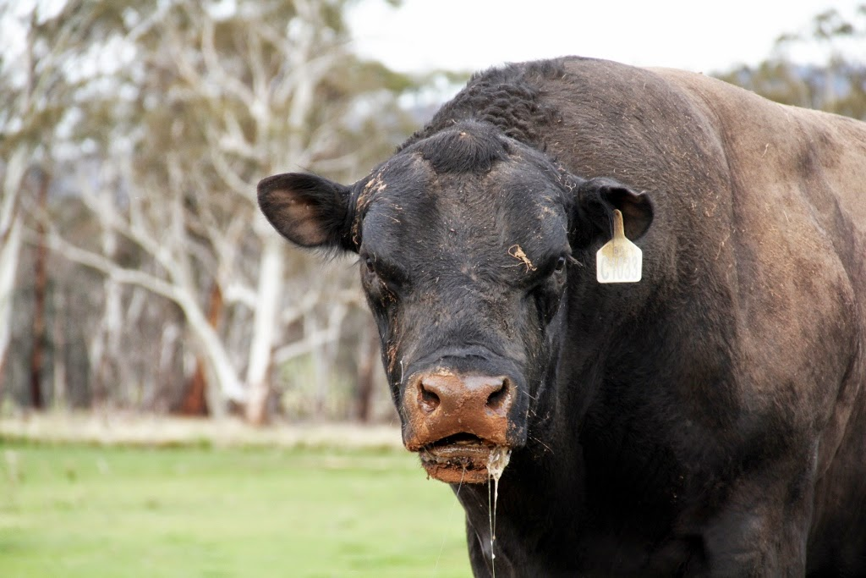

Slide 22
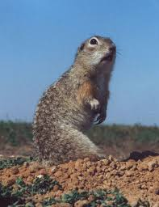
Smaller Critters
Rattlesnakes
Have a plan!
Wear snake guards (no Tevas!)
Mice/ground squirrels
Hanta virus
Plague
-Keep your food and kitchen ware animal proof even if you are not in “bear country”

Slide 23
Biting/Stinging Insects
Bees/Wasps
Find out about allergies ahead of time!
Ants
Spiders
Brown Recluse
Black Widows
Mosquitos
Ticks & the things they carry
Talk to your safety specialist and know what’s in your area

Slide 24
But I want to play with all the animals…..
Exercise situational awareness
Not all puppies are friendly
STAY CALM

Slide 25
All of the other safety concerns…
Unexploded ordinances
Meth labs
Marijuana grows
H2S
Valley fever
Giardia
Poison oak and ivy
Abandoned vehicles
Trash dumps
Falling trees
Etc. etc.
Notes:
We can’t cover every concern in every field office so make sure to ask your local resources about safety concerns

Slide 26
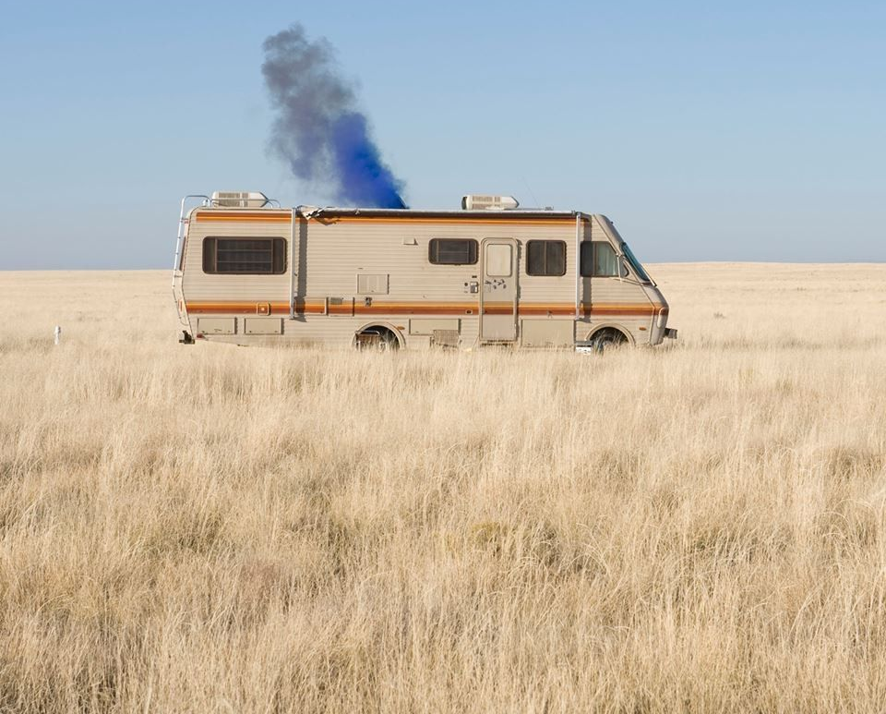
Does this meet the plot rejection criteria?

Slide 27
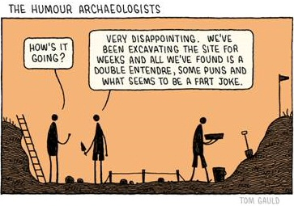
Archaeological Concerns
Cultural resources on federal lands are federal property managed for the public. Collecting these resources (e.g. picking up arrowheads) is illegal
If you encounter cultural resources, take a photo and a GPS point and report to FO archaeologist
In the rare event that you find anything that may be human remains, report this to the FO IMMEDIATELY. The BLM has strict timeframes that we must adhere to.

Slide 28
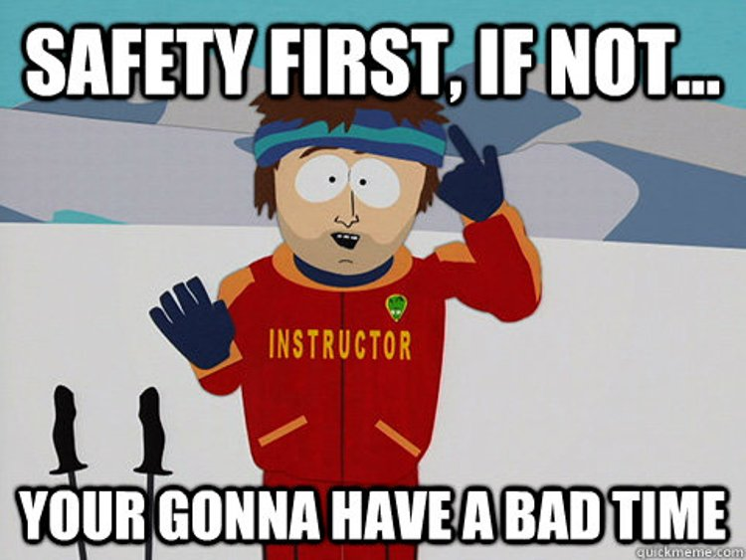

Slide 29
Questions, Comments, Concerns?

