Slide 1
Quality Assurance and Quality Control in AIM
Notes:
Before we get too far in to learning about what data to collect, I want to introduce a framework for thinking about how we approach collecting data.
Any time we interact with data we should be thinking about Quality Assurance and Quality Control.
Tips
-ask how many have heard of QA &QC?
-Can they give an example?
-Share a story about how QA&QC have been meaningful for you

Slide 2
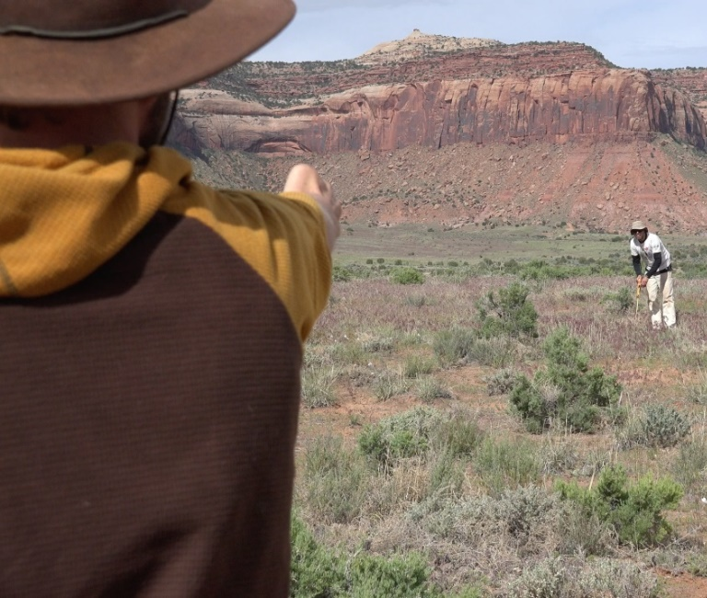
Objectives
Discuss importance of quality data
Define quality assurance and quality control
Identify specific QA and QC actions
Notes:
This presentation has three main objectives: 1) to discuss the importance of quality data, 2) Define quality assurance and quality control, and 3) Identify specific actions you can take in QA&QC

Slide 3
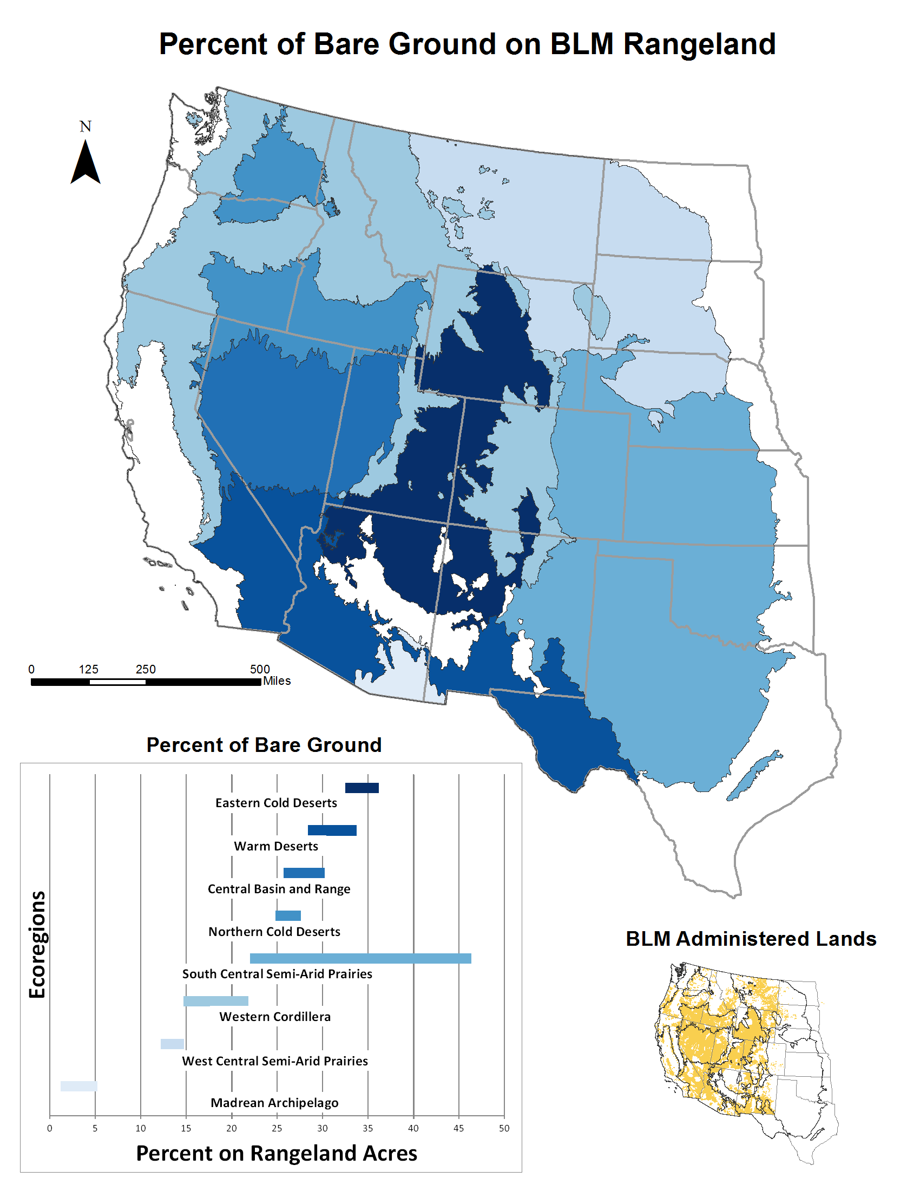
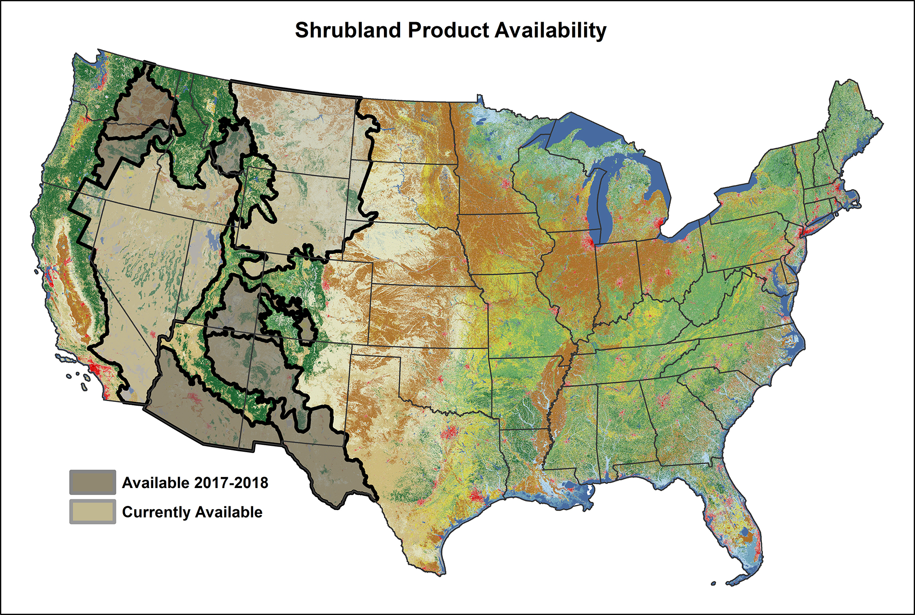
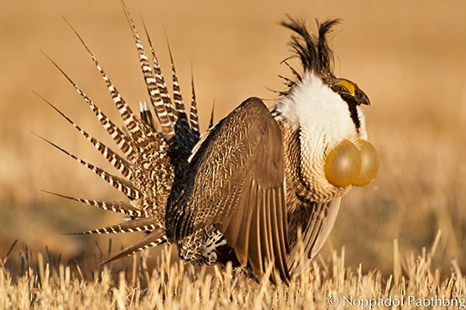
Diverse Applications of AIM Data
BLM Reports-Field Office to National
Applied Research
Notes:
AIM Data are used in many different ways. Within BLM these applications include treatment effectiveness reports, grazing permit renewals, sage grouse habitat assessments, and assessments of national condition.
However over 40 different organizations used AIM data for other applications and for applied research, including creating secondary, remote sensing based products, cheatgrass cover maps, and modelling wind and water erosion.
All of these groups rely on the AIM data collectors for quality data so that they can have an impact.

Slide 4
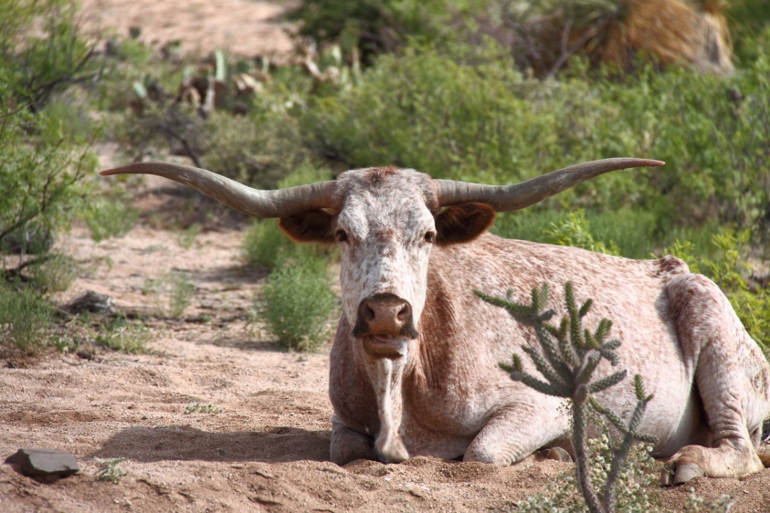
Interpret & Analyze
Collect
Plan
Summarize & Report
Decide
We need quality data!
Opportunity to affect data quality
Impact of Data Quality
Notes:
Because of the many uses of AIM data, data quality becomes all the more important. It can be helpful to think about the lifecycle of a dataset, from planning to collecting, to interpret and analyze, summarize, and then decide. The opportunity to affect data quality is at its highest during the planning and collection stage (which is where we are. At the same time, the impact of data quality is at its highest during the decision making phase. So errors that occur during collection magnify as they reach the decision stage. Similarly quality data are also amplified as you move through the data life cycle.

Slide 5
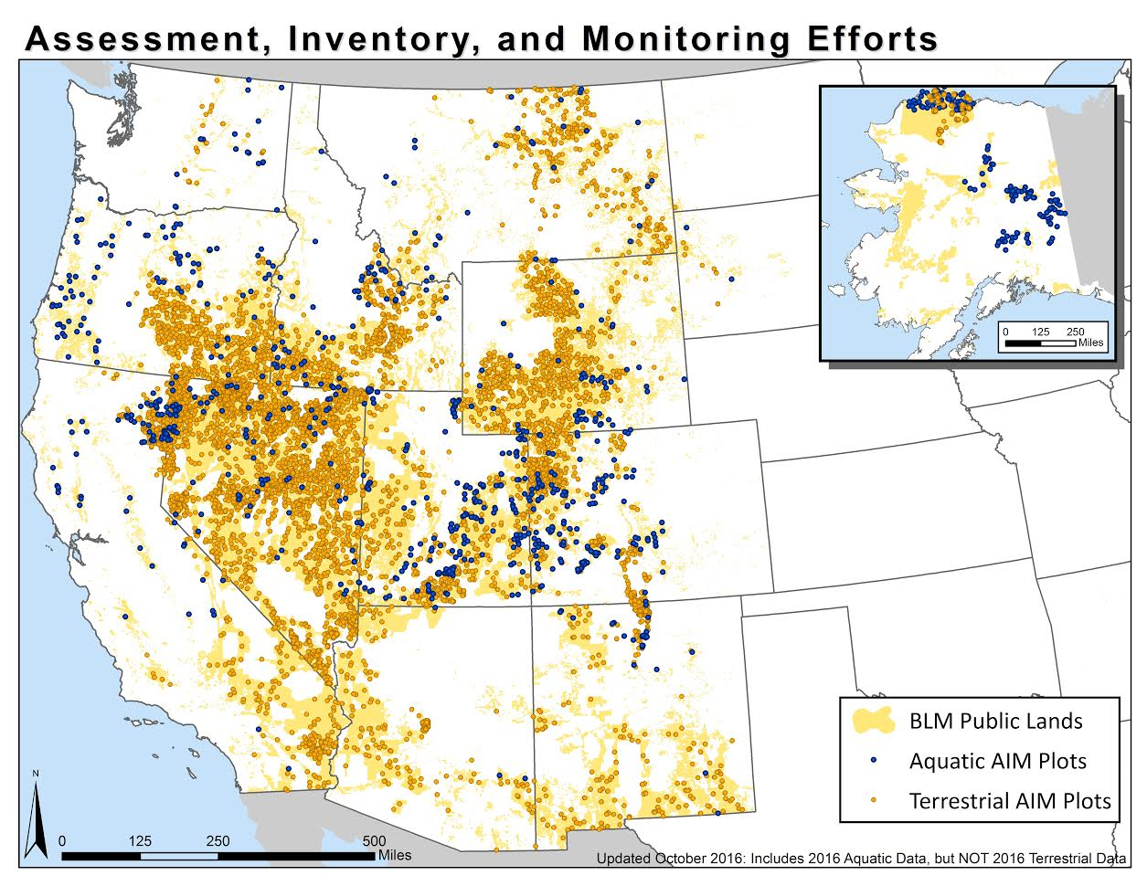
Quality Data for Informed Management
Defined data flow
Continuous quality assurance and quality control
Active data management
Notes:
So how do we get to quality data for informed data management? We develop a defined data flow, which you’ll hear more about later this week. Secondly, we need continuous QA&QC, and along with that active data management.

Slide 6
Defined Data Flow
See the AIM Data Management Protocol!
Notes:
So we do have a defined data flow within AIM, that identifies every piece of data, who interacts with it, when, and what tools they should use. By identify roles and responsibilities and timelines we cut down on a lot of errors due to disorganization. It may be helpful to build a more specific data flow within your crew.

Slide 7
Errors
Sampling Errors
Errors introduced when the indicator you are estimating is different than the actual value because you only sampled a portion of the population
Reduced by good sample design and method selection
Non-sampling Errors
Errors not due to sampling (e.g., measurement error)
Commission
Omission
Reduced by quality assurance and quality control
Notes:
Before I talk about QA and QC, we should take a minute to talk about what I mean by an error. In AIM we deal with 2 kinds of errors, sampling error and non-sampling error. Sampling errors are errors introduced when the indicator you are estimating is different than the actual value because you only sampled a portion of the population. We can prevent or reduce these errors by following and preserving a good sample design and be selecting unbiased methods. Most of this has already been done before, but as you will learn later there are some sample design QA&QC steps.
[ANIMATION]
The other kinds of errors are non-sampling errors, and this pretty much captures everything else. These errors can be due to commission (i.e., record the wrong plant species) or omission (forget to read a transect). We have the most control over these kinds of errors via QA &QC

Slide 8
Quality Assurance
Quality Assurance: proactive process to minimize the chance of an error being inserted into your data
GOAL: to prevent errors during data collection
Notes:
So what exactly do I mean by QA and QC? Let’s define them.

Slide 9
Quality Control
Quality Control: reactive process is to detect, note, and if possible fix, errors which occurred in the data collection and storage process
GOAL: to identify errors/problems after data
are collected and before they are released
Notes:
QC is a reactive process.
These concepts came out of manufacturing around World War II, so it might be helpful to think about how this relates to producing a car. QA deals with making sure the car is built correctly, the robots and the factor workers are doing their jobs, the car comes together. QC deals with test driving the car and the systems to see if they work properly and correcting any problems there.

Slide 10
Quality Assurance …preventing errors
Training
Calibration
Training
Field season
Data management
Electronic data capture
Data checks
Notes:
So what are some discrete steps of QA?
I am going to go over training, calibration, data management in a little more detail.

Slide 11
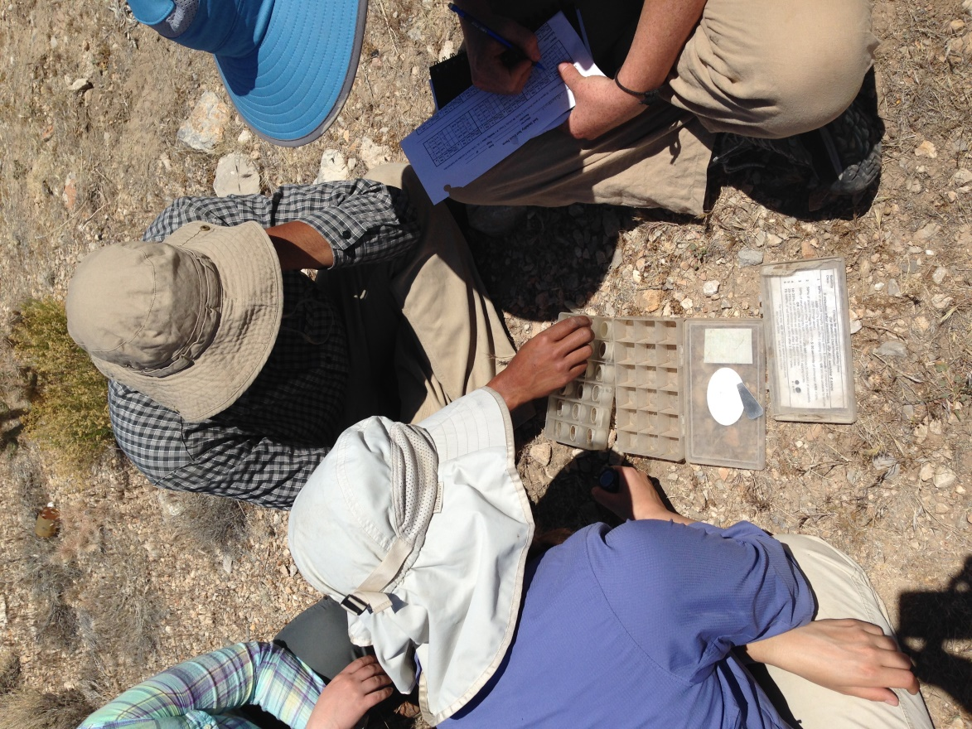
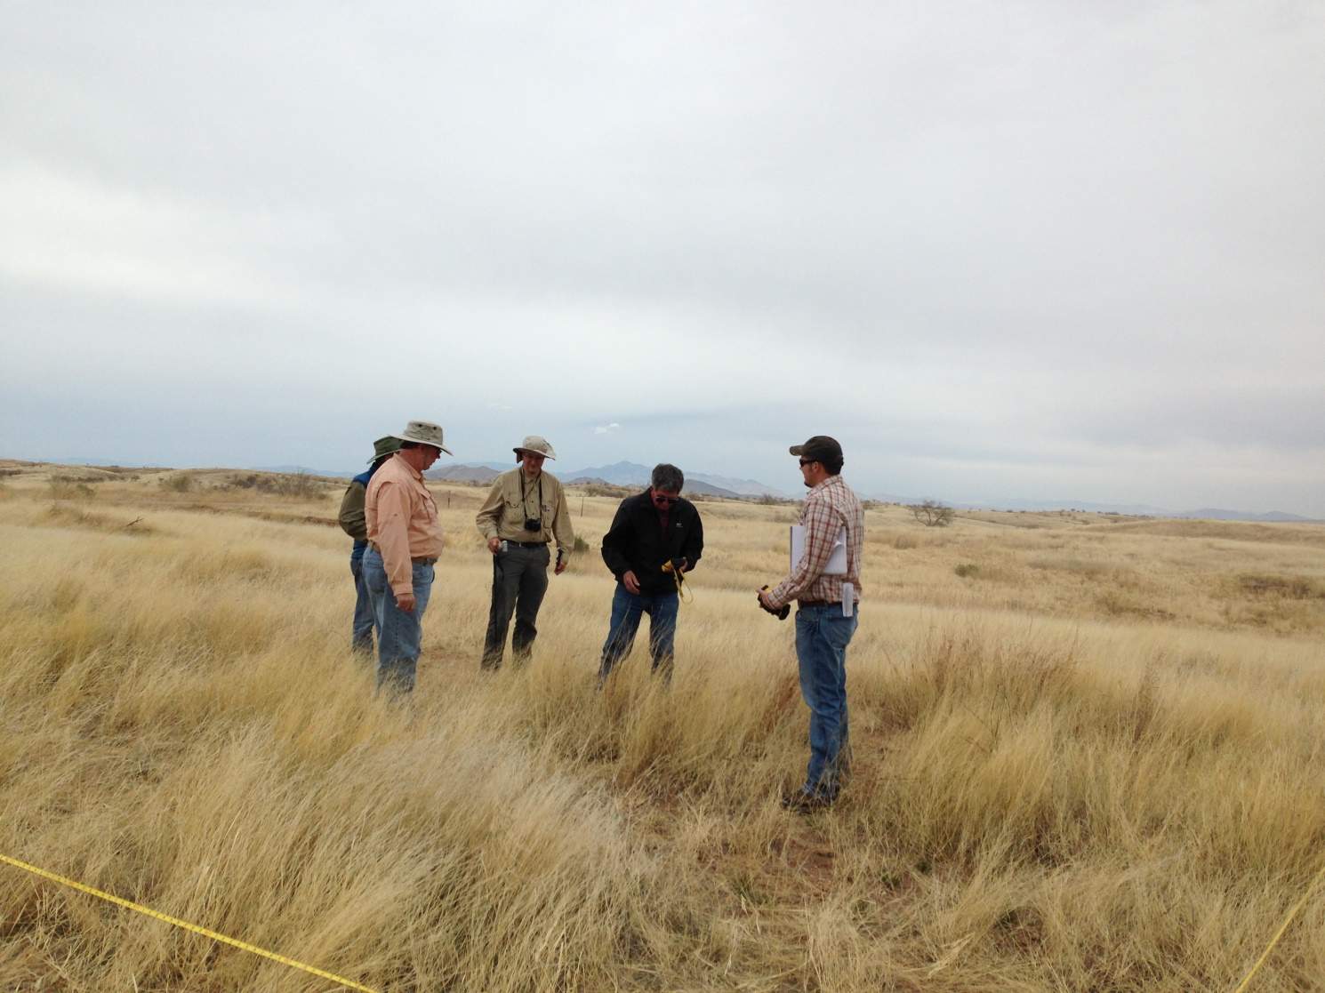
Training
All data collectors
Frequent
Calibration
Notes:
All data collectors should receive training and retraining prior to each data collection season and each training should be comprised of demonstration and calibration. We’re doing all of this this week so pat yourself on the back!

Slide 12
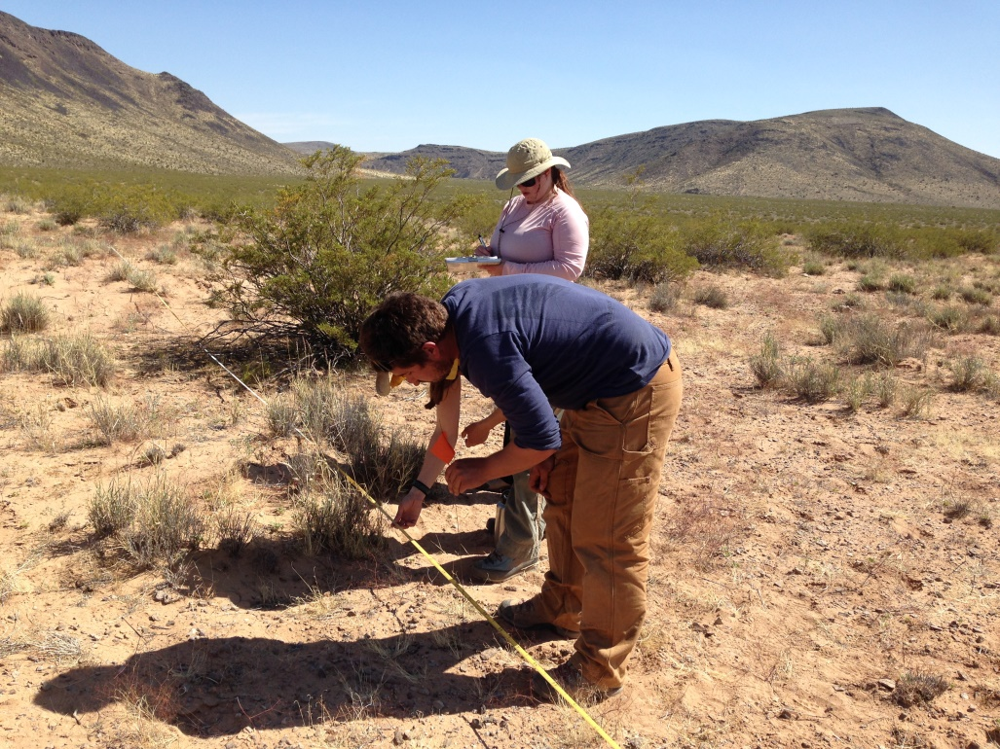
Calibration
Comparison between data collectors
Training
Whichever occurs sooner
Monthly
New ecosystem
Notes:
Calibration is a crucial component for ensuring quality data. It is used to make sure that each crew member is using the methods correctly and seeing the same information. This lets us know that regardless of who is collecting which method on a crew, it is accurate and consistent to that crew.
Your first calibration will occur at this training. Crews should also calibrate monthly, when a new crew member joins the team and/or when entering a new ecosystem.
We will cover more specifics of calibration later on in the training.

Slide 13
Establish Data Standards and Structures
Plot, File, Folder naming conventions
Field naming conventions
Field format-standard across data types
E.g., 2015-07-04 YYYY-MM-DD
See the AIM Data Management Protocol!
Data Type | Data Management Tool
AIM Data (field data and calibration data) | DIMA (Project and Calibration)
Plot Status (sample design and plot rejection) | Plot Tracking excel
Missing data (errors in dataset) | Missing Data/Known Errors template
Photos | ------
Description of the season, issues/concerns, successes, etc. | Implementation Summary Template
Notes:
In addition to calibrating, QA includes having established data standards and structures. Steps like folder naming conventions, field naming standards, date formats can all prevent errors later on. All of these are described in the AIM data management protocol.

Slide 14
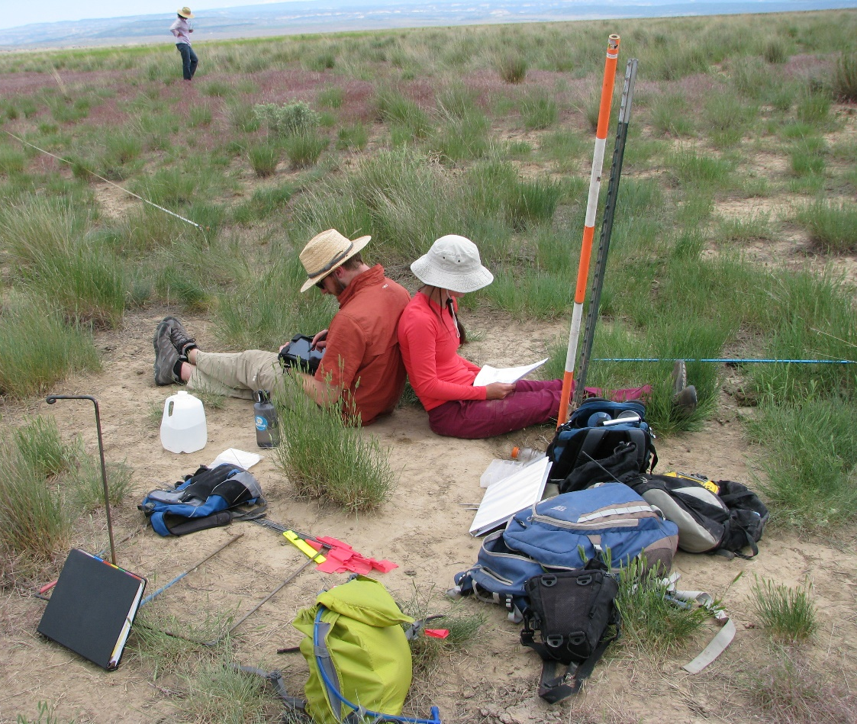
Quality Control …quantifying errors
Are the data…
Correct?
Complete?
Consistent?
Notes:
Quality control is the process of quantifying the errors that exist in your data set. A lot of QC is specific to the dataset you are working with, but ultimately we are asking 3 questions:
Are the data complete?
Are the data correct?
Are the data consistent?
So let’s review a couple of specific steps you can take

Slide 15
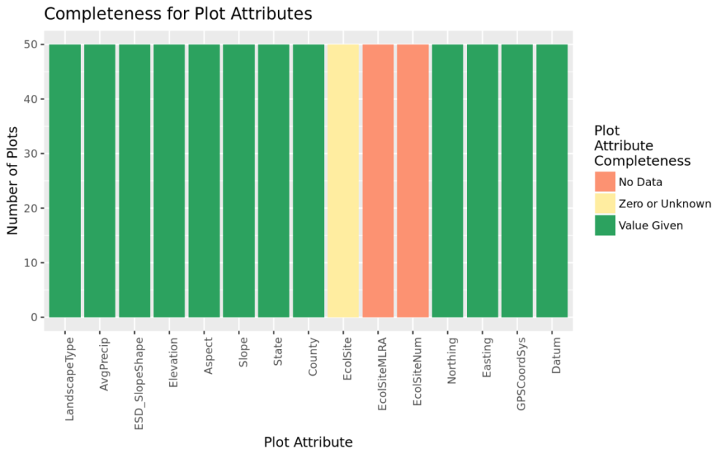
Are the data complete?
Every measurement on every line for every method
3 lines
LPI, Gap, Height, Species inventory, Species Stability….
Soil pit, plot photos
Tools
Visual checks
DIMA “Data Status” Button
DIMA Reports
Missing Data Tracking Sheet
Plot Checklist in Manual
Complete data sets
Notes:
To answer are the data complete, we need to do a review for holes—do we have all the data for every method, at each measurement point on each line? In addition to visual checks, there are some tools we can use to help us, like the DIMA “Data status button”, DIMA reports, and the Missing Data Tracking sheet.
The graph shows where missing data occur (red). Why are they missing? Because there was no ecological site developed for those plots, so that is an explainable missingness and isn’t an issue. But still document in the Missing Data tracking excel!

Slide 16
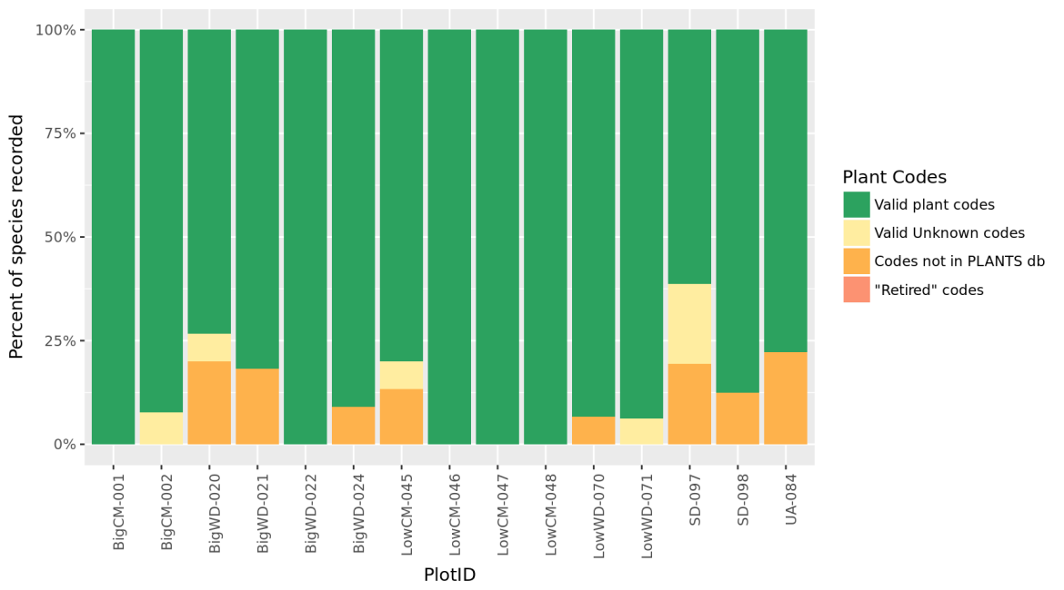
Are the data correct?
Were the data recorded correctly?
In the field
Office data entry
One person enters all data, and then two people check with one person at the computer and another reading the data sheet.
Logical checks
% Cover should be ≤100%
Height values should be consistent with vegetation types (300 cm sagebrush???)
Correct plant codes used for that location
Plot GPS locations
Lab checks
Voucher plant specimens
Voucher soil specimens
Correct plant protocols were followed
Notes:
Read through the slide.
The graph shows the number of times a USDA plant code was used (green), a valid unknown code was used (yellow) or an invalid code was used (orange). We can go look at those orange plots and figure out what is happening there.

Slide 17
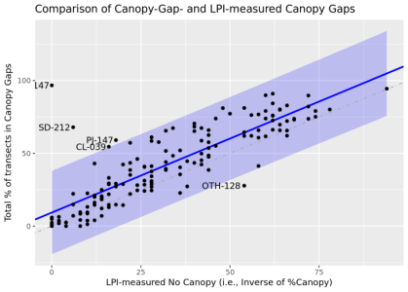
Are the data consistent?
Internal consistency
LPI and Gap tell the same story
Photos corroborate data
Soils and ecological site match data
Data are recorded and stored in the same way
External consistency
Plant codes match USDA Plants List
Unknown plant protocols are followed
Notes:
Finally we are looking for consistency…..
This figure shows the correlation of LPI bare ground and Canopy gaps. By and large the two indicators correlate except in a few plots. Why? Is that a feature of the spatial distribution of those plots or were there some errors in data collection? We’d need to look at the plot data and plot photos to explain that.

Slide 18
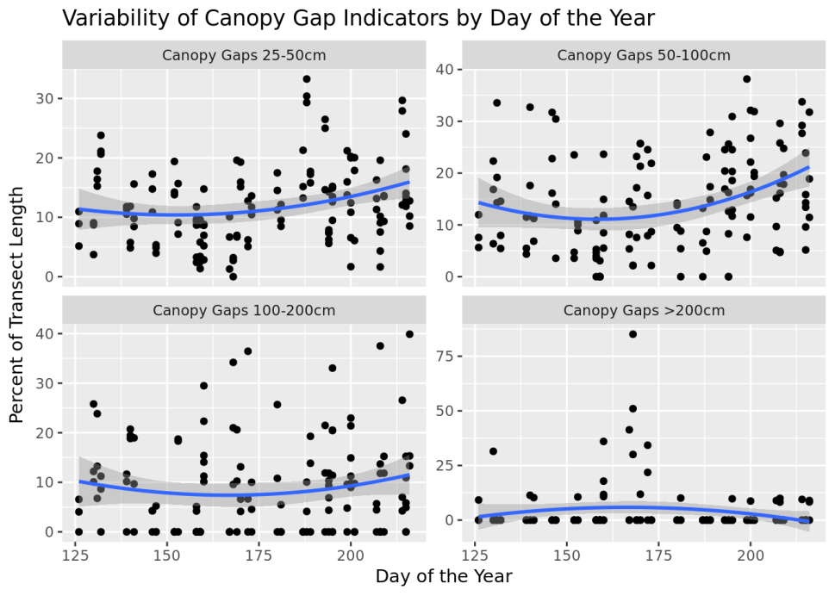
Look for Unexplained Bias
Are there errors or trend in your data that you can’t explain?
Record explanations in the Missing Data/Known Errors Log!
Maps of locations by time sampled can identify geographic bias to your data across the field season.
Notes:
Ultimately you are looking for unexplained errors and bias. Note anomalies and record their explanations. We’d rather have you explain an known error and understand the use limitations of the data than have an unknown error filter through the data set and possibly lead to the wrong management conclusion.

Slide 19
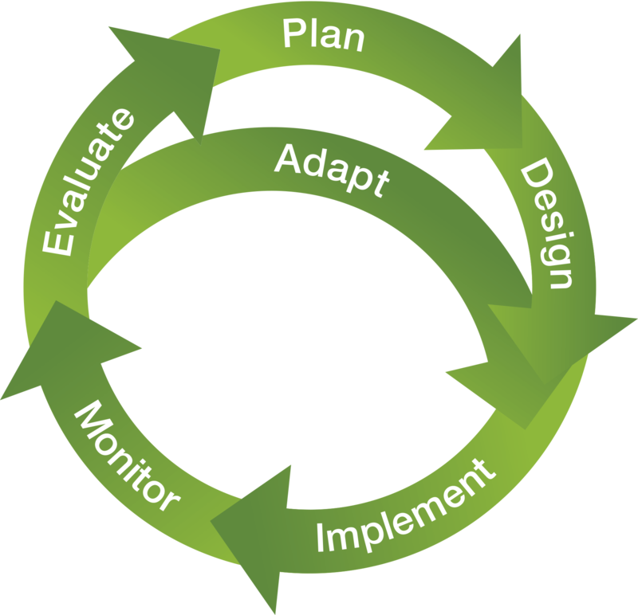
Implementing QA and QC
Vigilant data handling
Active data management
Before, during, after data collection
Known Roles and Responsibilities
Who is responsible for QA & QC?
Adaptive Monitoring
Use the results of QA and QC to improve your monitoring project.
Notes:
This talk has just been a brief overview of QA and QC. What I want you to take away from it is that QA &QC are a state of mind. It requires vigilant data handling, active data management, known roles and responsibilities, and learning from your mistakes to improve the process next time. In other words, adaptive monitoring!

Slide 20
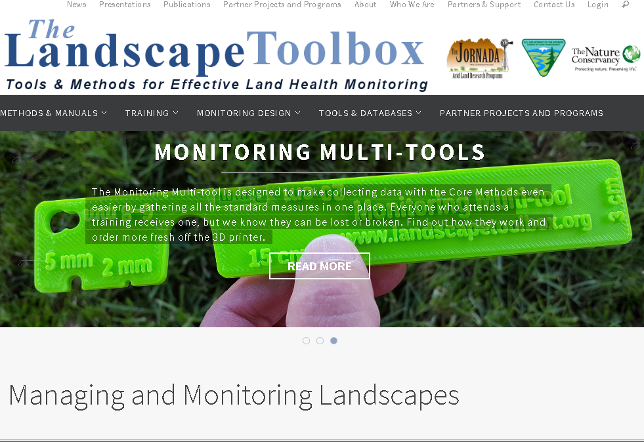
Resources
https://www.landscapetoolbox.org
Herrick, J.E., Van Zee, J.W., McCord, S.E., Courtright, E.M., Karl, J.W., Burkett, L.M., In Prep. Monitoring Manual for Grassland, Shrubland, and Savanna Ecosystems.
Wickham, Hadley. "Tidy data." Journal of Statistical Software 59.10 (2014): 1-23.
Notes:
If you’d like to read more about this, more information can be found at these sources (describe).

