Slide 1
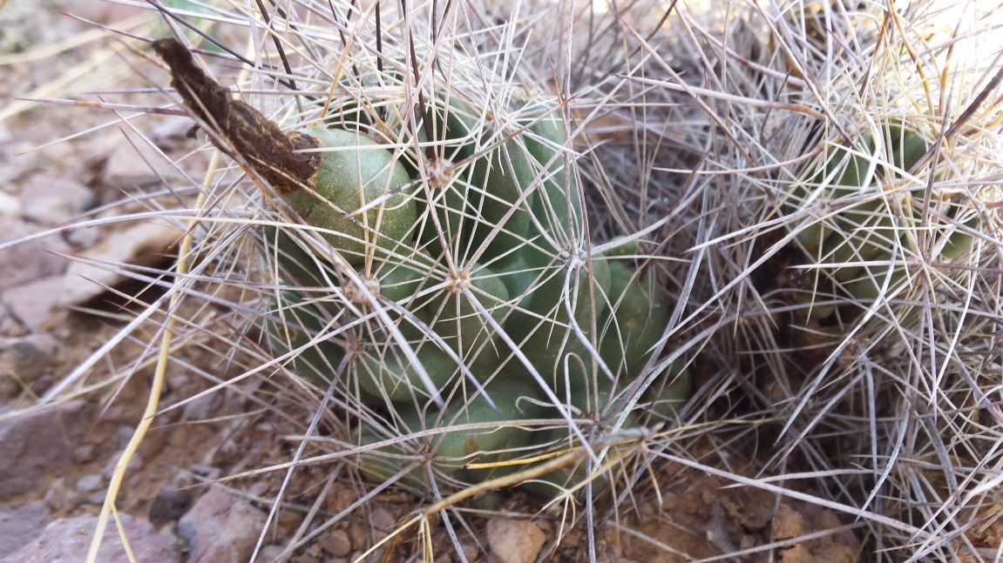
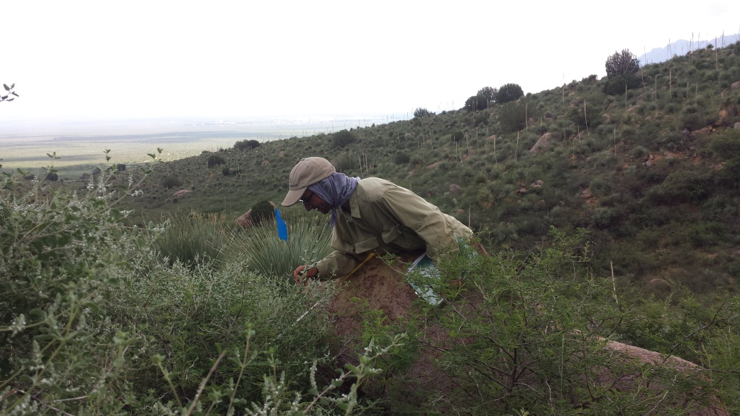
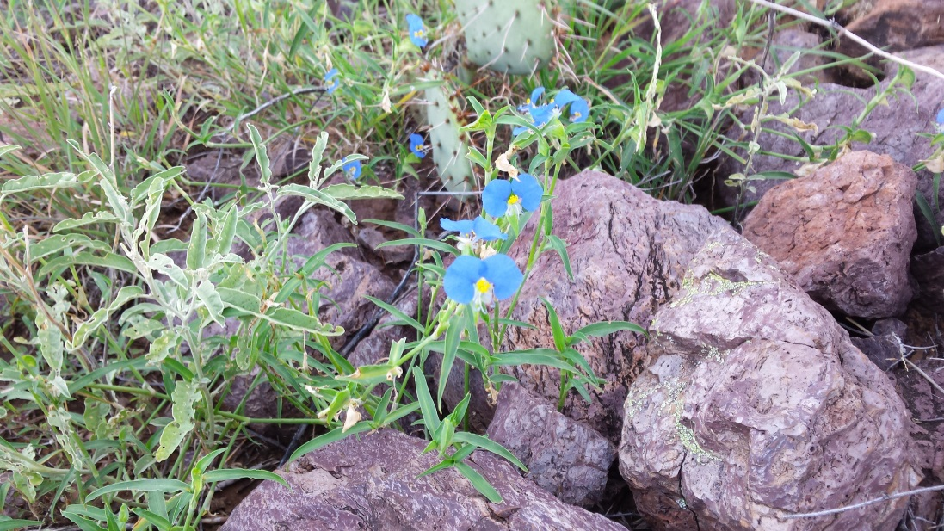
FLORA NEOMEXICAIMA
LCDO AIM CREW 2016

Slide 2
Guide Template
PHOTOS
Latin Name
USDA Code
Habitat
Description
Tips for lookalikes (When appropriate)
Native/non-native/invasive status

Slide 3
Grass
Annual and Perennial

Slide 4
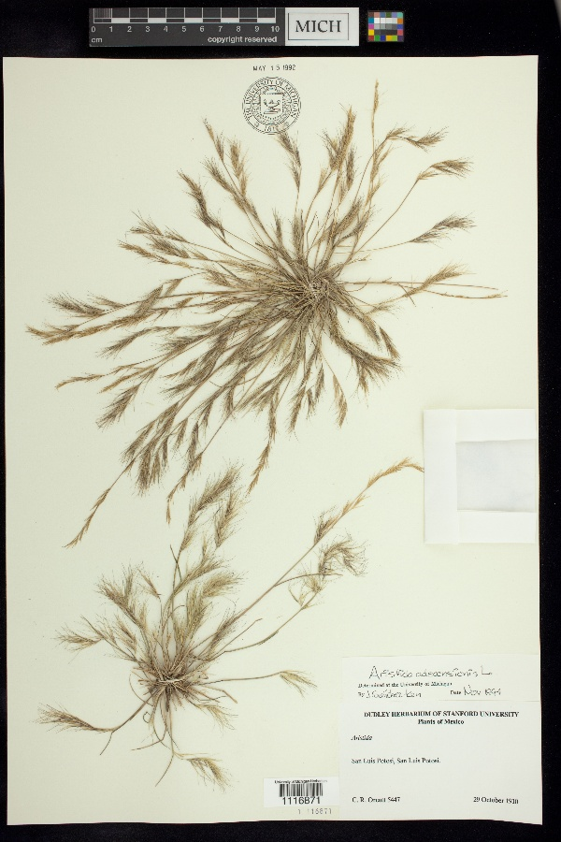
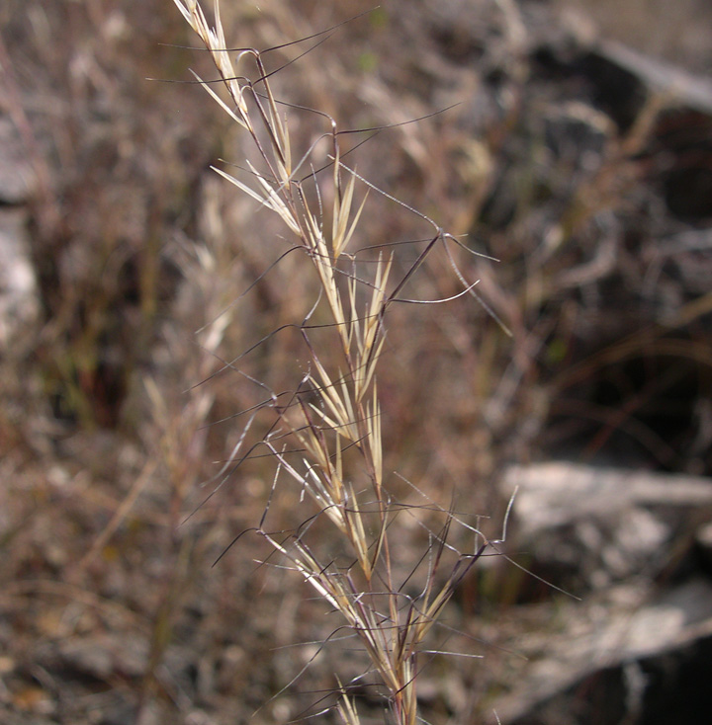
Aristida adscensionis
USDA code: ARAD
Common name: Sixweeks threeawn
Family: Poaceae
Habitat: waste ground, along roadsides, and on degraded rangelands and dry hillsides, often in sandy soils. It is associated with woodland, prairie, and desert shrub communities.
Description: Annual grass 10-30 cm; inflorescence narrow and spikelike, often with a purplish color; spikelets with one floret, unequal glumes; lemma elongated into a twisted awn column, apex bearing three awns 5-15 mm long.
Smaller than A. purpurea and A. ternipes
Native

Slide 5
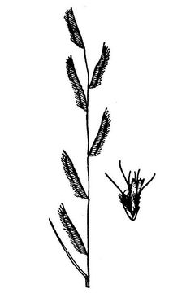
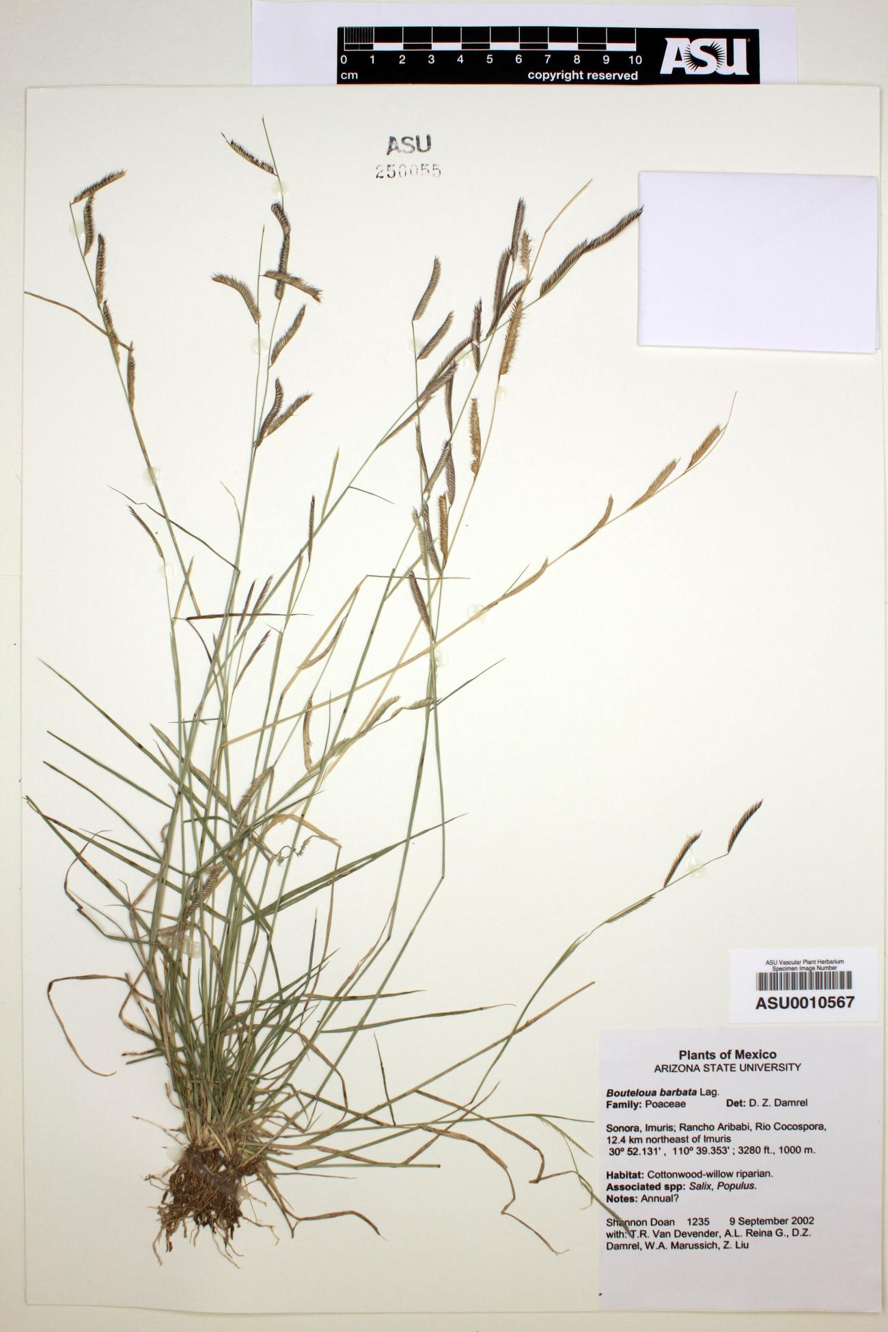
Bouteloua barbata
USDA code: BOBA2
Common name: Sixweeks grama
Family: Poaceae
Habitat: loose sands, rocky slopes, and washes, often on disturbed soils, usually at elevations below 2000 m
Description: annual; tufted
Much smaller than B. eriopoda, glabrous stem, annual.
Native

Slide 6
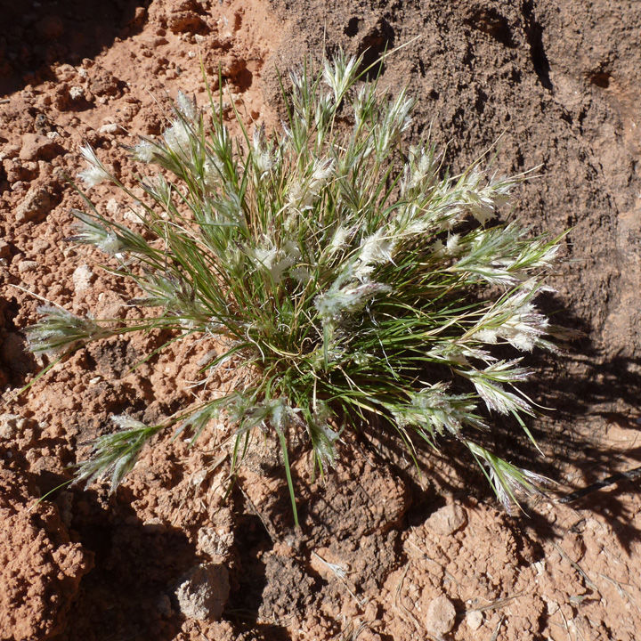
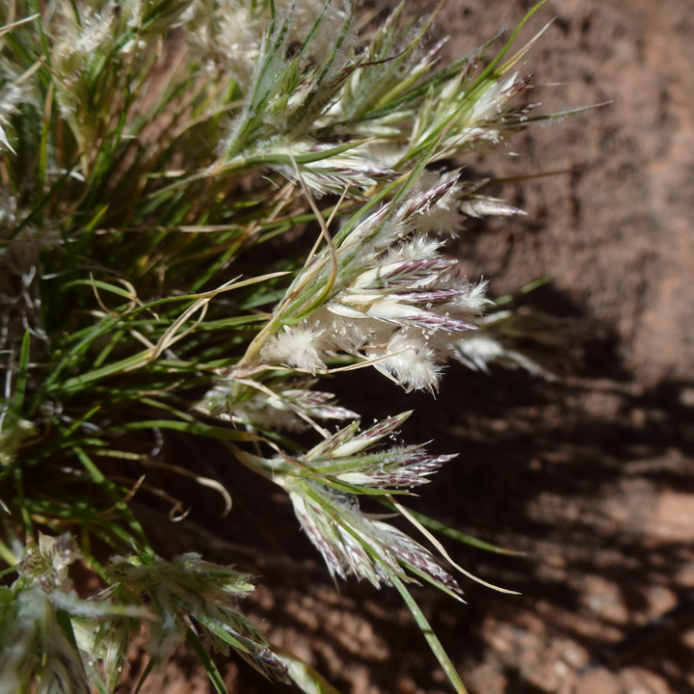
Dasyochloa pulchella
USDA code: DAPU7
Common name: Fluffgrass
Family: Poaceae
Previous names: Erioneuron pulchellum, Tridens pulchellus
Habitat: rocky, sandy arid soils
Description: Low perennial grass, appearing annual, < 15 cm; culms numerous, wiry, consisting mainly of a single elongated internode bearing at its apex a fascicle of leaves and spikelets, the fascicles eventually bending over to the ground and rooting; blades 1-5 cm long; inflorescence of capitate clusters of sessile or short-pedicelled spikelets most 7-13 mm long, 6 to 12-flowered.
Native

Slide 7
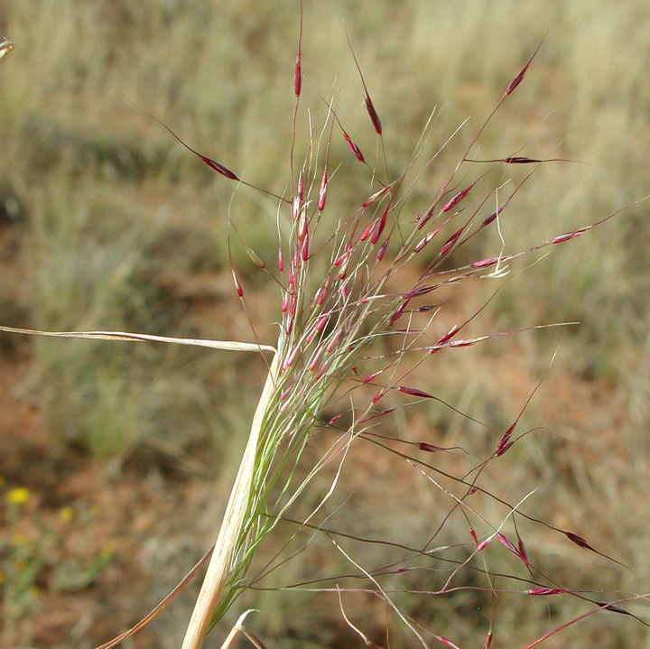
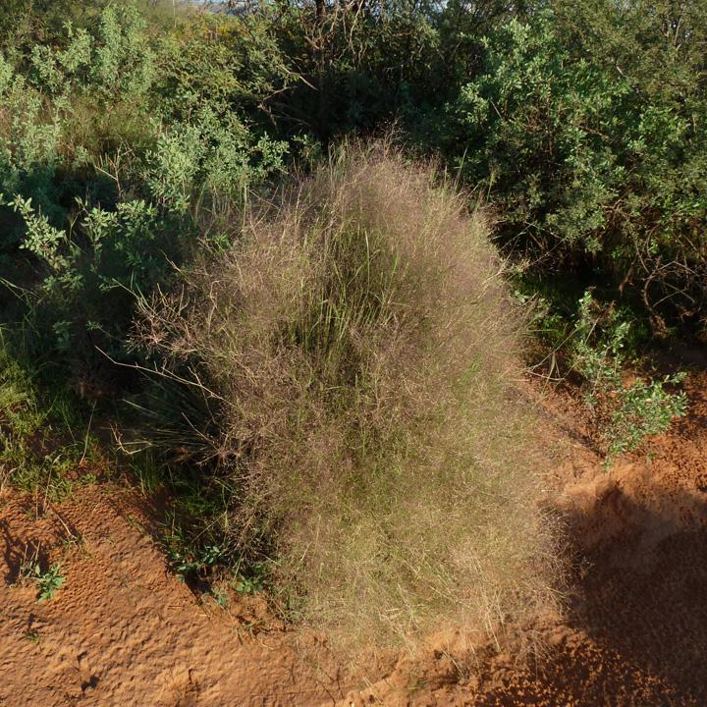
Muhlenbergia porteri
Common name: Bush muhly
USDA code: MUPO2
Family: Poaceae
Habitat: grows among boulders on rocky slopes and on cliffs, and in dry arroyos, desert flats, and grasslands, frequently in the protection of shrubs, at elevations of 600-1700 m.
Description: perennial; loosely cespitose from a knotty base, not rhizomatous, distinctly bushy in appearance. Purple to yellow stems, anthers, and leaves.
Native

Slide 8
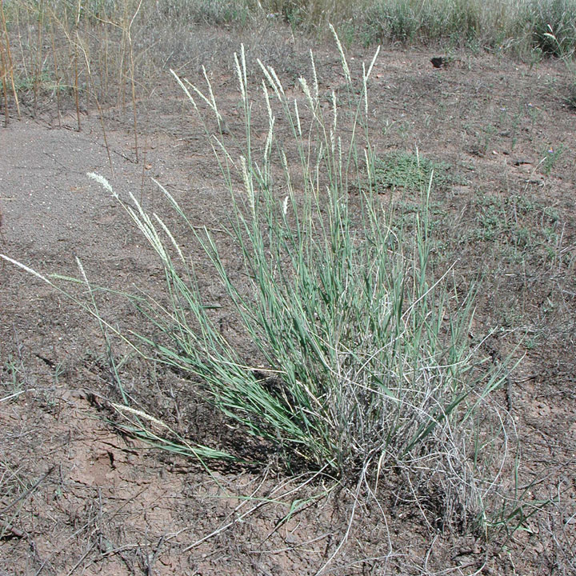
Pleuraphis mutica
USDA code: PLMU3
Common name: Tobosa
Family: Poaceae
Previous names: Hilaria mutica
Habitat: Plant: Rhizomatous perennial grass 30-60 cm, culms bending at middle nodes; leaf blades 2-15 cm, mostly scabrous on both sides; Inflorescence a terminal spikelike panicle 4-8 cm long, of reduced, disarticulating branches; each branch with three spikelets.
Decription: level upland areas and desert valleys subject to occasional flooding but lacking permanent streams
Native

Slide 9
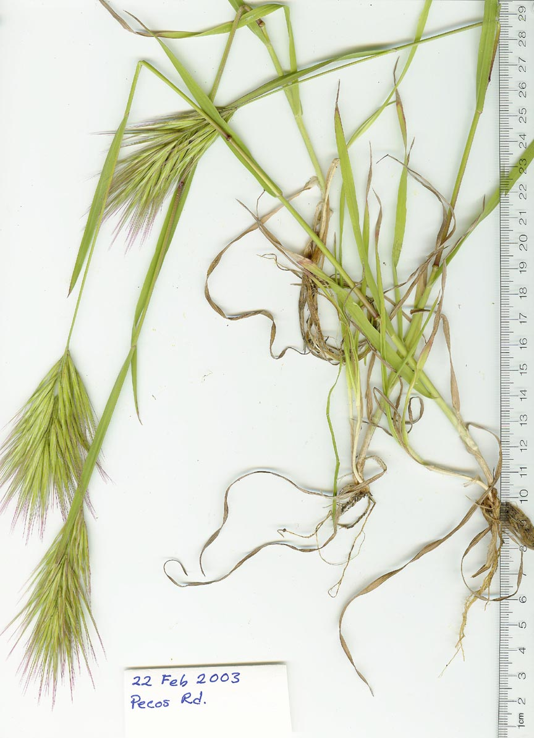
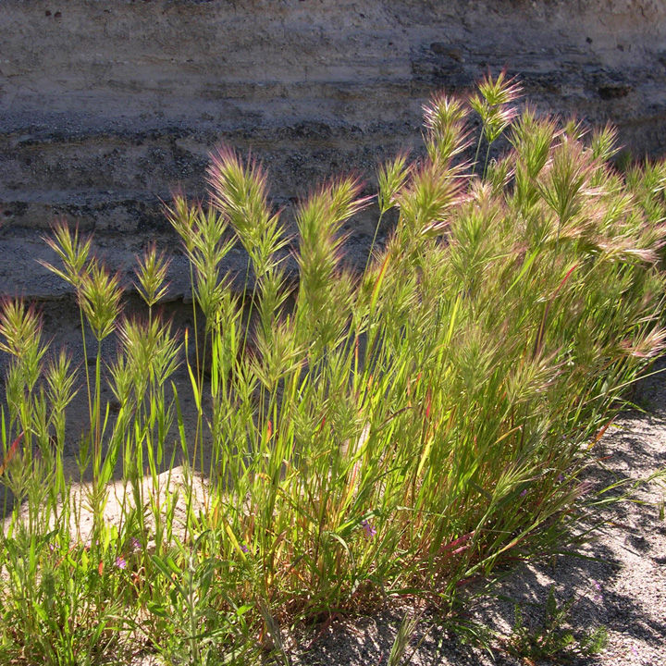
Bromus rubens
USDA Code: BRRU2
Common Name: Red brome
Family: Poaceae
Habitat: It now grows in North America in disturbed ground, waste places, fields, and rocky slopes, from southern Washington to southern California, eastward to Idaho, New Mexico, and western Texas.
Description: Annual. with fine retrorse pubescence; blades narrow, 1.5-4(-5) mm wide, sometimes involute; ligule 1-2.5(-3) mm; infl contracted, ovoid, short, to 10 cm, often purplish, the short branches and pedicels stout, ascending; spikelets 18-25(-30) mm, 3-8(-10)-fld, scaberulous to finely hirsute; glumes subulate, the first (5-)6.5-10 mm, 1-veined, the second 9-13 mm, 3-veined; lemmas subulate, 12-17 mm, 0.5-1.2 mm wide in side-view, 3- or 5-veined, the slender apical teeth 4-5 mm; awns 12-20(-24) mm, straight or slightly arcuate-spreading
Invasive

Slide 10
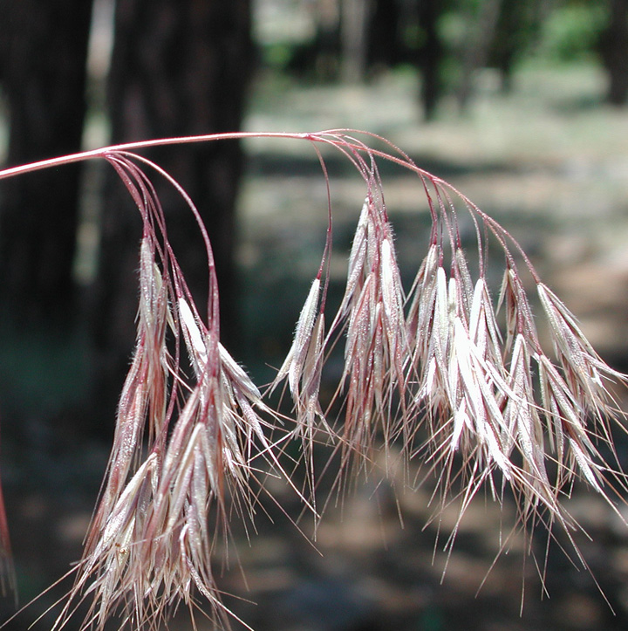
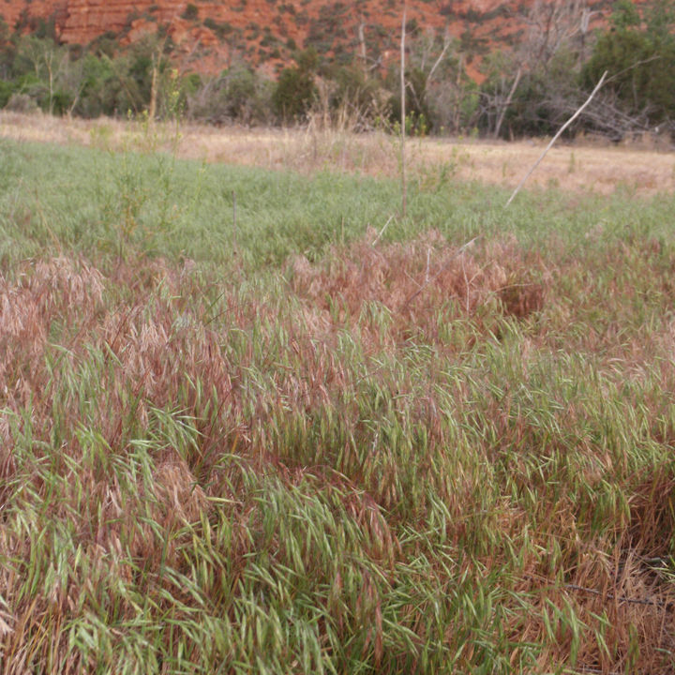
Bromus tectorum
USDA Code: BRTE
Common Name: Cheatgrass
Family: Poaceae
Habitat:disturbed sites, such as overgrazed rangelands, fields, sand dunes, road verges, and waste places. It is highly competitive and dominates rapidly after fire, especially in sagebrush areas.
Description: Annual. Culms 5-90 cm, erect, slender, puberulent below the panicle. Sheaths usually densely and softly retrorsely pubescent to pilose, upper sheaths sometimes glabrous; auricles absent; ligules 2-3 mm, glabrous, obtuse, lacerate; blades to 16 cm long, 1-6 mm wide, both surfaces softly hairy. Panicles 5-20 cm long, 3-8 cm wide, open, lax, drooping distally, usually 1-sided; branches 1-4 cm, drooping, usually 1-sided and longer than the spikelets, usually at least 1 branch with 4-8 spikelets. Spikelets 10-20 mm, usually shorter than the panicle branches, sides parallel or diverging distally, moderately laterally compressed, often purplish-tinged, not densely crowded, with 4-8 florets. Glumes villous, pubescent, or glabrous, margins hyaline; lower glumes 4-9 mm, 1-veined; upper glumes 7-13 mm, 3-5-veined; lemmas 9-12 mm, lanceolate, glabrous or pubescent to pilose, 5-7-veined, rounded over the midvein, margins hyaline, often with some hairs longer than those on the back, apices acuminate, hyaline, bifid, teeth 0.8-2(3) mm; awns 10-18 mm, straight,
Invasive

Slide 11
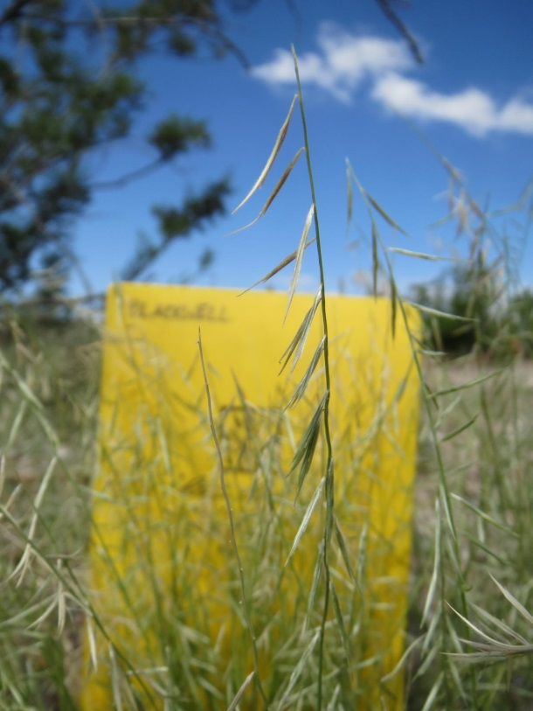
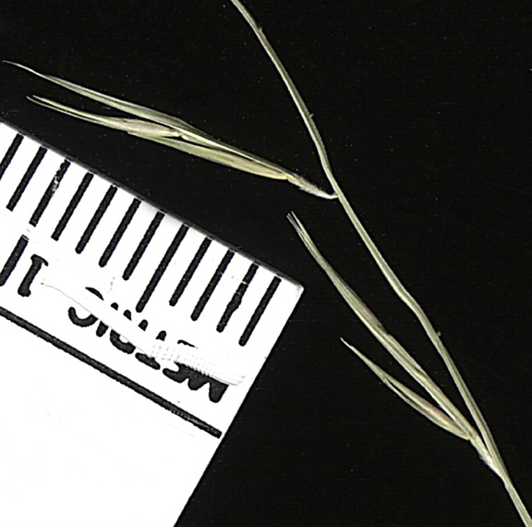
Bouteloua aristidoides
USDA code: BOAR
Common name: Needle-grama
Family: Poaceae
Habitat: loamy sand
Description: Plant: Annual grass to 50 cm; blades 2-5 cm long, <2mm wide, flat or folded; panicles 3-10 cm with 4-15 branches; branches one-sided, 10-45 mm, delicate, deciduous, densely pubescent with 2-10 spikelets/branch. Ligules 0.2-0.5 mm
Similar to, but much smaller than
B. curtipendula
Native

Slide 12
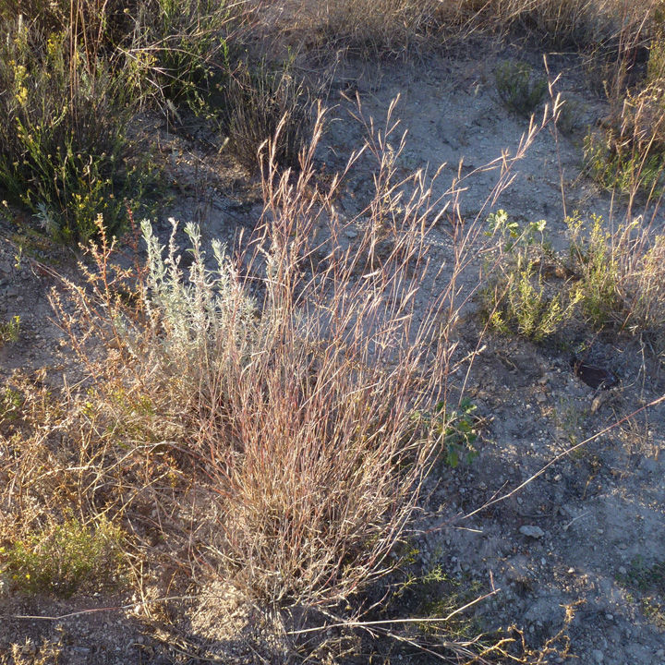
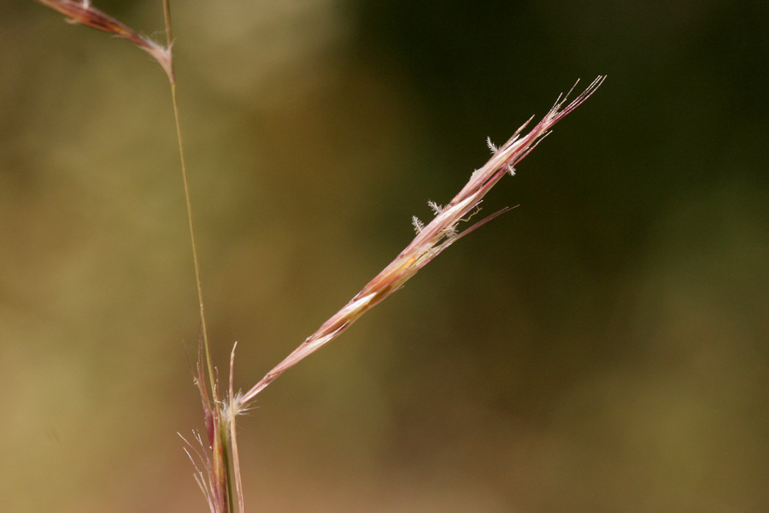
Bouteloua eriopoda
USDA code: BOER4
Common name: Black grama
Family: Poaceae
Habitat: grows on dry plains, foothills, and open forested slopes, often in shrubby habitats, and also in waste ground. It is usually found between 1000-1800 m, but extends to 2500 m.
Description: Stoloniferous perennial grass to 60 cm, stolons woolly-pubescent, culms wiry, decumbent, often rooting at nodes, lower internodes woolly; blades 3-6 cm long, <2mm wide; panicles 2-15 cm with 2-8 branches; branches persistent, with 8-18 spikelets
Native

Slide 13
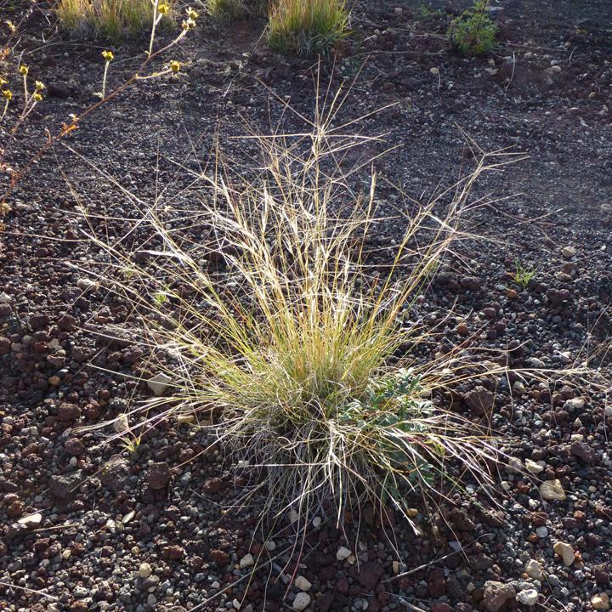
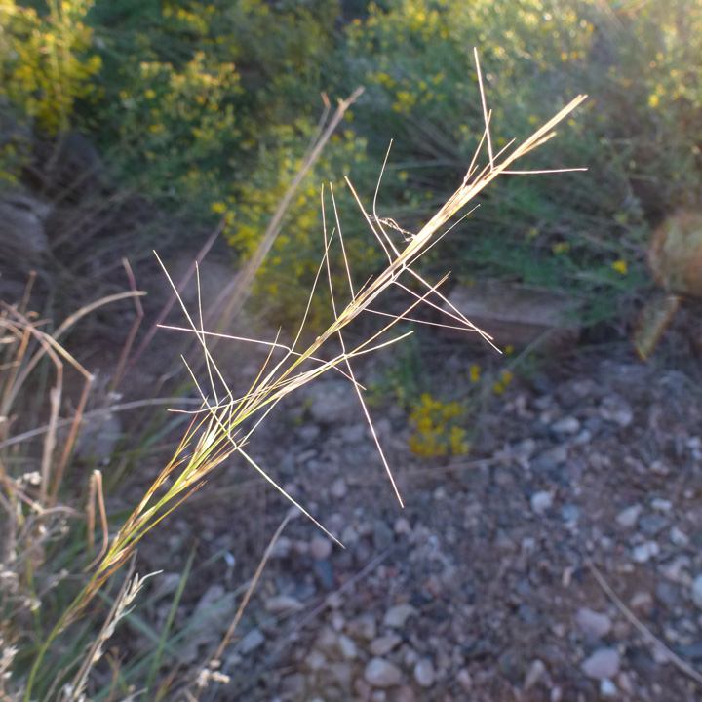
Aristida purpurea
USDA code: ARPU9
Common name: Purple threeawn
Family: Poaceae
Hatbitat: sandy
Description: Perennial grass 10-60 cm; inflorescence narrow and spikelike; spikelets with one floret, unequal glumes; lemma elongated into a twisted awn column, apex bearing three awns 7-10 cm long
Different from other Aristida in being perennial and having very unequal Glumes
Native

Slide 14
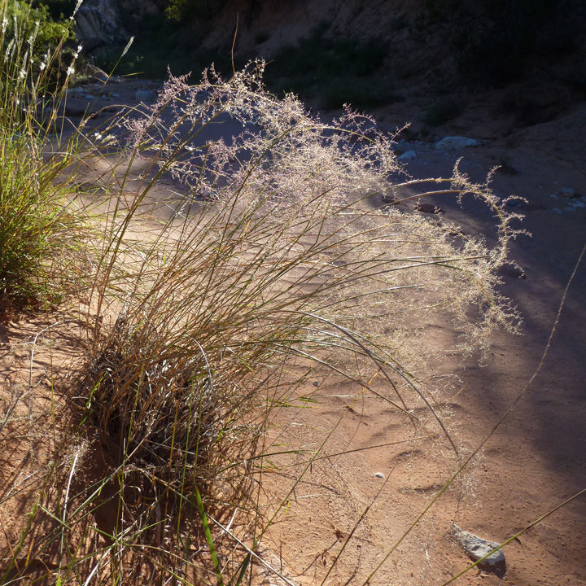
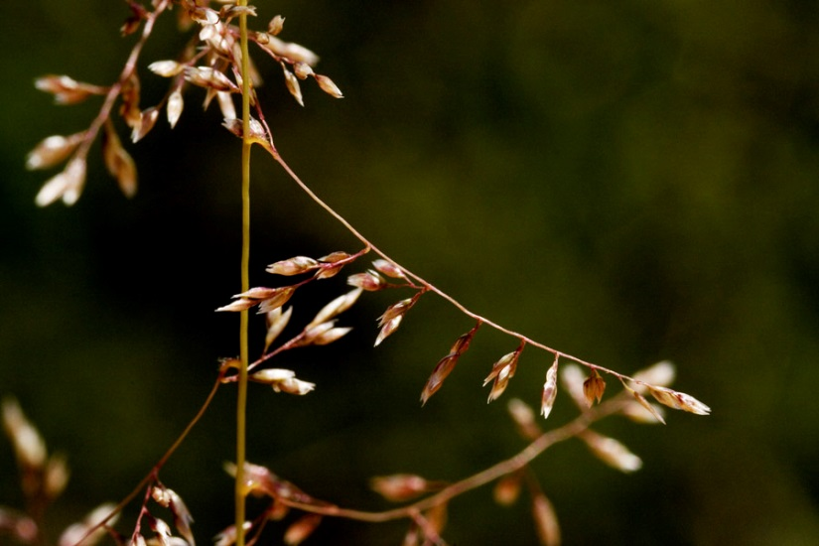
Sporobolus flexuosus
USDA code: SPFL2
Common name: Mesa dropseed
Family: Poaceae
Habitat: grows on sandy to gravelly slopes, flats, and roadsides
Description: Plants perennial (rarely appearing annual); cespitose, not rhizomatous, bases not hard and knotty. blades (2)5-24 cm long, 2-4(6) mm wide, ascending or strongly divergent, flat to involute, glabrous abaxially, scabridulous adaxially, margins scabridulous.
Primary branches usually reflexed and tangled, unlike S. crypatandrus and airoides
Native

Slide 15
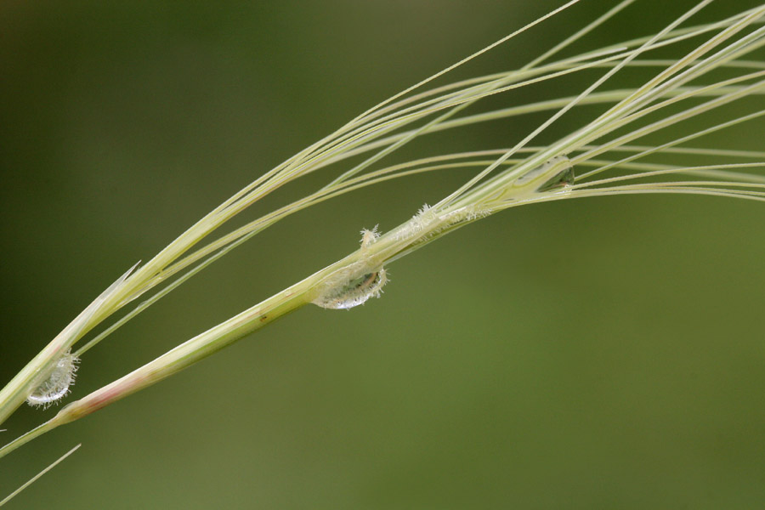
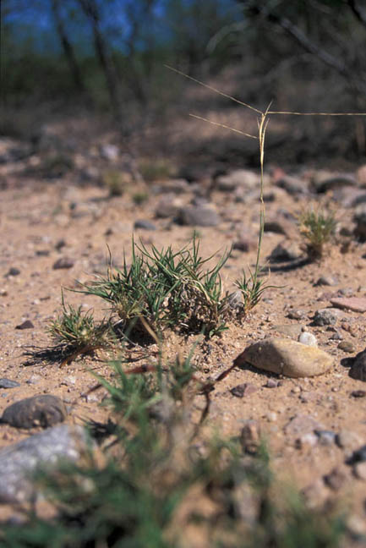
Scleropogon brevifolius
USDA code: SCBR2
Common name: Burrograss
Family: Poaceae
Description: Stolons to 50 cm, wiry, internodes 5-15 cm. Culms (5)10-20 cm, erect. Ligules about 1 mm; blades 2-8(12) cm long, 1-2 mm wide. Bisexual spikelets 2-4 cm, staminate florets below the pistillate florets. Staminate spikelets 2-3 cm. Pistillate spikelets subtended by a glumelike bract; lemma bodies 2.5-3 cm. 2n = 40.
Habitat: grows on grassy plains and flats, generally being most abundant on disturbed or overgrazed land. Its North American range extends from the southwestern United States. Perennial
Native

Slide 16
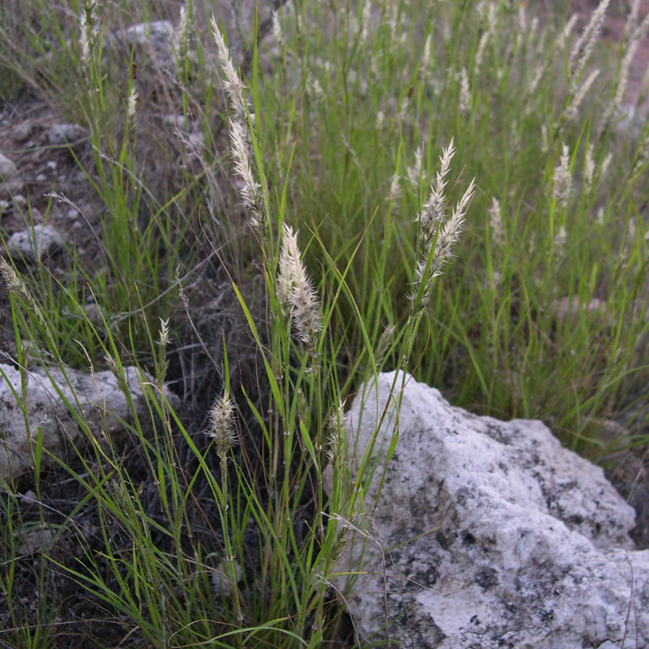
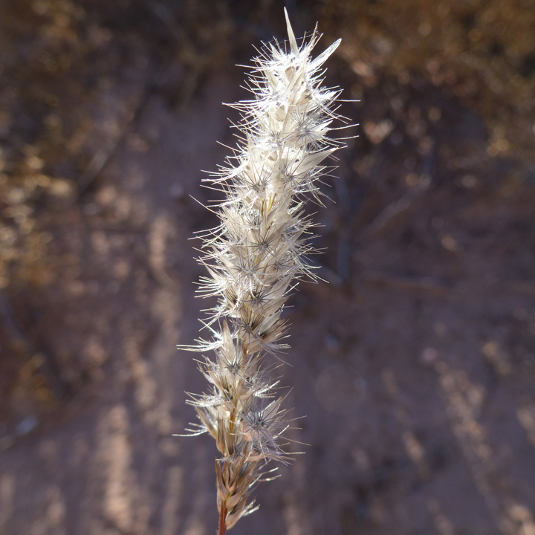
Enneapogon desvauxii
USDA code: ENDE
Common name: Spike pappusgrass
Family: Poaceae
Habitat: open areas of the southwestern United States
Description: Perennial or annual grass to 45 cm, culm nodes hairy; blades 2-12 cm long, 1-2 mm wide; slightly hairy, involute; Panicles spike-like 2-10 cm, grayish-green; spikelets with 3-6 florets, lemmas strongly 9-veined, these extending into barbed awns.
Native

Slide 17
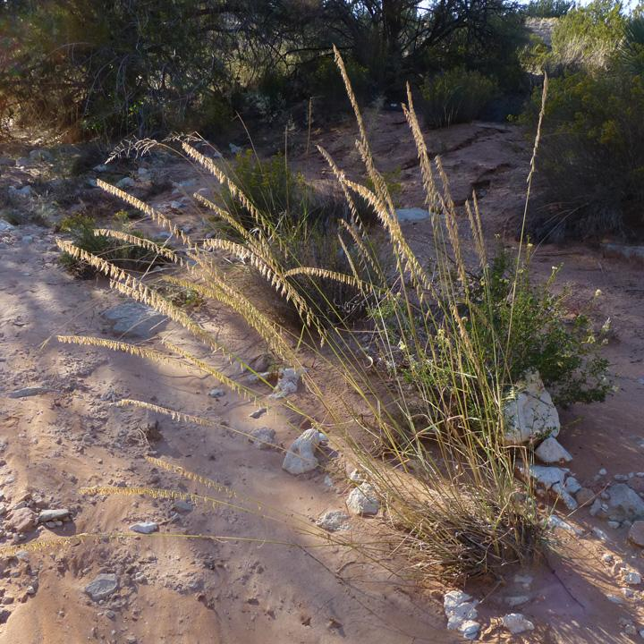
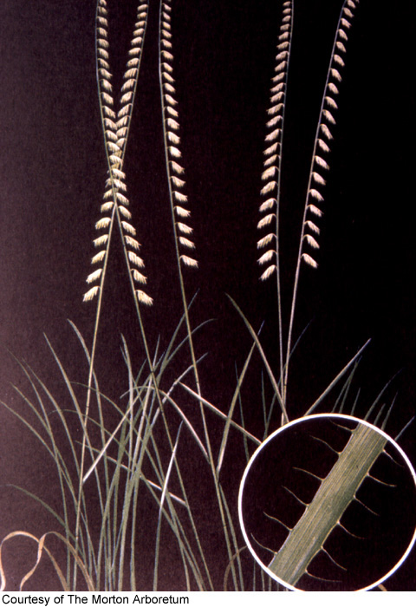
Bouteloua curtipendula
USDA code: BOCU
Common name: Sideoats grama
Family: Poaceae
Habitat:. grasslands and wetlands of the drier portions of the central grasslands of North America
Description:Perennial grass often rhizomatous, culms to 80 cm; blades to 30 cm long, 3-7 mm wide, scabrous on underside; panicles one-sided, with 13-30 reflexed branches; branches 10-30 mm, deciduous with 2-7 spikelets
Native

Slide 18
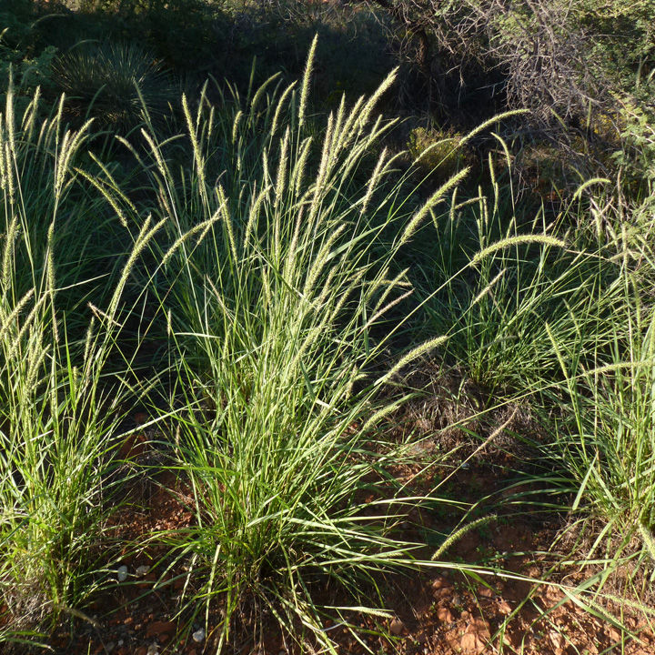
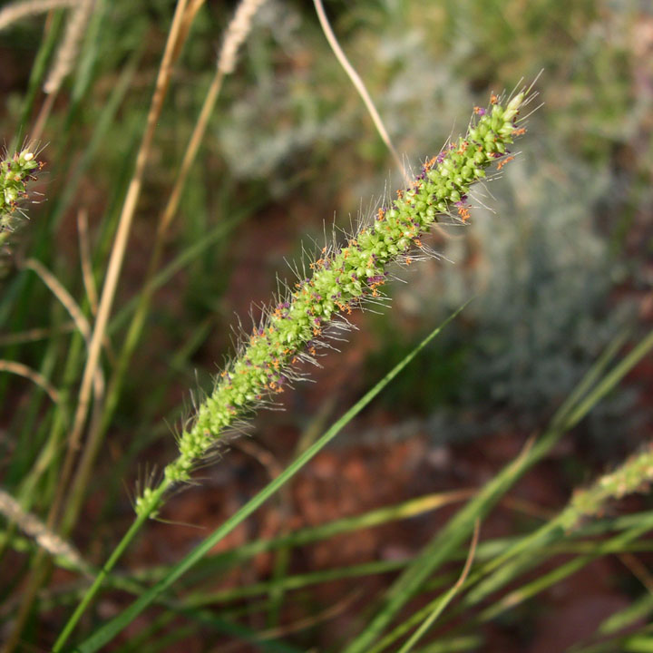
Seteria leucopila
USDA code: SELE6
Common name: Plains bristlegrass
Family: Poaceae
Alternate names: Setaria macrostachya, Setaria vulpiseta
Habitat:Dry plains and washes, rocky slopes, often in partial shade
Description:Perennial bunchgrass to 1m; blades flat or folded 8-25 cm long, 2-5 mm wide, usually scabrous on both surfaces; panicle densely flowered and spike-like; spikelets 2-2.5 mm long; 1st glume about 1/2 as long as the spikelet, three nerved; bristles usually solitary below each spikelet.
Native

Slide 19
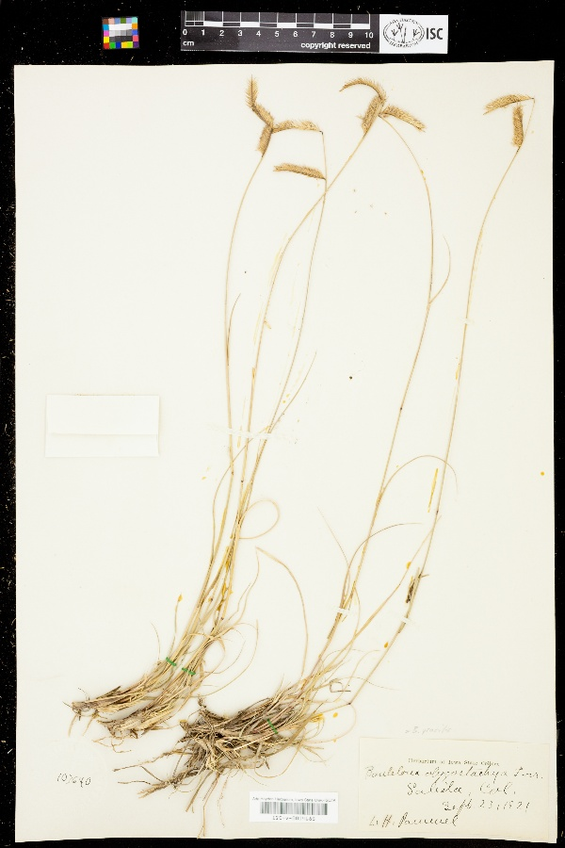
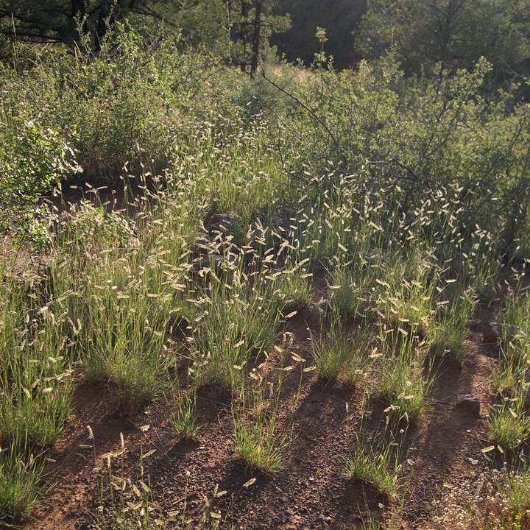
Bouteloua gracilis
USDA code: BOGR2
Common name: Blue grama
Family: Poaceae
Habitat: Bouteloua gracilis grows in pure stands in mixed prairie associations and disturbed habitats, usually on rocky or clay soils and mainly at elevations of 300-3000 m. Its native range extends from Canada to central Mexico; records from the eastern portion of the Flora represent introductions.
Description: Culms 24-70 cm, not woody basally, erect, geniculate, or decumbent and rooting at the lower nodes, not branched from the aerial nodes; nodes usually 2-3, glabrous or puberulent; lower internodes glabrous. Leaves mainly basal; sheaths glabrous or sparsely hirsute; ligules 0.1-0.4 mm, of hairs, often with marginal tufts of long hairs; Perennial
Different from B. hirsuta in that it does not have extended primary branch past terminal spikelet.
Native

Slide 20
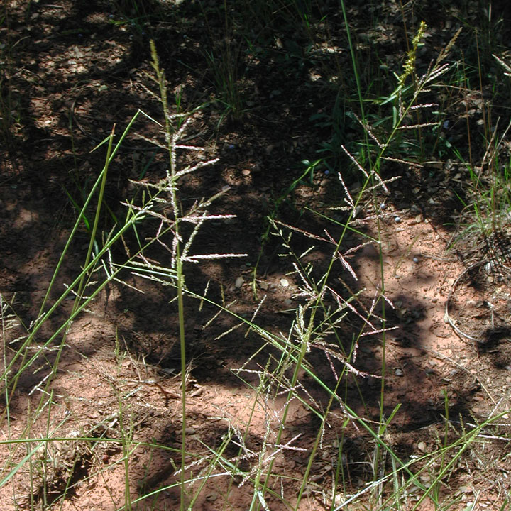
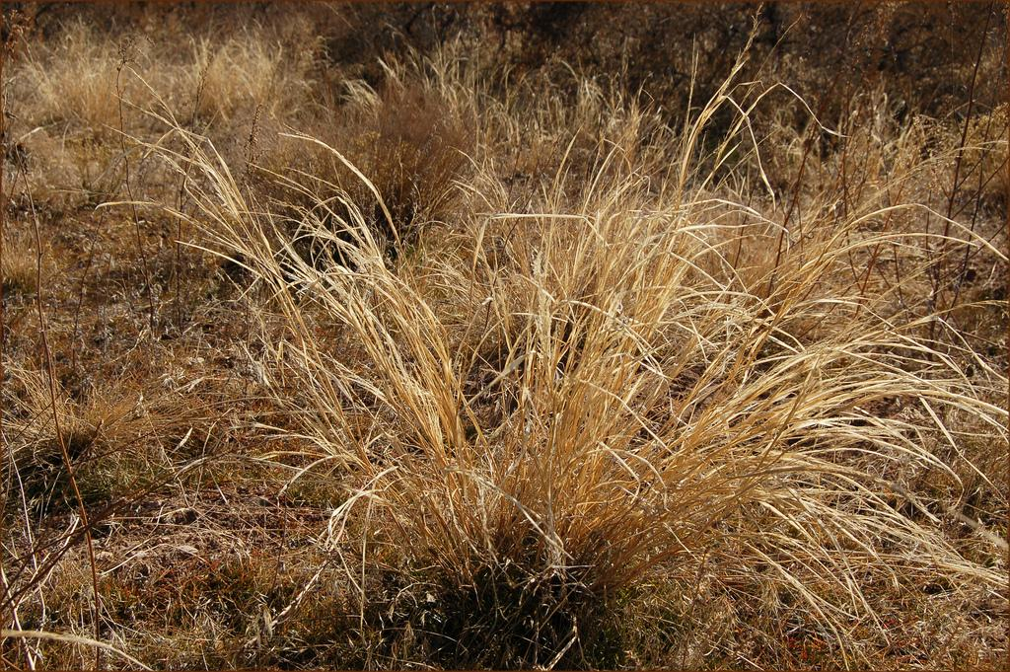
Sporobolus cryptandrus
USDA code: SPCR
Common name: Sand dropseed
Family: Poaceae
Habitat: It grows in sandy soils and washes, on rocky slopes and calcareous ridges, and along roadsides in salt-desert scrub, pinyon-juniper woodlands, yellow pine forests, and desert grasslands.
Description: Plants perennial; cespitose, not rhizomatous, bases not hard and knotty. Culms 30-100(120) cm tall, 1-3.5 mm thick, erect to decumbent. Sheaths rounded below, glabrous or scabridulous, margins sometimes ciliate distally, apices with conspicuous tufts of hairs, hairs to 4 mm; ligules 0.5-1 mm; blades (2)5-26 cm long, 2-6 mm wide, flat to involute, glabrous abaxially, scabridulous to scabrous adaxially, margins scabridulous.
Does not have the extremely appressed branches of S. contractus or the extremely reflexed branches of S. flexuosus.
Native

Slide 21
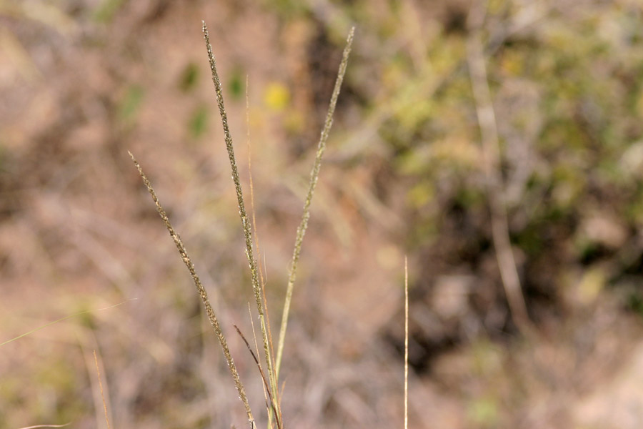
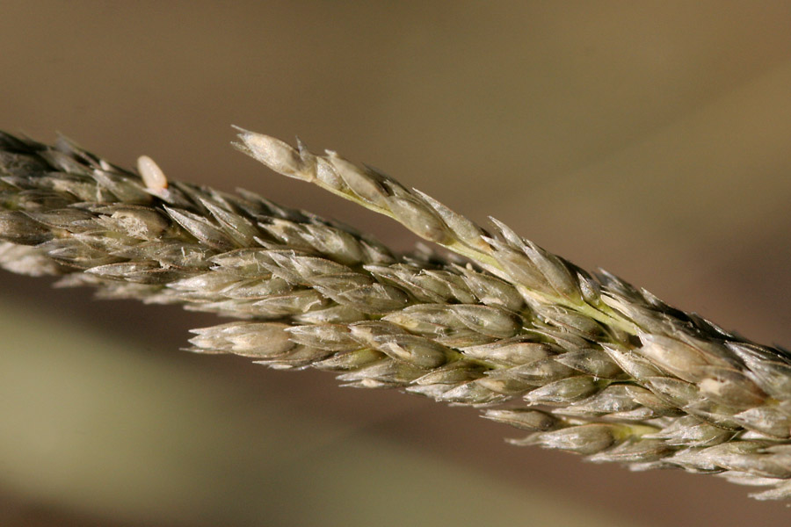
Sporobolus contractus
USDA Code: SPCO4
Common name: Spike dropseed
Family: Poaceae
Habitat: grows in dry to moist, sandy soils, salt-desert scrub, desert grasslands.
Description:Plants perennial; cespitose, not rhizomatous. Culms 40-100(120) cm tall, 2-4(5) mm thick near the base. Sheaths rounded below, margins hairy, particularly distally, hairs to 3 mm, apices with conspicuous tufts of hair; ligules 0.4-1 mm; primary branches 0.3-1.5 cm, appressed, spikelet-bearing to the base.
Native

Slide 22
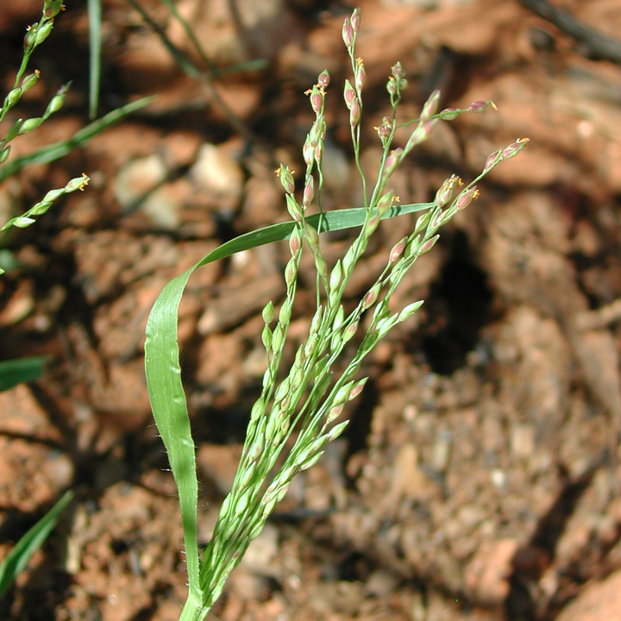
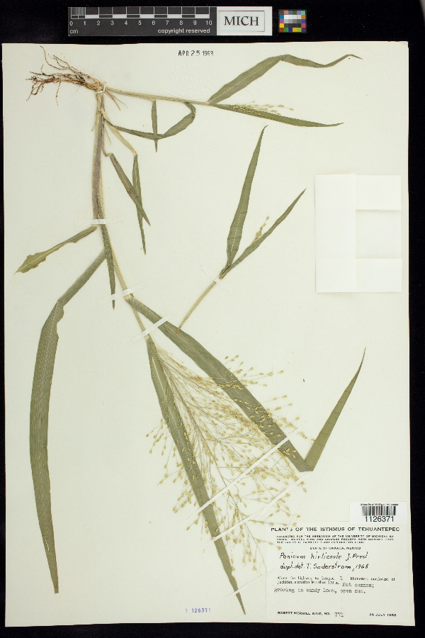
Panicum hirticaule
USDA Code: PAHI5
Common name: Mexican witch
Family: Poaceae
Habitat: gravel, loamy sites
Description:Annual grass 20-40 cm; sheaths and leaf blades pappilose-hispid 4-8 cm long, 3-7 mm wide; panicle open 1/3 to 1/4 the length of the culm; spikelets 3-4 mm long; first glume about 1/2 length of second glume; fruit smooth and shiny; fertile lemma not "winged" at base
Smaller infloresensces than P. obtusifolium
Native

Slide 23
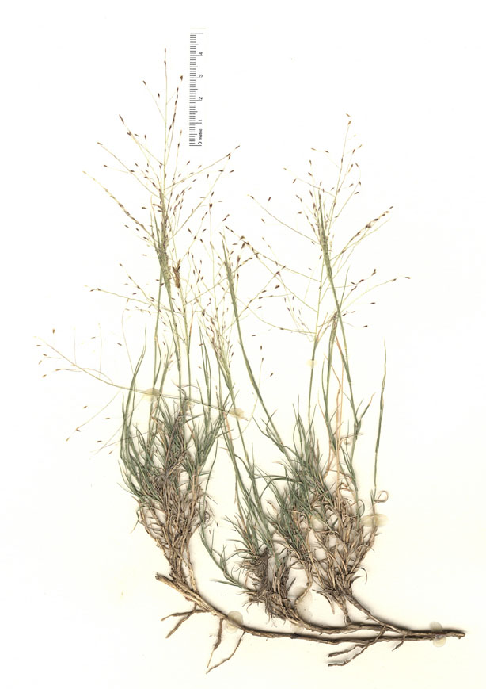
Muhlenbergia arenacea
USDA Code: MUAR
Common name: Ear muhly
Family: Poaceae
Habitat: grows in sandy flats, plains, alluvial fans, washes, depressions, and alkaline mesas in open grasslands
Description: perennial; rhizomatous, not cespitose. Culms 10-30(40) cm, decumbent, terete to somewhat compressed-keeled near the base; internodes scabridulous below the nodes. Sheaths about 1/2 as long as the internodes, margins hyaline; ligules 0.5-2 mm, hyaline, with lateral, 1-2 mm lobes; blades 0.7-4(6) cm long, 0.5-1.7 mm wide, flat, occasionally folded, tapering, scabrous abaxially, strigulose adaxially, margins and midveins thickened, whitish, apices narrow, often sharp.
Native

Slide 24
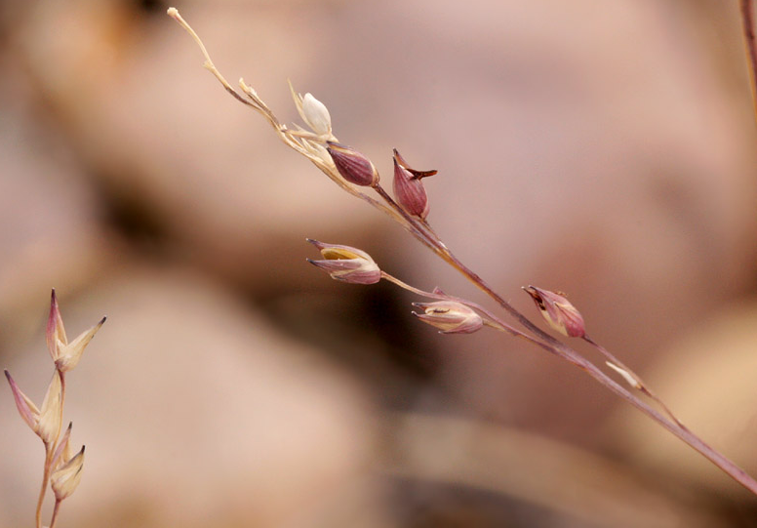
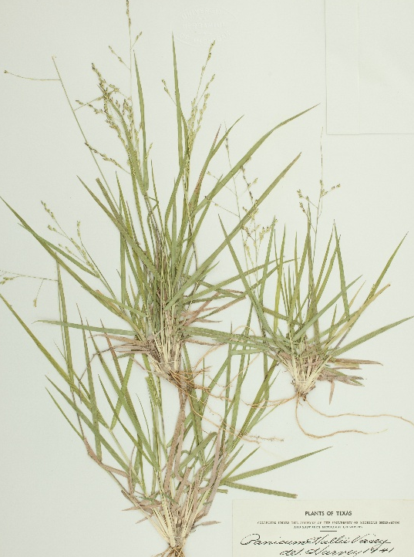
Panicum hallii
USDA code: PAHA
Common name: Hall’s panicgrass
Family: Poaceae
Habitat:
Hall’s panicum grows on sandy to clayey calcareous soils. It will tolerate soils that are weakly saline.
Description: Perennial
Hall’s Panicum curls at the edges of its hairless leaves when it matures or dries. It can be anywhere from six to twenty inches in height. It flowers from April to November and forage value is fair for livestock and wildlife.
Native

Slide 25
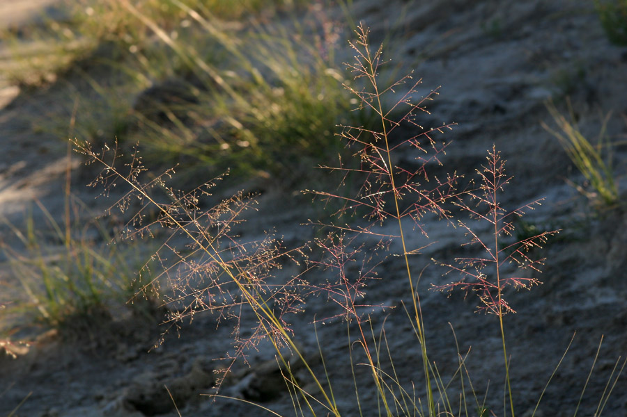
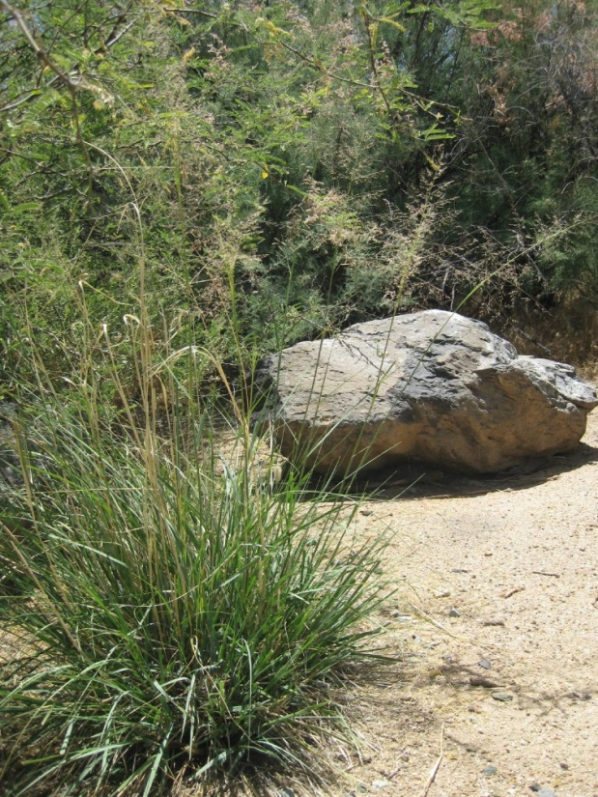
Sporobolus airoides
USDA Code: SPAI
Common name: Alkali Sacaton
Family: Poaceae
Habitat: Sporobolus airoides grows on dry, sandy to gravelly flats or slopes, at elevations from 50-2350 m. It is usually associated with alkaline soils.
Description: Culms 35-120(150) cm, stout. Sheaths rounded below, shiny, apices glabrous or sparsely hairy, hairs to 6 mm; ligules 0.1-0.3 mm; blades (3)10-45(60) cm long, (1)2-5(6) mm wide, flat to involute, glabrous abaxially, scabridulous adaxially, margins smooth or scabridulous; flag blades ascending. Panicles (10)15-45 cm long, 15-25 cm wide, diffuse, subpyramidal, often included in the uppermost sheath; primary branches 1.5-13 cm, spreading 30-90° from the rachis; secondary branches spreading, without spikelets on the lower 1/4-1/3. Perennial.
Taller than S. cryptandrus and S. flexuosus.
Native

Slide 26
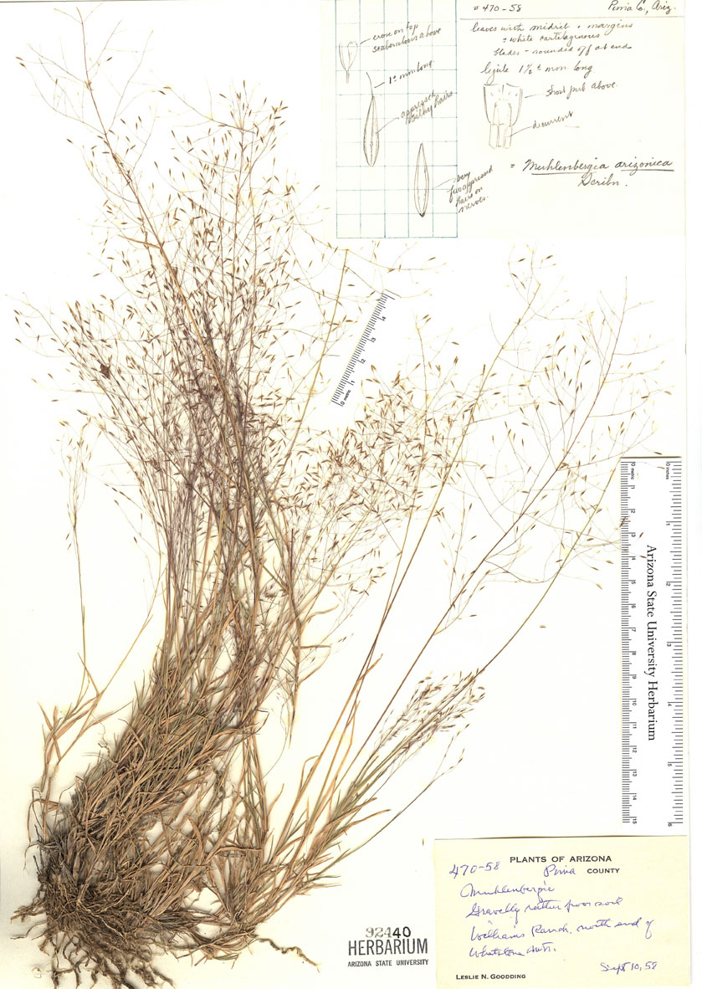
Muhlenbergia arenicola
USDA code: MUAR2
Common name: Sand muhly
Family: Poaceae
Habitat: Muhlenbergia arenicola grows on sandy mesas, limestone benches, and in valleys and open desert grasslands, at elevations of 600-2135 m.
Description: Culms (15)20-60(70) cm, somewhat decumbent, 1 or more nodes exposed; internodes hispidulous below the nodes. Leaves somewhat basally concentrated, most blades not reaching more than (1/4)1/2 of the plant height; sheaths usually a little shorter than the internodes, not keeled, scabridulous, margins hyaline, basal sheaths rounded, not becoming spirally coiled when old; ligules 2-9 mm, hyaline, acute, lacerate, often with lateral lobes; blades 4-10(16) cm long, 1-2.2 mm wide, not arcuate, flat, folded, or involute, scabrous, often glaucous. Perennial
Native

Slide 27
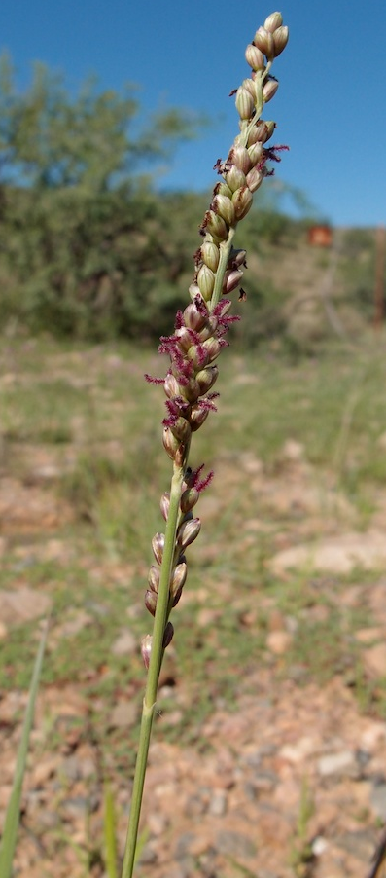
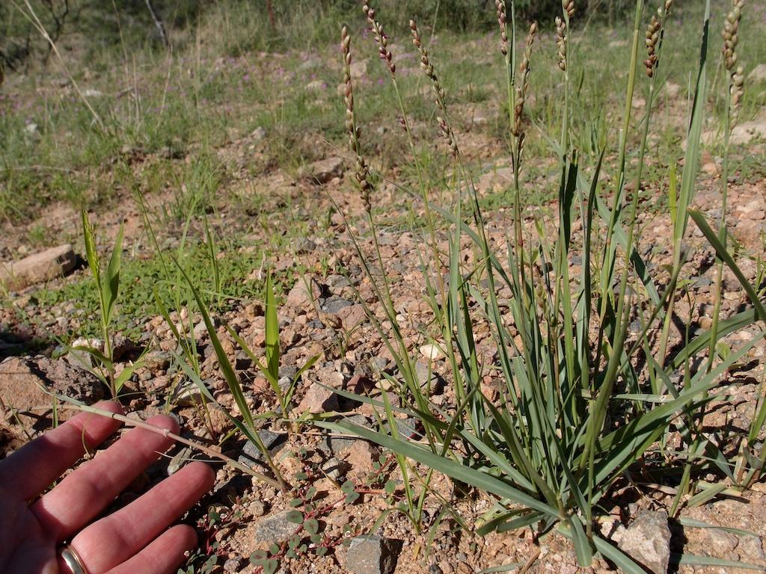
Panicum obstusum
USDA Code: PAOB
Common name: Vine mesquite
Habitat: Perennial
Family: Poaceae
Description: Stolons or runners present, branching above base or distally at nodes, Stem internodes solid or spongy, Stem internodes hollow, Stems with inflorescence less than 1 m tall, Stems, culms, or scapes exceeding basal leaves, Leaves mostly cauline, Leaves conspicuously 2-ranked. Leaf blades 2-10 mm wide, Leaf blades mostly flat, Leaf blades mostly glabrous, Leaf blades scabrous, roughened , or wrinkled, Leaf blades glaucous, blue-green, or grey, or with white glands, Ligule present, Ligule an unfringed eciliate membrane, Inflorescence terminal, Inflorescence solitary, with 1 spike, fascicle, glomerule, head, or cluster per stem or culm
Narrow inflorescences compared to other Panicum; has stolons
Native

Slide 28
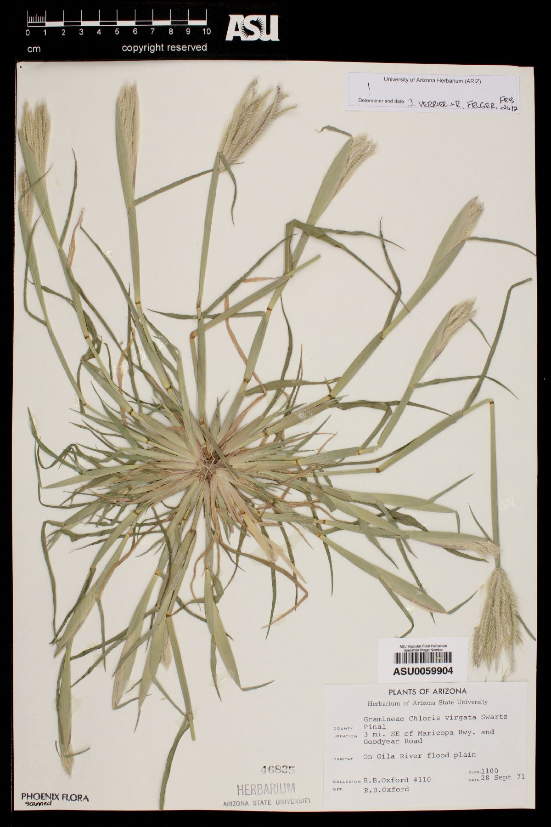
Chloris virgata
USDA Code: CHVI4
Common name: Showy windmillgrass
Family: Poaceae
Habitat: tropical to temperate areas with hot summers
Description: Annual grass to 60 cm; blades weak, flat or folded, 2-8 mm broad; inflorescence branches usually numerous, 2-6 cm long, densely aggregated at the culm apex (finger-like); spikelets small, numerous along spike branches.
Native

Slide 29
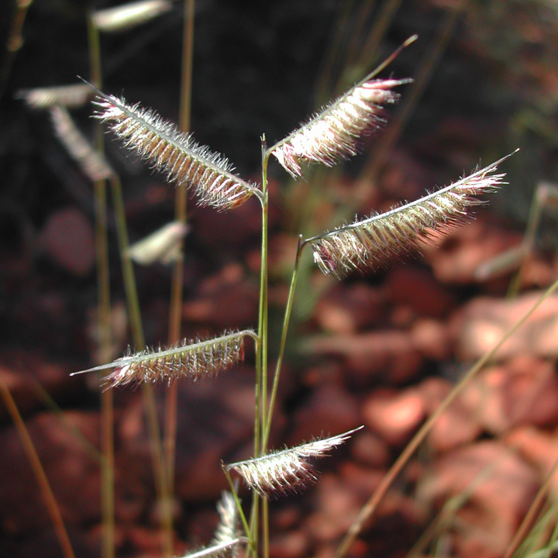

Bouteloua hirsuta
USDA Code: BOHI2
Common name: Hairy grama
Family: Poaceae
Habitat:
Description: perennial; densely or loosely cespitose, occasionally stoloniferous. Culms 15-75 cm, erect or decumbent, sometimes branched basally, sometimes branched aerially; nodes 3-6; internodes glabrous or sparsely to densely pubescent with papillose-based hairs. Leaves basal or mainly cauline; sheaths mostly glabrous, finely scabrous, or pubescent, pilose near the ligules; ligules 0.2-0.5 mm, of hairs; blades 1-30 cm long, 1-2.5 mm wide, flat to involute, papillose-based hairs often present on both surfaces, usually present on the bases of the margins. branches 10-40 mm, persistent, straight, with 20-50 spikelets, axes extending 5-10 mm beyond base of the terminal spikelets; disarticulation above the glumes
Primary branches extend past spikelets, differentiating it from B. gracilis
Native

Slide 30

Eragrostis lehmanniana
USDA Code: ERLE
Common name: Lehmann’s lovegrass
Family: Poaceae
Habitat:sandy flats, along roadsides, on calcareous slopes, and in disturbed areas,
Description: Perennial bunchgrass 40-90 cm, culm commonly geniculate; blades 2-12 cm long, 1-3 mm wide flat-inrolled; panicles 7-18 cm; spikelets 5-12 mm long, 1 mm wide with 4-12 florets; grain without groove+
Different from E. pectinacea in being much larger and perennial
Invasive

Slide 31


Eragrostis pectinacea
USDA Code: ERPE
Common name: Desert lovegrass
Family:Poaceae
Habitat: cultivated and waste areas, parkways and parking lots, and cindery or sandy waste ground like railroad ballast.
Description: Annual grass to 60 cm; blades 2-15 cm, 2-4 mm wide, flat; panicles 10-25 cm, open; spikelet stalks (pedicles) widely spreading; spikelets 5-8 mm long, <2 mm wide with 5-15 florets.
Much smaller than E. lehmanii and annual
Native

Slide 32


Tridens muticus
USDA Code: TRMU
Common name: Slim tridens
Family: Poaceae
Habitat:
Description: Perennial grass to 50 cm; blades narrow; inflorescence 6-20 cm long, paniculate or racemose, narrow and spikelike, the spikelets not crowded; spikelets 9-13 mm long, 5 to 8-flowered; lemmas tinged with purple.
Native

Slide 33


Bouteloua warnockii
USDA Code: BOWA
Common name: Warnock’s grama
Family: Poaceae
Habitat: grows on limestone ledges and dry slopes below limestone outcrops.
Description: Perennial. Culms 20-35(50) cm, stiffly erect. Leaves bluish-green, more or less glaucous; sheaths mostly glabrous, hairs present distally; ligules 1-1.5 mm, of hairs; blades 5-15(25) cm long, 1-1.5(2.5) mm wide, stiffly erect or curving, involute when dry; mostly glabrous, ligular area with long and short hairs, bases usually with papillose-based hairs on the margins. Panicles 5-13(20) cm, with 9-15(30) branches; branches 4-5.5 mm, deciduous, scabrous, with 2-6 spikelets, axes terminating well beyond the terminal spikelets, apices entire; disarticulation at the base of the branches. Spikelets 5-6.5 mm
Compared to B.curtipendula, has narrower leaves, and is found almost exclusively on the open grasslands and rocky hills of Otero Mesa
Native

Slide 34


Bothriochloa barbinodis
USDA Code: BOBA3
Common name: Cane bluestem
Family: Poaceae
Habitat: along roadsides, drainage ways, and gravelly slopes in desert grasslands,
Description: Smells like blueberries. Fuzzy. Culms 60-120 cm tall, rarely more than 2 mm thick, erect, geniculate at the base, often branched at maturity, not glaucous below the nodes; nodes hirsute, hairs 3-4 mm, mostly erect to ascending, tan or off-white. Leaves cauline; ligules 1-2 mm, often erose; blades 20-30 cm long, 2-7 mm wide, not glaucous, glabrous or sparingly pilose near the throat. Panicles 5-14(20) cm on the larger shoots, oblong to somewhat fan-shaped, silvery-white; Sessile spikelets 4.5-7.3 mm; lower glumes short pilose, with or without a dorsal pit; awns 20-35 mm;
Perennial
Native

Slide 35

Lycurus sp.
USDA Code: LYCUR
Common name: Wolftail
Family: Poaceae
Habitat:
Description: Plants perennial; cespitose. Culms 10-60 cm, erect to somewhat decumbent, usually branched. Sheaths open, compressed-keeled, glabrous, smooth or scabridulous, mostly shorter than the internodes, a 2-veined prophyllum often present; ligules hyaline, strongly decurrent, truncate or rounded to elongate and acuminate, sometimes with narrow triangular lobes extending from the edges of the sheath on either side; branches short, fused to the rachis, terminating in a pair of unequally pedicellate spikelets or a pedicellate spikelet and a short secondary branch with two spikelets. disarticulation at the fused base of the pedicels or pedicel and branch, paired spikelets falling as a unit, leaving a cuplike tip. Spikelets with 1 floret
Native

Slide 36


Aristida ternipes
USDA Code: ARTE3
Common name: Spidergrass
Family: Poaceae
Habitat: Sandy and Rocky soils??
Description: Culms 25-120 cm, wiry, erect to sprawling, unbranched, ligules less than 0.5 mm; blades 5-40 cm long, 1-2.5 mm wide, flat to folded, straight to lax at maturity,, primary branches 5-25 cm, remote, stiffly ascending to divaricate, with axillary pulvini, usually naked near the base; secondary branches and pedicels usually appressed. Spikelets usually congested. keeled, usually not twisted, 0.1-0.2 mm wide apices, junction with the awns not evident; awns unequal or almost equal, not disarticulating at maturity; central awns 8-25(30) mm, straight to arcuate at the base; lateral awns absent or to 0-23 mm.
Perennial
Much taller than A. adsensionis, and perennial
Native

Slide 37


Leptochola dubia
USDA Code: LEDU
Common Name: Green Sprangletop
Family: Poaceae
Habitat: often in well-drained, sandy or rocky soils
Description: Perennial.Culms (10)30-110 cm, round or basally compressed, tillering from the basal nodes, not branching from the aerial nodes, mostly glabrous, sometimes pilose basally; internodes solid. Sheaths sometimes with a pilose collar; ligules 1-2 mm, truncate, erose; blades (2)8-35 cm long, 2-8 mm wide, glabrous, strigose, or pilose. Panicles 8-20 cm, with 2-15 subdigitate or racemose branches; secondary panicles often hidden in the lowest leaf sheaths; branches 2-19 cm, ascending to spreading at maturity.
Native

Slide 38
Annual Forbs

Slide 39


Eriogonum abertianum
USDA Code: ERAB
Common Name: Abert’s wild-buckwheat
Family: Polygonaceae
Habitat: Sandy, gravelly, or clayey flats, washes, and slopes, mixed grassland, saltbush, greasewood, creosote bush, blackbrush, and manzanita communities, oak and conifer woodlands
Description: Annual forb to 50 cm; herbage velvety Leaves: leaves oblong to ovate, in whorls along stem Flowers: flowers cream in head-like clusters at branch tips. Branching inflorescense.
More diffuse than E. wrightii.
Native

Slide 40

Solanum elaeagnifolium
USDA Code: SOEL
Common Name: Silverleaf nightshade.
Famliy: Solanaceae
Habitat: Disturbed areas
Description: LEAVES: alternate, simple, linear to oblonglanceolate, to 10 cm long and 2.5 cm wide, the margin entire, sinuate-repand or 6 CANOTIA Vol. 5 (1) 2009 shallowly lobed; blade coriaceous, the lower surface densely covered with stellate hairs; petiole to 5 cm long; base attenuate, oblique, or rounded; apex acute. INFLORESCENCE: panicles, 5-8-flowered; peduncles to 15 mm long. FLOWERS: zygomorphic (Fig. 3C); pedicels to 2 cm long; calyx to 1 cm long, the lobes 1/2 as long to as long as the tube, unequal, linear; corolla rotate, purple or sometimes white, to 3.5 cm in diameter
Native

Slide 41


Descurainia pinnata subsp. ochroleuca
USDA Code: DEPIO2
Common Name: Western tansy-mustard
Family: Brassicaceae
Habitat: Washes, slopes, often saline soils; disturbed areas.
Description: leaves alternate, pinnate, bipinnate, or pinnatisect, 3-7 cm long Flowers: flowers minute, cream, in elongate racemes Fruit: a 2-celled clavate capsule, 5-10 mm long; Seeds 5-20 per chamber, 2 rows per chamber, 0.5-1 mm
Native

Slide 42

Salsola tragus
USDA Code: SATR12
Common Name: Russian thistle.
Family: Amaranthaceae
Description: Annual forb usually much-branched Leaves: leaves reduced, 8-52 mm, thread-like, becoming rigid; base becoming wide, leathery, becoming thick and spine-tipped; margin at base translucent INFLORESCENCE: inflorescence axillary Flowers: flowers generally 1 per axil, sepals becoming thickened and winged in fruit
Invasive

Slide 43


Tidestromia lanuginosa
USDA Code: TILA2
Common Name: Woolly tidestromia
Family: Amaranthaceae
Habitat:Primary and disturbed vegetation, riparian forests, pinyon-juniper woodlands, desert scrub, creosote bush scrub, mesquite-yucca communities, grasslands, coastal dunes, beaches, roadsides, fields, in basalt deposits, limestone, gypseous, calcareous, alluvial, rocky, volcanic, gravelly, sandy, silty, muddy, and clayey soils
Description: Annual forb; stems procumbent to prostrate, radiating from the root; stems reddish, herbage with branched hairs making leaves appear whitish Leaves: leaves (opposite) broadly ovate to spatulate; young terminal leaves white-gray, tomentose-canescent, hairs short, much-branched, wearing off, older leaves green above, more whitish below INFLORESCENCE: cymes, clusters of 1-5 flowers, axillary, sessile, subtended and ± enclosed by involucres of 2-3 bract-like leaves that become hardened; bracts scarious Flowers: flowers yellow, in small axillary clusters, bisexual;
Native

Slide 44

Physaria gordonii
USDA Code: LEGO
Common Name: Gordon’s bladderpod
Family: Brassicaceae
Habitat: Sandy or light soils, rocky plains, caprock ledges, gravelly brushland, sandy desert washes, stream bottoms, pastures, roadsides, abandoned fields;
Description: Annual; stems several from base, erect to decumbent or prostrate, (unbranched or branched, sometimes densely leaved), 1-3.5(-4.5) dm. Basal leaves: blade obovate to broadly oblong, 1.5-5(-8) cm, margins lyrate-pinnatifid, dentate, or entire.
LEFE (Physaria fendleri) is a perennial, usually on rockier soils.
Native

Slide 45


Astragalus nuttallianus
USDA Code: ASNU4
Common Name: Nutall’s locoweed
Family: Fabaceae
Habitat: Gravelly
Description: Plant: Annual, slender, minutely strigose; stem prostrate or weakly ascending, 4-45 cm Leaves: generally compound, alternate, stipuled, 1.5-6.5 cm, odd-1-pinnate;; leaflets 5-13, 2-10 mm, at least upper elliptic, acute at tips, lower sometimes blunt, notched at tip INFLORESCENCE: raceme, axillary; flowers 1-4, 4-7 mm Flowers: bilateral; calyx 5-lobed; corolla whitish, faintly lilac-tinged (rarely purplish); banner outside wings in bud, keel blades with small protrusion at base locking into pit on adjacent wing
Native
Unlike A. allochrous, has less “inflated” fruits, and is pubescent

Slide 46

Plantago patagonica
USDA Code: PLPA2
Common Name: Woolly plantain
Family; Plantaganaceae
Habitat:Introduced from farther west. Locally frequent in sandy soils. It also occurs in newly disturbed sand and along roads.
Description: Annual herb with a taproot flowering stem to 20 cm tall Leaves: basal, semi-clasping, to 18 cm long and 1 cm wide, linear to thread-like with a tapering base and pointed tip, more or less parallel-veined, white woolly
Native

Slide 47


Dimorphocarpa wislizeni
USDA Code: DIWI2
Common Name: Spectaclepod
Family: Brassicaceae
Habitat: Sandy roadsides, sandstone knolls, sand hills and dunes, sandy streambeds and dry washes, desert flats.
Description: Annuals. Stems unbranched or branched basally, branched distally, (1-)2-6(-8) dm. Basal leaves: petiole 1-4(-5) cm; blade lanceolate to linear-lanceolate, (2-)3-7(-10) cm × 4-15(-20) mm, base cuneate to attenuate, margins pinnately lobed to coarsely dentate. Cauline leaves: (proximalmost) petiole 1-4(-5) cm, (distalmost) shortly petiolate or subsessile; blade linear to narrowly lanceolate, base cuneate, margins usually entire, rarely dentate, or repand. Fruiting pedicels divaricate to slightly reflexed, (6-)8-14 (-22) mm. Flowers: sepals (2.5-)3-4 × 1-1.5 mm, pubescent
Tastes like horseradish.
Native

Slide 48


Erodium cicutarium
USDA Code: ERCI6
Common Name: Filaree
Family: Geraniaceae
Habitat: Open, disturbed sites, grassland, scrub
Description: Winter-annual or biennial herb up to 40 cm tall Stem: very short at first, then becoming much-branched with branches loosely ascending or spreading, and hairy throughout.
Invasive

Slide 49


Senna bauhinioides
USDA Code: SEBA3
Common Name: Twinleaf senna
Family; Fabaceae
Habitat: dry sandy areas at lower elevation
Description: spreading low plant with gray-green foliage. The yellow flowers frequently only partly open. The fruit is a plump pod. The leaves are paired
Native

Slide 50


Eriogonum trichopes
USDA Code: ERTR8
Common Name: Little desert-trumpet
Family: Polygonaceae
Habitat: Clayey, sandy to gravelly flats, washes, and slopes, mixed grassland, saltbush, creosote bush, blackbrush, and mesquite communities, pinyon and/or juniper woodlands
Description: Delicate, much-branched annual forb, usually less than 25 cm Leaves: leaves ovate, in basal rosette Flowers: flowers minute, yellow
Native

Slide 51

Oenothera primiveris
USDA Code: OEPR
Common Name: Early evening-primrose
Family: Onagraceae
Habitat: Sandy flats, low hills, dune margins, arroyos
Description: Annual acaulescent forb; herbage often pubescent Leaves: leaves 3-30 cm long, deeply toothed or lobed; ovary inferior Flowers: flowers 4-merous, showy, petals yellow, turning pinkish, 2-3 cm long; capsule at base a plant, sharply 4-angled, thick and hard.
Native

Slide 52


Boerhavia triquetra
USDA Code: BOIN
Common Name: Slender spider-wing
Family: Nyctaginaceae
Habitat: Sandy or gravelly areas in deserts
Description: Herbs, annual; taproot tapered, soft or ± woody. Stems erect or ascending, occasionally decumbent, moderately or profusely branched, Leaves mostly in basal ¹/2 of plant; larger leaves with petiole 4-8[-15] mm, blade broadly ovate or oval to lanceolate, 10-21[-35] × 6-8[-13] mm (distal leaves smaller, proportionately narrower), adaxial surface usually glabrous, rarely minutely puberulent, abaxial surface paler than adaxial, glabrous, Flowers: pedicel 0.3-4.5 mm; bracts at base of perianth quickly deciduous, 2, linear-lanceolate to lanceolate [ovate], 0.5-0.6 mm; perianth whitish to pale pink or purplish, campanulate beyond constriction, 1 mm; stamens 2-3, included or barely exserted.
Native
Has umbellate flowers, unlike B. torreyana

Slide 53


Cryptantha crassisepala
USDA Code: CRCR3
Common Name: Thick-sepal cat’s-eye
Family: Boraginaceae
Habitat:
Description:Annual forb 10-30 cm; herbage bristly; flowers white, in loose cymes; nutlets 4, with pale tuberculations, one axial odd nutlet. Flowers: flowers white, in loose cymes; nutlets 4, with pale tuberculations, one axial odd nutlet.
Native

Slide 54


Laënnecia coulteri
USDA Code: LACO13
Common Name: Coulter’s woolwort
Family: Asteraceae
Habitat: Stream banks, roadsides, other disturbed sites, clays or sands, often alkaline soils
Description: Taprooted annual forb to 1 m; herbage sticky glandular Leaves: Taprooted annual forb to 1 m; herbage sticky glandular; leaves mostly alternate, clasping, oblong-lanceolate, 2-15 mm wide, regularly toothed or shallowly lobed
Native

Slide 55


Aphanostephus ramosissimus
USDA Code: APRA
Common Name: Low faintcrown
Family: Asteraceae
Habitat:
Description: Annuals, 10-45 cm; vestiture hispidulo-puberulent, stem hairs spreading to deflexed, 0.2-0.6 mm. Phyllary apices acute. Ray florets 20-41. Disc florets: corolla bases not conspicuously swollen and indurate. Cypselae: hairs apically straight; pappi minutely ciliate crowns 0.1-0.2 mm or absent or nearly so
Native

Slide 56


Chamaesyce serpyllifolia
USDA Code: CHSE6
Common Name: Thyme-leaf spurge
Family: Euphorbiaceae
Habitat:
Description:Prostrate annual forb branching from central point; herbage with milky sap; stems reddish Leaves: leaves opposite, inequilateral at base, serrate margins on upper half, often red along midvein
Native
Unlike C. serrulata, is glabrous.

Slide 57

Chamaesyce micromera
USDA Code: CHMI7
Common Name: Desert spurge
Family: Euphorbiaceae
Habitat: Sandy places; < 1000 m.; Sep-Dec, also Apr-Jun
Description: Prostrate annual forb; herbage with milky sap Leaves: leaves opposite, cauline, short-petioled, inequilateral at base, <5 mm long, margins entire INFLORESCENCE: flower-like, generally 1 per node; involucre < 1 mm, bell-shaped, glabrous to hairy; gland << 0.5 mm, round, red or pink; appendage 0 Flowers: flowers monoecious borne in cyathia, petaloid appendages absent or minute; ovary and capsule glabrous; Staminate flowers 2-5, generally in 5 clusters around pistillate flower.
Unlike C. albacaulis, no petals and annual—thus it will never appear partially buried in sands
Native

Slide 58


Chamaesyce serrula
USDA Code: CHSE7
Common Name: Sawtooth spurge
Family: Euphorbiaceae
Habitat:?
Decription: Plant: Prostrate to ascending annual forb; herbage pilose, with milky sap Leaves: leaves opposite, inequilateral at base, with serrulate margins, sometimes with red along midvein Flowers: flowers monoecious borne in cyathia; petaloid appendages white; ovary and capsule glabrous, ~2mm long; seeds smooth.
Has hairs unlike C. serpyllifolia
Native

Slide 59

Portulaca pilosa
USDA Code: POPI3
Common Name: Kiss me quick
Family: Portulacaceae
Habitat: occur in shallow, sandy soils, often on rocky outcrops, and are often highly branched, compact, short, and not very pilose. in warm, moist environments tend to branch quickly into a spreading habit, with erect growth following secondarily. Plants in cool, dry habitats grow erect first, then branch more slowly
Description: roots fibrous to slightly fleshy. Stems prostrate, suberect to erect, succulent; trichomes conspicuous at nodes and in inflorescence; branches 3-25 cm. Leaf blades linear to oblong-lanceolate, terete to hemispheric, 5-20 × 1-3 mm, apex acute; involucrelike leaves 6-9.
Native

Slide 60


Mollugo cerviana
USDA Code: MOCE
Common name: threadstem carpet weed
Family: Molluginaceae
Habitat:weed of sandy places in tropical and subtropical regions around the world
Description: erect, 3-20 cm. Leaves glaucous, in whorls of 4-12, basal rosette present; petiole 0.8-1.1 mm; blade linear to spatulate, 3-15 × 1-5 mm, base cuneate, apex acute to obtuse. Inflorescences: flowers in groups of 3-4 in stalked, axillary and terminal umbellate cymes. Flowers: sepals pale green, glaucous abaxially, white adaxially, elliptic to obovate, 1-1.5 × 1-1.6 mm, margins white, membranous; stamens 5, alternate with sepals; pedicel erect to spreading,
Non-Native/Introduced

Slide 61


Amaranthus palmeri
USDA Code: AMPA
Common Name: Palmer’s pigweed
Famiy: Amaranthaceae
Habitat: Roadsides ditches, fields, arroyos, swales, microplayettes
Description: Plants glabrous or nearly so. Stems erect, branched, usually (0.3-)0.5-1.5(-3) m; proximal branches often ascending. Leaves: long-petiolate; blade obovate or rhombic-obovate to elliptic proximally
AMAC has narrower leaves, spiny fruits, and is usually on loose sand.
Native

Slide 62

Chenopodium sp.
USDA Code: CHENO
Common Name: Goosefoot
Family: Amaranthaceae
Habitat:
Description: Herbs, annual or perennial [rarely suffruticose, or small trees], farinaceously pubescent with small white inflated hairs or glabrous. Stems erect to prostrate, branched (rarely simple), not jointed, not armed, not fleshy. Leaves alternate
Only native species in the district; non-native species further north or at higher elevations.

Slide 63



Machaeranthera tanacetifolia
USDA Code: MATA2
Family: Asteraceae
Habitat:Desert scrub, pinyon/juniper woodland
Description:Plant: Taprooted annual or biennial forb to 1m Leaves: leaves alternate, simple, deeply lobed to bipinnatifid, generally 3-12 cm INFLORESCENCE: primary inflorescence a head, each resembling a flower; heads radiate, solitary or cymosely clustered; phyllaries generally in 3-5 series, tips elongate, acuminate, spreading to bent backward
Native

Slide 64



Boerhavia torreyana
USDA Code: BOTO2
Common Name: Torrey’s spiderling
Famliy: Nyctaginaceae
Habitat: Usually on sandy soils in deserts or arid grasslands, especially among mesquite coppice dunes.
Description:Herbs, annual; taproot tapered, soft or ± woody. Stems prostrate or decumbent-ascending, usually profusely branched throughout, 10-80 dm, minutely puberulent with flat hairs, usually also with spreading hairs, sometimes also glandular basally, glabrous distally.
Unlike B. triquetra, does not have flowers in umbellate groups.
Native

Slide 65


Nama hispidum
USDA Code: NAHI
Common Name: Sandbells
Family: Boraginaceae
Habitat:
Description: Plant: Annual 5-15 cm; herbage pubescent Leaves: leaves alternate, narrowly spatulate, gradually narrowing to a winged petiole, upper leaves smaller, sessile Flowers: flowers lavender, 13-15 mm long Fruit: a capsule.
Native

Slide 66


Kalistroemia parviflora
USDA Code: KAPA
Common Name: Warty caltrop
Family: Zygophyllaceae
Habitat:
Description: Stem: prostrate, diffusely branched, grayish-hairy. Leaves: opposite, pinnately compound, short-stalked, 3 - 6 cm long. Leaflets usually in pairs of four, about 1 cm long, oblong or elliptic, and hairy. Flowers: on 1 - 3 cm long stalks, yellow, to 1 cm wide. Sepals awl-shaped. Ovary ten-chambered. Fruit: dry, indehiscent, splitting into ten one-seeded sections, to 4 mm wide, egg-shaped, long-beaked, wrinkled, with tuber-like projections.
Native

Slide 67


Pectis papposa
USDA Code: PEPA2
Common Name: Limoncillo
Family: Asteraceae
Habitat:
Description: herbage spicy-scented. Stems ascending, glabrous or puberulent. Leaves linear, 10-60 × 1-2 mm, margins with 1-3 pairs of setae, faces glabrous (dotted on margins with round to oval oil-glands 0.3-0.5 mm). Heads in congested or open, cymiform arrays. Peduncles 3-40 mm. Involucres campanulate to cylindric
Compared with P. angustifolia, has pappus on all fruits.
Native

Slide 68

Eriastrum diffusum
USDA Code: ERDI2
Common Name: Miniature woolly-star
Family: Boraginaceae
Habitat: Open sites, desert shrublands, sagebrush, pinyon-juniper woodland
Description: PLANT: Annual 3-35 cm tall, erect and simple to diffusely branching. LEAVES: subglabrous to sparsely woolly, entire or with 1-2 pairs of lobes near the base of the rachis, 1-3 cm long.
Native

Slide 69


Ipomopsis longiflora
USDA Code: IPLO2
Common Name: Blue trumpets
Family: Polemoniaceae
Habitat:
Description: PLANT: Annual in AZ or biennial, 25-100 cm tall, simple to branched; stems glabrous to sparsely short pubescent. LEAVES: glabrous to sparsely short pilose, deeply lobed. INFLORESCENCE: diffuse, with 1-3, subsessile to long pedicelled flowers at tips of branches.
Native

Slide 70


Sanvitalia abertii
USDA Code: SAAB
Common Name: Abert’s dome
Family: Asteraceae
Habitat: dry slopes
Description:Slender annual forb <20 cm; stems spreading or erect, simple to much-branched, strigose Leaves: simple, opposite, lanceolate or lance-linear, sessile or short-petioled, 2-5 cm, acute, scabrous INFLORESCENCE: primary inflorescence a head, each resembling a flower; heads radiate, generally in cymes
Native

Slide 71



Bahia pedata
USDA Code: BAPE
Common Name: Blunt-scale bahia
Family: Asteraceae
Habitat:Sandy soils, limestone, openings in grasslands and pinyon-juniper woodlands
Description:Annuals or biennials, 15-70(-120+) cm. Stems mostly erect. Leaves all or mostly alternate (proximalmost sometimes opposite); blades simple or 1-2-ternately lobed, lobes ovate or obovate to lanceolate or oblanceolate, 2-25 × 1-6(-8) mm, faces sparsely scabrellous, usually gland-dotted as well.
Native

Slide 72


Lepidium lasiocarpum
USDA Code: LELA
Common Name: Wright’s pepperweed
Family: Brassicaceae
Habitat:Beaches, tidal shores, saline soils, roadsides
Description: Annual forb usually less than 20 cm, ± glabrous, grayish, rhizomed; stems much-branched Leaves: leaves alternate, pinnatifid to entire; basal < 3 dm, 6-8 cm wide, toothed, long-petioled; cauline reduced but many 1-4 cm wide, lower petioled, upper sessile INFLORESCENCE: dense racemes Flowers: small, cream, bisexual; sepals 4, free, < 1 mm, margins wide, white; petals white; stamens 6; ovary 1, superior, chambers generally 2, septum membranous, connecting 2 parietal placentas, style 1, stigma simple or 2-lobed
Native

Slide 73


Gutierrezia sphaerocephala
USDA Code: GUSP
Common Name: Round-head snakeweed
Family: Asteraceae
Habitat:Grasslands, roadsides, lake edges, alkaline flats with Atriplex, oak-pine-juniper woodlands, often over gypsum or limestone;
Description:Annuals, 20-50 cm. Stems minutely, prominently, often sparsely, papillate-scabrous (hairs triangular or deltate to lanceolate, less than 0.1 mm). Leaves: proximal usually absent at flowering; cauline blades 1-nerved, linear, 0.5-1.2 mm wide, little reduced distally. Heads in loose arrays.
More diffuse than GUMI & GUSA2; annual.
Native

Slide 74


Lappula occidentalis
USDA Code: LAOCO
Common Name: Spiny sheepbur
Family: Boraginaceae
Habitat:
Description: Plant: Annual forb 10-40 cm; Leaves: herbage dark green, bristly Flowers: flowers pale blue or white in racemes Fruit: a spiny bur.
Native

Slide 75


Hedosyne ambrosiifolia
USDA Code: HEAM11
Common Name: Ragged marsh-elder
Family: Asteraceae
Habitat: in sandy, gypseous, or calcareous soils; 1000-2000 m
Description: Leaves: petioles 5-12(-45) mm; blades 3-5(-9) × 4-5(-8) cm overall, lobes 1-3 mm wide. Peduncles 3-12+ mm. Involucres 2-3+ mm. Phyllaries: outer 5 sparsely strigose or glabrous. Paleae 1-1.5 mm. Functionally staminate florets: corollas 1.5-2 mm.
Native

Slide 76


Amaranthus acanthochiton
USDA Code: AMAC
Common Name: Greenstripe
Family: Amaranthaceae
Habitat: Flowering summer-fall. Sandy areas, sand dunes, riverbanks, disturbed habitats
Description: Plants glabrous or glabrescent. Stems erect, much-branched, 0.1-0.8 m; proximal branches ascending. Leaves: petiole shorter than blade; blade narrowly linear-lanceolate to linear, 2-8 × 0.2-1.2(-1.7) cm, base narrowly cuneate to narrowly decurrent, margins erose, crispate, or irregularly undulate, apex acute to subobtuse. Inflorescences terminal spikes, erect, usually stiff. Bracts completely enfolding flower; of pistillate flowers with prominent excurrent midrib, venation distinct,
Compared with AMPA, has more lanceolate leaves, prickly fruits, and usually found on loose sand.
Native

Slide 77


Proboscidea parviflora
USDA Code: PRPA2
Common Name: Wooton’s devil’s claw
Family: Martyniaceae
Habitat:
Description: Erect or spreading annual to 2.5 m across and 1 m high. LEAVES: simple; petioles to 25 cm long or more; blades broadly triangular-ovate to subobicular-ovate, cordate or inequilateral, rounded to obtuse at apex, to 25 cm long and nearly as broad, the margins entire to shallowly 3- to 7-lobed, the sinuses obtuse, denticulate. INFLORESCENCE: slender racemes to 2.5 dm long at maturity.
Native

Slide 78


Rafinesquia neomexicana
USDA Code: RANE
Common Name: Desert chicory
Family: Asteraceae
Habitat: Gravelly and sandy desert soils, often partially supported in branches of shrubs
Description:Annual, glabrous; sap milky; stems erect, 1-several from base, 1-4 dm, in larger plants generally < 5 mm diam near base Leaves: basal and cauline, alternate, 3-15 cm, dentate or ± narrowly lobed INFLORESCENCE: primary inflorescence a head, each resembling a flower; heads generally 1-5 per stem, ligulate; peduncles 2-8(15) cm; involucres generally 17-30 mm; phyllaries in 3-4 series.
Native

Slide 79


Malacothrix fendleri
USDA Code: MAFE
Common Name: Fendler’s desert-dandelion
Family: Asteraceae
Habitat:Grasslands, pinyon-juniper woodlands, creosote bush associations
Description:Annuals, 3-15(-25+) cm. Stems (1-)3-8, ± decumbent or spreading-ascending, branched proximally and distally, glaucous or glabrous. Cauline leaves: proximal elliptic to oblong-oblanceolate, sometimes pinnately lobed (lobes 2-4+ pairs, oblong to triangular, unequal, apices acute), not fleshy, ultimate margins usually dentate, faces glabrous; distal reduced (narrowly triangular to linear or filiform, margins dentate or entire).
Native

Slide 80

Lappula occidentalis var. cupulata
USDA Code: LAOCC
Common Name: Spiny sheepbur
Family: Boraginaceae
Habitat:
Description:Annual forb 10-40 cm; Leaves: herbage dark green, bristly Flowers: flowers pale blue or white in racemes Fruit: a spiny bur.
Native

Slide 81


Heliomeris longifolia
USDA Code: HELOA2
Common Name: Annual Goldeneye
Family: Asteraceae
Previous names: Viguiera longifolia
Habitat: Rocky slopes.
Description: Annuals, 7-15 cm (taprooted). Stems strigose. Leaves usually opposite proximally, sometimes alternate (distal); blades lance-linear to linear, 10-160 × 1.5-8(-12) mm, margins ciliate to ¹/4 their lengths, hairs mostly less than 0.5 mm, faces strigose to strigillose (hair bases narrowly tuberculate), abaxial often gland-dotted. Heads 6-25+. Peduncles 0.2-0.5(-2) cm, lengths ¹/20-¹/2 times leafy portions of stems. Involucres 6-14 mm diam. Phyllaries 3-6 mm. Paleae oblong, 4-4.5 mm, acute to cuspidate. Ray florets 12-14; laminae ± elliptic, 5-17 mm (glabrous or puberulent). Disc florets 50+; corollas 2.5-4 mm.
Native

Slide 82


Xanthisma gracile
USDA Code: MAGR10
Common Name: Slender sleep-daisy
Family: Asteraceae
Previous names: Machaeranthera gracilis
Habitat:Rocky to sandy washes, plains, slopes, roadsides
Description:Annuals, 5-45 cm; taproots 2-5+ cm. Stems 1-15+, often branched at base or throughout, moderately stout to stout, not wiry, moderately hairy (hairs antrorsely appressed). Leaves: basal often withering by flowering, blades 20-60 × 10-25 mm, pinnatifid to 2-pinnatifid; cauline evenly spaced, blades obovate to oblanceolate (proximal), oblong to linear (distal ² / 3 +), 4-10(-20) × 1-3 mm, markedly reduced distally, margins evenly serrate to serrulate, teeth 3-6 per side, each tipped with prominent white bristle 1.5-2.5 mm, faces moderately hairy (hairs antrorsely appressed
Native

Slide 83



Hymenoxys odorata
USDA Code: HYOD
Common Name: Poison rubberweed
Family: Asteraceae
Habitat: Roadsides, open flats, mesquite and creosote-bush flats, ditches and drainage areas, stream banks and bottoms
Description:Annual 15-60 cm, soft-hairy, ± glabrous in age; stems erect, branched above Leaves: basal generally 0 at time of flower; cauline 1-5 cm, simple, alternate, divided into linear lobes 1 mm or less wide, dotted with sunken resin glands
Native

Slide 84


Phacelia arizonica
USDA Code: PHAR13
Common Name: Arizona Scorpionweed
Family: Boraginaceae
Habitat: Low, clayey sites, usually in tobosa grassland.
Description: Annual forb to 40 cm; herbage glandular, with stiff hairs Leaves: leaves alternate, entire to bipinnate, larger leaves basal Flowers: inflorescences helicoid (curled at the tip like a scorpion's tail); corolla tubular, light blue, stamens and styles exerted 3-4 mm Fruit: a capsule; central ridge of seeds lacking corrugations.
Native

Slide 85


Sisymbrium irio
USDA Code: SIIR
Common Name: London Rocket
Family: Brassicaceae
Habitat: Disturbed areas, orchards, roadsides
Description: Annual forb to 90 cm, branched from near base; hairs 0 or above, few, ± short, thin Leaves: leaves alternate, variable in length; basal not clustered, petioled, pinnately lobed, terminal lobe > lateral, often hastate; upper cauline pinnately lobed to ± entire INFLORESCENCE: racemes, many-flowered; bracts 0 Flowers: bisexual; sepals 4, free, erect to ± spreading; petals (0)4, free, 2.5-4 mm, barely > sepals, narrowly oblong, pale yellow, claws long; stamens generally (2,4)6, generally 4 long, 2 short; ovary 1, superior, chambers generally 2, septum membranous, connecting 2 parietal placentas, style 1, stigma simple or 2-lobed
Invasive

Slide 86


Tribulus terrestris
USDA Code: TRTE
Common Name: Goatheads
Family: Zygophyllaceae
Habitat: Local along unpaved roads and streets, and in the parking lots of towns with sandy soil. It has also been found along railroads and in sandy cultivated fields.
Description: Prostrate annual forb, diffusely branched Leaves: leaves compound Flowers: flowers yellow, 5 mm across Fruit: a spiny bur.
Invasive

Slide 87
Perennial Forbs

Slide 88


Bahia absinthifolia
USDA Code: BAAB
Common Name: Hairyseed bahia
Family: Asteraceae
Habitat: Sandy soils with mesquite or desert scrubs, calcareous places
Description: Perennial forb to 50 cm; herbage white woolly Leaves: leaves opposite below, alternate above, dissected
Native

Slide 89

Acourtia nana
USDA Code: ACNA2
Common Name: Desert-holly
Family: Asteraceae
Previous names: Perezia nana
Habitat: Gravel, sandstone, silty, or caliche soils in desert scrub
Description: Perennial forb 5-15 cm; stems woolly at base Leaves: leaves alternate, spine-toothed, holly-shaped Flowers: flowers all bilabiate with scabrous, bristly pappus.
Native

Slide 90

Croton pottsii
USDA Code: CRPO2
Common Name: Leatherweed
Family: Euphorbiaceae
Habitat: Disturbed, rocky/gravelly
Description: Plant: Monoecious perennial forb usually < 30 cm; herbage with watery latex, stellate to lepidote pubescence Leaves: leaves alternate, mostly lanceolate, < 2.5 cm wide Flowers: inflorescences terminal and axillary; pistillate flowers proximal and numerous, staminate flowers distal with well-developed corollas Fruit: a 3-seeded capsule.
Native

Slide 91


Baileya multiradiata
USDA Code: BAMU
Common Name: Desert marigold
Family: Asteraceae
Habitat: Stony slopes, mesas, and sandy plains
Description: Perennial forb 30-50 cm with well-developed taproot; herbage densely white woolly Leaves: leaves in basal rosettes and alternate on stems, pinnatifid below, reduced and entire on stems
Compared with B. absinthifolia has multiple layers of ray florets and more tomentose leaves.
Native

Slide 92


Hoffmannseggia glauca
USDA Code: HOGL2
Common Name: Waxy rush-pea
Family: Fabaceae
Habitat: Dry, alkaline flats in deserts, disturbed areas; up to 5,000 ft
Description: Plant: Rhizomatous perennial forb 10-20 cm; roots often tuberous Leaves: leaves bipinnately compound, leaflets small INFLORESCENCE: raceme, terminal, scapose, 5-15 cm, often glandular Flowers: yellow, gland-dotted red; slightly bilateral; sepals ± free, equal; petals ± equal, spreading; stamens 10, exserted, free, filaments often glandular
Native

Slide 93


Thymophylla acerosa
USDA Code: THAC
Common Name: Prickle-leaf dogweed
Family: Asteraceae
Habitat: Calcareous outcrops, gypseous soils;
Description: Subshrubs or shrubs, green, to 25 cm, usually puberulent, sometimes glabrescent, rarely glabrous. Stems erect (branched from bases). Leaves mostly opposite; blades not lobed, linear to acerose, 10-18 mm. Peduncles 0-10 mm, puberulent or glabrous. Ray florets 7-8; corollas lemon-yellow, laminae 5-6 × 2-3 mm.
THPE4 has deeply lobed leaves and flower heads elevated well above the leaves.
Native

Slide 94


Sphaeralcea hastulata
USDA Code: SPHA
Common Name:Wrinkled globemallow
Family: Malvaceae
Habitat:?
Description: Landeolate, tri-lobed leaves come to a pointed tip occasionally. Green/ grayish due to hairs on leaf. Lightly serrated. Rather pubescent, tomentose and hirsute. 5 orange petals, fuzzy stem.
Lower-growing than most other Sphaeralcea. Compared with SPSUP2, has less lobed leaves.
Native

Slide 95


Verbesina encelioides
USDA Code: VEEN
Common Name: Cowpen daisy
Family: Asteraceae
Habitat: Fine sandy soil, low elevations.
Description: Leaves all or mostly alternate (proximal usually opposite); blades deltate-ovate or rhombic to lanceolate, 3-8(-12+) × 2-4(-6+) cm, bases broadly cuneate to ± truncate, margins coarsely toothed to subentire, apices acute to attenuate, faces strigoso-scabrellous to sericeous. Involucres ± hemispheric to saucerlike, 10-20+ mm diam Ray florets (8-)12-15+; laminae 8-10(-20+) mm. Heart-shaped seeds.
The winged fruits differentiate this from most of our other asters. Smells acrid.
Native

Slide 96


Chamaesaracha sordida
USDA Code: CHSO
Common Name: Hairy five-eyes
Family: Solanaceae
Habitat: Found in disturbed areas and deserts
Description: Perennial forb, usually low and spreading, from deep roots; herbage glandular with stellate hairs Leaves: leaves alternate, 3-10 cm long, narrowly elliptic, the margins pinnately lobed or wavy Flowers: flowers in axils on slender pedicels, corolla rotate, 2-4 cm, cream-yellow with a dark center Fruit: globose berry.
Native

Slide 97


Astragalus allochrous
USDA Code: ASAL6
Common Name: Halfmoon locoweed
Family: Fabaceae
Habitat:
Description: Short-lived perennial acaulescent forb to 30 cm Leaves: leaves compound, leaflets linear-lanceolate about 1 cm long, strigose on both sides Flowers: flowers purple in many-flowered racemes; pods inflated 15-25 mm long
Native
Unlike A. nuttallianus, has inflated fruits and is glabrous

Slide 98



Allionia incarnata
USDA Code: ALIN
Common Name: Trailing windmills
Family: Nyctaginaceae
Habitat: Widespread on open dry, silty to rocky soils in desert scrub and grasslands
Description: Prostrate perennial forb herbage glandular pubescent Leaves: leaves opposite, unequal in pair, oblong to ovate, 1-2 cm Flowers: flowers, grouped in threes in axils, subtended by rose-purple bracts.
Native

Slide 99

Sphaeralcea pumila
USDA Code: SPSUP2
Common Name: Globemallow
Family: Malvaceae
More lobed leaf than S. Hastulata
Native

Slide 100


Chaetopappa ericoides
USDA Code: CHER2
Common Name: Heath-aster
Family: Asteraceae
Habitat:
Description: Perennial forb to subshrub, to 15 cm; caudex ± woody; stems ascending to erect, generally branched, strigose, ± glandular Leaves: basal and cauline (basal 0 at flower), 4-12 mm, alternate, entire, linear to scale-like, pointing up along stem, obtuse to abruptly pointed, ± glandular, bristly-hairy below
Native

Slide 101


Chamaesyce albomarginata
USDA Code: CHAL11
Common Name: Rattleweed spurge
Family: Euphorbiaceae
Habitat: Dry slopes
Description: Prostrate perennial forb branching from central point Leaves: herbage glabrous with milky sap, stipules united into a glabrous, membranous scale
Native
Perennial, and may appear buried unlike other annual Chamaesyce sp.

Slide 102


Physaria fendleri
USDA Code: LEFE
Common Name: Fendler’s bladderpod
Family: Brassicaceae
Previous names: Lequerella fendleri
Habitat: hills, gravels, sandy washes, rocky slopes, bluffs, shallow drainage areas, plains and desert shrub areas
Description: caudex branched, (sometimes woody at base); densely (silvery) pubescent, trichomes (sessile or short-stalked), several-rayed, rays not furcate, fused (webbed) ca. 1/2 their length, (tuberculate throughout or tubercles scarce or absent over center). Stems several from base, erect or laterally decumbent
Native

Slide 103


Thymophylla pentachaeta
USDA Code: THPE4
Common Name: Parralena. Five Needeled prickly leaf
Family: Asteraceae
Habitat:
Description: Plant: Perennial forb to 30 cm Leaves: leaves with translucent oil glands, filiform and clustered at nodes
Has an elevated flower head, unlike T. acerosa
Native

Slide 104


Pectis angustifolia
USDA Code: PEAN
Common Name: Limoncillo
Family: Asteraceae
Habitat:
Description:Annuals or perennials, 1-20 cm (caudices slender, woody); herbage lemon-scented or spicy-scented. Stems erect or ascending, glabrous or puberulent. Leaves linear, 10-45 × 1-3 mm, margins with 2-5 pairs of bristles 1-2 mm, faces glabrous (dotted with oil-glands 0.2-0.7 mm). Heads in congested, cymiform arrays
Has no pappus, unlike P. papposa
Native

Slide 105


Tiquilia canescens
USDA Code: TICA3
Common Name: Woolly crinklemat
Family: Boraginaceae
Habitat: Slopes, ridges of broken granite, limestone, gneiss; 500-1500 m.
Description: Leaves: leaves irregularly alternate and clustered, ovate-elliptic <1 cm long, soft-canescent, grayish; veins obscure, margin entire, spiny-ciliate INFLORESCENCE: ± axillary; flowers ± solitary; bracts 0 Flowers: calyx 3-5 mm, free 2/3-3/4 length; corolla 5-lobed, generally ± funnel-shaped, tube yellow when young, appendages 0; style branched < 1/3 from tip, shortly exserted from calyx
Native

Slide 106


Sida abutifolia
USDA Code: SIAB
Common Name: Spreading fan-petal
Family: Malvaceae
Habitat:Arid, sandy plains and on roadsides
Description:perennial herb; Procumbent perennial herbs, stellate-pubescent and usually with simple hairs 1-2 mm long Leaves: ovate to oblong, crenate, up to 1.5 cm long (occasionally larger) Flowers: solitary in the leaf axils on slender pedicels; calyx 4-5(-7) mm long; petals white, 5-6 mm long; styles 5 Fruit: FRUITS oblate-conical schizocarp, pubescent, 5 mm diameter; mericarps 5, with apical spines 0-0.5 mm long; SEEDS solitary, glabrous
Non-Native

Slide 107


Sphaeralcea emoryi
USDA Code: SPEM
Common Name: Emory’s globemallow
Family: Malvaceae
Habitat:
Description:Perennial forb or subshrub to > 1 m; herbage stellate pubescent Leaves: leaves alternate, ovate-triangular, 3-lobed, 3-5 cm long Flowers: inflorescence racemose-paniculate, many-flowered; corolla reddish, petals 10-12 mm long
Native

Slide 108

Mentzelia multiflora
USDA Code: MEMU3
Common Name: Adonis blazingstar
Family: Loasaceae
Habitat: sand and gravel bars, roadcuts and banks
Description: Perennial herb; stems to 80 cm tall, usually producing branches along their entire length Leaves: to 15 cm long, to 3 cm wide, sessile, narrowly elliptic to lanceolate, occasionally oblanceolate; margins toothed to lobed, sometimes pinnatifid, sometimes approaching entire in very narrow leaves; upper leaves commonly with broad, clasping bases and sometimes with clasping basal lobe
Native

Slide 109

Lepidium sp.
USDA Code: LEPID
Common Name: Pepperweed
Family: Brassicaceae
Habitat:
Description: Plants not scapose; glabrous, pubescent, hirsute, or pilose. Stems usually erect or ascending, sometimes procumbent, decumbent, or prostrate, unbranched or branched. Leaves usually basal and cauline (basal absent in L. fremontii); petiolate or sessile; basal rosulate or not, petiolate (or petiole undifferentiated from blade), blade margins entire, dentate, denticulate, serrate, crenate, or lobed; cauline petiolate or sessile, blade (base auriculate or not), margins entire, dentate, or pinnately divided. Racemes (usually corymbose), elongated or not in fruit. Fruiting pedicels erect to divaricate, slender or stout.
Native and Non-Native species

Slide 110

Sphaeralcea sp.
USDA Code: SPHAE
Common Name: Globemallow
Family: Malvaceae
Habitat:
Description:
Native

Slide 111


Melampodium leucanthum
USDA Code: MELE2
Common Name: Plains blackfoot daisy
Family: Asteraceae
Habitat: Open sites, grasslands, roadcuts, arid or desert scrublands; (200-)1000-2000(-2500) m
Description: Perennials or subshrubs, 12-40(-60) cm. Leaf blades lanceolate, linear-oblong, or linear, 20-35(-45) × 1-10(-12) mm, lengths 3-8+ times widths, pinnately lobed, lobes 1-6, ultimate margins entire. Peduncles 3-7 cm. Outer phyllaries 5, connate 1/2-3/5 their lengths, ovate, 5-7 mm. Ray florets 8-13; corollas cream-white (sometimes purplish abaxially), laminae oblong-elliptic, 7-13 × 2.5-8 mm. Disc florets 25-50.
Native

Slide 112


Talinum aurantiacum
USDA Code: TAAU
Common Name: Orange flameflower
Family: Portulacaeae
Previous names: Phemeranthus aurantiacus
Habitat: Usually on rocky slopes, sometimes in gravelly flats.
Description: Plants to 5 dm; roots woody-tuberous. Stems erect, simple or branching, slender to stout, sometimes suffrutescent. Leaves subsessile; blade narrowly planate, narrowly lanceolate or rarely oblanceolate, to 6 cm, base attenuate. Inflorescences: flowers usually solitary, sometimes in 2-3-flowered cymules. Flowers: sepals deciduous, ovate, sometimes cuspidate, 5-10 mm; petals orange, sometimes reddish, rarely pinkish, obovate, 9-15(-25) mm; stamens usually 20-30; stigmas 3, linear; pedicel often recurving in fruit.
TAPO5 has narrower leaves and yellow flowers.
Native

Slide 113



Xanthisma spinulosum
USDA Code: MAPI
Common Name: Lacy sleep-daisy
Family: Asteraceae
Previous names: Machaeranthera pinnatifida
Habitat:
Description:Perennial forb to 50 cm Leaves: leaves entire, spinulose-toothed or lobed, the lobes bristle-tipped
Native

Slide 114


Acleisanthes chenopodioides
USDA Code: AMCH3
Common Name: Goosefood moonpod
Family: Nyctaginaceae
Previous names: Ammocodon chenopodioides
Habitat: Dry, sandy, and gravelly areas, rock, gypseous clay
Description:herbaceous, overall lightly pubescent with white, T-shaped minute hairs. Stems erect or ascending, sparsely to moderately leafy, 15-40 cm. Leaves dull green when fresh or dry, petiolate, those of a pair very unequal (the smaller often less than ¹/2 the size of the larger), gradually reduced toward inflorescence, fleshy; petiole 5-45 mm; blade ovate to ovate-oblong or deltate, 15-50 × 6-40 mm, base rounded to subcordate, margins entire or undulate, apex acute, obtuse, or rounded. Flowers 3-25 in umbellate clusters, in forks of branches and distal axils, and terminal on branches; pedicel 1-4 mm; perianth 4-6 mm, tube greenish pink, limbs pink to lavender, 4-6 mm diam.; stamens 2(-3), widely spreading.
Native

Slide 115


Boerhavia sp.
USDA Code: BOERH2
Common Name: Spiderling
Family: Nyctaginaceae
Habitat:
Description:Herbs, annual or perennial, sometimes suffrutescent at base, slender, often glandular, glabrous, or pubescent, from slender and soft or stout, ± woody, and ropelike or fusiform taproot. Stems procumbent, decumbent, ascending, or erect, unarmed, with or without glutinous bands on internodes. Leaves petiolate, pairs unequal in size in each pair; blade thin or thick and slightly fleshy, base symmetric to asymmetric.
Native

Slide 116


Rumex hymenosepalus
USDA Code: RUHY
Common Name: Cainagre
Family: Polygonaceae
Habitat: Flowering spring. Sandy and rocky places: plains, slopes, stream beds, alkaline soils;
Description: Plants perennial, glabrous or indistinctly papillose-pubescent, with distinctly tuberous roots and short rhizomes. Stems usually erect, rarely ascending, branched above middle, 25-90(-100) cm. Leaves: ocrea prominent and persistent at maturity, whitish or silvery white, membranous; blade oblong, oblong-elliptic, or obovate-lanceolate, (5-)8-30 × 2-8(-12) cm, base cuneate or narrowly cuneate, margins entire, flat or indistinctly crisped, apex acute or acuminate, rarely obtuse. Inflorescences terminal, occupying distal 1/ 2 of stem, narrowly paniculate, rarely simple. Pedicels articulated near middle or in proximal 1/ 3, filiform, 5-15(-20) mm, articulation indistinct.
Native, and sometimes noxious

Slide 117

Lepidium montanum
USDA Code: LEMO2
Common Name: Mountain pepperweed
Family: Brassicaceae
Habitat: Sandy, gravelly, often saline soils; 800-2100 m.
Description: Plant: Biennial to shrub-like, rounded; root crown simple or branched; stems generally ± erect, 1-several, (1)2-4 dm; branches 0 or many Leaves: alternate; basal 3-15 cm, pinnately lobed, lobes generally dentate or dissected; cauline reduced, upper generally entire, petioled to not INFLORESCENCE: racemes, 2-4 cm, many-flowered Flowers: small, bisexual; sepals 4, free, 1.2 mm, hairs 0 to sparse; petals ± 2 mm, white to pale cream; stamens (2)6; ovary 1, superior, chambers generally 2, septum membranous, connecting 2 parietal placentas, style 1, stigma simple or 2-lobed Fruit: capsule with 2 deciduous valves, 2.5-4 mm, ± ovate, glabrous, dehiscent; pedicel ± cylindric, slender
Native

Slide 118


Peganum harmala
USDA Codes: PEHA
Common Name: African rue
Family: Nitrariaceae
Habitat: Dry waste areas
Description: smells foul when crushed. It is a much branched suffrutescent perennial. The leaves are pinnatifid with linear, glabrous segments. There are four or five white petals that have greenish veins visible and 8-10 stamens with filaments that are dilated at the base. The fruit is a nearly globose capsule that contains many seeds
Invasive & noxious weed

Slide 119


Talinum polygaloides
USDA Code: TAPO5
Common Name: Orange Flameflower
Family: Portulacaceae
Habitat: Usually in low-lying, clayey areas, especially in tobosa or burrograss grassland.
Description: Herbs to 5 dm tall. ROOTS woody tuberous. STEMS simple or branching, erect, sometimes suffrutescent. LEAVES: subsessile; blades linear, basally attenuate, to 6 cm long. INFLORESCENCE: lateral with flowers inserted singly or occasionally in cymules; pedicels often recurving in fruit. FLOWERS: sepals ovate, sometimes cuspidate, 5-10 mm long, deciduous; petals obovate, 9-15(-25) mm long, yellow; stamens usually 20-30; stigmas 3, linear.
TAAU has wider leaves and orange flowers.
Native

Slide 120
Shrubs and Subshrubs

Slide 121


Larrea tridentata
USDA Code: LATR2
Common name: Creosote bush
Family: Zygophllaceae
Habitat: Sandy soils
Description: Shrub to 2 m Leaves: leaves two-lobed Flowers: flowers yellow, fruit a schizocarp covered in white hairs Notes: leaflets fused with rachis protruding in gap between them, may appear as a single dissected leaf
Native

Slide 122

Prosopis glandulosa
USDA Code: PRGL2
Common name: Honey mesquite
Family: Fabaceae
Habitat: anywhere there isn’t a creosote shrubland.
Description: bush with thorns, opposite leaflets
Native

Slide 123

Gutierrezia sarothrae
USDA Code: GUSA2
Common name: Broom snakeweed
Family: Asteraceae
Habitat: Grasslands, deserts, montane areas
Description: Subshrub 1-6 dm; stems sprawling or upright, brown below, green or tan above Leaves: alternate, sometimes in axillary clusters, entire, gland-dotted, sometimes gummy, glabrous or minutely scabrous, dark gray-green, lance-linear if single, thread-like if clustered. Ray flowers 2-8
Native

Slide 124

Parthenium incanum
USDA Code: PAIN2
Common name: Mariola
Family: Asteraceae
Habitat: Openings in desert scrub, often on limestone soils
Description: Shrub to 70 cm; herbage grey-tomentose Leaves: leaves alternate, pinnatifid, with blunt roundish lobes
Native

Slide 125

Yucca elata
USDA Code: YUEL
Famiy: Asparagaceae
Habitat: Sandy soils
Description: Different from Yucca baccatta in that it is solitary and taller. Yucca Baccatta only gets ~3-4’ tall. Rosette herb, mature specimens tree-like up to 8 m, with one to several stems Leaves: leaves linear, 35-45 cm long, .5 cm wide, numerous in rosette Flowers: flowers cream Fruit: a dry capsule
Native

Slide 126


Ephedra trifurca
USDA Code: EPTR
Common name: Longleaf Mormon-tea
Family: Ephedraceae
Habitat: Dry rocky slopes to flat sandy areas
Description: Dioecious shrub with slender, jointed branches Leaves: leaves reduced to three scales at nodes.
Compared to E. Torreyana, has longer leaves and sharper tipped stems.
Native

Slide 127


Flourensia cernua
USDA Code: FLCE
Common name: Tarbush
Family: Asteraceae
Habitat: Limestone or alkaline or clay soils, gravelly sites, desert scrub;
Description: Plant: Shrub to 1.5 m; stems much-branched; herbage resinous Leaves: leaves alternate, small, ovate to oval, entire Flowers: flowers yellow; achene cuneate, laterally compressed but somewhat thickened, villous; pappus of two unequal awns.
Native

Slide 128

Gutierrezia microcephala
USDA Code: GUMI
Common name: Threadleaf snakeweed.
Family: Asteraceae
Habitat: Grasslands, chaparral, oak or oak-pine woodlands, usually over gravelly or rocky limestone or gypsum substrates.
Description: Leaves: leaves alternate, linear-filiform 15-40 mm long, gland-dotted, sometimes gummy, glabrous or minutely scabrous, dark gray-green INFLORESCENCE: primary inflorescence a head, each resembling a flower; heads 1-3-flowered, in groups of 5-6, sessile; involucres generally < 3.2 mm, < 1.2 mm diam, cylindric; phyllaries 4-6 in 2 series Flowers: Ray flowers 1-2; corollas 2.1-3.5 mm, yellow;
Native

Slide 129


Cylindropuntia leptocaulis
USDA Code: CYLE8
Common name: Tasajillo
Family: Cactaceae
Habitat: deserts (commonly with nurse plant), sandy, loamy to gravelly substrates, flats, bajadas and slopes to desert and plains grasslands to chaparrals and oak-juniper woodlands
Description: Shrubs or small trees, sparingly to densely branched, usually bearing many short, commonly spineless branchlets arranged along major axes, 0.5-1.8 m tall; STEM segments gray-green to purplish, very narrow, 20-80 mm long, 3-5 mm in diam; tubercles not prominent, linear, drying as elongate, rib-like wrinkles, 11-20(-30) mm long.
Native

Slide 130


Opuntia macrocentra
USDA Code: OPMA8
Common name: Purple prickly-pear
Family: Cactaceae
Habitat: Sandy desert flats to rocky hills and valleys, desert uplands, grasslands or oak woodlands
Description: Shrubs, erect to decumbent. PADS all purple to green with purple near areoles and pad margins, glabrous, broadly obovate to subcircular, thickish
Upright plants, turn purple when drought-stressed; relatively few spines, usually 0 or 1 per areole.
Native

Slide 131


Zinnia acerosa
USDA Code: ZIAC
Common Name: Desert Zinnia
Family: Asteraceae
Habitat: Rocky open slopes, flats, calcareous soils
Description:Subshrub usually <30 cm Leaves: leaves opposite, entire, 3-ribbed
Compared to Z. Grandiflora has white flowers and shorter leaves.
Native

Slide 132


Opuntia phaeacantha
USDA Code: OPPH
Common name: New Mexico prickly-pear
Family: Cactaceae
Habitat: Sandy to rocky soils, deserts, surrounding mountains, plains;
Description: Not usually more than 2 pads high. Spines smaller than macrocentrum.
Low-growing, sprawling across the ground; turns orange, reddish, or brownish when stressed; several brownish spines per areole.
Native

Slide 133

Atriplex canescens
USDA Code: ATCA2
Common name: Four-wing saltbrush
Family: Amaranthaceae
Habitat: Clay to gravelly flats, slopes, scrub;
Description: Leaves persistent, alternate, sessile or nearly so, blade linear to oblanceolate, oblong, or obovate, mainly 10-40 × 3-8 mm, margin entire, apex retuse to obtuse. Staminate flowers yellow (rarely brown), in clusters 2-3 mm wide, borne in panicles 3-15 cm. Pistillate flowers borne in panicles 5-40 cm. Fruiting bracteoles 8-25 mm, as wide, on stipes 1-8 mm, with 4 prominent wings extending the bract length
Native

Slide 134


Dalea formosa
USDA Code: DAFO
Common name: Feather-plume
Family: Fabaceae
Habitat: Dry, scrubby areas
Description: Shrub usually <1 m Leaves: leaves alternate, compound, odd pinnate, glad-dotted, leaflets < 3 mm long Flowers: flowers in terminal few-flowered spikes; corolla purple, bracts, setaceous
Native

Slide 135


Yucca baccata
USDA Code: YUBA
Common name: Bannana yucca
Family: Asparagaceae
Habitat:
Description: Plants often forming open colonies of rosettes, acaulescent or short-caulescent, shorter than 2.5 m. Stems, if present, decumbent, 1-24, aerial or subterranean, simple or sometimes branched, to 2 m. Leaf blade erect, bluish green, concavo-convex, 30-100 × 2-6 cm, rigid, scabrous or glaucous, margins brown.
Thicker, tougher and pointier leaves than Y. Elata
Native

Slide 136

Lycium berlandieri
USDA Code: LYBE
Common name: Silver wolfberry
Family: Solanaceae
Habitat: Gravelly, sandy soils
Description: Shrub 0.7-2.5 m tall, rather sparingly branched, with few thorns at the end of branches, or practically unarmed; branches somewhat crooked, decumbent or flexuous, tan to silvery-gray, the older stems often dark reddish brown
Native

Slide 137


Menodora scabra
USDA Code: MESC
Common name: Bull’s-balls
Family: Oleaceae
Habitat: Sandy, desert types.
Description: Plant: Subshrub to 60 cm Leaves: leaves alternate, linear-lanceolate 1-3 cm long Flowers: flowers yellow with 5 lobes 10-15 mm across, calyx 7 or more linear lobes, stamens 2 Fruit: paired globose capsule
Native

Slide 138


Zinnia grandiflora
USDA Code: ZIGR
Common name: Plains zinnia
Family: Asteraceae
Habitat:Dry, often slopes, mesas, shortgrass prairies, calcareous soils
Description:Plant: Subshrub usually <30 cm Leaves: leaves opposite, entire, 1-ribbed
Compared to Z. acerosa, has longer
Leaves and yellow flowers.
Native

Slide 139


Fouquieria splendens
USDA Code: FOSP2
Common name: Ocotillo
Family: Fouquieriaceae
Habitat: Chihuahuan and Sonoran deserts and mesquite grasslands
Descriptions:Shrub to small tree; short trunk 10-20 cm tall bearing numerous usually simple, erect, spiny branches 2-6 m high Leaves: 1-2 cm long, 2-8 mm wide, obovate, on terminal long growth or axillary short shoots, the tips rounded or notched
Native

Slide 140


Rhus microphylla
USDA Code: RHMI3
Common name: Littleleaf sumac
Family: Anacardiaceae
Habitat: Gravelly mesas and rocky hillsides, often on limestone, in Chihuahuan Desert, semi-desert grassland, and oak (encinal) woodland, occasionally along dry washes and in mesquite bosques and riparian woodlands
Description: Densely branched shrub, to 2 m tall; old bark dark gray, lenticular; branches gray, stiff and spinescent, puberulent to glabrate. LEAVES: 12-20 mm long, deciduous, odd-pinnately compound, 5-9 foliolate, with a winged rachis; leaflets sessile, elliptic, 6-9 mm long, 2-5 mm wide, entire, hirsute.
Native

Slide 141


Isocoma tenuisecta
USDA Code: ISTE2
Common name: Burroweed
Family: Asteraceae
Habitat: Flowering Sep-Nov. Sandy or gravelly flats and hills, grasslands, usually matorral or Larrea stands; 700-1600 m;
Description: Herbage minutely hispidulous to hirtellous or sparsely puberulous (at least distal stems), not resinous. Leaf blades oblong-oblanceolate, 20-35 mm, margins pinnatifid (lobes spreading at right angles, linear to filiform). Involucres 4-6.5 × 2-2.8 mm. Phyllary apices with small, sharply delimited, green resinous area, not aristate, often distinctly thickened and approaching resin pockets, usually gland-dotted. Florets 8-12(-15); corollas 4.5-6 mm.
Native

Slide 142


Koeberlinia spinosa
USDA Code: KOSP
Common name: Crucifixion-thorn
Family: Koeberliniaceae
Habitat:
Description: Plant: Shrub usually wider than tall, often forming thickets; stems leafless, twigs slender and thorn-tipped Flowers: inflorescence of small semipersistent racemes; flowers pale yellow, clustered, ~4mm Fruit: a globose berry ~3mm.
Native

Slide 143


Eriogonum wrightii
USDA Code: ERWR
Common name: Bastard-sage
Family: Polygonaceae
Habitat:
Description:Subshrub 20-30 cm Leaves: Subshrub 20-30 cm; leaves alternate, <2cm long, oblanceolate, tomentose Flowers: inflorescence branches tomentose, 10-20 cm long; flowers 3 mm long, cream with pink stripe, in 4-5 flowered involucres
Compared with E. abertianum, has flowers in racemes, is taller and generally less diffuse.
Native

Slide 144

Opuntia engelmannii
USDA Code: OPEN3
Common name: Engelmann’s prickly-pear
Family: Cactaceae
Habitat:
Description:Shrubs or trees, with short trunk , spreading to sometimes de-cumbent. Spines (0-)1-6(-12) per areole, white to yellow, usually red to dark brown at extreme bases, aging gray to ± black, subulate, straight to curved, flattened to angular at least near base, the longest spreading to strongly reflexed, 10-30(-50) mm. Glochids widely spaced, sparse in crescent at adaxial edge, encircling areole or nearly so, and scattered in subapical tuft, yellow to red-brown, aging gray to blackish, of irregular lengths, to 10 mm.
Upright plants, with larger pads than other common Opuntia, stays green or turns grayish when stressed; several tan or whitish spines per areole.
Native

Slide 145

Aloysia wrightii
USDA Code: ALWR
Common name: Spicebush, oreganillo
Family: Verbeneaceae
Habitat:
Description: Shrub 1-2 meters; herbage fragrant Leaves: Shrub 1-2 meters; herbage fragrant (smells more or less like oregano); leaves opposite, 1cm, crenate Flowers: inflorescence a terminal or lateral spike; flowers white.
Native

Slide 146


Dasylirion wheeleri
USDA Code: DAWH2
Common name: Common sotol
Family: Asparagaceae
Habitat: open, rocky slopes
Description: Rosette herb 40-100 cm tall, flowering scape 3-6 m tall Leaves: leaves 40-70 cm long, 1 cm wide, spines on margins numerous Flowers: male and female flowers on separate plants, in large terminal spike-like panicles Fruit: a three-winged capsule.
Native

Slide 147


Artemisia filifolia
USDA Code: ARFI2
Common name: Sand sage
Family: Asteraceae
Habitat: A. filifolia occurs in sandy soils and cohabits with species of Yucca, Cactaceae, and
Description: Shrubs, 60-180 cm (rounded), faintly aromatic. Stems green or gray-green, wandlike (usually slender, curved, sometimes stout and stunted in harsh habitats), glabrous or sparsely hairy. Leaves gray-green; blades linear if entire, obovate if lobed, (1.5-)2-5(-6) × 0.1-2.5 cm, entire to 3-lobed, lobes filiform (less than 1 mm wide), apices acute, glabrous or sparsely hairy. Heads (mostly sessile) in paniculiform arrays 8-15(-17) × 2-4(-5) cm (branches erect to somewhat recurved). Involucres globose, 1.5-2 × 1.5-2 mm.
Native

Slide 148

Ephedra torreyana
USDA Code: EPTO
Common name: Torrey’s mormon-tea
Family: Ephedraceae
Habitat: Dry rocky to sandy areas
Description: Bark gray, cracked and irregularly fissured. Branches alternate or whorled, rigid, angle of divergence about 45°. Twigs blue-green, becoming gray with age, glaucous, with numerous very fine longitudinal grooves; internodes 2--5 cm. Terminal buds conic, less than 4 mm. Leaves in whorls of 3, 2--5 mm, connate to 2/3 their length; bases becoming gray and shredded with age; apex acute.
More flexible and less pointy leaves than than EPTR; somewhat grayish-blue stems; usually in low-lying areas on clayey soils.
Native

Slide 149


Nolina texana
USDA Code: NOTE
Common name: Texas beargrass
Family: Lilliaceae
Habiatat: Rocky hillsides, limestone, granite, grasslands, shrublands;
Description: Plants acaulescent, cespitose; rosettes from vertical, subterranean branched caudices. Leaf blades wiry, stiff, triangular, slightly concavo-convex toward base, 40-90 cm × 2-4(-7) mm, not glaucous; margins entire, rarely remotely serrate with widely separated, noncartilaginous teeth, tips dying; inflorescence leaf blades curling distally, 10-50 cm. Scape curling distally, 0.5-2 dm. Inflorescences paniculate, rarely purple, 2.5-7 dm × 5-17 cm, held completely or partially within rosettes; main rachis and divisions thick, rigid, lateral branches ascending; bracts persistent, to 10-40 cm;
Native

Slide 150


Artemisia ludoviciana
USDA Code: ARLUA
Common name: Silver sage
Family: Asteraceae
Habitat: Rocky areas/gravel
Description:
Perennials, 20-80 (rarely to 120 in desert washes) cm, aromatic (rhizomatous). Stems relatively few to relatively numerous, erect, gray-green, simple or widely branched, hairy. Leaves cauline, uniformly gray-green, green, or white, or bicolor (white and green); blades linear to broadly elliptic, 1.5-11 × 0.5-4 cm, entire or lobed to relatively deeply pinnatifid, faces hairy.
Native

Slide 151


Krascheninnikovia lanata
USDA Code: KRLA2
Common name: Winterfat
Family: Amaranthaceae
Previous names: Eurotia lanata, Ceratoides lanata
Habitat:Rocky to clay soils, flats, gentle slopes
Description:Shrub generally 5-10 dm, generally monoecious; hairs white, becoming ± rust-colored Leaves: 6-30 mm, 1.5-5 mm wide, linear to lanceolate, flat, entire; margins inrolled INFLORESCENCE: 3-19 cm; staminate flowers many; pistillate flowers 1-4 in lower axils; bractlets densely hairy, 4-6 mm in fruit Flowers: Staminate flower: calyx lobes 4, 1-2 mm, densely hairy; stamens 4, exserted; Pistillate flower: calyx lobes 0; stigmas 2, exserted
Native

Slide 152


Mimosa biuncifera
USDA Code: MIAC3
Common name: Catclaw
Family: Fabaceae
Habitat:
Description: The flowers are in globose white clusters, and the leaves are small and pinnately compound. The branches frequently look reddish. The fruits are flattened and curved. The seeds are reddish brown, 3-4mm and ovoid.
In most of the district, this is the only shrub with hooked spines. In Hidalgo County, SEGR3 is similar.
Native

Slide 153



Vachellia vernicosa
USDA Code: VAVE
Common Name: Viscid acacia
Family: Fabaceae
Habitat:
Description: Spiny shrubs; spines straight & white; leaves twice-pinnately compound; flowers yellow, in dense heads.
Native
Leaves have 1 to 3 pairs of pinnae (see illustration); MIAC3 and VAVE have 4 to 8 pairs of pinnae per leaf.

Slide 154

Vachellia constricta
USDA Code: VACO9
Common name: Whitethorn acacia
Habitat:
Description: Shrub to 4 m, usually with paired spines at nodes aging white Leaves: leaves alternate, twice compound with 3-5 pinnae Flowers: flowers yellow, in dense globose heads Fruit: a linear straight or slightly curved pod, strongly constricted between seeds.
Native
MIAC3 has hooked spines; VAVE has fewer pairs of pinnae per leaf (see illustration under VAVE).

Slide 155


Opuntia tortispina
USDA Code: OPTO3
Family: Cactaceae
Common name: Twistspine prickly pear
Habitat: Grass-lands, pinyon-juniper-oak woodlands, sandy or shaley flats, rocky hills
Description:Shrubs, low, to 0.4 m, creeping from clumps, sometimes from thickened rootstocks. Stem segments not easily detached, pale green to deep green, graying with age, wrinkled when stressed, flattened, broadly obovate to ovate, 6.5-15 × 4-10 cm, tuberculate, glossy, glabrous; areoles 6-9 per diagonal row across midstem segment, oval, obovate, or subcircular, 2.5-5 × 1.5-4 mm; wool tan, aging brown. Spines 1-9 on most areoles to only on distal ¹/2 of stem segment, white to gray with pale brown tips and bases, sometimes brown throughout; central spines 1-3, all deflexed or 1-2 porrect or ascending, terete or flattened, occasionally spirally twisted, 25-70 mm; small spines (2-)3-6(-8) strongly deflexed, usually slender, even bristlelike, 5-15 mm
Native

Slide 156

Peniocereus greggii subsp. greggii
USDA Code: PEGRG
Common Name: Spiny sheepbur
Family: Cactaceae
Habitat:
Description:Shrubs erect to sprawling, sparingly branched, inconspicuous, 0.4-1.2(-3) m tall; root solitary, large, light-brown, napiform, usually 15-30 cm long, 5--12 cm wide, but much larger ones are known . STEM gray-green to gray to purple, the distal parts 8-25 mm in diameter, bearing 4-6 prominent, angular, papillose-canescent ribs, the basal parts usually narrowed, brown and cylindric. AREOLES white-woolly, aging gray to blackish, (3.5-)4.5-12(-15) mm apart on each rib Leaves: SPINES black to yellowish-white, (9-)11-15(-17) per areole, usually in 3 vertical rows; apical ones black, subulate to 1 mm long; basal 3-5 spines yellowish white throughout to only at tips, thinner, to 3 mm long, appressed, puberulent when young
Native

Slide 157


Krameria erecta
USDA Code: KRER
Common Name: Range ratany
Family: Krameriaceae
Habitat:Deserts to oak savanna and chaparral
Description:Plant: shrub, Much branched shrub 1-2 m high; young stems strigose, occasionally bearing glanduar capitate trichomes, these especially dense on the youngest branch tips and foliage; old stems gray, with striate bark Leaves: alternate, exstipulate, sessile, linear to linear-lanceolate, the margins entire; borne in long and short shoots, (0.5-)1.0-12(-27) mm long, 0.5-2 mm wide, variably strigose, sometimes bearing glandular, capitate trichomes INFLORESCENCE: uniflorous in leaf axils, terminal racemes or open panicles
Native

Slide 158



Fallugia paradoxa
USDA Code: FAPA
Common Name: Apache-plume
Family: Rosaceae
Habitat: lower to middle elevation shrub of dry habitats
Description: The flowers bear five white petals and dozens of stamens. The achenes have a long twisted hairy red style or "plume." The plume presumably aids in wind dispersal of the seeds.
Native

Slide 159


Lepidium alyssoides
USDA Code: LEAL
Common Name: Mesa pepperweed
Family: Brassicaceae
Habitat: Pinyon-juniper or sagebrush communities, prairies, grasslands, sandstone outcrops, gypsum flats, sand dunes, dry flats and river bottoms, gravelly roadsides
Description: . Stems few to several from base, erect to ascending, branched throughout, (0.7-)1-4.8(-6.1) dm. Basal leaves often not rosulate; petiole 1-6 cm; blade pinnately lobed, (1-)1.5-8(-11) cm × (5-)10-35 mm, margins (of lobes) entire or denticulate. Cauline leaves sessile; blade linear, (0.8-)1.3-7(-9.5) cm × (0.7-)1-2(-3) mm, base attenuate, not auriculate, margins entire. Flowers: sepals ovate to oblong, 1-2 × 0.8-1 mm; petals white, suborbicular, 2-3 × 1-2 mm, claw 0.5-1.5 mm; stamens 6; filaments 1.5-2 mm, (glabrous); anthers 0.2-0.4 mm.
Native

Slide 160

Ferocactus wislizeni
USDA Code: FEWI
Common Name: Fish-hook barrel cactus
Family: Cactaceae
Habitat: Desert scrub, grasslands, south-facing slopes in lower edges of oak woodlands, flats, bajadas, mountainsides, usually relatively deep soils of limestone and igneous origin
Description: St ems usually leaning southward in adulthood, depressed-spheric to ovoid-cylindric, 19-100(-300) × (20-)36-65(-100) cm. Ribs 20-30(-40), shallowly notched immediately above each areole. . Flowers similar in color inside and out, 4-8.5 × 4-6.5 cm; inner tepals orange, red, or yellow with orange to red midstripes, or wholly yellow; stigma lobes yellow, orange, or red. Fruits ± readily dehiscent through basal pore, bright yellow, 35-60 × 18-40 mm, thick walled, leathery or fleshy, locule dry, hollow except for seeds.
Native

Slide 161


Ziziphus obtusifolia
USDA Code: ZIOB
Common Name: Lotebush
Family: Rhamnaceae
Habitat:
Description: Shrubs to 4 m tall, armed. STEMS: green to gray, or brown, canescent to glaucous; branchlets thorn-tipped, occasionally with axillary recurved thorns, the thorn tips mostly glabrous and brown. LEAVES: thin or thick, deciduous; stipules triangular; petioles 0.5- 5 mm long; blades linear to narrowly elliptic to oblong or ovate, 5-20 (-27) mm long, 2-15 mm wide, green to pale green, glabrous to canescent; margins entire to serrate or crenate. FLOWERS: inconspicuous, (1-) 2-15 (sometimes more) per inflorescence; hypanthium 1.0-2 mm long, glabrous to canescent; sepals yellowish green, glabrous to canescent; petals ca. 1 mm, white to light green; stigma 2-lobed.
Native

Slide 162


Cercocarpus breviflorus
USDA Code: CEBR6
Common Name: Desert mountain-mahogany
Family: Rosaceae
Alternate name: Cercocarpus montanus (true Cercocarpus montanus is mostly north of LCDO)
Habitat: mountainous parts of the southwestern United States (Texas, New Mexico, Arizona) and northern Mexico (from Sonora to Tamaulipas, south as far as Querétaro), on both limestone and igneous rock.
Description:evergreen tree or large shrub growing to about 5 metres (16 ft) tall, often with several branches springing from the base. The small leaves are oblong to oblanceolate, up to 2 cm (1 in) long, pubescent and entire apart from a few weak teeth near the apex. They are fasciclate, with groups of two to four leaves forming small tufts separated by lengths of bare twig. The yellowish-green tubed flowers are inconspicuous and grow from the axils of the leaves. The fruits are achenes with twisted, hairy, elongated and persistent styles, looking like long narrow feathers
Native

Slide 163


Viguiera stenoloba
USDA Code: VIST
Common Name: Resinbush
Family: Asteraceae
Habitat: Chihuahuan Desert scrub, usually on rocky limestone.
Description: Shrubs, 50-150 cm. Leaves opposite or alternate; sessile or subsessile; blades ovate (and shallowly to deeply lobed, lobes 3-9, ± linear) or linear, 1.5-10.8 × 1-9 cm, ultimate margins entire (revolute), faces: abaxial loosely to densely strigillose (canescent) and gland-dotted, adaxial densely strigose to glabrate. Heads usually borne singly
Native

Slide 164
Trees

Slide 165


Cylindropuntia imbricata
USDA Code: CYIM2
Common name: Cane cholla
Family: Cactaceae
Habitat: sand, rocky, and grasslands
Previous names: Opuntia imbricata
Description: tubercles very prominent, widely spaced, (1.5-)2-5 cm; areoles elliptic, 5-8 × 3-4 mm. Spines (5-)8-15(-30) per areole or spineless to nearly spineless
Longer spines and tubercles than CYSP8. Found east and north of the West Potrillo Mountains.
Native

Slide 166


Cylindropuntia spinosior
USDA Code: CYSP8
Common Name: Walking-stick cholla
Family: Cactaceae
Previous names: Opuntia spinosior
Habitat: Desert and plains grasslands on a variety of soils; rocky slopes.
Description: Trees, compact, widely branching, 0.4-2 m. Stem segments firmly attached, whorled or subwhorled, green to purple, 5-23 × 1.3-3.5 cm; tubercles crowded, pronounced, oval to narrowly oval, 0.5-1.2(-1.5) cm; areoles broadly obdeltate to elliptic, 4.5-7 × 2-4 mm; wool yellow to tan, aging gray to black. Spines (4-)6-18(-24) per areole, at most areoles, interlacing with spines of adjacent areoles, pale tan (rarely yellowish), pinkish to red-brown; abaxial spines erect to usually deflexed, terete, often flattened basally, 8-19 mm; adaxial spines erect or spreading, subterete;
Shorter spines and smaller tubercles than CYIM2; found in the West Potrillos and westward.
Native
Notes:
.

Slide 167


Juniperus monosperma
USDA Code: JUMO
Common Name: One-seed juniper
Family: Cupressaceae
HabitatDry, rocky soils and slopes
Description: shrub or small tree; 3-8(-18) m tall; dioecious; STEMS short shoots 6-12 mm long, 1-2 mm wide, branching apart at 50 degrees to 70 degrees angle; bark red-brown weathering brown to gray Leaves: decussate, closely appressed, scale-like, glaucous; glands on awl-like leaves rarely (less than 20 percent) covered with conspicuous white resin; margin denticulate or serrulate under magnification. Less resinous than J. arizonica
Native

Slide 168


Tamarix ramosissima
USDA Code: TARA
Common Name: Saltcedar
Family: Tamaricaceae
Habitat: Riparian areas.
Description: Has 5-merous fls, with the filaments arising from (or just outside) the sinuses of the 5-lobed disk (the disk lobes often emarginate
Invasive

Slide 169


Ulmus pumila
USDA Code: ULPU
Common Name: Siberean elm
Family: Ulmaceae
Habitat: Widely cultivated, naturalized or weedy in riparian areas and developed land (including roadsides
Description: frequently root-sprouting; buds spherical to subspherical; bark of mature trunk gray to brown, rough Leaves: blade ovate to lanceolate (occasionally obovate), 2-6.5(7.5) cm long, (1.5)2-3.5 cm wide, nearly symmetrical, the apex acute to acuminate, glabrous to scabrous above, glabrous below with tufts of hair and/or domatia in vein axils; margins once or twice serrate; 0-3(4) of the lateral veins forking per side
Invasive

Slide 170


Juniperus deppeana
USDA Code: JUDE2
Common Name: Alligator Juniper
Family: Cupressaceae
Habitat:
Description: shrub or tree; single-trunked, 7-15(-30) m tall; dioecious. STEMS: bark ashy gray outside, dark brown to black inside, 1-20 cm thick, deeply fissured into rectangular plates Leaves: usually decussate, closely appressed, scale-like, gland obvious Cones: POLLEN CONES terminal, 3-4 mm long, oblong. SEED CONES terminal, 8-20 mm long, sub-spheric to broad-ellipsoid, green, maturing bluish to usually red-tan to red-brown in second year, glaucous, dry, hard, fibrous to obscurely woody Fruit: SEEDS (1)4-5(-7) per cone, 6-9 mm long, ovoid or oblong or irregular, often angled, brown
Native

